Slide 1
Baylor Scott & White Neurosurgery Residency Program Baylor College Of Medicine - Temple
Laura K. Reed, MD
PGY-6

Slide 2
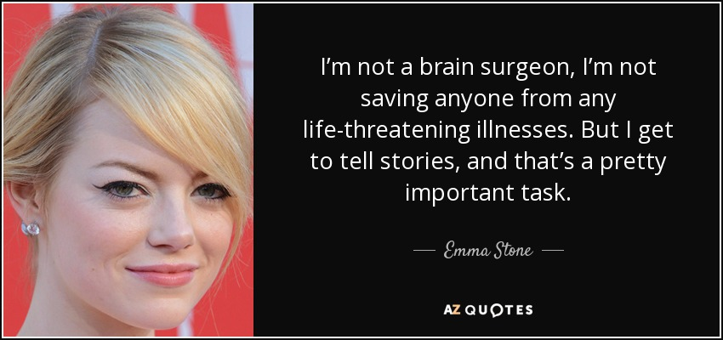

Slide 3
Welcome to
Baylor Scott & White
Medical Center

Slide 4
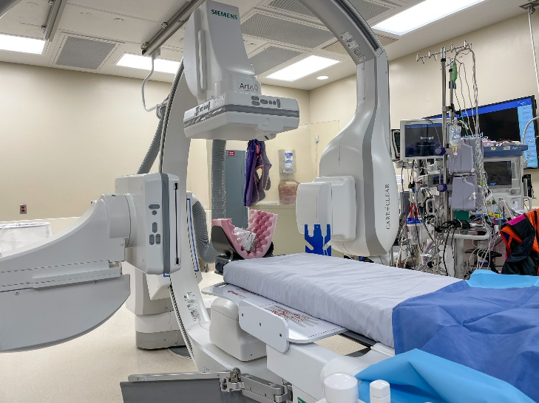
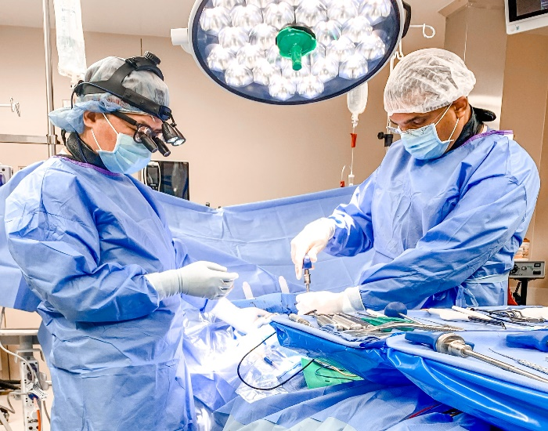
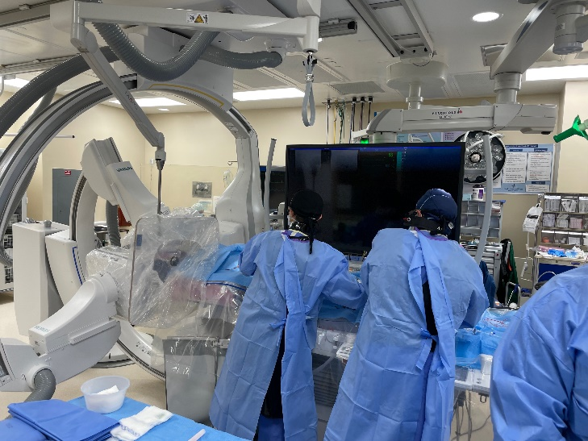
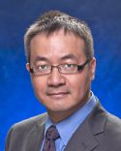
Department of Neurosurgery at Baylor Scott & White Health
It is our vision to provide our patients life-changing and innovative treatment and care. We do this by training and educating the best neurosurgeons in the country, conducting cutting edge clinical and translational research, and by providing a constant, consistent, and rigorous continuing education curriculum to students, residents, staff, and physicians.
Jason H. Huang, MD, FACS
Program Director, Neurosurgical Residency
Chair, Department of Neurosurgery
Professor of Surgery

Slide 5
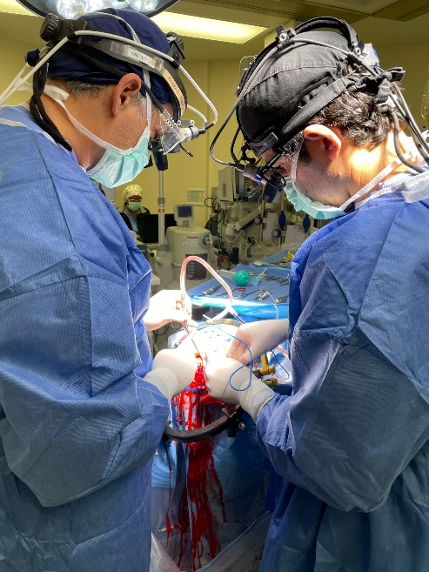
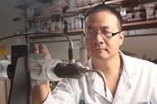
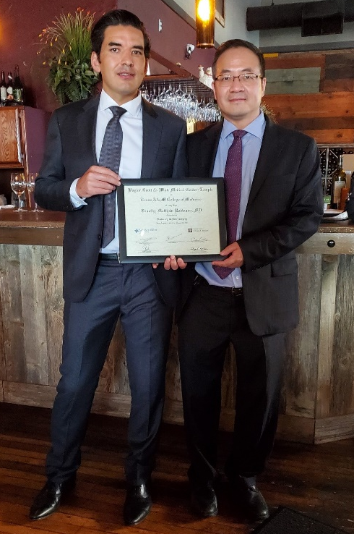
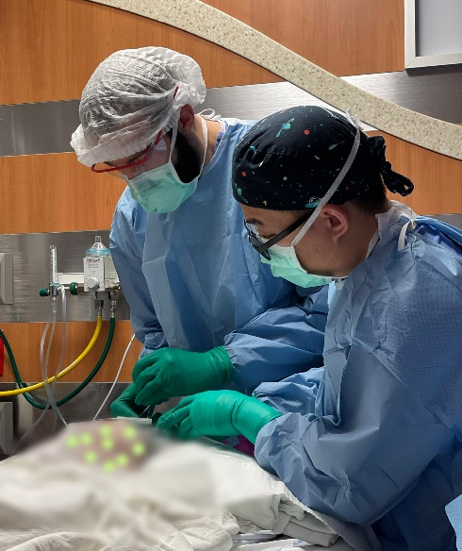
Clinical Care Research Education
Department of Neurosurgery

Slide 6
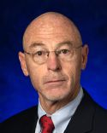
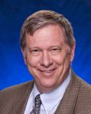
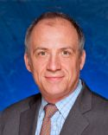
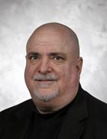
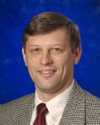
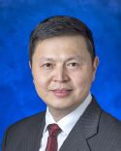
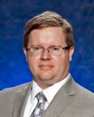
Full service: We treat all diseases of the nervous system: from brain to spinal cord to peripheral nerves; including stroke, epilepsy, brain tumors, chronic pain – in pediatric and adult patients
Jason H. Huang, MD, FACS
Chair & Program Director
Frank S. Harris, MD
Neurosurgery
David Garrett, MD
Complex Spine
Ethan Benardete, MD PhD
Cerebrovascular
Eric Trumble, MD
Pediatric
Neurosurgery
Walter Lesley, MD
Endovascular
Dongxia Feng, MD, PhD
Skull-base
Kevin Cooper, MD
Spine
Assoc. Program Director
Awais Vance, MD
Cerebrovascular
Assoc. Program Director

Slide 7
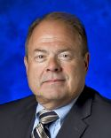
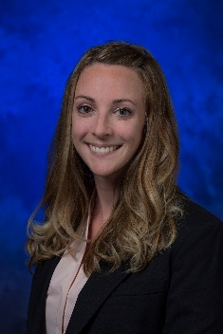
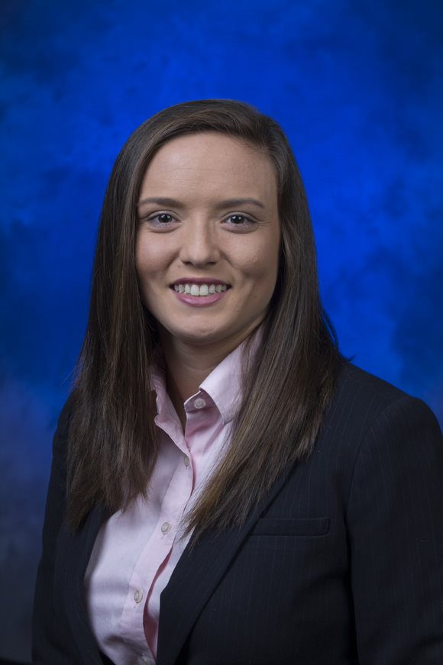
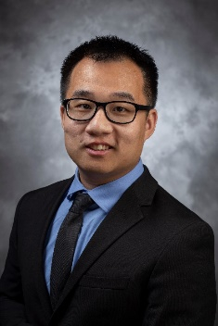
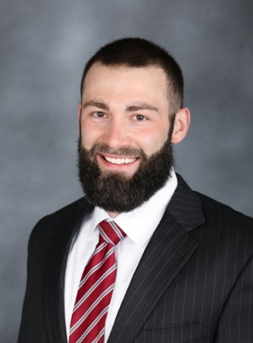
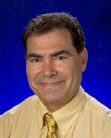
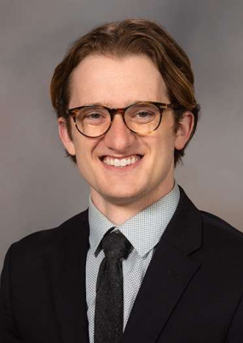
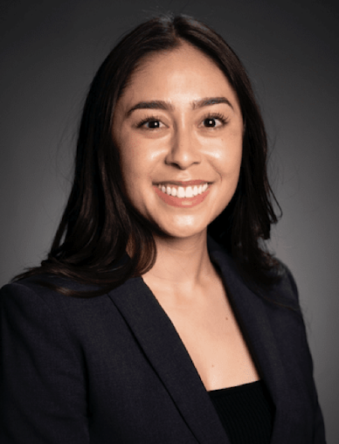
Additional Senior Staff & Residents
The Resident Family
Kimball Pratt, MD
Neurosurgeon
Waco
Ibrahim El Nihum, MD
Neurosurgeon
College Station / Temple

Slide 8
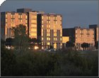
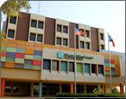
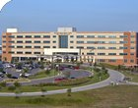
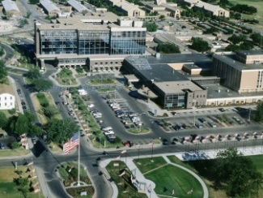
Neurosurgery Residency Program Facilities
Baylor Scott & White Medical Center - Temple
Baylor Scott & White Medical Center - Temple is a Level 1 Trauma Center and Comprehensive Stroke Center. It is a tertiary referral center and the largest such center in Central Texas with an expansive catchment area. Because it serves patients with diverse backgrounds, you are exposed to a wide variety of neurosurgical disorders. This facility is the primary teaching hospital for the program. There are 33 operating rooms with state-of-the-art equipment and over 636 inpatient beds.
McLane Children's Scott & White Hospital - Temple
McLane Children's Scott & White Hospital - Temple provides resident exposure to a wide variety of pediatric neurosurgical problems. Throughout the residency, the resident gains experience with all aspects of pediatric neurosurgery including pediatric brain tumors, hydrocephalus, congenital malformations and trauma. Pediatric neurosurgeons at McLane Children's participate in several multi-specialty teams including neuro-oncology and craniofacial. This facility offers 5 operating rooms.
Baylor Scott & White Hillcrest Medical Center - Waco
Baylor Scott & White Hillcrest Medical Center is an acute care hospital serving the health care needs of Central Texas. Residents will experience many health care advancements in Waco — such as a major Level II Trauma Center, a Level III Neonatal Intensive Care Unit and Aquilion 64-slice CT scanner — which are found only at Baylor Scott & White Hillcrest. There are 8 well-equipped operating rooms.
Olin E. Teague Veteran's Medical Center (Transfers)
The Veteran’s Affairs system has always been an integral part of resident education. It serves a population particularly susceptible to specific diseases whose pathology and treatment are crucial to your development including but not limited to traumatic brain injury, peripheral nerve injury and complex spine disorders. These patients are transferred to our main BSW hospital for care.

Slide 9
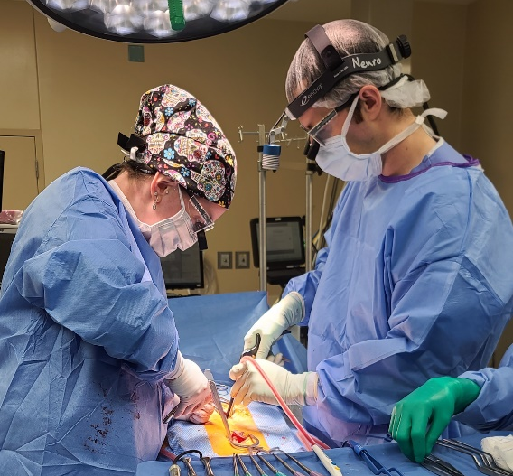
What You Will Learn
Adult & Pediatric craniotomy-brain tumor
Adult & Pediatric craniotomy-trauma
Adult craniotomy for intracranial vascular lesion
Endovascular therapy for tumor or vascular lesions
Adult cranial: transsphenoidal-sellar/parasellar tumors
Adult cranial: extracranial vascular procedures
Adult radiosurgery
Adult functional procedures
Vagal Nerve Stimulation
Stimulation for pain
Deep Brain Stimulation
Cordotomy/Rhizotomy
Sympathectomy
Intrathecal pumps
Adult & Pediatric VP shunt
Pediatric spine procedures
Adult spine: Anterior & Posterior Cervical approaches for decompression/stabilization and craniocervical junction
Adult spinal-lumbar discectomy
Adult spinal-thoracic/lumbar instrumentation fusion
Adult spinal-peripheral nerve procedures
Adult and pediatric craniotomy-epilepsy
Craniofacial
Spinal AVM
Spinal tumor resection: intradural/intramedullary
Spinal vascular lesion resection
Reconstructive secondary procedures
Complex peripheral nerve surgery
…and more!

Slide 10
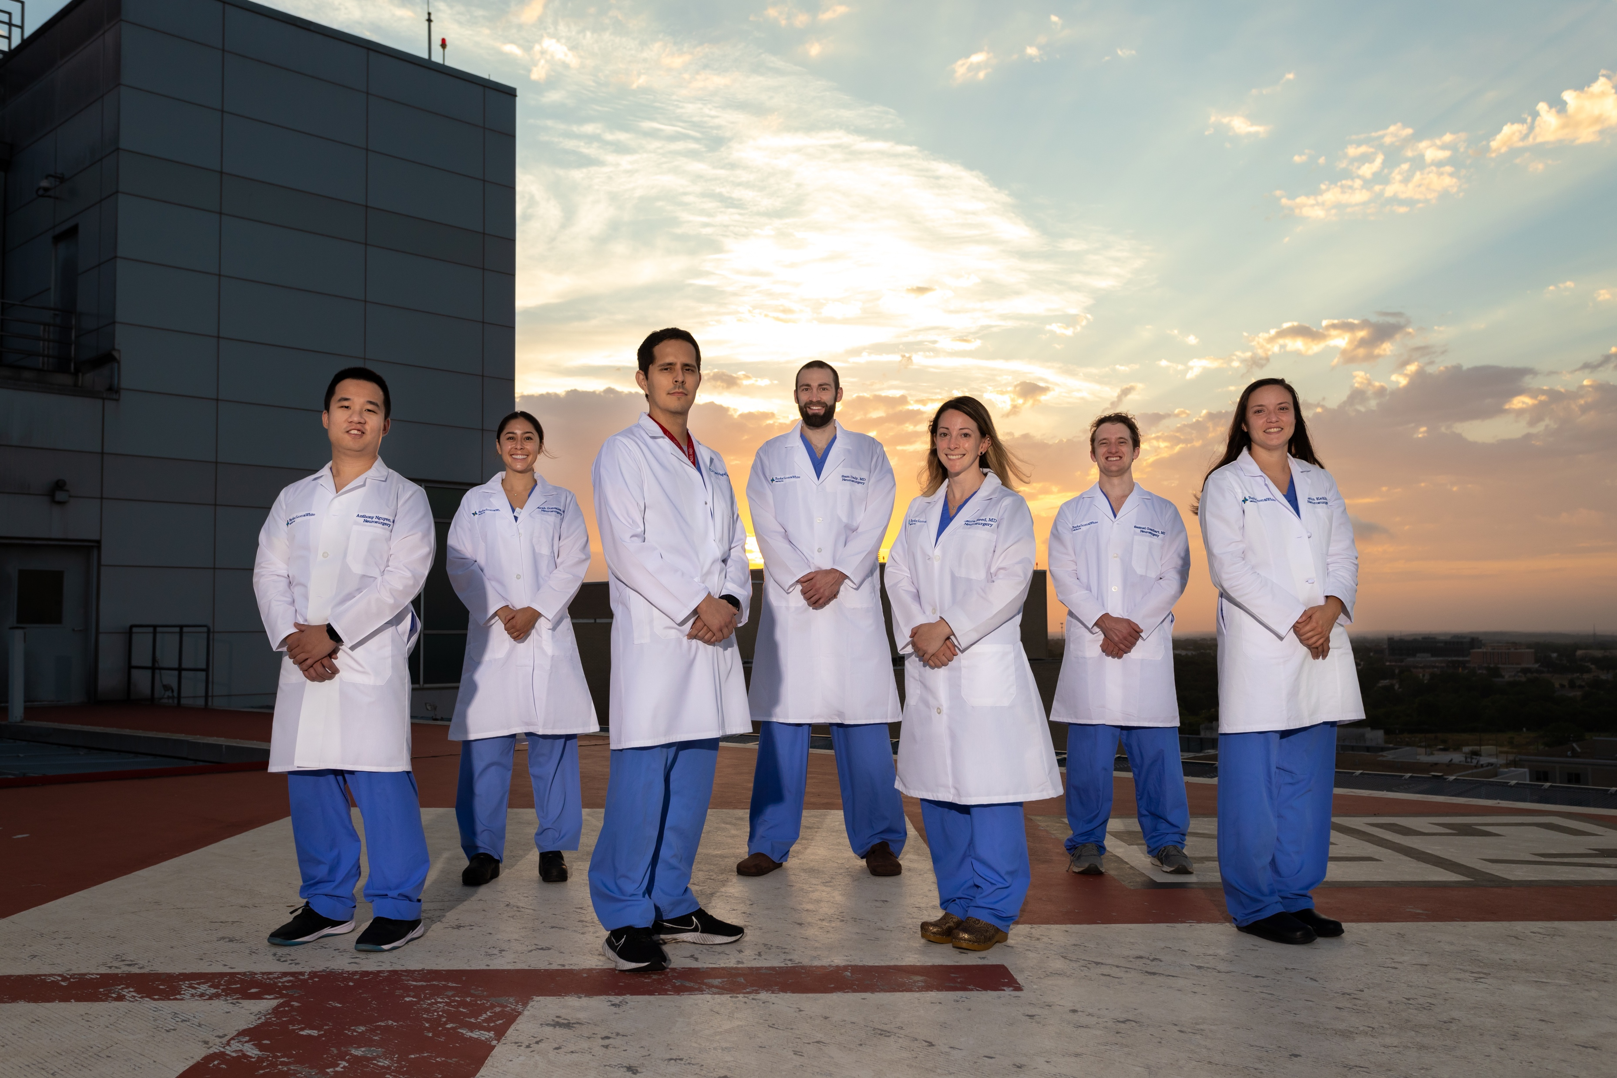
Resident Rotations
PGY-1 | NS trauma | Neuro ICU | Peds Gen Surg | NeuroRad
PGY-2 | Neuro ICU | NS spine | NS peds | NS tumor
PGY-3 | NS peds | NS spine | NS vascular | NS spine
PGY-4 | NeuroPath | NS endo | NS tumor | NS spine
PGY-5 | Research / Elective | Elective
PGY-6 | Junior Chief
PGY-7 | Admin Chief

Slide 11
Conference Highlights
Type | Frequency | Responsible for Oversight | Required to Attend |  | Description
 |  |  | Faculty | Resident
Neurosurgery Case Conference | Bi-weekly | J. Huang | Yes | Yes | Various difficult or unusual cases brought for discussion of potential treatment or outcomes.
Grand Rounds | Monthly | J. Huang | Yes | Yes | Various topics related to all aspects of neurosurgery.
Journal Club | Monthly | W. Lesley | Yes | Yes | Discussion of latest publications or areas of interest
Neuro-oncology Conference | Bi-weekly | D. Feng | Yes | Yes | Case discussion of various neuro-oncology diagnosis and treatments
Neuro-Radiology | Bi-weekly | Vance | Yes | Yes | Various topics in neuroradiology and review of cases
Morbidity and Mortality | Monthly | J. Huang | Yes | Yes | Case discussion of unexpected outcomes

Slide 12
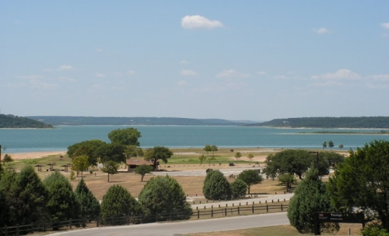
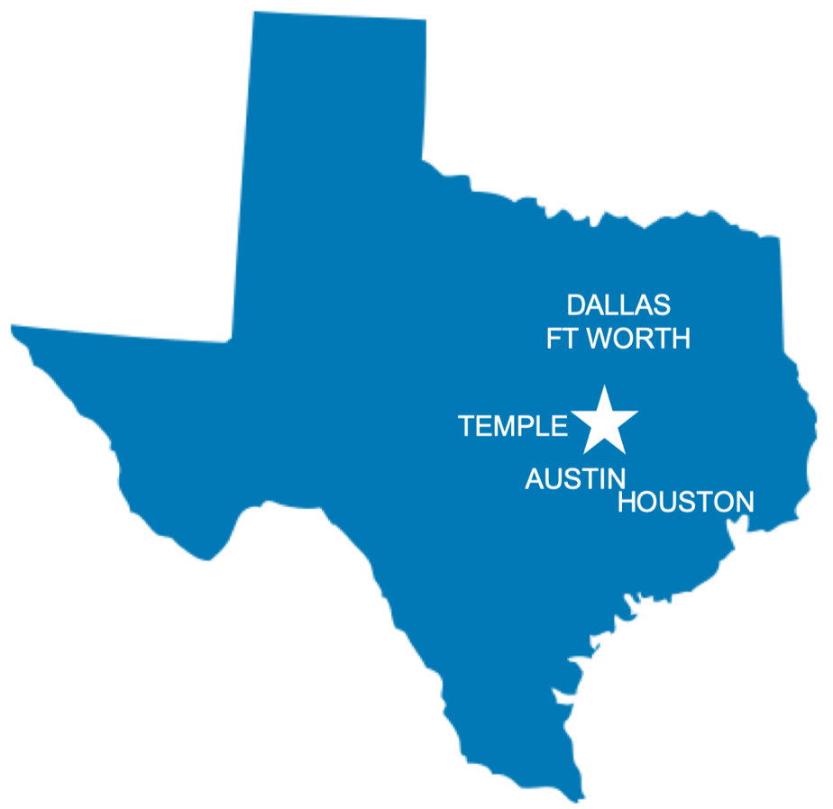
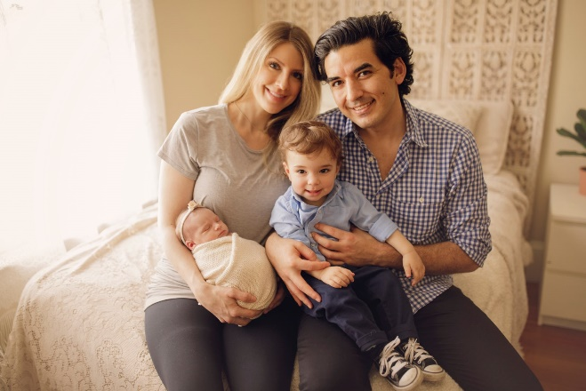
Resident Life
Lake Belton
Whether you enjoy water sports, fishing, camping or just hanging out by the shore, Lake Belton offers something for everyone. Located within minutes of the hospital - provides a refuge during weekends, or holidays.
Outdoor Activities
42 parks, 22 miles of paved trails, Belton Lake Outdoor Recreation Area, golf, Scott & White cycling club, mountain biking, hunting, fishing, water sports.
Affordable Living
Central Texas is an extremely affordable place to live and attracts many looking for a great place to live. It is a successful, vibrant, growing community coupled with quality of life amenities that matter such as great parks, public transportation and variety of cultural activities.
Family Friendly
Temple is so affordable that residents are able to buy houses within minutes of the hospital, and traffic is non-existent. It is 10 minutes to everywhere in this thriving community. The combination of good schools, abundant community pride, endless outdoor activities, an expanding economy, and a touch of Southern hospitality make Temple a great place to raise a family.

Slide 13
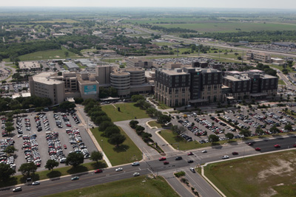
Choose BSW Temple
Superior education
Great cost of living
Outstanding faculty
Close, family-centered team
One of the best hospitals in the United States

Slide 14
Thank you! Questions?
Email:
laura.reed@bswhealth.org
Twitter: @LKReedMD
@BSWHTemple_NSGY

