Slide 1
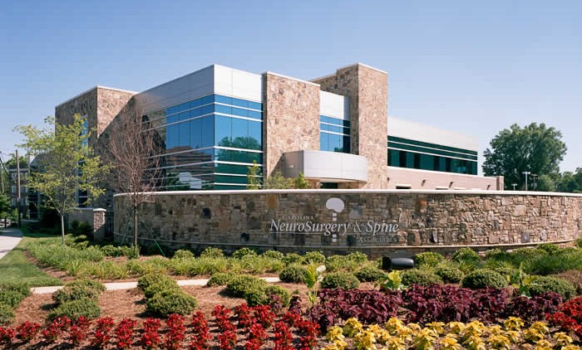
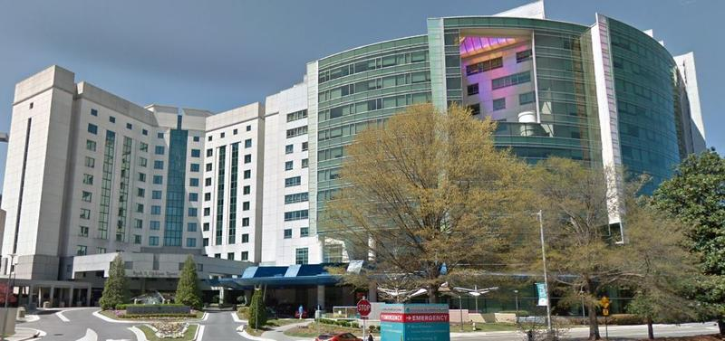
Carolinas Medical Center
Neurological Surgery Residency
Charlotte, NC

Slide 2
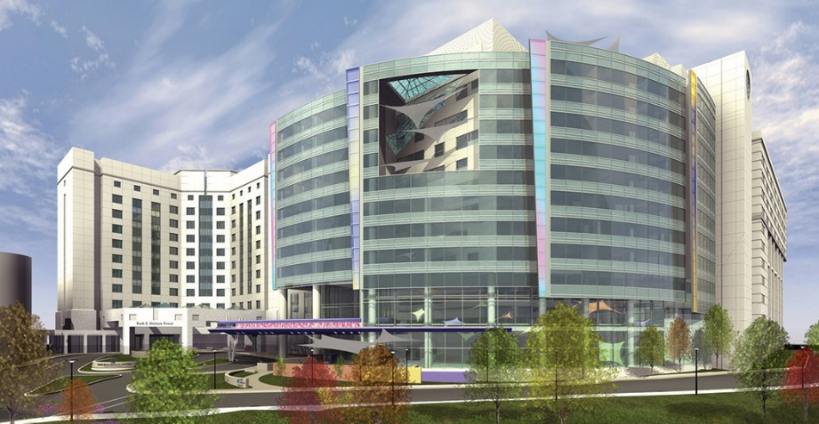
Carolinas Medical Center
Level 1 trauma center
900+-bed tertiary care center
300+ residents and fellows in 30 training programs
28 bed neurosurgical ICU
32-bed neurosurgical floor
22-bed neurosurgical step-down unit
4-bed neuromonitoring unit
14-bed pediatric ICU
Operating rooms:
6 dedicated neurosurgery ORs
1 angio suite
3 ambulatory surgery center ORs
Approximately 5,500 major neurosurgical procedures performed each year
Flagship Hospital of Atrium Health

Slide 3
Atrium Health
2nd largest public healthcare system
$11.1 Billion operating revenue
50+ hospitals in the system
7,600+ licensed beds in the system
69,800+ employees in the system
12 million patient interactions per year
CMC main is the primary referral center for neurosurgical patients
Pathology is extremely diverse and complex
We refer nothing out

Slide 4
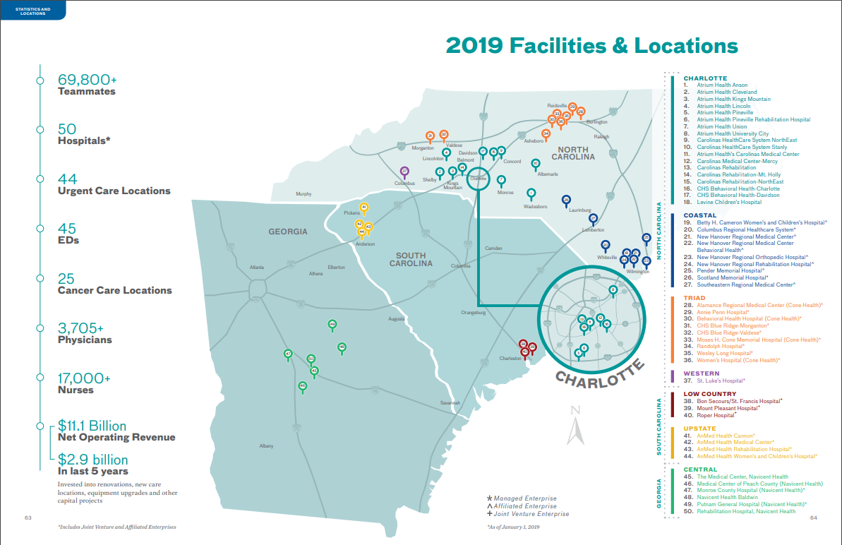

Slide 5
Carolina Neurosurgery and Spine Associates
Celebrated its 80th Anniversary in 2020
35 Neurosurgeons, 1 orthopedic spine surgeon, and multiple physiatrists
8 regional offices with over 400 employees
Charlotte CNSA partners perform in the range of 7000 surgeries per year,
5500 per year at CMC Main and CCSS
Carolina Center for Specialty Surgery
Imaging capabilities in Charlotte office:
1.5 tesla MRI
Upright MRI
CT
Fluoro
X-ray

Slide 6
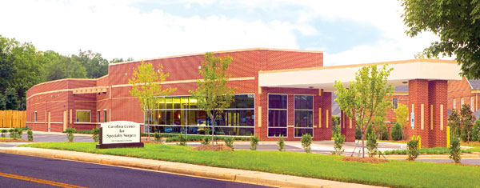
Carolina Center for Specialty Surgery (CCSS)
3 Operating Rooms
Leader in out-patient spine surgery
Leader in outcomes research proving effectiveness, safety, and cost-savings of out-patient spine care
Model for many outpatient neurosurgery centers throughout the country
Ultimate model efficiency
15-minute room turnovers
6 cases before 1pm

Slide 7
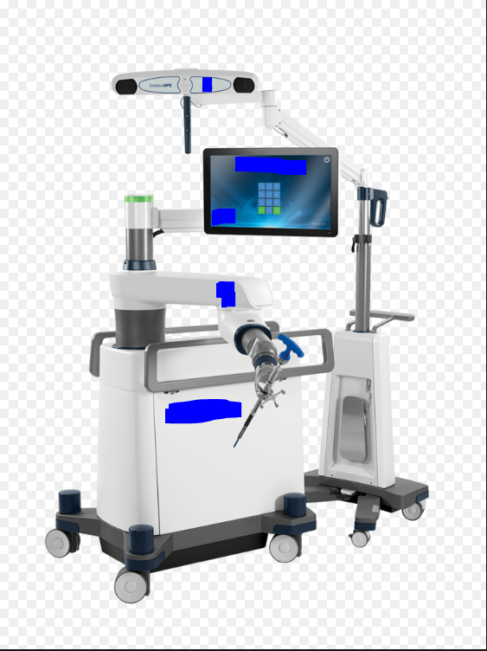
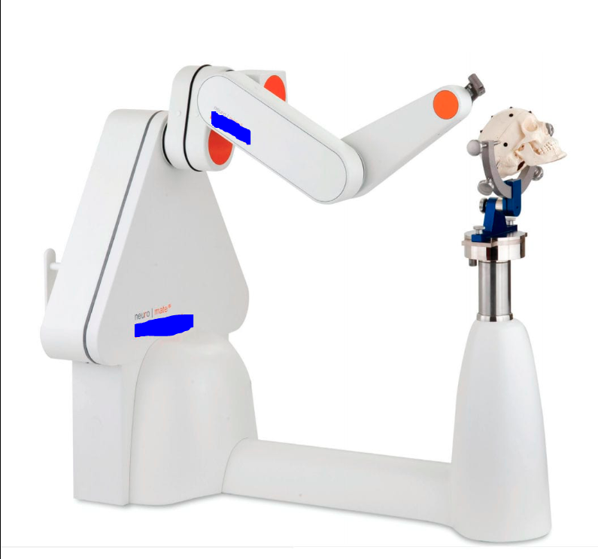
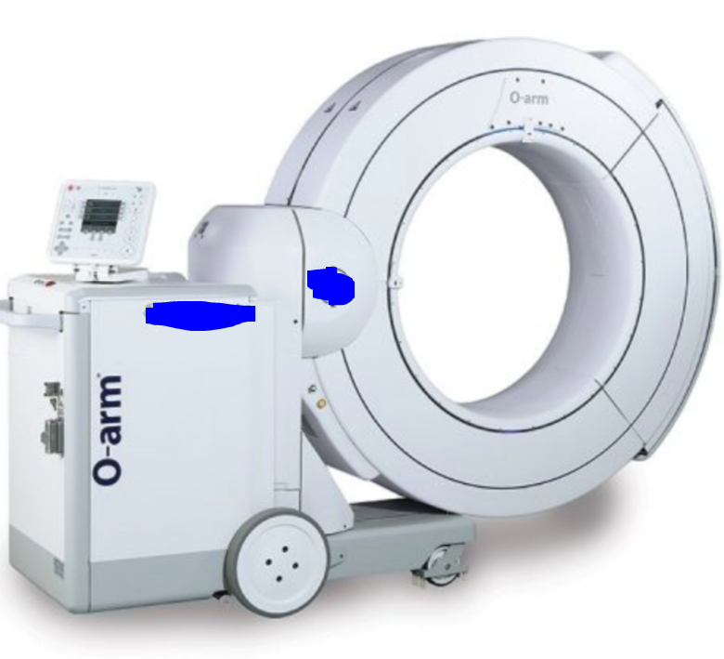
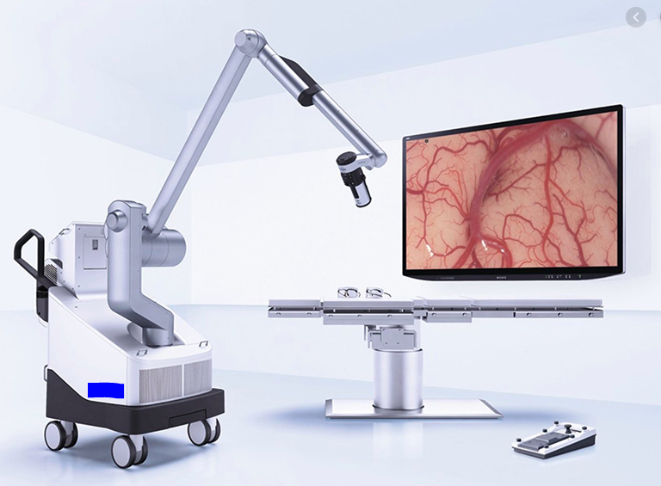
Cutting Edge Equipment
O-arm intraoperative spinal navigation
Spine robot
Renishaw Epilepsy robot
Intraoperative 3T MRI
LITT
4K Exoscopes
Updated Gamma Knife
Currently >1000 additional procedures per year

Slide 8
Cardiovascular and Neuroscience Institute Coming 2025?

Slide 9
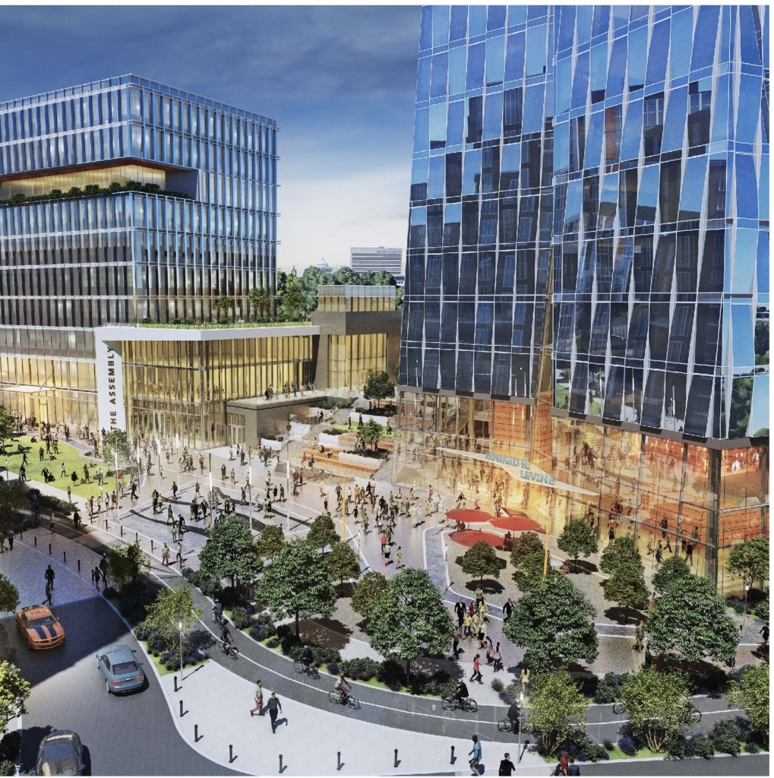
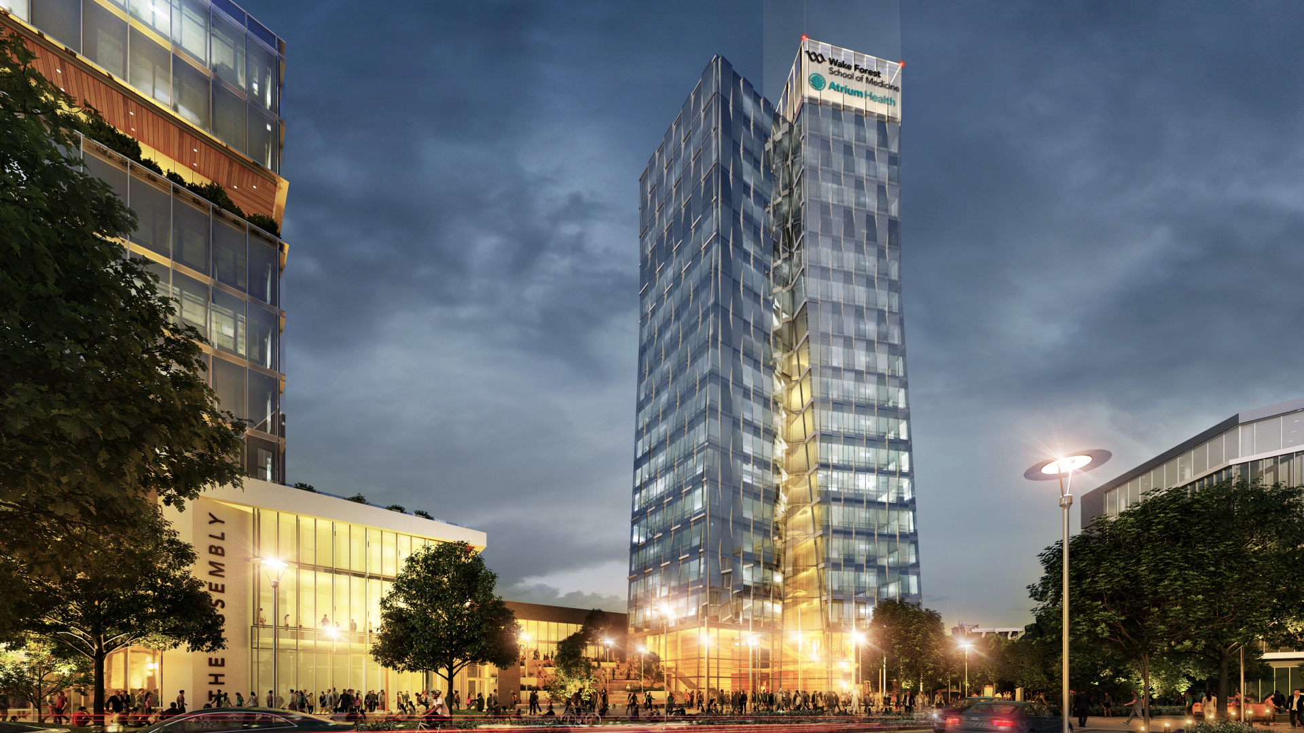
Charlotte Medical School Atrium Health and Wake Forest Baptist Health

Slide 10
CNSA Neurosurgeons
CORE FACULTY (16):
Tim Adamson, MD - (Yasargil fellowship, UTSW) Anthony Asher, MD - (2008 CNS president, 2023 AANS pres) Joe Bernard, MD - (UT Memphis)
Michael Bohl, MD - (Barrow) Domagoj Coric, MD - (2013 SNS Pres., 2022 Spine Sect. Pres.) Hunter Dyer, MD - (UTSW) Martin Henegar, MD - (WashU)
Christopher Holland, MD, PhD - (Emory/Utah) Sarah Jernigan, MD, MPH - (Brigham/Miami) Paul Kim, MD - (Cleveland Clinic) Matthew McGirt, MD - (Hopkins/Vanderbilt)
Jonathan Parish, MD – (CMC) - 2022 Mark Van Poppel MD - (UT Memphis) Mark Smith, MD - (UT Memphis)
Will Stetler, MD - (Michigan/Florida/UAB) Scott Wait, MD - (Barrow)
NON-CORE FACULTY (8)
Daniel Oberer, MD- (Vanderbilt/Hopkins)
Taylor Jarrell, MD
Byron Branch, MD
Andrew Healy, MD- (Cleveland Clinic)
John Ziewacz, MD, MPH- (Michigan/UCSF) Joseph Cheatle, MD
Daniel Leas, MD – (CMC Orthopedics)
Benjamin Boudreaux, MD
OTHER (13) Henry A. Pool, MD Gary P. Cram Jr., MD
Joseph D. Stern, MD, FACS
Neelesh Nundkumar, MD
Robert W. Nudelman, MD, FACS David S. Jones, MD
Jeffrey D. Jenkins, MD, FACS
Ernesto M. Botero, MD, FACS
Kyle L. Cabbell, MD
Benjamin J. Ditty, MD
Henry J. Elsner, MD, FACS
Frederick E. Finger, III, MD
Jerry M. Petty, MD

Slide 11
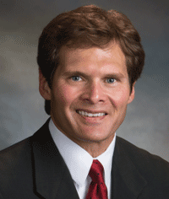
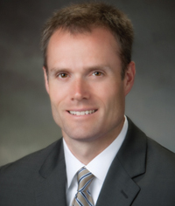
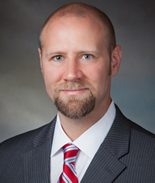
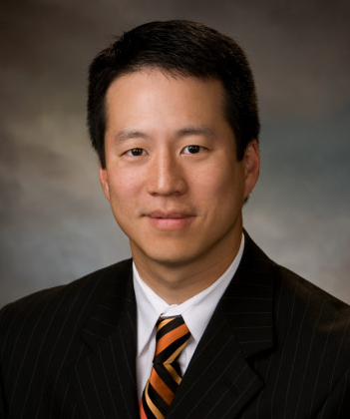
Residency Leadership
Dr. Asher
Dr. Wait
Program Director
Dr. Van Poppel Associate Program Director
Dr. Kim
Chief of Neurosurgery

Slide 12
Call Schedule
PGY1
q8 24hr in-house buddy call with senior when on-service
PGY2
q4 in-house call
PGY3
q5 in-house call
PGY4
q5 home call (3 of which are in house per month with the PGY1)
PGY5
q5 home call (1 of which is in house per month with the PGY1)
PGY6
Research/International
PGY7
q5 home call

Slide 13
Call Specifics
OR all day until your cases are finished
On call with a NP/PA
Pick up “pager” at 5:00pm until 7:00am next morning
Responsible for all consults and necessary procedures
Responsible for any operative case during the shift
Pass the “pager” off to the NP/PA who will answer floor calls and pages while in the OR
Leave when duties are finished the next day with option of sticking around for a first start case admitted overnight
Post-call day
Call nights range between 5-12 consults a night
Operative case (on average) every other night

Slide 14
Resident Routine
Consult Service (E-service) Routine Pre-round on operative patients Round on patients with team of 3 other PAs Average census 30-50 patients Operative cases for the day
Spine fractures Trauma cranis SDH Abscess Degen spine EVDs, bedside procedures Hospital until 5pm
Private service routine Preselect schedule from week before, cherry-picking best cases Pre-round on operative patients Preop patients OR until finished with day Home when done
Rotations
Consult Service (E-service)
Private Services
Endovascular/Vascular
Simple spine
Complex spine
Cranial
Pediatrics

Slide 15
Vacation / Perks
Vacation
Three weeks per year
Conferences
5 weekdays off per year
Fully-funded if presenting
Other perks
Personalized lead
Loupes
Lead glasses
$2000 per year book fund
$2400 per year in food allowance
Free food/snacks/soda in multiple locations
Workout room
On Panthers side-line as PGY5
Resident Retreats
Fall Retreat
Spring Ski Trip to Park City, Utah
Softball tournament
Visiting professors
Duke Samson- UTSouthwestern
Richard Ellenbogen- UWash
Dennis Spencer- Yale
Nate Selden- OHSU
Charlie Teo- Australia
Robert Spetzler- BNI
Randy Jensen- Utah
Guy McKhann- Colombia
Chris Shaffrey- Duke
Geoff Manley- UCSD/UCSF

Slide 18
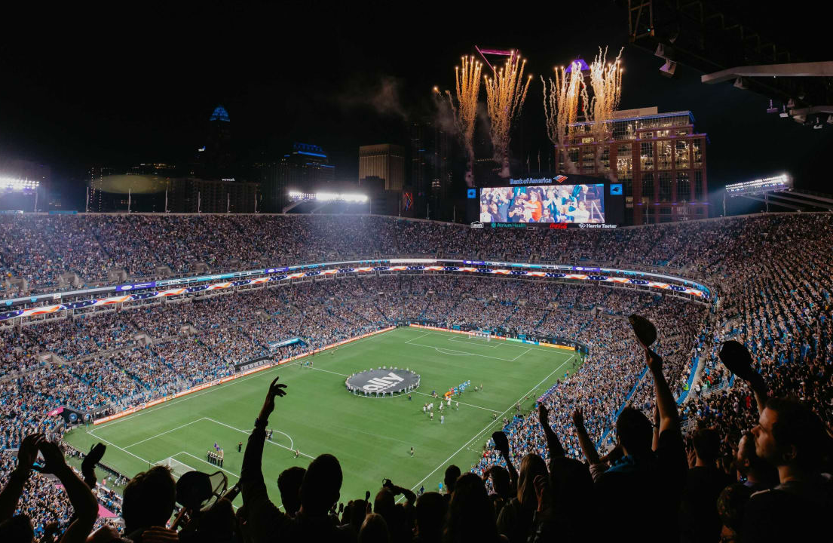
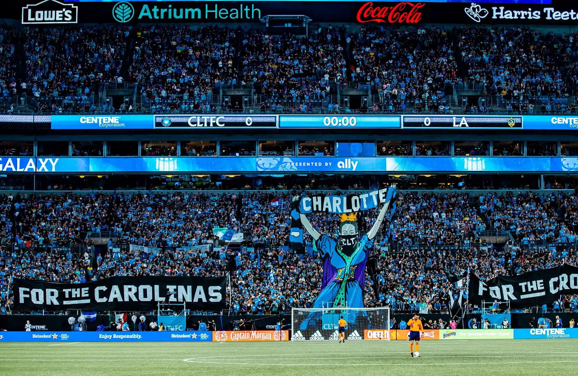
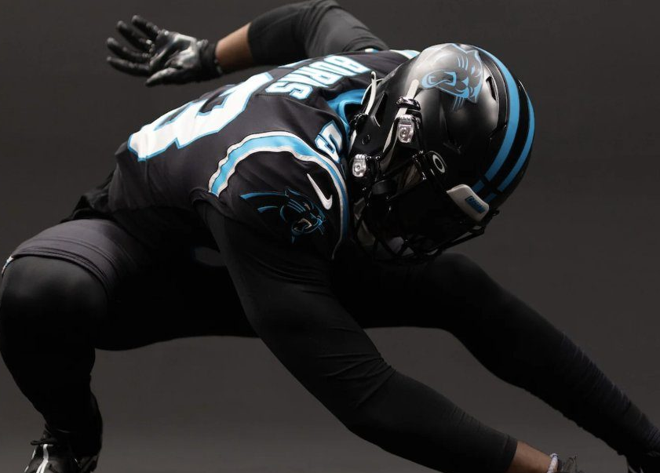
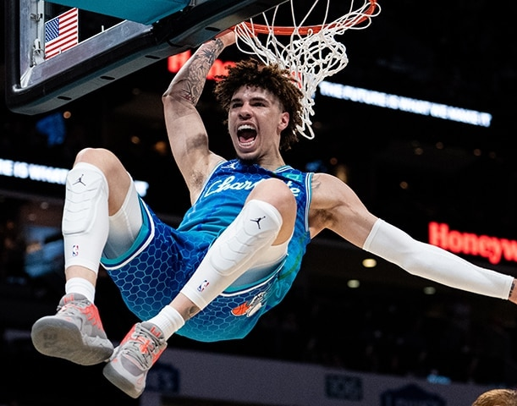

Slide 19
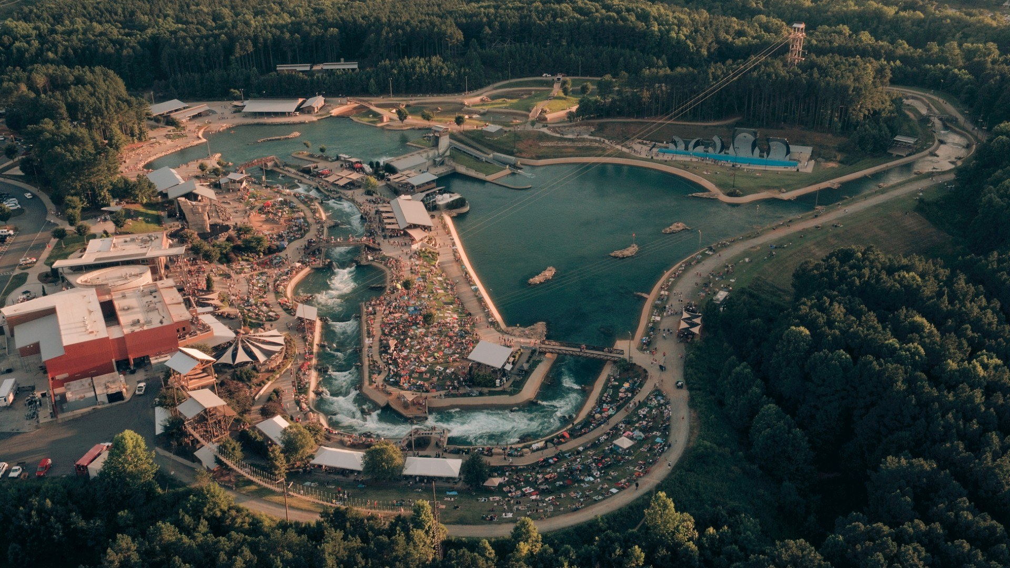

Slide 20
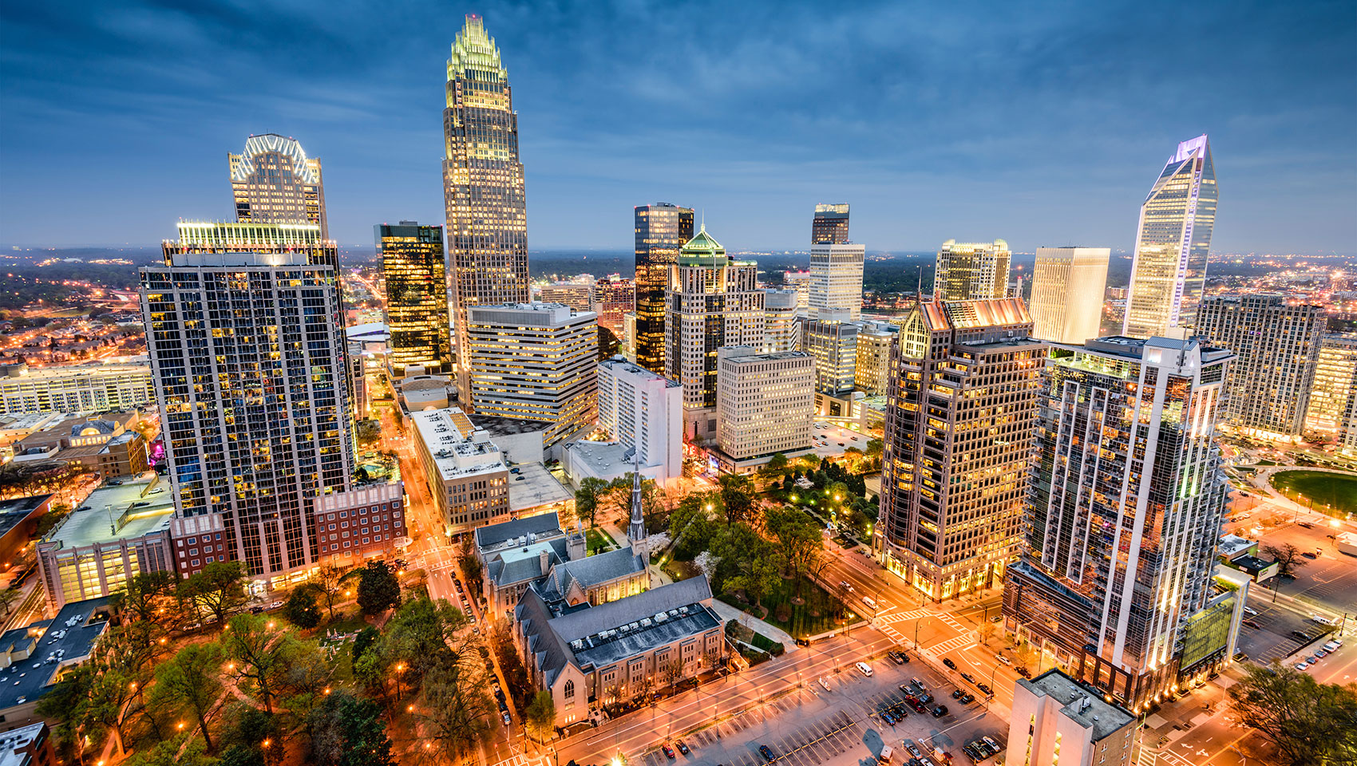
Welcome to Charlotte

