Slide 1
The University of Kansas Health System Department of Neurological Surgery Residency Program Overview
Bryan Schatmeyer, PGY 6
Jean-Luc Kabangu, PGY 6

Slide 2
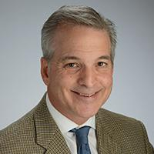
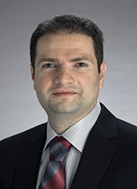
Department of Neurosurgery
2 Residents per year
19 Faculty
13 Adult Neurosurgeons – Spine, Tumor, Skull base, Functional, Epilepsy, Open vascular, Endovascular
5 Pediatric Neurosurgeons
1 Neuro-oncologist
1 PhD Scientist
1 Research Writer
Paul Camarata, MD
Chairman
Roukoz Chamoun, MD
Program Director
Notes:
High volume of all specialties (one of the highest volume epilepsy centers in the nation)

Slide 3
Facilities
3 clinical sites (KUMC Main Campus, KUMC Indian Creek Campus, Children’s Mercy KC)
ACS Level 1 Trauma Center
NCI Comprehensive Cancer Center
Comprehensive Stroke Center
Comprehensive Epilepsy Center

Slide 4
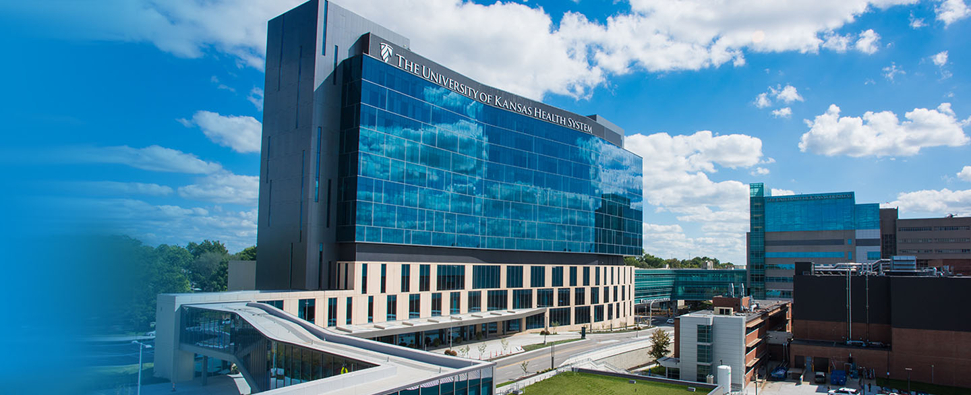
Cambridge Tower
Notes:
This is where you work. NeuroICU, ORs, and patient floors all located here.

Slide 5
Facilities
State of the Art Operating Rooms
Spacious and dedicated for neurosurgery
Intraoperative MRI
Globus Robot
ROSA Robot
BrainLab AIRO CT & O-Arm
Focused Ultrasound
Built in BrainLab Navigational Systems

Slide 6
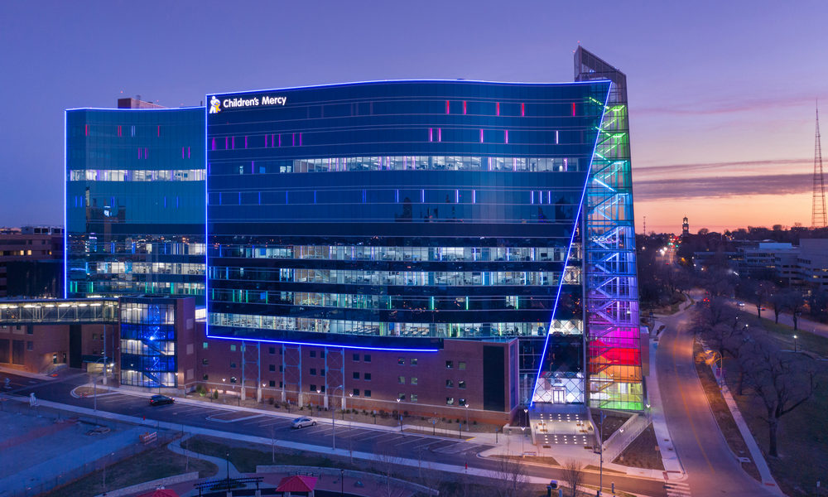
Children’s Mercy Medical Center
3 clinical sites (KUMC Main Campus, KUMC Indian Creek Campus, Children’s Mercy KC)
ACS Level 1 Trauma Center
NCI Comprehensive Cancer Center
Comprehensive Stroke Center
Comprehensive Epilepsy Center
Notes:
High volume (5 pediatric neurosurgeons)

Slide 7
Program Curriculum
PGY 1 – NS, Neurocritical care, Trauma/Surgical ICU, Anesthesia, Neurology, Neuropathology
PGY 2 – NS KUMC, Neuroradiology (Endovascular Interventions)
PGY 3 – NS KUMC, NS CMH
PGY 4-5 – Research 12-18 months, NS KUMC
PGY 6 – NS Pediatric Chief, NS ICC, NS KUMC
PGY 7 – NS KUMC Chief
Support throughout residency to attend conferences when presenting research

Slide 8
Program Highlights
Heavy operative experience early on
~5 OR rooms a day
Amazing mid level support
6 AM rounds
Night float system for call
Radiology conference
Board review
No fellowships

Slide 9
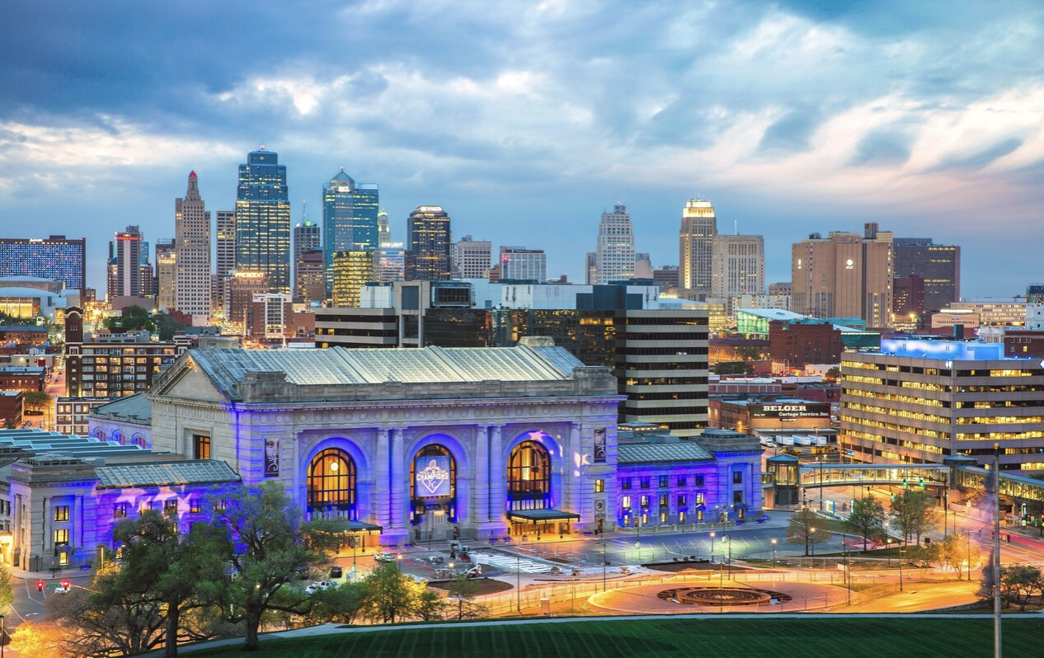
Kansas City
Notes:
This is your home for the next 7 years

Slide 10
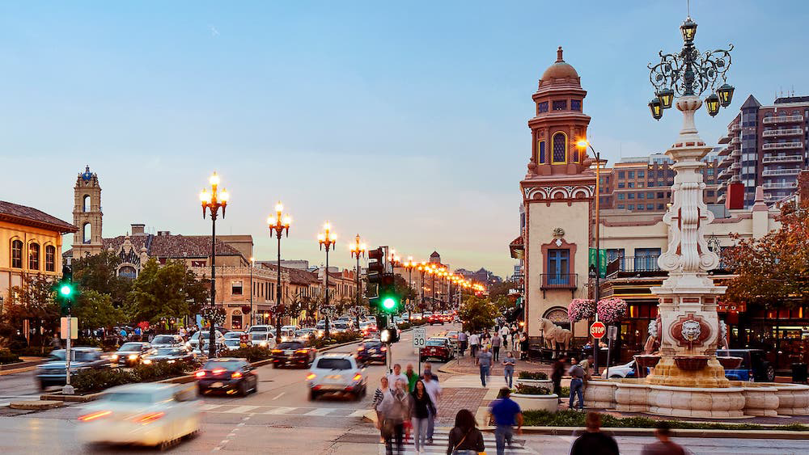
Kansas City
Greater metropolitan area population 2.2 million
Country Club Plaza, River Market District
Kansas City Chiefs
Kansas City Royals
Sporting KC
Kansas City Jazz
World War I Museum

Slide 11
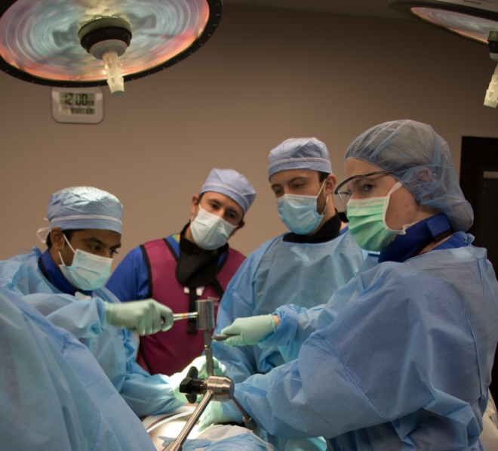
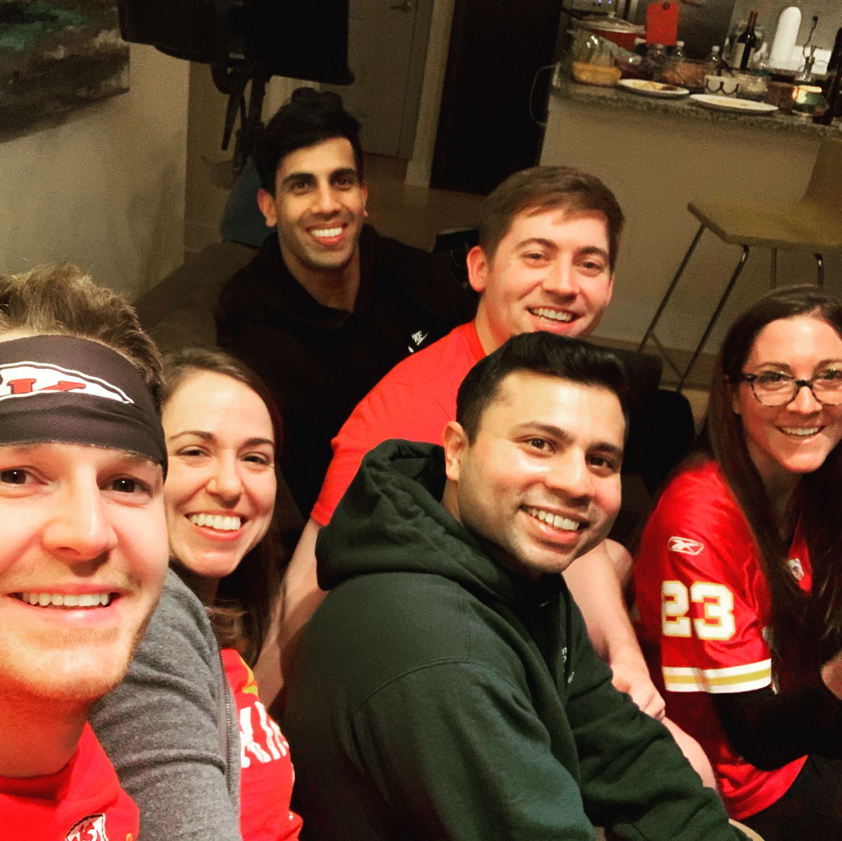
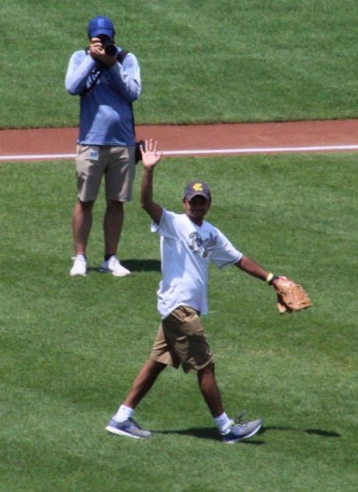
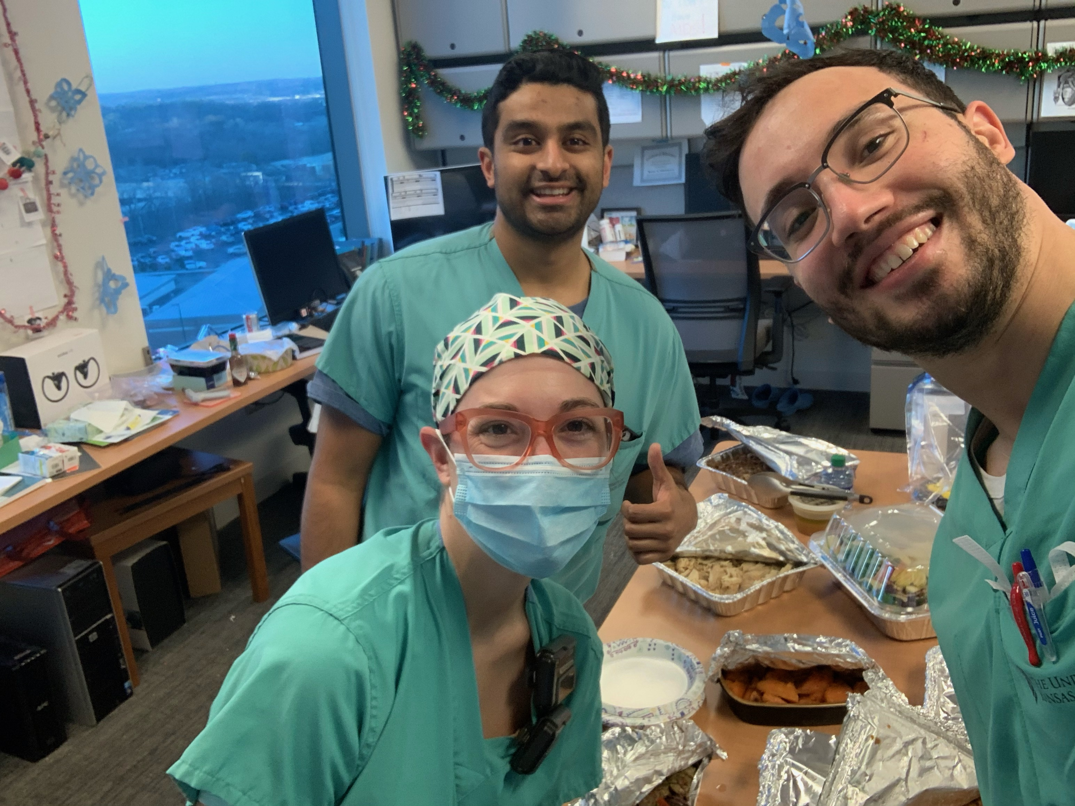
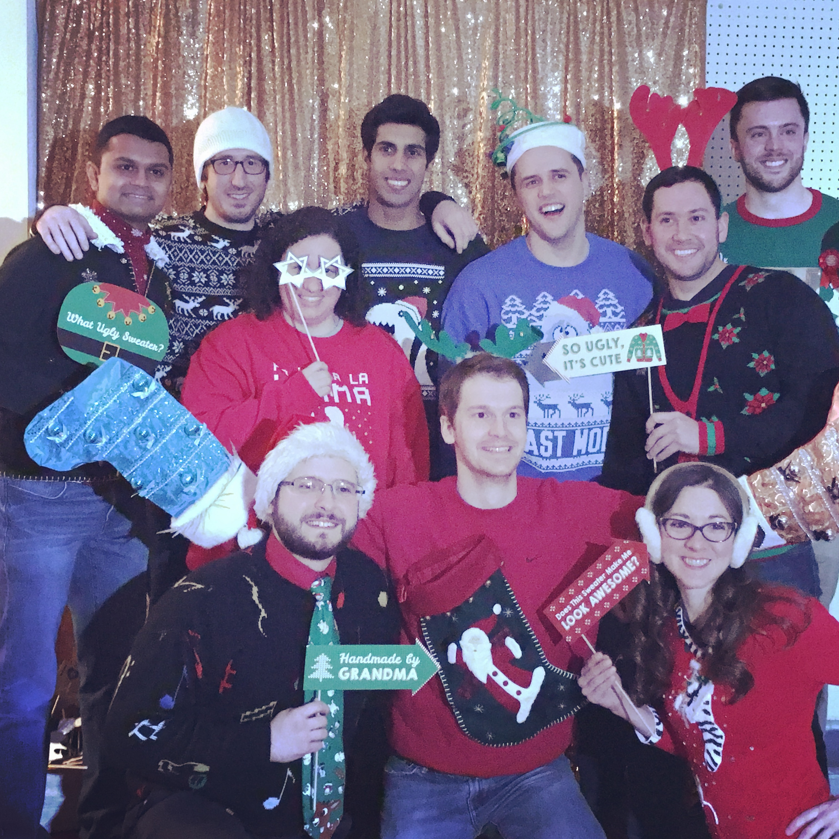
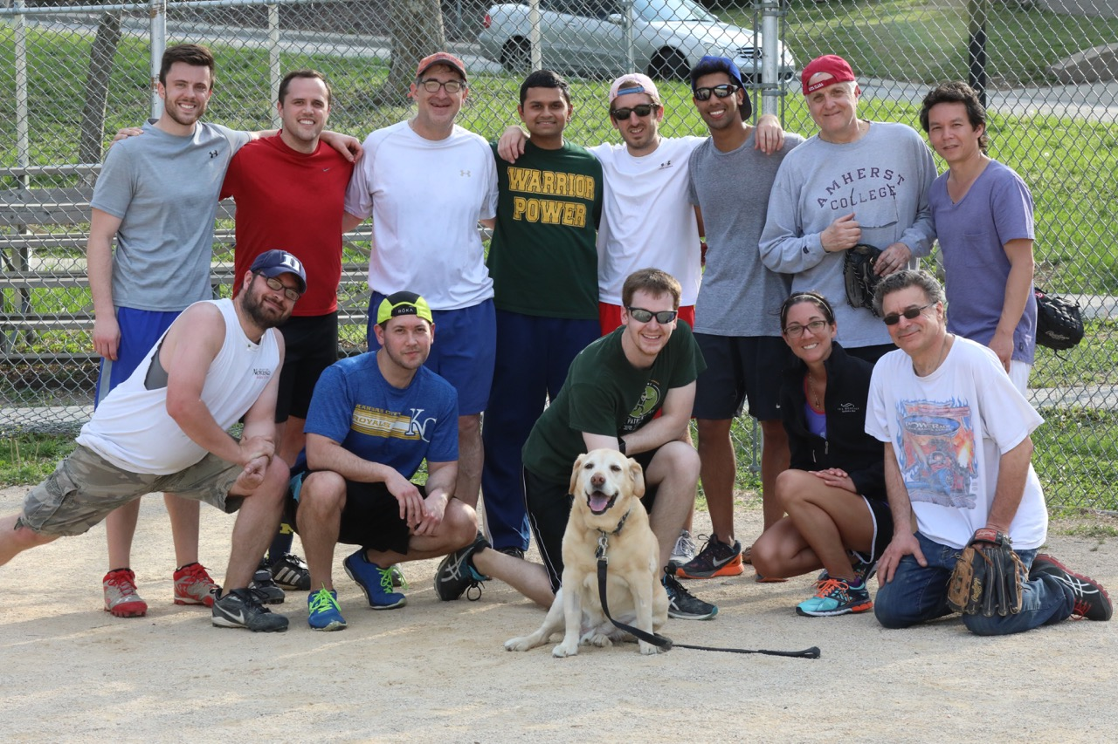
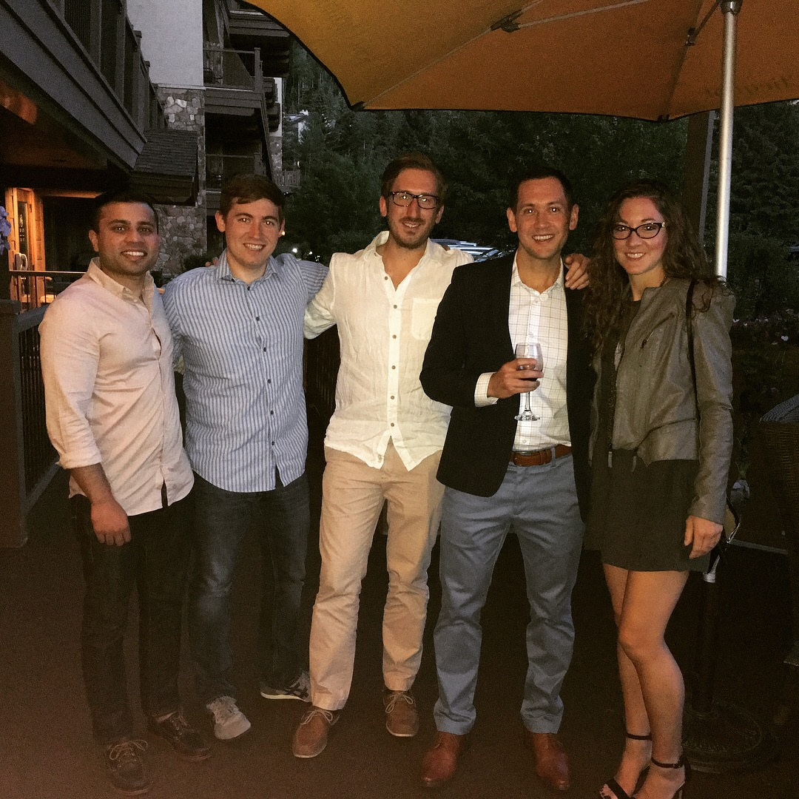
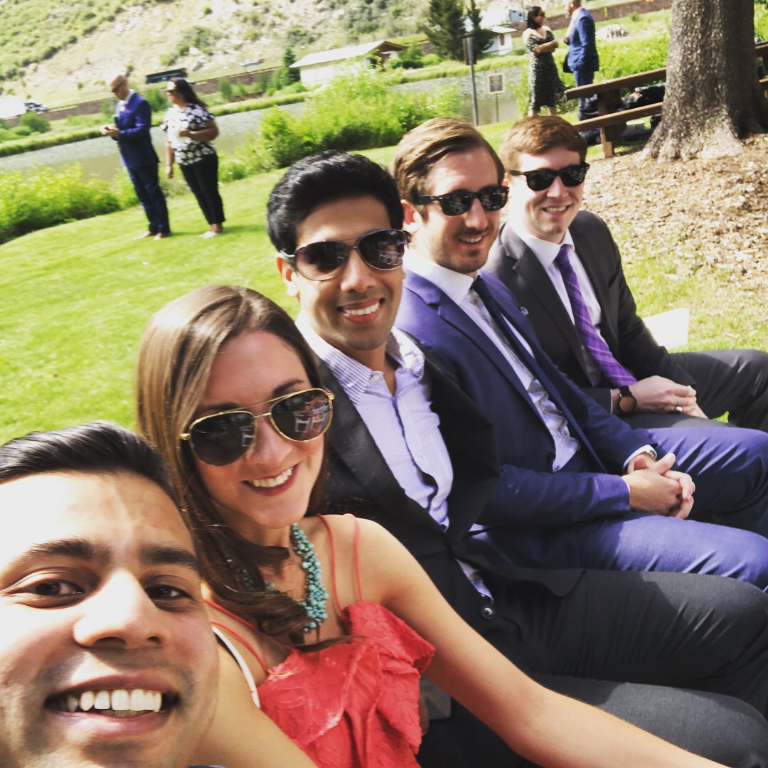
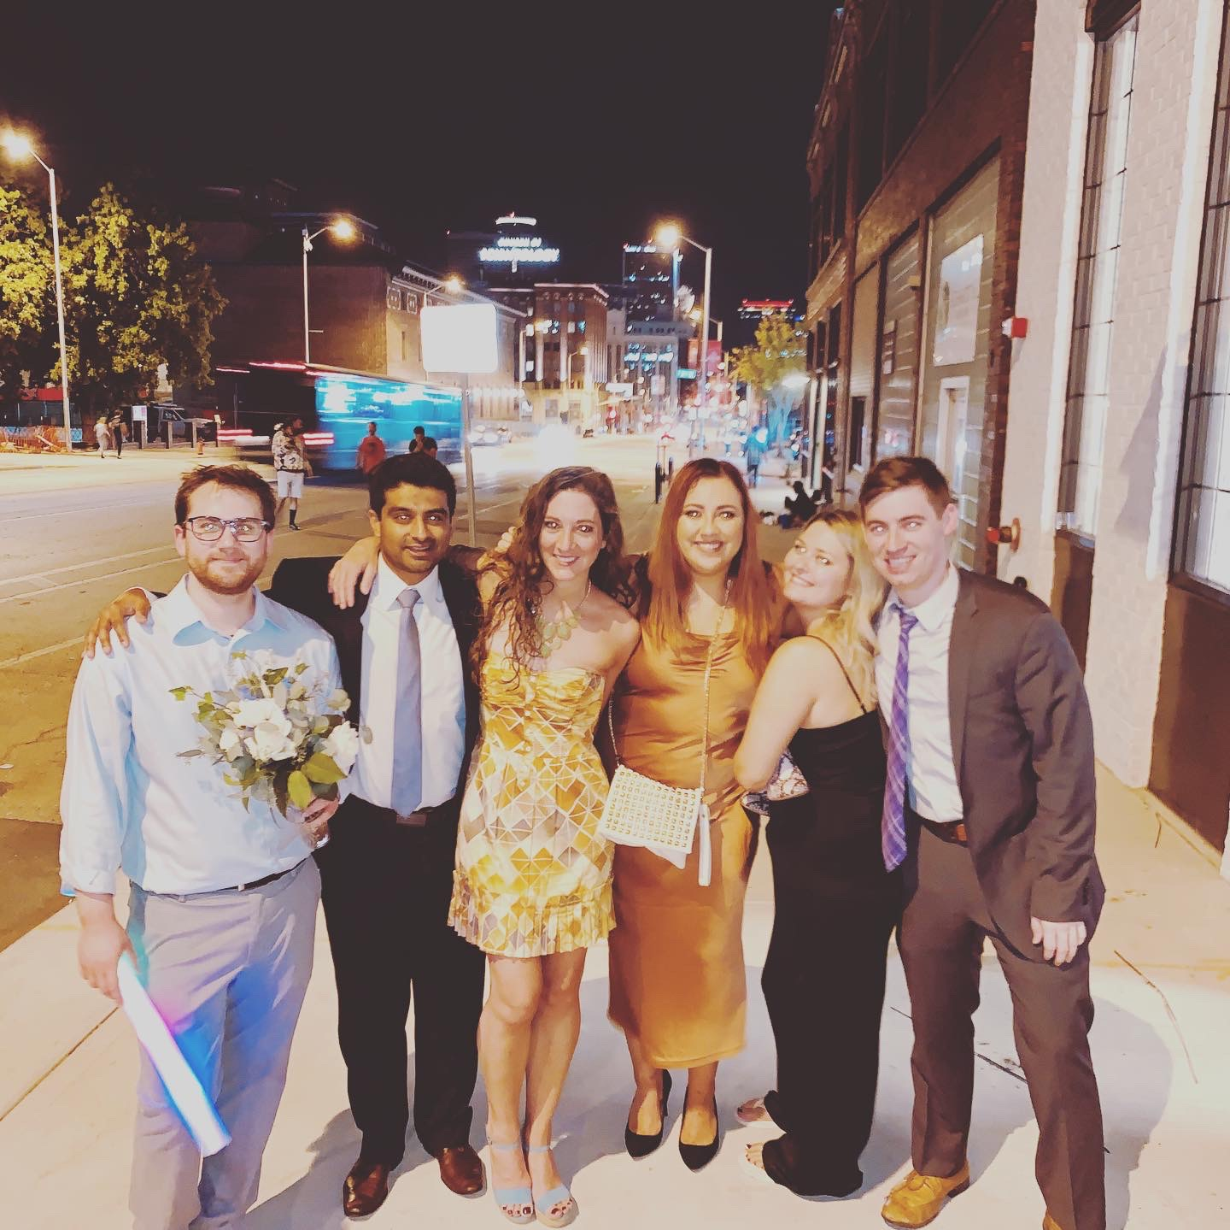
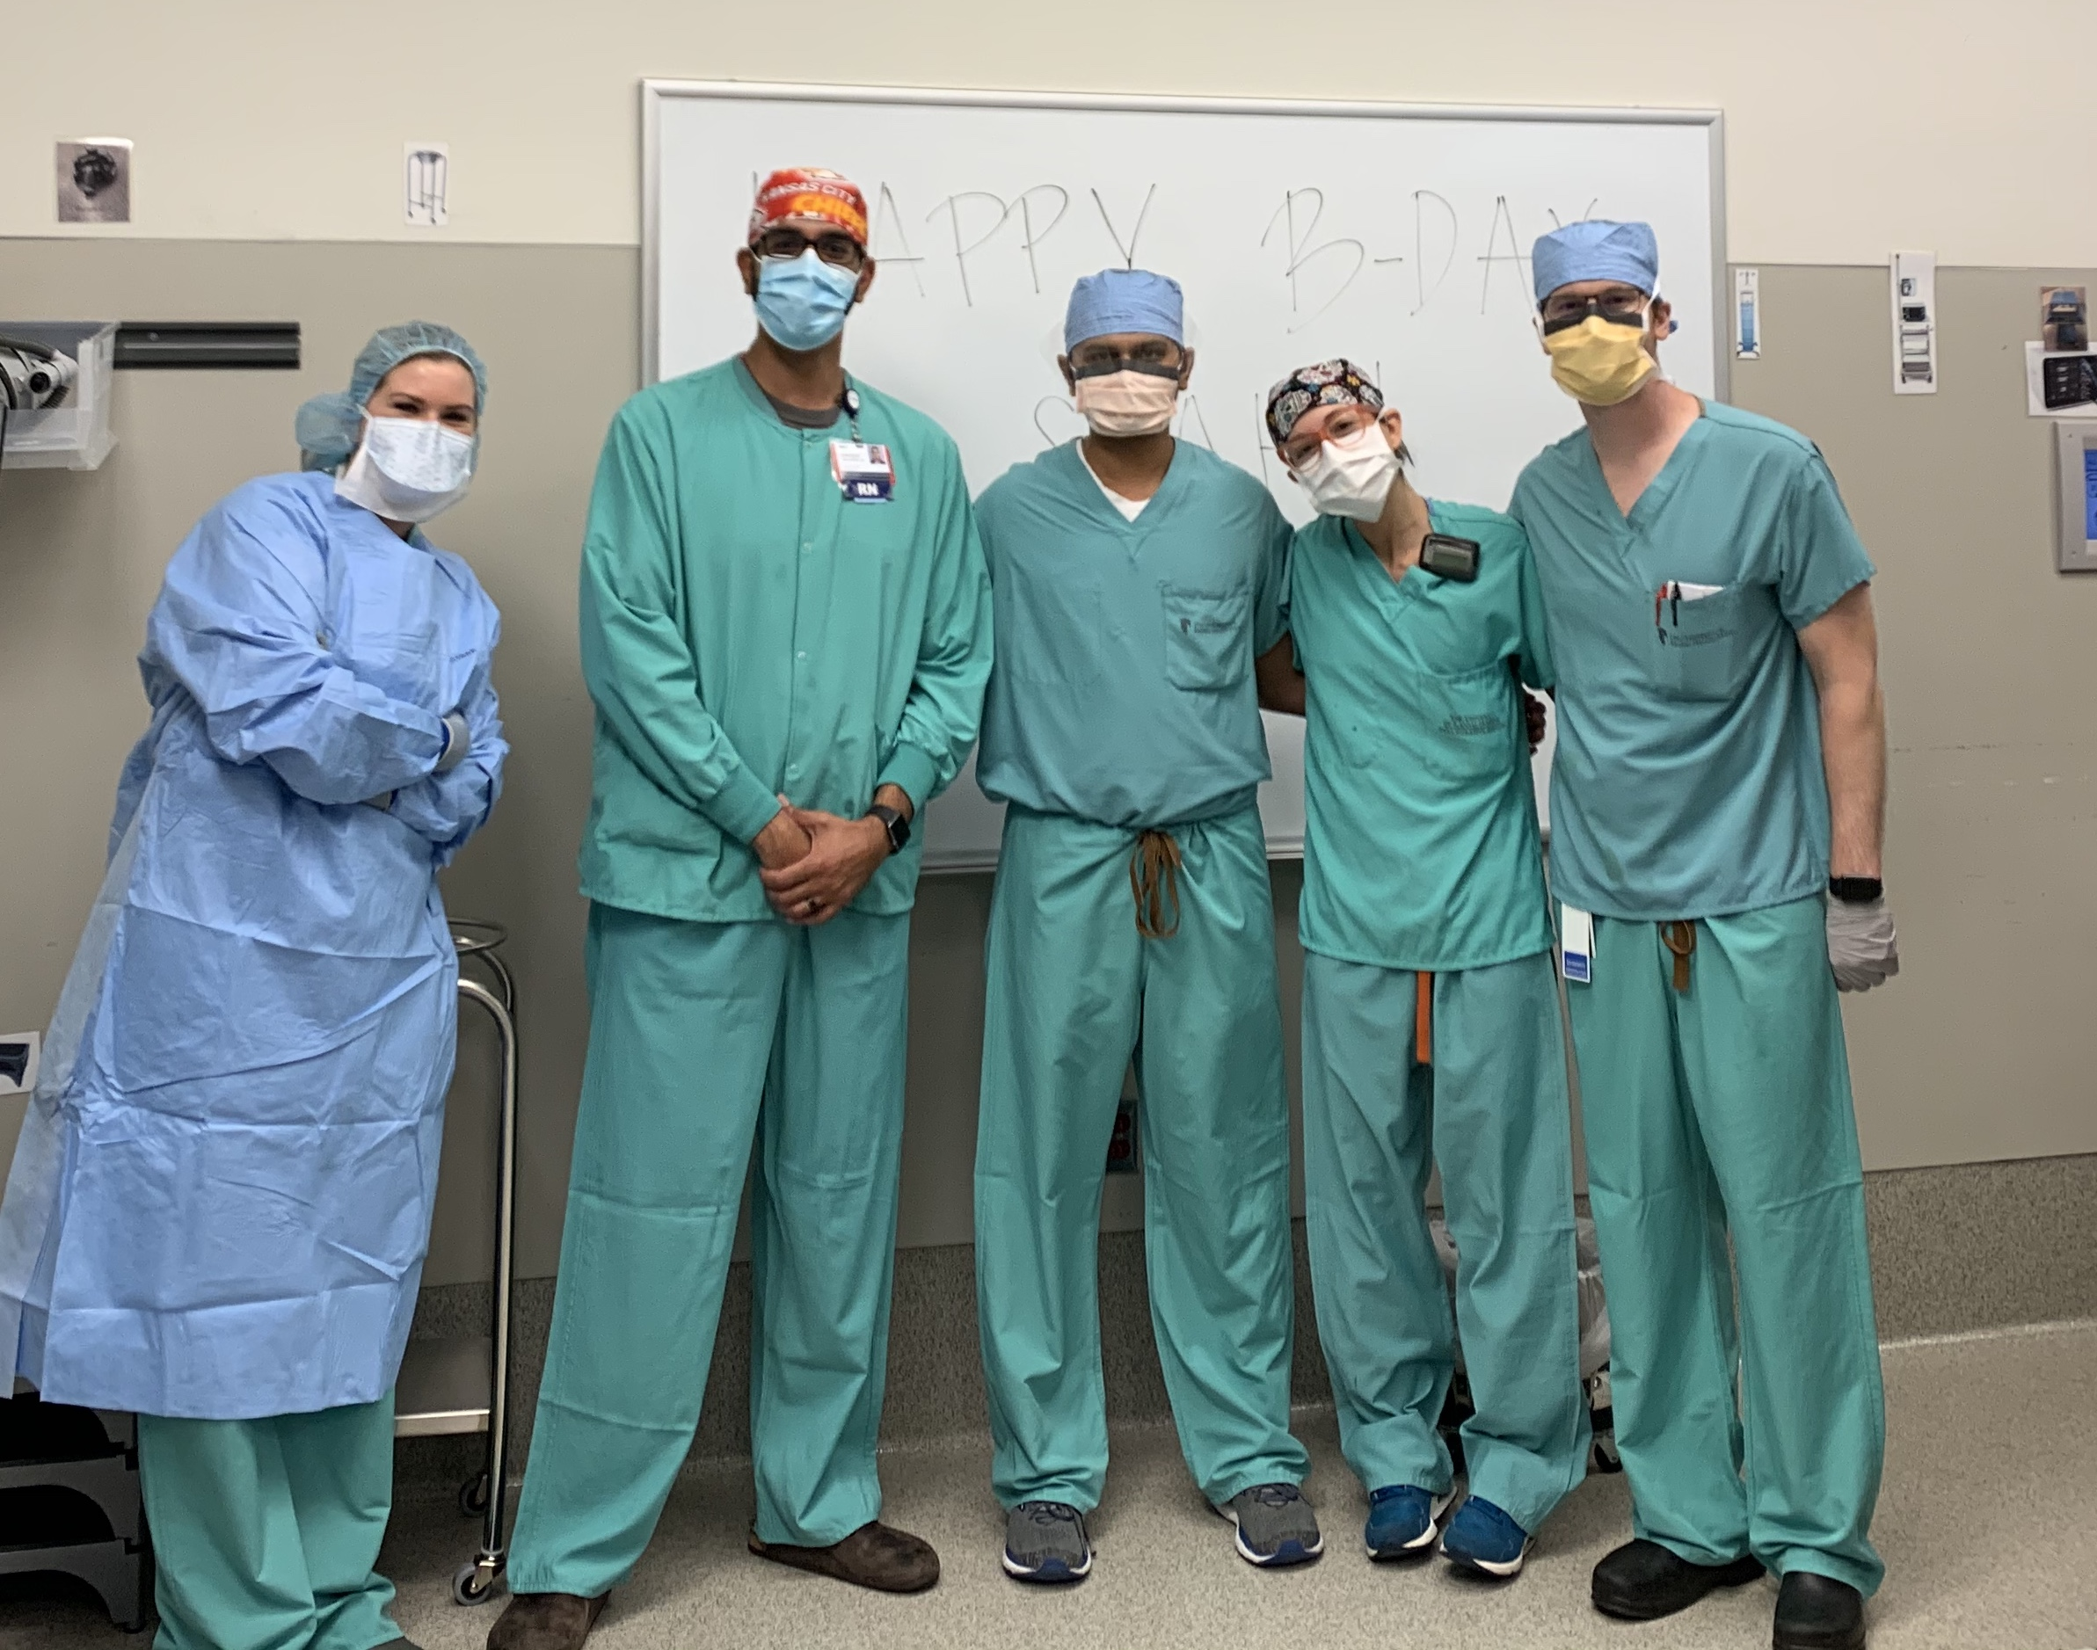
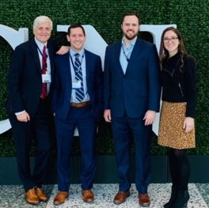
Notes:
Most important thing are the people. 7 years is a long time.

Slide 12
The University of Kansas Health System Department of Neurological Surgery
Bryan Schatmeyer, PGY6
bschatmeyer@kumc.edu
Margaret Minea
Program Coordinator
mminea2@kumc.edu
www.kumc.edu/school-of-medicine/neurosurgery.html
Follow us on Instagram
@kuneurosurgresidents

