Slide 1
Medical College of Wisconsin
Department of Neurosurgery
Residency Program

Slide 2
Department of Neurological Surgery: Medical College of Wisconsin
Vision
MCW Department of Neurosurgery will advance the field of neurological surgery through world-class clinical care, groundbreaking research, and innovative education.
Mission
Our mission is to:
Deliver subspecialty adult and pediatric neurosurgical care that is patient-centered, evidence-informed, and value-based
Conduct research that advances the science of neurologic disease and has a positive translational impact on clinical care
Promote an environment of education and scholarship for trainees, faculty
and staff

Slide 3
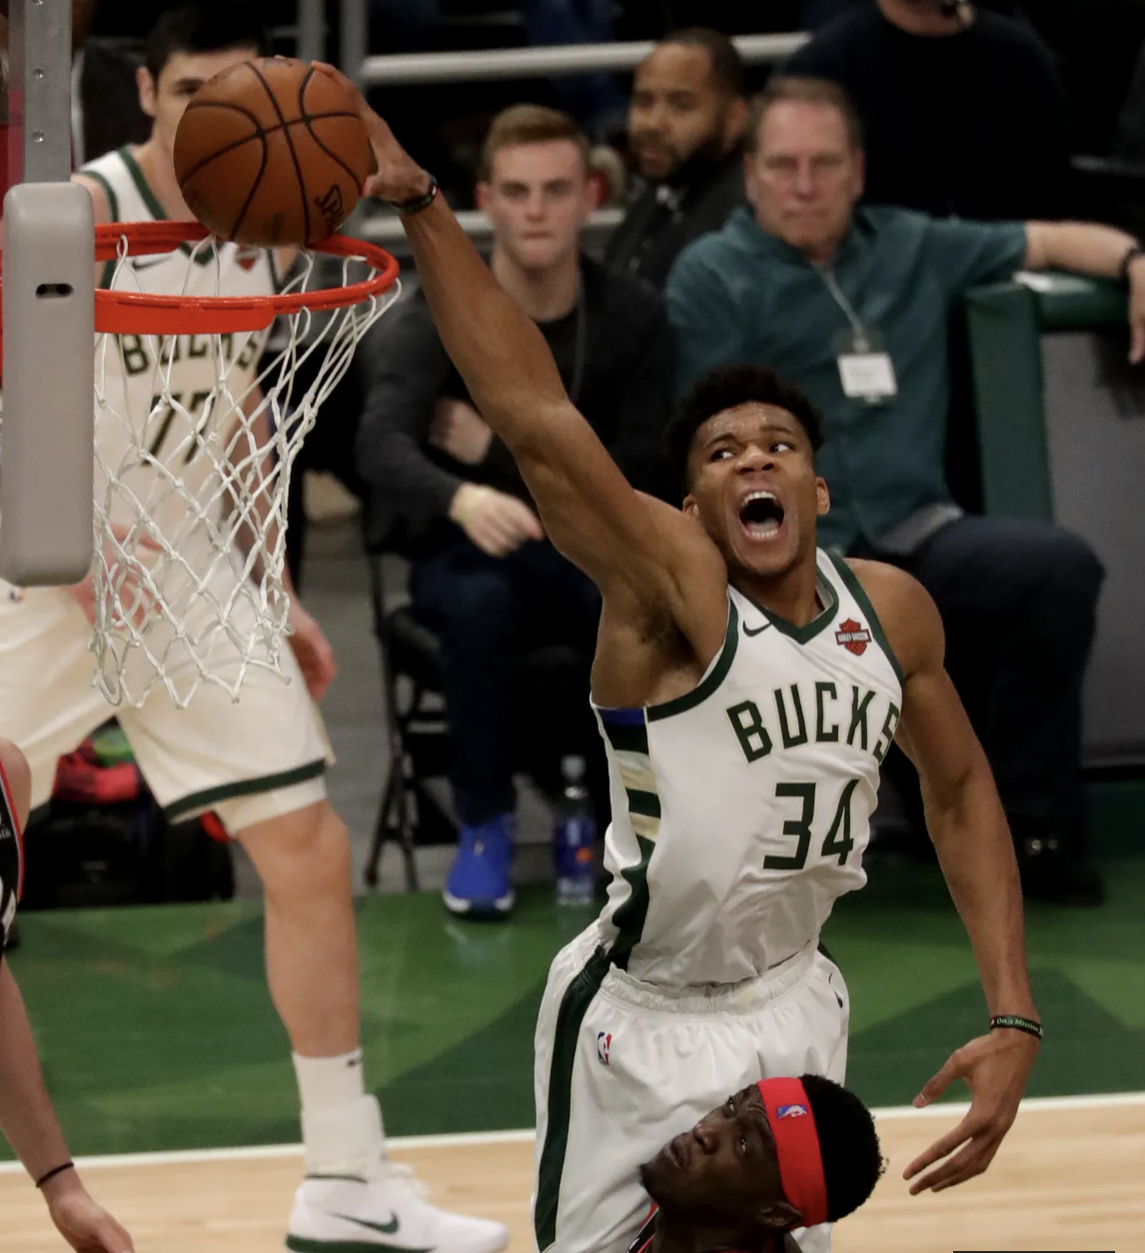
Milwaukee…
  The largest city in the state of Wisconsin
  Population: 1.57 million (Milwaukee-Metropolitan Area)
    30% of the population of Wisconsin
    The 32nd largest city in the US by population
  The “City of Festivals”
    Summerfest grounds (June to September)
  Sports
    Green Bay Packers
    Milwaukee Bucks
    Milwaukee Brewers
    Milwaukee Admirals
  “Excellent quality of life and overall livability for residents” – Omar, a resident

Slide 4
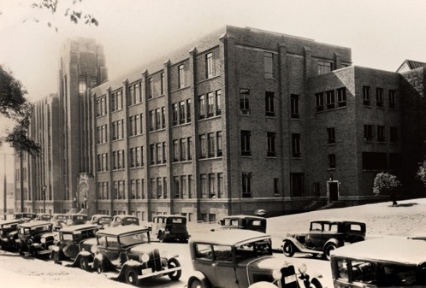
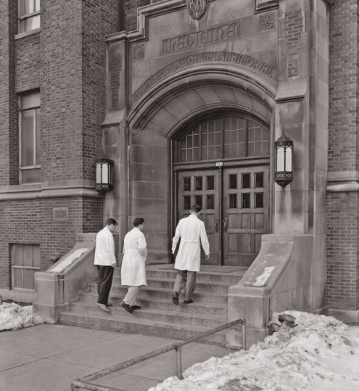
History of MCW Neurosurgery
1893 |  | Established as Wisconsin College of Physicians and Surgeons and Milwaukee Medical College
1913 |  | Becomes Marquette University School of Medicine
1963 |  | Division of Neurosurgery (Sanford Larson, MD/PhD-first chair)
1967 |  | MCW separates from Marquette to become independent medical institution
1987 |  | Dr. Larson initiated the first neurosurgical spine fellowship program in the country.
1988 |  | Department of Neurosurgery

Slide 5
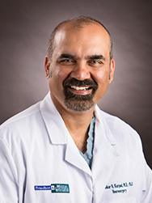
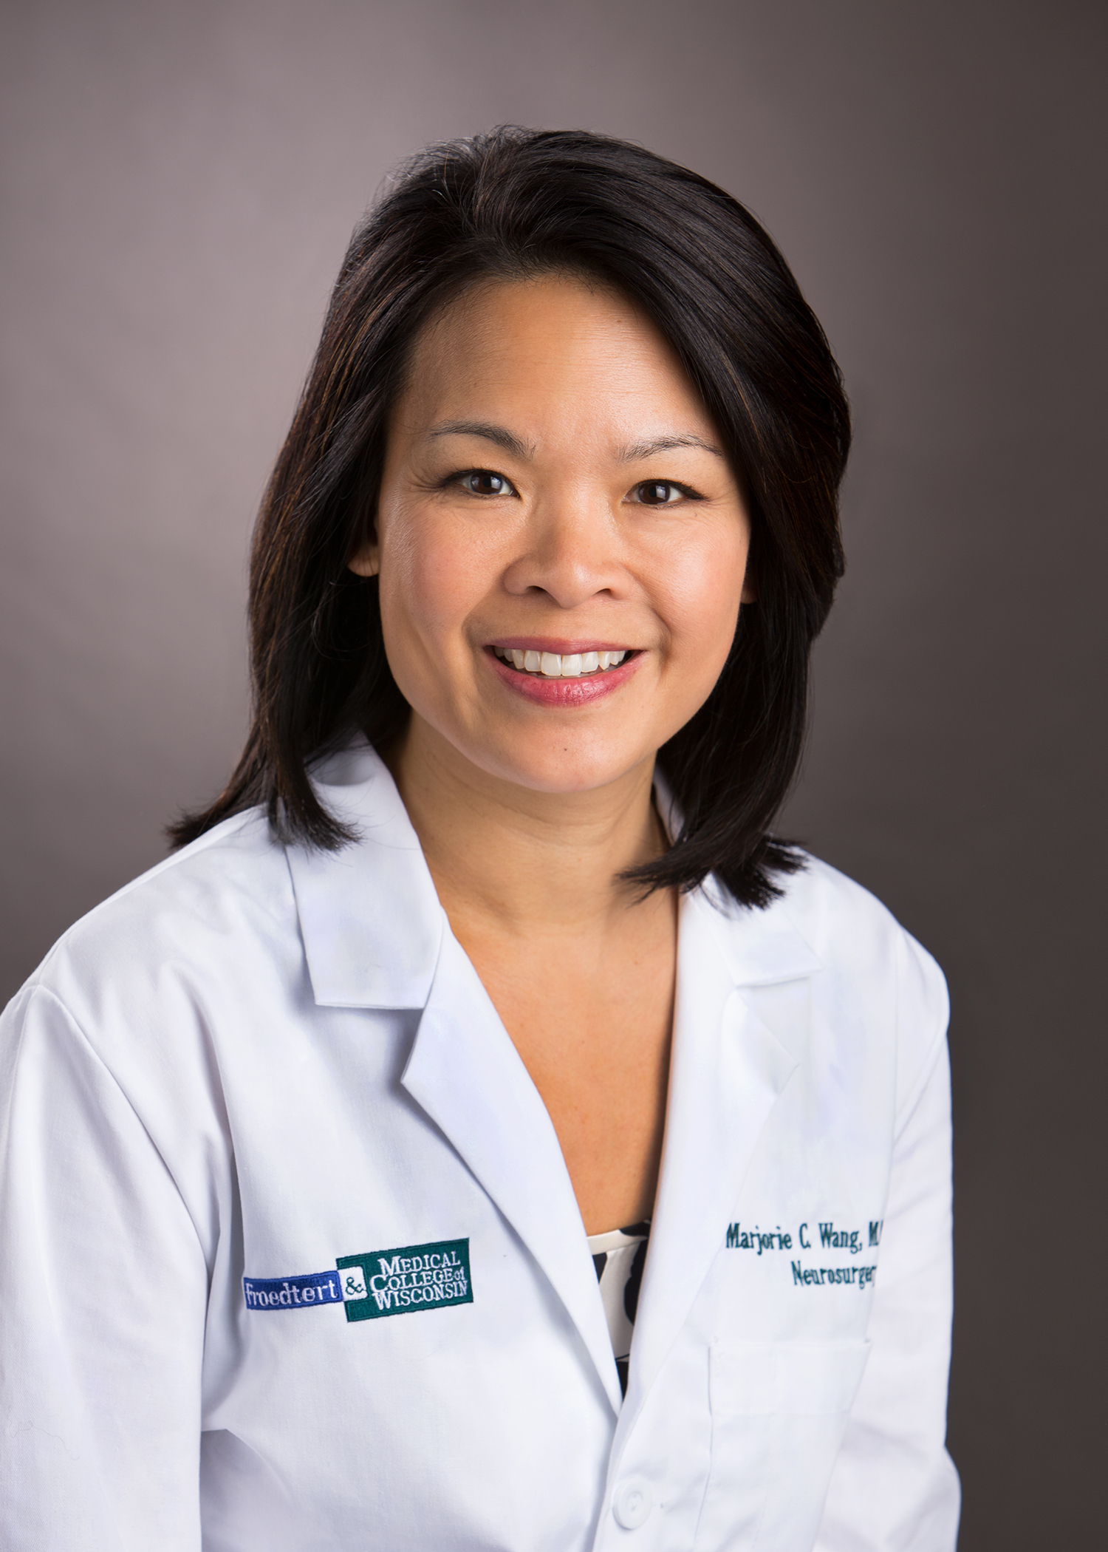
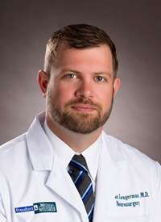
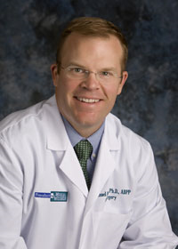
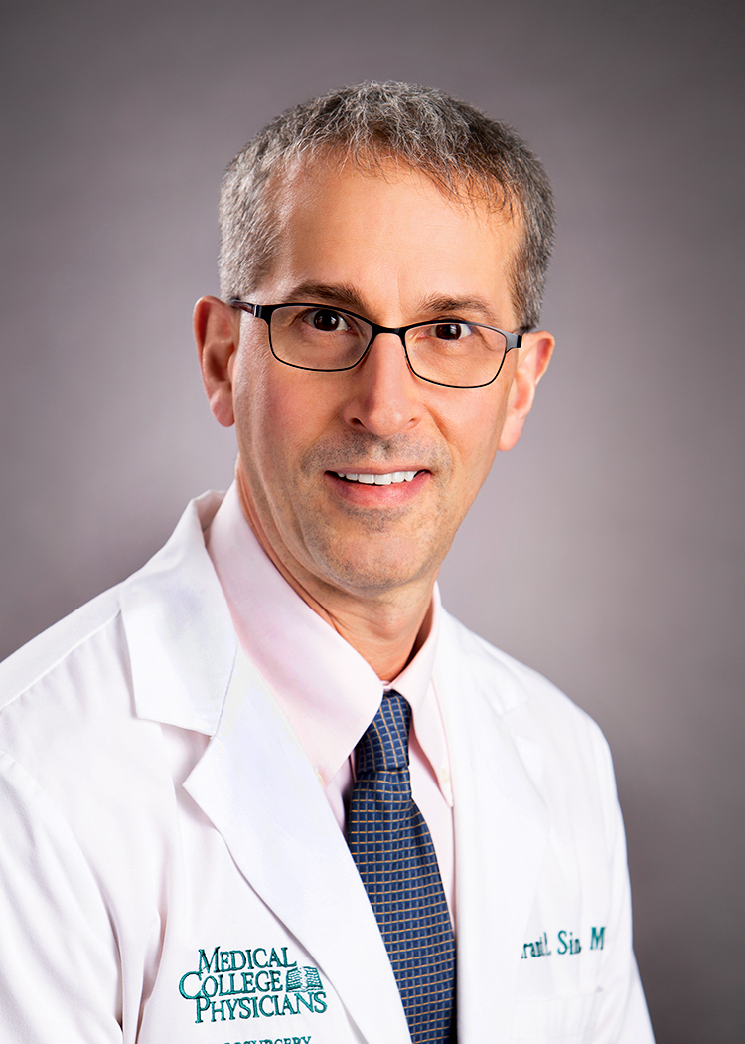
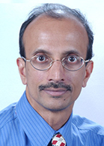
Program Leadership
Department Chair/Director of Neuroscience Institute Shekar Kurpad, MD, PhD Professor of Neurosurgery |  | Director of Community Neurosurgery Marjorie C. Wang, MD, MPH Professor of Neurosurgery
Program Director Nathan Zwagerman, MD Associate Professor of Neurosurgery |  | Director, Brain Injury Research Michael McCrea, PhD, ABPP Professor of Neurosurgery
Associate Program Director Grant Sinson, MD Associate Professor of Neurosurgery
Chairman, Biomedical Engineering Narayan Yoganandan, PhD Professor of Neurosurgery

Slide 6
MCW Neurosurgery
  20 Full-time teaching faculty
    7 professors, 7 associate professors, 5 assistant professors
    15 adult neurosurgeons
    4 pediatric neurosurgeons
  14 residents (2/yr)
  10 PhD Neuroscientists
    + Collaborative efforts with Radiology, Biophysics, Oncology, Marquette Biomedical Engineering

Slide 7
Academic and Organized Neurosurgery
CNS President
  Christopher Wolfla, MD (2012-2013)
AANS/CNS Section Chairs
  Spine
    Marjorie Wang, MD, MPH (2017-2018)
    Christopher Wolfla, MD (2011-2012)
Society of Neurological Surgeons (“Senior Society”)
  Shekar Kurpad, MD, PhD
  Dennis Maiman, MD, PhD
  Marjorie Wang, MD
  Sean Lew, MD
American Board of Neurological Surgeons
  Marjorie Wang, MD, MPH
  Journal Editorial Boards
    Neurosurgery
      Shekar Kurpad, MD, PhD
      Christopher Wolfla, MD
    Journal of Neurosurgery: Spine
      Shekar Kurpad, MD, PhD
    Journal of Neurosurgery: Pediatrics
      Sean Lew, MD
    Journal of Neurosurgery: Case Lessons
      Irene Kim, MD
    World Neurosurgery
      Marjorie Wang, MD, MPH

Slide 8
Resident/Fellow Achievements
  ~50% graduates obtain academic positions
  AANS President
    Paul McCormick, MD (2011-2012)
  AANS/CNS Spine Section Chair
    P. McCormick, E. Benzel, C. Wolfla, J. Cheng, M. Groff, M. Wang
  Department Chairs
    Edward Benzel, MD (Cleveland Clinic)
    Dennis Maiman, MD, PhD (MCW)
    Meic Schmidt, MD, MBA (New York Medical College)
    Joseph Cheng, MD, MS (Cincinnati)

Slide 9
Program Highlights
  Two main hospitals are the only Level I Trauma Centers in southeastern Wisconsin
  International leaders in spine surgery and spine biomechanics, brain injury, and imaging research
  Adult and pediatric NAEC Level 4 epilepsy surgery programs
  High volume pediatric and adult brain tumor programs
  High volume movement disorder program
  Intraoperative O-arm (3)
  Intraoperative MRI
  Stereotactic radiosurgery (Gamma Knife)
  Hybrid neurovascular operating room at both main hospitals
  Pediatric and adult neurosurgical robots (brain and spine)
  Magnetoencephalography (MEG)
  High volume endoscopic skull-base practice
  Stereotactic Laser Ablation (aka LITT)

Slide 10
Educational Conferences
    Protected 3.5 hours/week
      Board Exam Review (weekly, September – March)
      Resident Lecture series (weekly, April – August)
      Case Conference (1-2x/month)
      Adult QI/M&M conference (1x/month)
      Pediatric QI/M&M conference (1x/month)
      Journal/Book club (1x/month)
      Neurosurgery Grand Rounds (weekly)
    Protected educational days
      Larson Day
      Spine Day

Slide 11
On-Campus Clinical Conferences
    Epilepsy Surgery (combined Adult and Pediatric)
    Neuro-Oncology Board (separate Adult and Pediatric)
    Neurovascular Conference (separate Adult and Pediatric)
    Neuro Critical Care Conference (separate Adult and Pediatric)
    Spinal Cord Stim Conference (Adult)
    Spine Tumor Board
    Neurointerventional and Neuro Critical Care M&M

Slide 12
Off-Campus Educational Experiences
    Industry-sponsored, ACGME-compliant cadaver workshops (cranial and spine)
    AANS/CNS-sponsored national and regional courses
    Board Review courses
    PGY 1-2 Neurosurgery SNS “boot camps”
    SNS Resident Update in Neuroscience for Neurosurgeons (RUNN) Course

Slide 13
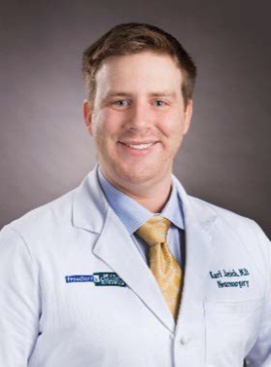
Recent Graduates
2022 Graduate: Karl Janich
2087 operative cases (Senior + Lead)
  Adult brain tumors
    -General: 190 (62%)
    Sellar/parasellar: 48 (75%)
  Open vascular: 47 (48%)
  Endovascular (AVM/aneurysm/stent): 38 (50%)
  Cranial functional: 10 (6%)
  Adult spine (total, 696):
    Anterior-cervical: 72 (43%)
    Posterior-cervical: 181 (98%)
    Thoracic, lumbar, or sacral: 240 (80%)
    Lumbar: 165 (77%)
    Spinal Other: 38 (63%)
  Epilepsy: 40 (76%)
  Pediatric (total, 202)
    Cranial tumor: 18 (64%)
    Cranial trauma/other: 51 (95%)
    Cranial CSF: 97 (95%)
    Spinal: 38 (63%)
  10 publications (1 first author)
  Assistant Professor Neurosurgery, UI Arnett, Lafayette, IN

Slide 14
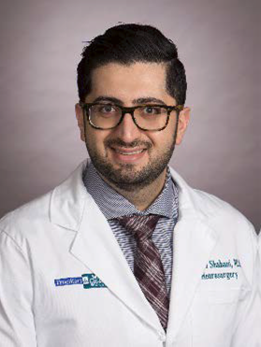
Recent Graduates
2021 Graduate: Saman Shabani
2151 operative cases (Senior + Lead)
  Adult brain tumors
    -General: 233 (81%)
    Sellar/parasellar: 37 (62%)
  Open vascular: 32 (16%)
  Endovascular (AVM/aneurysm/stent): 31 (48%)
  Cranial functional: 45 (92%)
  Adult spine (total,1031):
    Anterior-cervical: 132 (84%)
    Posterior-cervical: 284 (99%)
    Thoracic, lumbar, or sacral: 399 (97%)
    Lumbar: 193 (85%)
    Spinal Other: 23 (40%)
  Epilepsy: 29 (58%)
  Pediatric (total, 143)
    Cranial tumor: 23 (78%)
    Cranial trauma/other: 24 (60%)
    Cranial CSF: 69 (89%)
    Spinal: 25 (81%)
  45 publications (8 first author)
  Spine Fellowship: UCSF
*current faculty

Slide 15
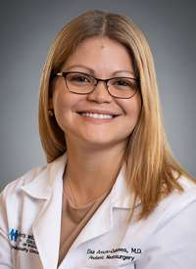
Recent Graduates
  2019 Graduate: Elsa Arocho-Quinones
    1516 operative cases (52%)
      Adult brain tumors: 165 (50%)
      Open vascular: 40 (35%)
      Endovascular (AVM/aneurysm/stent): 18 (31%)
      Functional: 160 (84%)
      Adult spine: 279 (14%)
      Epilepsy: 34 (83%)
      Pediatric: 233 (97%)
    8 publications (6 first-author)
    Pediatric Neurosurgery Fellowship, Harvard Medical School, Boston Children’s
    Academic Pediatric Neurosurgery, UT-Austin Dell Medical School/Children’s Medical Center, MCW
*current faculty

Slide 16
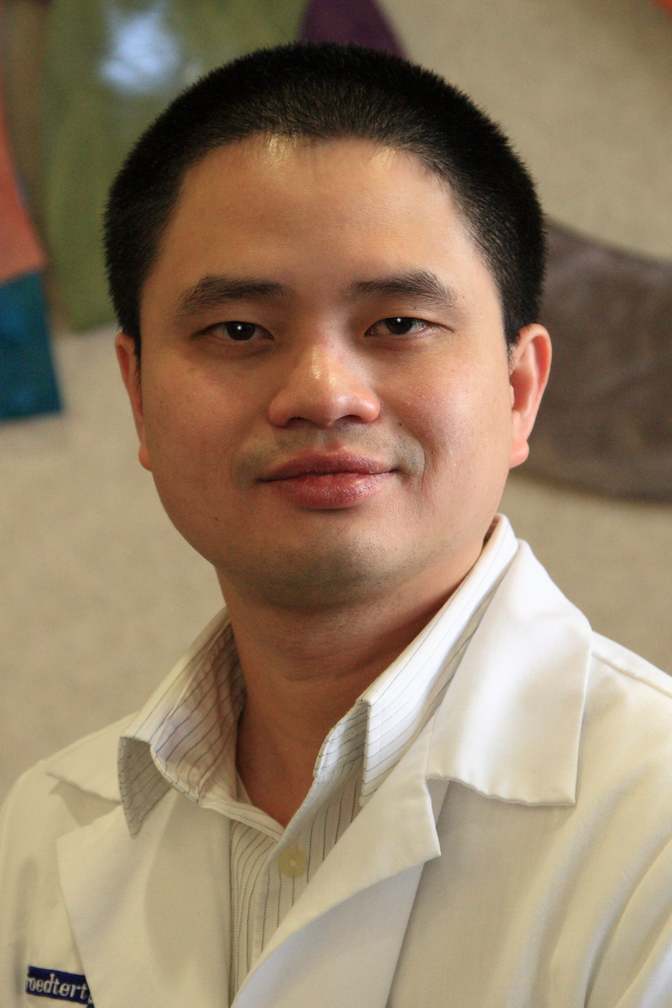
Recent Graduates
  2018 Graduate: Ninh Doan
    1276 operative cases (25%)
      Adult brain tumors: 201 (73%)
      Open vascular: 43 (45%)
      Endovascular (AVM/aneurysm/stent): 18 (37%)
      Functional: 115 (68%)
      Adult spine: 364 (29%)
      Epilepsy: 26 (75%)
      Pediatric: 93 (57%)
    43 publications (10 first author)
    Academic, University of South Alabama

Slide 17
Operative Experience
  2017 Graduate: Akin Oni-Orisan
    1768 operative cases (79%)
      Adult brain tumors: 169 (56%)
      Open vascular: 85 (90%)
      Endovascular (AVM/aneurysm/stent): 49 (84%)
      Functional: 119 (70%)
      Adult spine: 517 (68%)
      Epilepsy: 34 (83%)
      Pediatric: 129 (79%)
    7 publications (1 first author)
    Neuroendovascular Surgery Fellowship at U of Texas – Houston
    Private, Stroke and Neurovascular Center of Central CA

Slide 18
Recent Graduates
    2022: Andrew Montoure, MD (skull base fellowship U-Wash)
    Karl Janich, MD (academic, Indiana University)
    2021: Saman Shabani, MD, (academic, complex spine fellowship, UCSF, MCW)
    2020: Michael Gelsomino, MD (private, Athens GA)
    2019: Elsa Arocho-Quinones, MD (academic, pediatric fellowship, UT-Austin, MCW)
    2018: Ha Son Nguyen, MD (private, CA)
    Ninh Doan, MD, PhD (academic, U South Alabama)
    2017: Akin Oni-Orisan, MD (private, vascular fellowship, Santa Barbara, CA)
    2016: Andrew Lozen, MD (private, FL)
    Abishiek Sharma, MD (private, AZ)
    2015: Gerald Eckhardt, MD (private, WI)
    2014: Joseph Cochran, MD (academic, UT-Health, TX)
    2013: Alastair Hoyt, MD (academic, Marshall, WV)

Slide 19
Perks….
  Competitive salary
    PGY-1 (2022-2023): $65,180 (national median for 2022-2023: $66,318 NIH)
    Additional $1500/year for exams/fees/books
    Cost of living in Milwaukee ~9% below average for metropolitan areas
  Provided without charge
    Laptop computer
    Surgical loupes (PGY-1)
    Lead aprons and goggles
  Conferences/courses support:
    One week for academic conferences/courses per year (beside 3 weeks of vacation)
    $4500 reimbursement conference expenses per year
Notes:
https://www.aamc.org/download/493114/data/2018stipendsurveyreportfinal.pdf

Slide 20
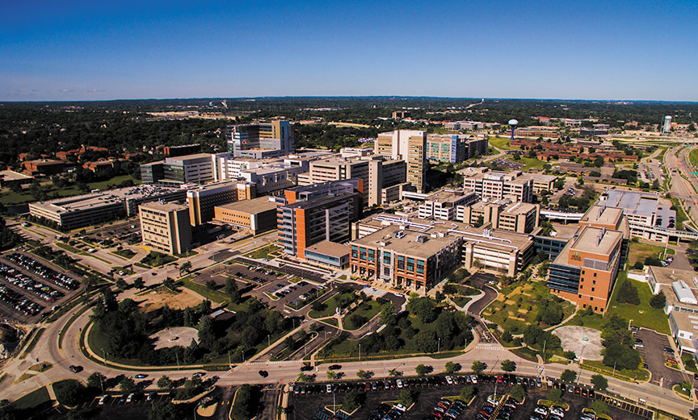
Medical Regional Medical Center
Medical College of Wisconsin (MCW)
Froedtert Hospital
Children’s Wisconsin
Versiti Blood Center of Wisconsin
Eye Institute
Curative Care Network
Milwaukee County Behavioral Health
Cancer Center
Froedtert
Children's
Behavioral Health
Curative
Eye Institute
HUB
MCW
Blood Center

Slide 21
Froedtert Hospital
Only adult Level I Trauma Center in SE Wisconsin
Over 3500 neuro procedures (neurosurgical + endovascular)

Slide 22
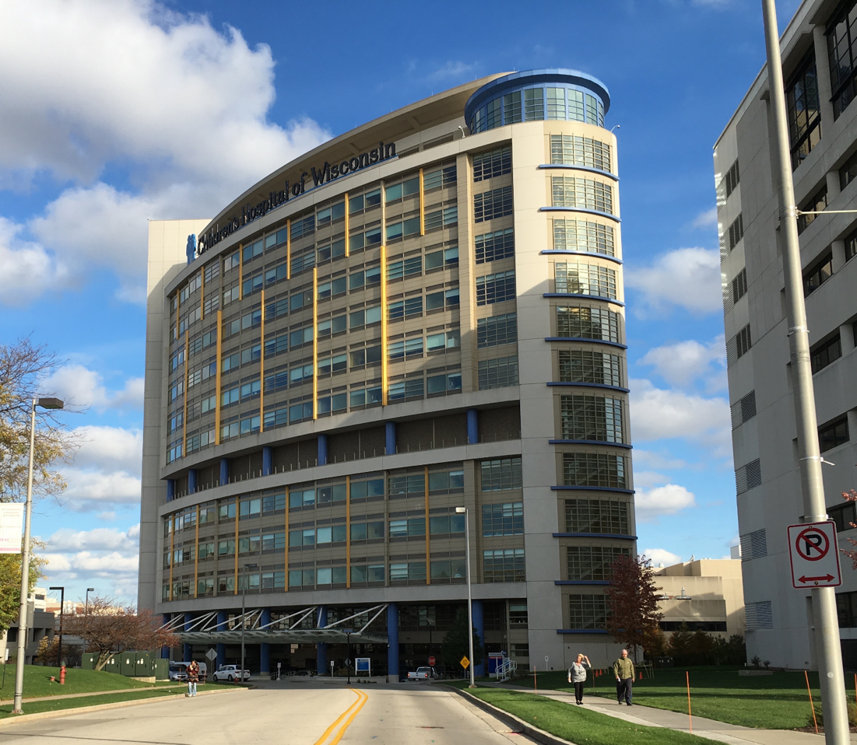
Children’s Wisconsin
Only pediatric Level I Trauma Center in SE Wisconsin
~600 neurosurgical procedures/yr
4 pediatric neurosurgeons
Largest volume pediatric neurosurgery practice in U.S. without a fellowship

Slide 23
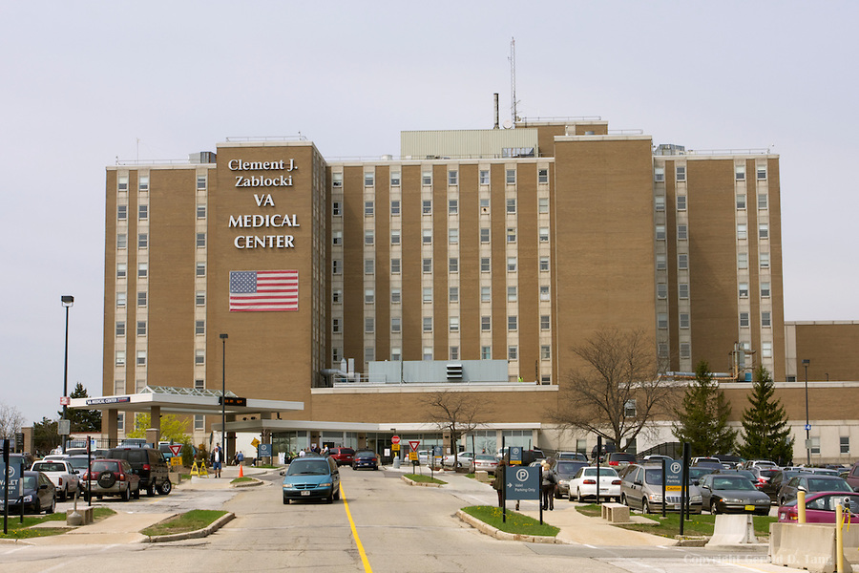
VAMC
100-200 neurosurgical procedures/year
Site of Neurosurgery Research Facility

Slide 24
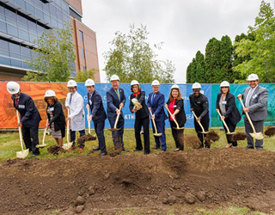
MCW Cancer Research Building
MCW is constructing Milwaukee’s only cancer-dedicated research facility to stimulate new synergies in science that will decrease the region’s cancer burden and improve clinical outcomes for patients.
When completed, the facility will:
Provide valuable wet and dry lab space
Connect researchers, state-of-the-art equipment and laboratories under one roof
Foster innovation, collaboration and team science
Create an inviting space for community members to take part in research with MCW and our affiliated research partners
Support improved clinical outcomes for patients in our community
*Construction of the building is expected to be completed by late 2024.

Slide 25
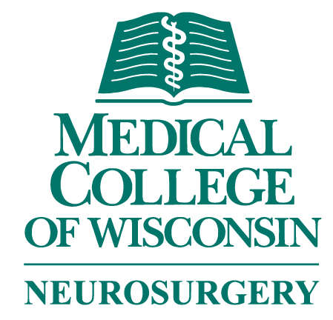
NEUROSURGERY RESEARCH: BIG PICTURE

Slide 26
NEUROSURGERY RESEARCH: BIG PICTURE
Per Google Scholar, 2/16/22
H-Index Guide:
20 = Good 40 = Outstanding 60 = Exceptional
Per MCW Faculty Collaborative Data Base, 2/16/22
H-Index: No. of pubs for which author is cited by other authors at least that same number of times

Slide 27
