Slide 1
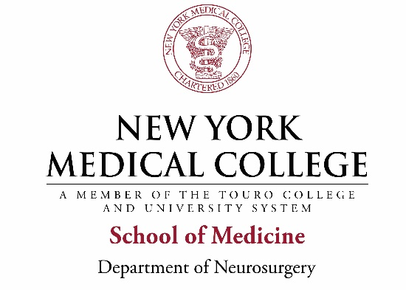
Neurological Surgery Residency Training Program Westchester Medical Center/ New York Medical College Valhalla, NY

Slide 2
Westchester County, NY
Consistently rated as one of the most desirable places to live in the US
Population- 1 million
Proximity to New York City
Provides the best of both worlds, city access and outdoor activities in the Hudson Valley
30-40 minute drive to Manhattan from most of the county
Easy public transport and dedicated airport (White Plains)

Slide 3
WMCHealth Alliance
Dominant health system in Westchester
Largest hospital and healthcare network between NYC and Albany
Massive catchment of over 3 million people
Tertiary care facility handling the most complex surgical and medical cases
Satellite and feeder hospitals extending nearly 150 miles north, just short of Albany

Slide 4
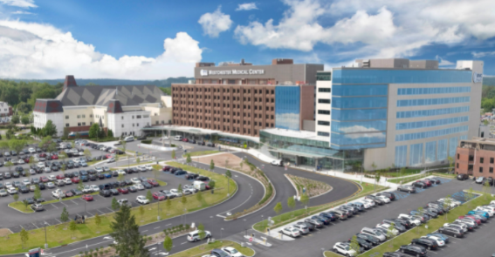
Neurosurgery at WMC/NYMC
WESTCHESTER MEDICAL CENTER
Tertiary care medical center for 100 mile radius
Level 1 Trauma, CSC, Level 4 Epilepsy Centers
700 bed hospital
ACGME Sponsor for 35 Programs

Slide 5
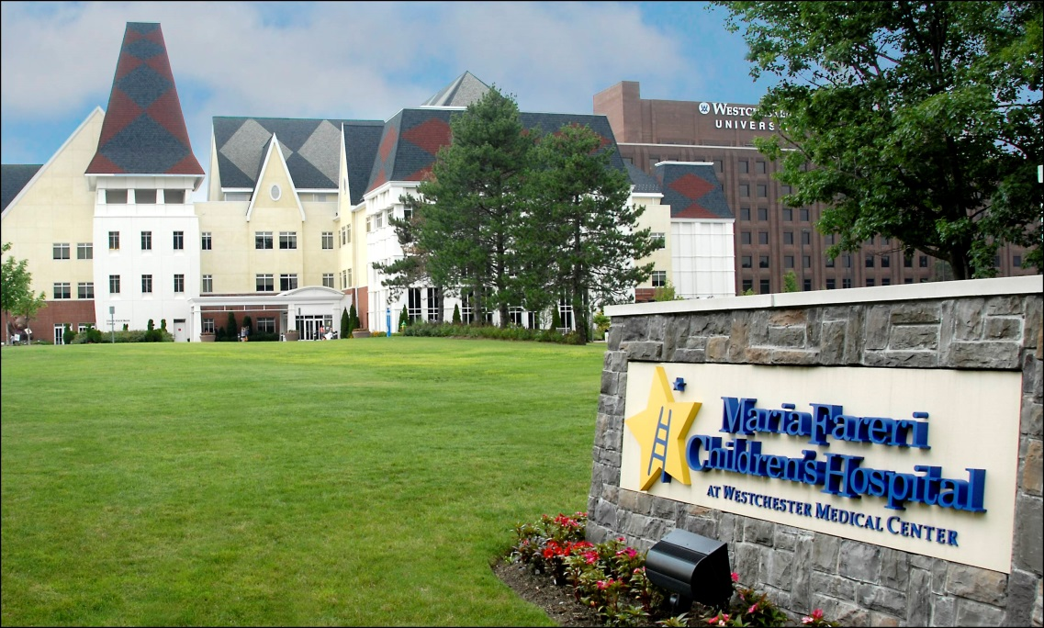
Neurosurgery at WMC/NYMC
MARIA FARERI CHILDREN’S HOSPITAL
Tertiary care center-Only Regional Peds Level 1
Neonatal ICU, Pediatric ICU
Dedicated Pediatric OR

Slide 6
Neurosurgery at WMC/NYMC
ICU PAVILION
Start in 2023, Completion in 2025
5 floor ICU Tower with advanced imaging

Slide 7
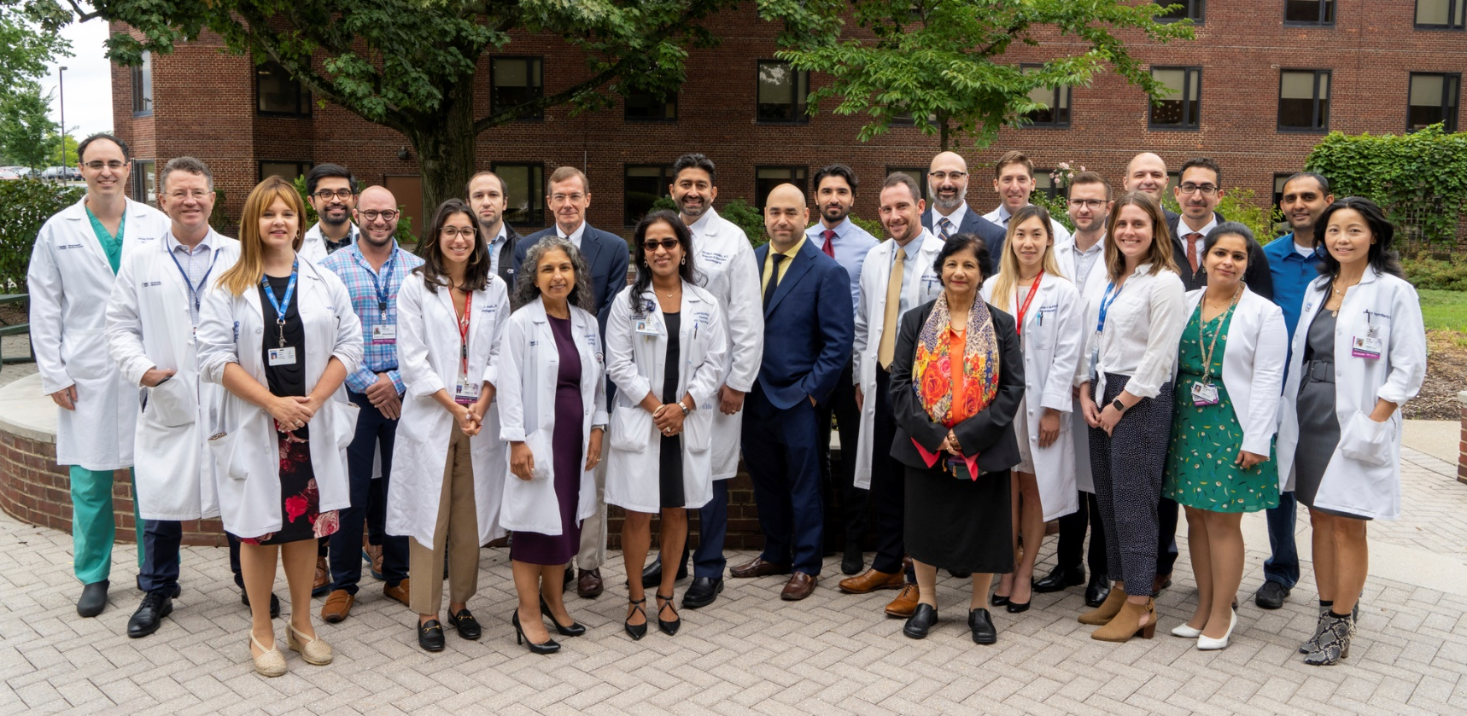
Neurosurgery at WMC/NYMC
Residency complement: 2 residents per year
Fellowships offered in Endovascular and Neurocritical Care
Plans for more…
Extensive APP support

Slide 8
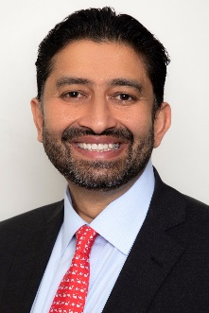
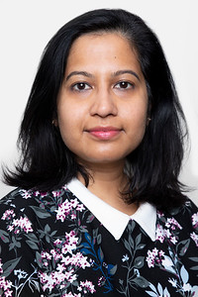
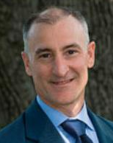
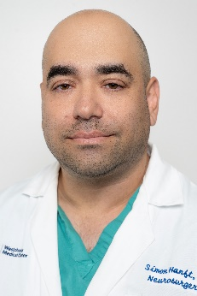
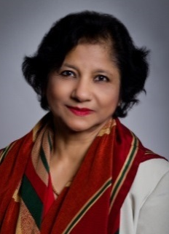
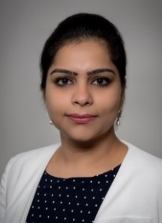
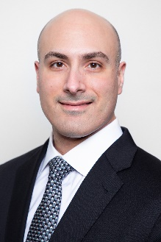
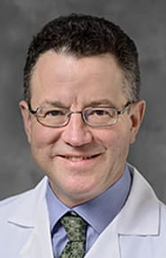
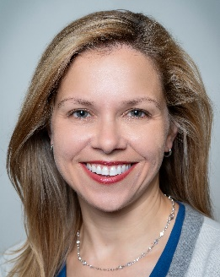
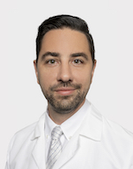
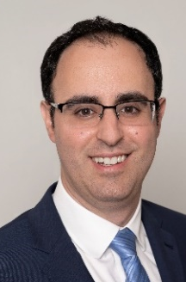
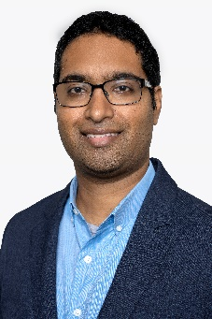
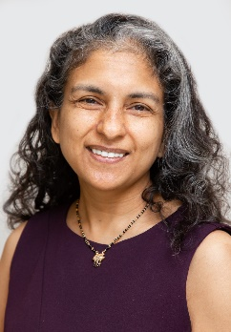
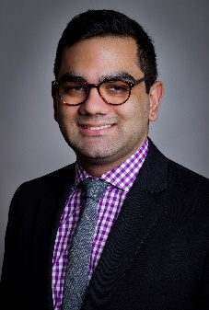
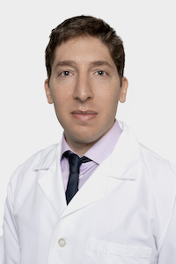
Core Faculty- WMC
Wide variety of training programs represented
WMC!!
Emory
Columbia
Mount Sinai
UPenn
Montefiore
Stanford
Barrow (BNI)
UMiami
Duke
Chirag Gandhi Fawaz Al-Mufti Arundhati Biswas P. Charles Garell Simon Hanft
Meena Jhanwar-Uniyal Gurmeen Kaur Merritt Kinon Stephan Mayer Avinash Mohan Carrie Muh Andrew Bauerschmidt
Jared Pisapia Justin Santarelli Vishad Sukul Michael Tobias Rachana Tyagi John Wainwright Jon Rosenberg
Notes:
Core Neurosurgical Areas:
Cerebrovascular
Endovascular
Complex Spine
Spine Oncology
Stereotactic/Functional
Pediatric
Skull Base
Peripheral Nerve
Neurotrauma
Radiosurgery

Slide 9
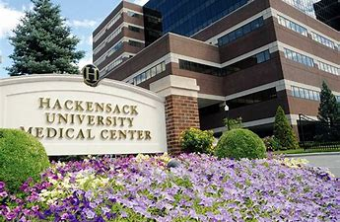
Hackensack University Medical Center
3000 Neurosurgery procedures annually, 13 surgeons
Excellent operative experience
PGY-3 through PGY-7 rotations

Slide 10
Clinical Excellence
Broad scope of neurosurgical pathology taught by sub-specialized faculty
State of the art facilities and newest technology
Closely supervised autonomy in the OR and clinics
Intense daily Neurosurgery ICU experience
Involvement in daily management decisions

Slide 11
Clinical Excellence: Graduating Volumes
Chief Resident 2023: 1,728
Chief Resident 2022: 1,459
Chief Resident 2021: 1,698
Chief Resident 2021: 1,694

Slide 12
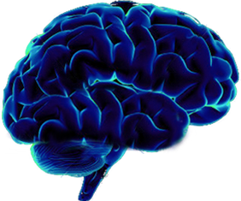
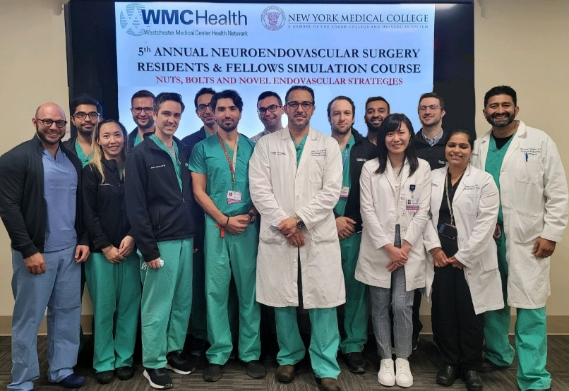
Education
Weekly
Chief of Service Rounds
Neurovascular Case Conference
Multidisciplinary Epilepsy Conference
Bi-Weekly
NICU Rounds
Neuro-Oncology Tumor Board
Peds Neuro-Oncology Tumor Board
Cedarwood Outpatient Clinic
Neuroendovascular Didactics

Slide 13
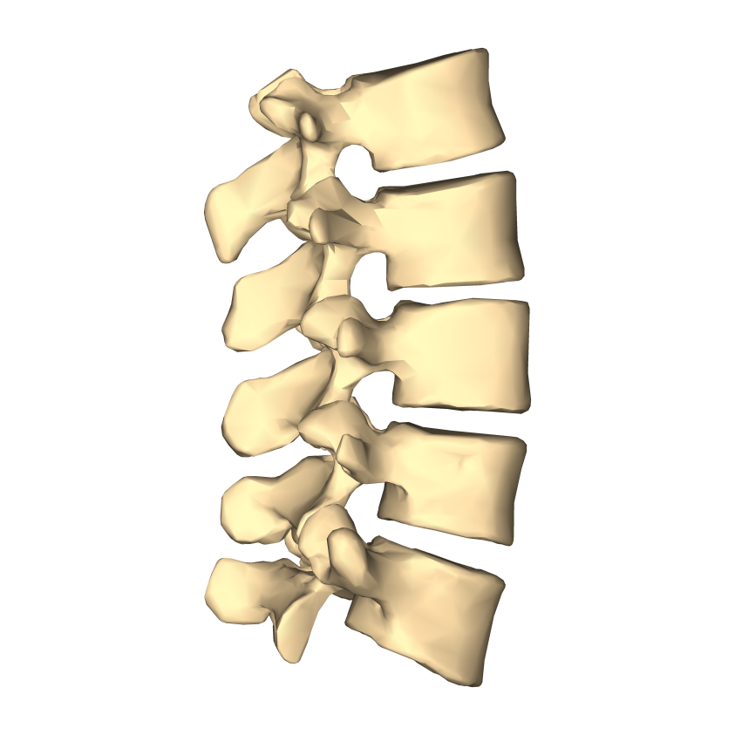
Education
Monthly
Grand Rounds
Morbidity and Mortality Conference (NCC, NIR, NS)
Joint Cerebrovascular Conference
Joint Neuro-Ortho Spine Conference
Indications Conference
Research Meeting
Resident Case Conference
Spine Didactics
Functional Neurosurgery Conference
Resident Focused Topic Review
Critical Care Grand Rounds
Journal Club
Faculty Lunch Series
Peripheral Nerve Case Conference
Multidisciplinary Neurosurgery Conference

Slide 14
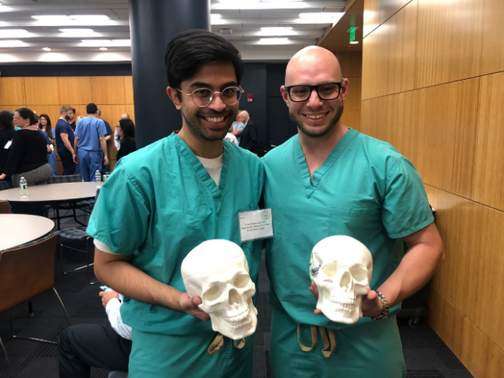
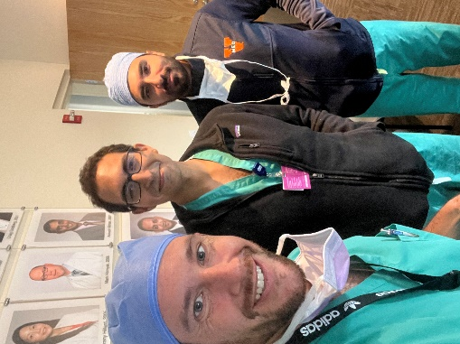
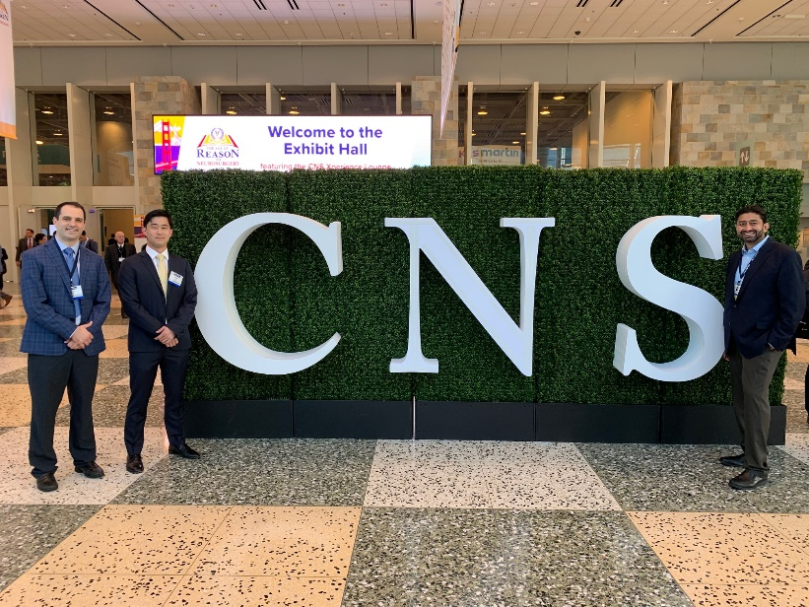
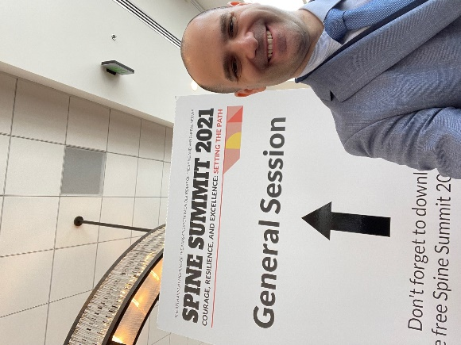
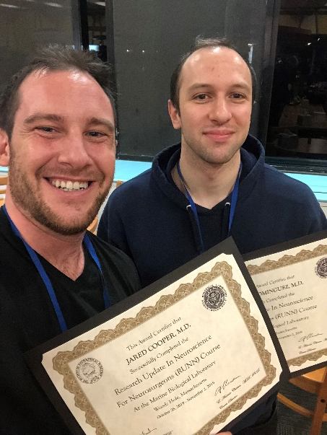
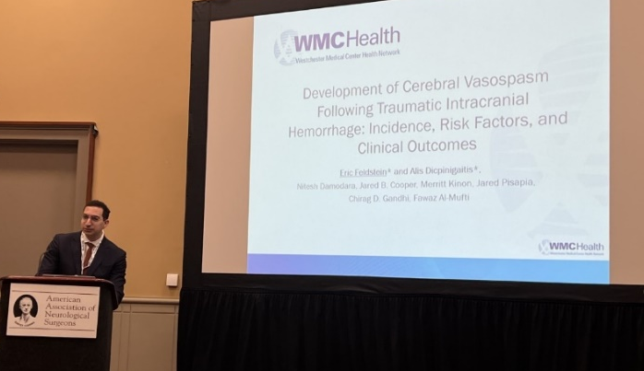
Education
PGY-1 Year- Intern Boot Camp
PGY-2 Year- Junior Boot Camp
PGY-3 Year- RUNN
PGY-4 or 5 Research Year
Basic Science Research
Endovascular (or NCC)
Off-site based on career goals
PGY-6/7 –Senior courses
Regional and National Meetings
AANS/CNS Resident Courses
Written Board Prep Courses

Slide 15
Professional Development and Mentorship
Residency training is where long-term professional relationships are formed
Establish close relationships with faculty that can help with career advancement
Open door policy for all faculty!!!

Slide 16
Graduates: Where Are They Now?
2023: Jared Cooper
Endovascular Fellowship, WMC
2022: Tolga Sursal
Spine Fellowship, UVA
2021: John Wainwright
Spine Fellowship, Thomas Jefferson, PA
Current Position: Westchester Medical Center, Valhalla, NY
2021: Michael Kim
Skull Base Fellowship, UC-Irvine, CA
Current Position: Asst Clinical Professor, UCI and Practice in Long Beach, CA
2020: Anubhav Amin
Neurosurgical Oncology Fellowship, Memorial Sloan Kettering, NY
Current Position: Asst Professor, Spine Oncology, University of Washington, WA
2018: Jennifer Ronecker
Pediatric Neurosurgery Fellowship, Barrow Medical Center, AZ
Current Position: Clinical Asst Professor, Phoenix Children’s Hospital, AZ
2018: Arthur Wang
Endovascular Surgery Fellowship, Columbia University, NY
Current Position: Assistant Professor, Neurovascular Surgery, Tulane, LA

Slide 17
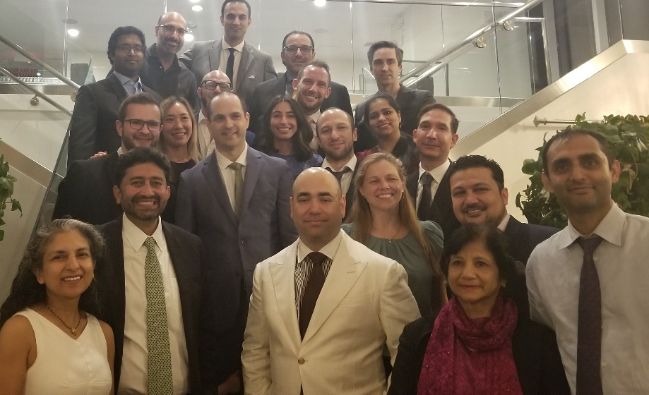
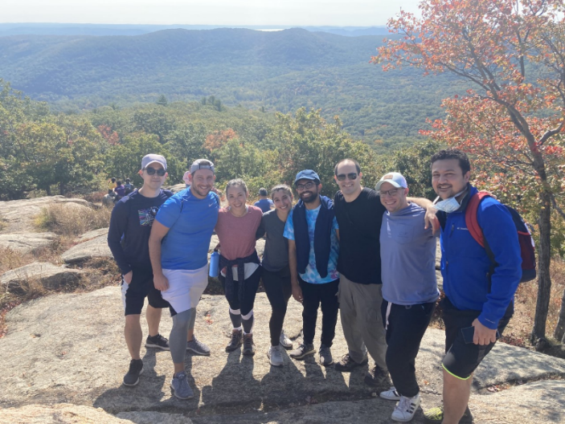
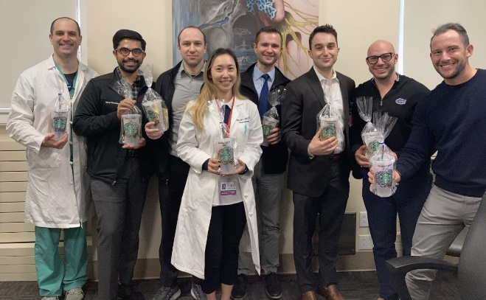
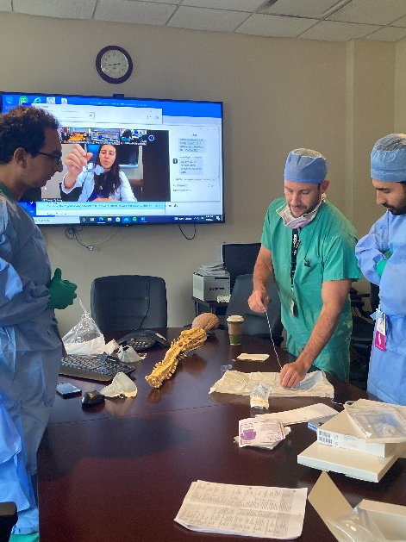
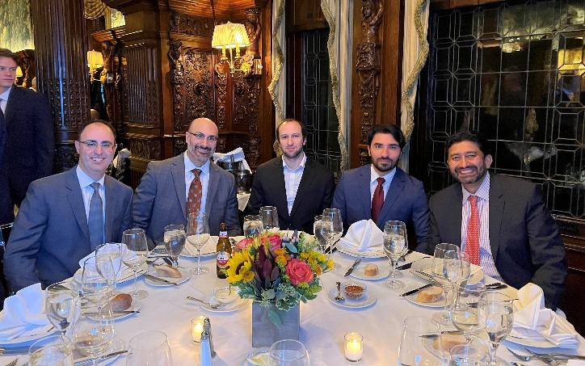
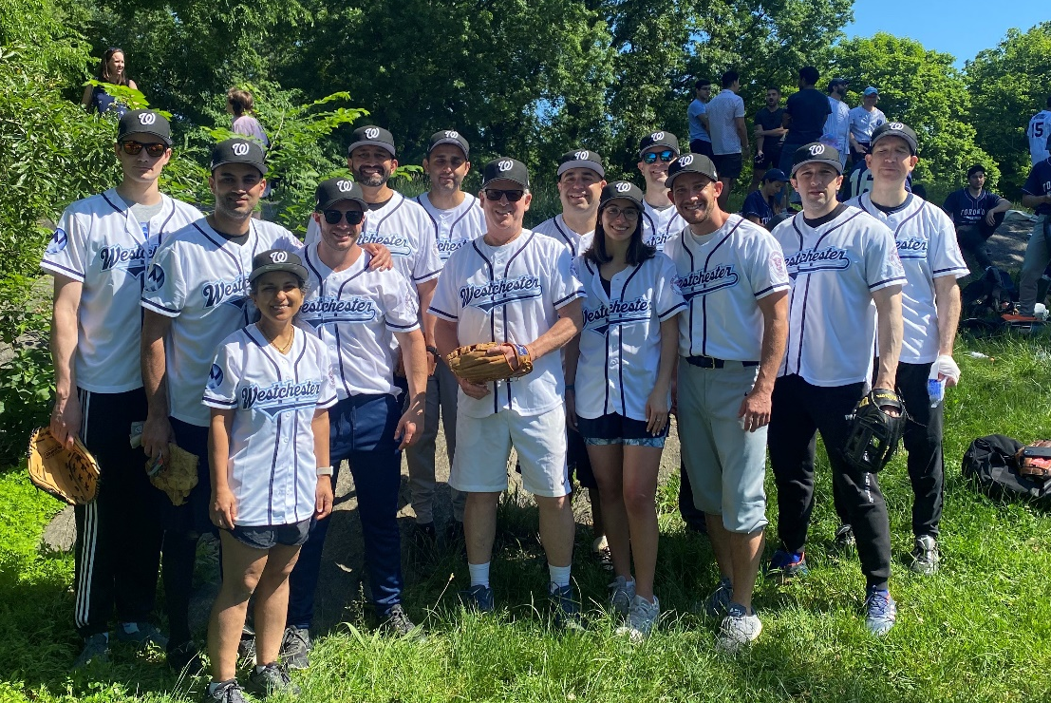
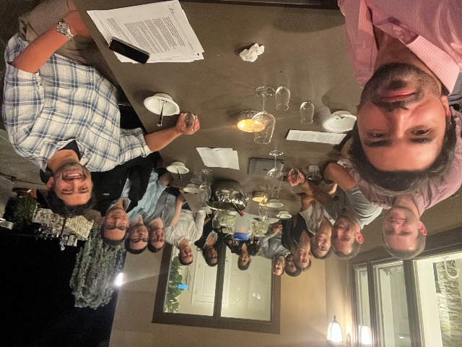
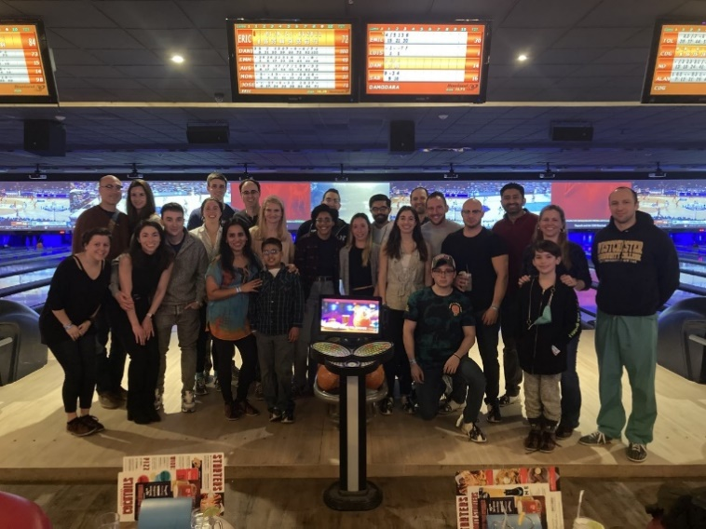
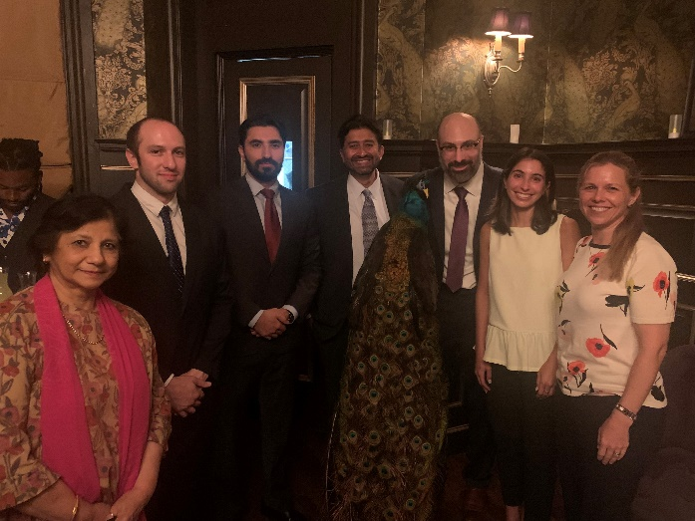
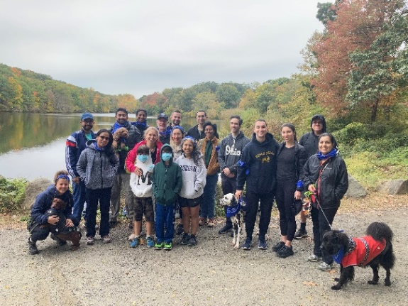

Slide 18
You will be part of a close-knit program with an intimate, homegrown feel
You will be part of a program that is progressive, dynamic, and believes in constant innovation and evolution
You will get significant attention from each faculty member at every step of the way
You will grow under a system of graded responsibility, independence, and autonomy
You will be surrounded by highly motivated faculty and leadership, enthusiasm about building the department together

Slide 19
Welcome!

