Slide 1
The essential educational and professional development partner for neurosurgeons, trainees, and industry innovators.
Residency at UT Houston

Slide 2
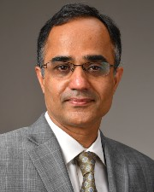
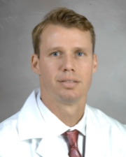
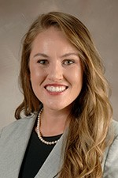
University of Texas Health Science Center in Houston
Chairman ad interim
Nitin Tandon, MD
Program Director
Spiros Blackburn, MD
Presenter
Samantha Parker, MD,
PGY7 resident

Slide 3
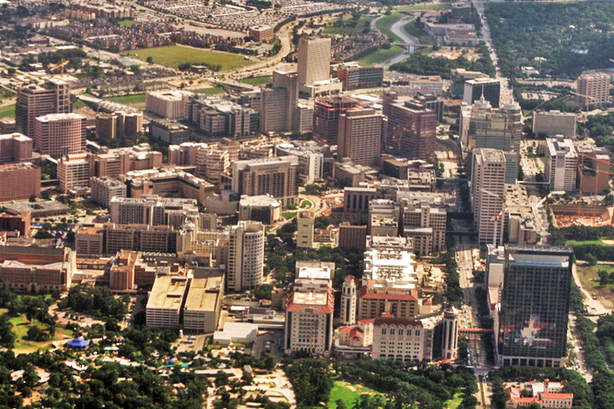



Slide 4
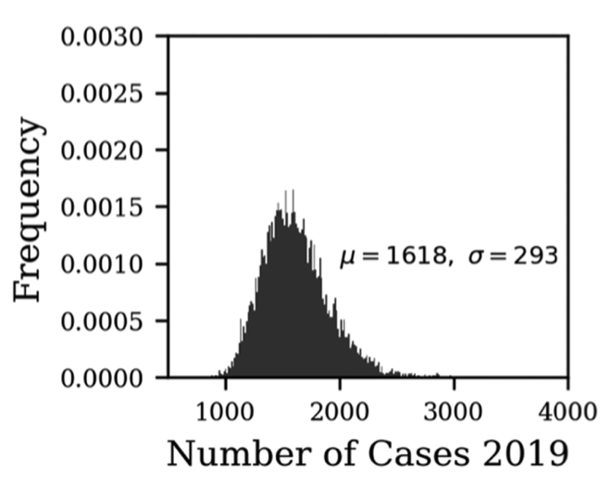
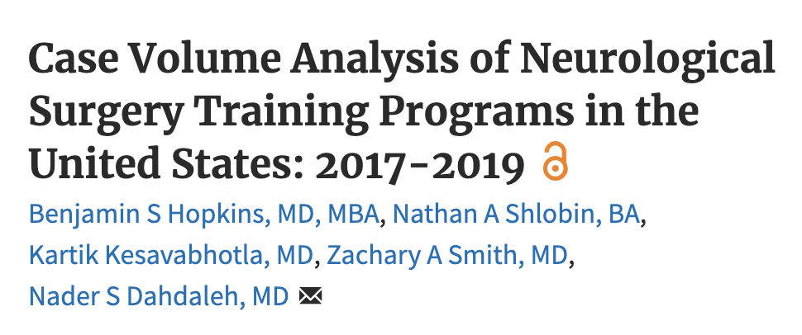

Approx. 2000-2100 cases
~60% cranial
*** Need to exclude critical care, endovascular, and radiosurgery
Notes:
4200 cases puts you in the 90th percentile of 3/yr programs

Slide 5
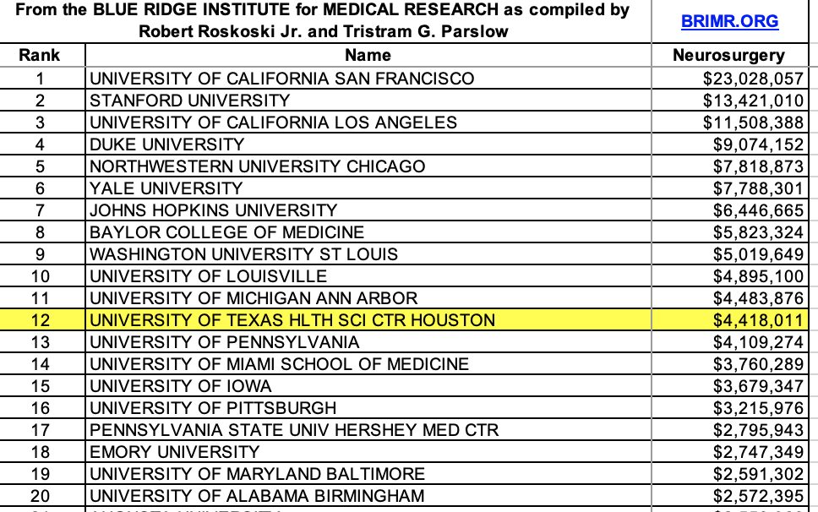
Research
R25 grant
Funds PGY5 year +/- PGY7; will provide part-time RA
Only 16 programs have an R25 (via NINDS)
U Alabama, Stanford, UCSF, UCLA, USC, Yale, U Florida, Miami, Hopkins, Harvard, Michigan, WashU, Baylor, Duke, Southwestern, Uwash
NIH grants
$4.4m up from $2.7m
R01s: Tandon,
McCullough,
  Savitz, etc
R41: Chen

Slide 6
Fellowships
Upcoming:
Matthew Mullarkey MD – 2024 neurosurgical oncology at U Toronto with Zadeh
Hussein Zeineddine MD – 2024 open vascular at U Toronto with Radovanovic
Past:
Mike Monterrey MD – 2023 MIS at Miami with Wang
Brad Budde MD – 2023 peripheral nerve at WashU with Ray
Cole Lewis MD – 2022 neurosurgical oncology at MSK with Tabar
Chris Conner MD/PhD – 2022 DBS at U Toronto with Lozano
Yoshua Esquenazi MD – neurosurgical oncology at MSK
Wes Jones MD – Spine at WashU

Slide 7
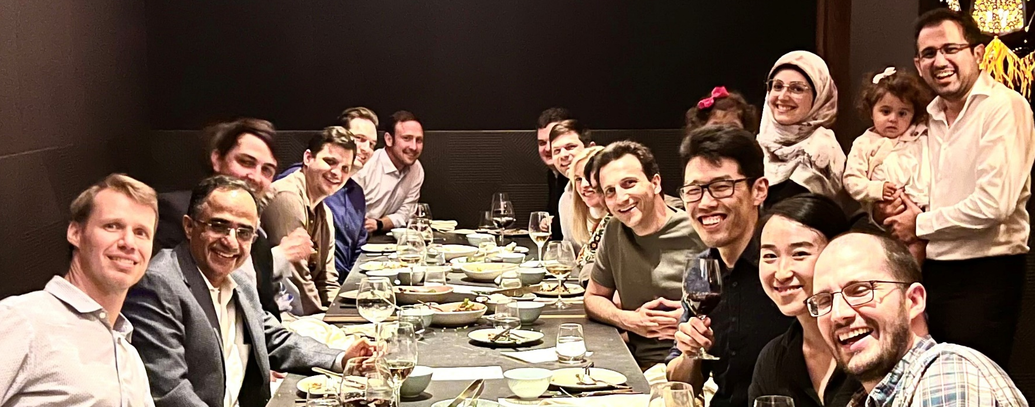
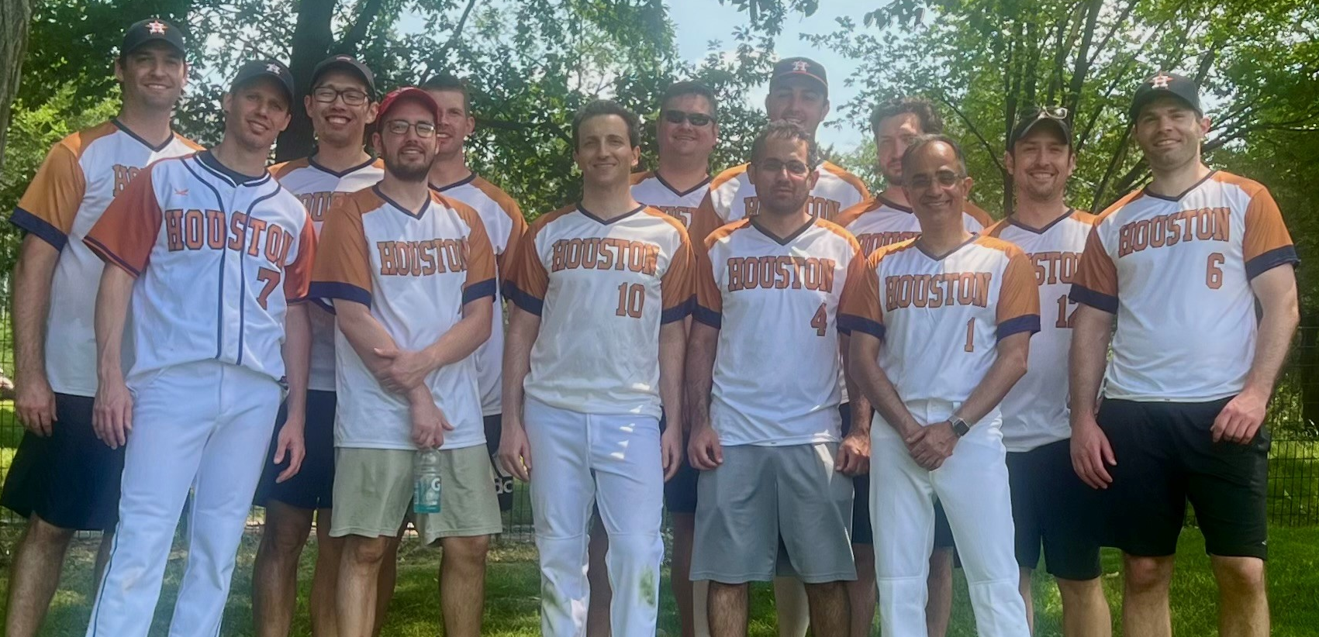

Slide 8
Program Contact Information
Program Coordinator- Meredith Suescun
  Email- Meredith.L.Hamilton@uth.tmc.edu
  Phone Number- (713) 486-8056
Please reach out with any questions
you may have…

