Slide 1
CNS Virtual residency fair
University of California Irvine
Department of neurosurgery
Notes:
Please email Leslie Weterrings at lweterri@uci.edu with any questions or for more information.
Please email any of our residents to learn more about our program (today’s presenter: Alexander Lopez, PGY-4: amlopez1@uci.edu)

Slide 2
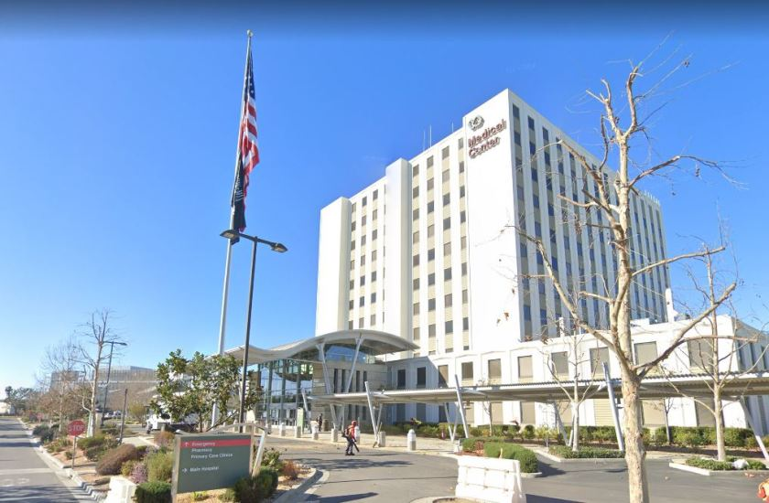
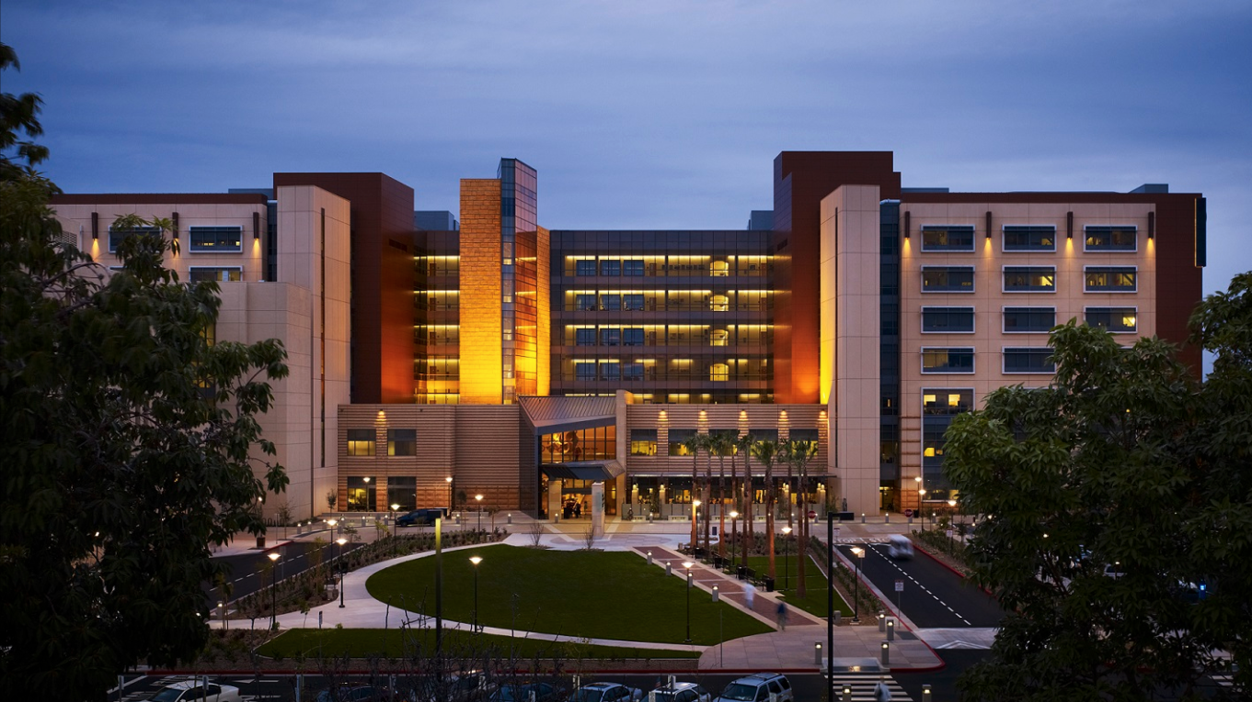
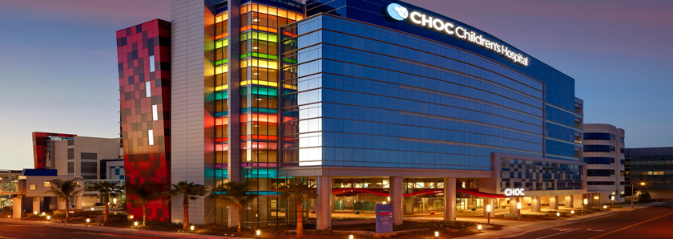
Rotation Sites
Long Beach VA Hospital
UC Irvine Medical Center
Children’s Health of Orange County: CHOC
Notes:
Please email Leslie Weterrings at lweterri@uci.edu with any questions or for more information.
Please email any of our residents to learn more about our program (today’s presenter: Alexander Lopez, PGY-4: amlopez1@uci.edu)

Slide 3
Notes:
Please email Leslie Weterrings at lweterri@uci.edu with any questions or for more information.
Please email any of our residents to learn more about our program (today’s presenter: Alexander Lopez, PGY-4: amlopez1@uci.edu)

Slide 4
Notes:
Please email Leslie Weterrings at lweterri@uci.edu with any questions or for more information.
Please email any of our residents to learn more about our program (today’s presenter: Alexander Lopez, PGY-4: amlopez1@uci.edu)

Slide 5
Notes:
Please email Leslie Weterrings at lweterri@uci.edu with any questions or for more information.
Please email any of our residents to learn more about our program (today’s presenter: Alexander Lopez, PGY-4: amlopez1@uci.edu)

Slide 6
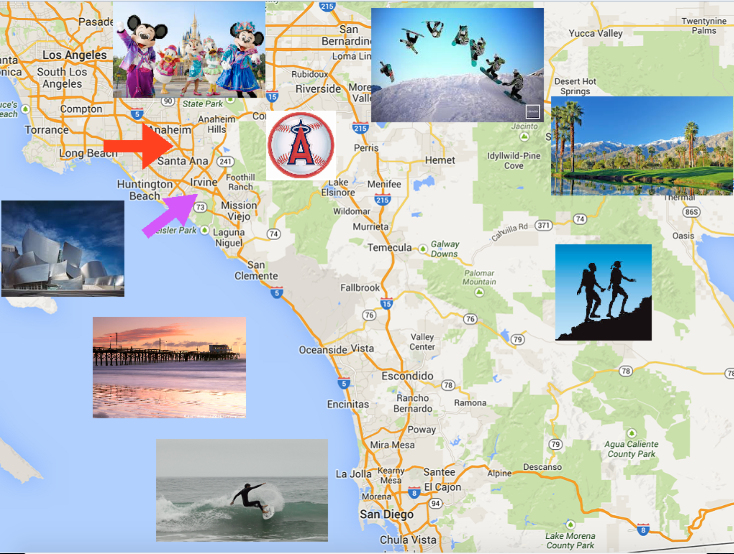
Notes:
Please email Leslie Weterrings at lweterri@uci.edu with any questions or for more information.
Please email any of our residents to learn more about our program (today’s presenter: Alexander Lopez, PGY-4: amlopez1@uci.edu)

Slide 7
Notes:
Please email Leslie Weterrings at lweterri@uci.edu with any questions or for more information.
Please email any of our residents to learn more about our program (today’s presenter: Alexander Lopez, PGY-4: amlopez1@uci.edu)

Slide 8
Notes:
Please email Leslie Weterrings at lweterri@uci.edu with any questions or for more information.
Please email any of our residents to learn more about our program (today’s presenter: Alexander Lopez, PGY-4: amlopez1@uci.edu)

Slide 9
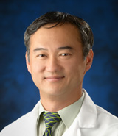
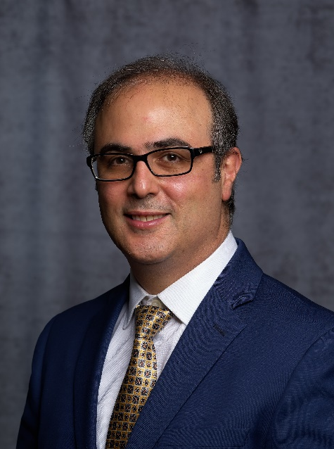
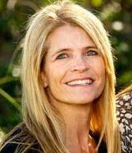
Program contacts
Frank Hsu, MD, PhD
Chairman of Neurosurgery
fpkhsu@hs.uci.edu
Kiarash Golshani, MD
Residency Program Director
kgolshan@hs.uci.edu
Leslie Weterrings
Residency Program Coordinator
lweterri@uci.edu
(714) 456-6966
Sumeet Vadera, MD
Associate Residency Program Director
svadera1@hs.uci.edu
Notes:
Please email Leslie Weterrings at lweterri@uci.edu with any questions or for more information.
Please email any of our residents to learn more about our program (today’s presenter: Alexander Lopez, PGY-4: amlopez1@uci.edu)

Slide 10
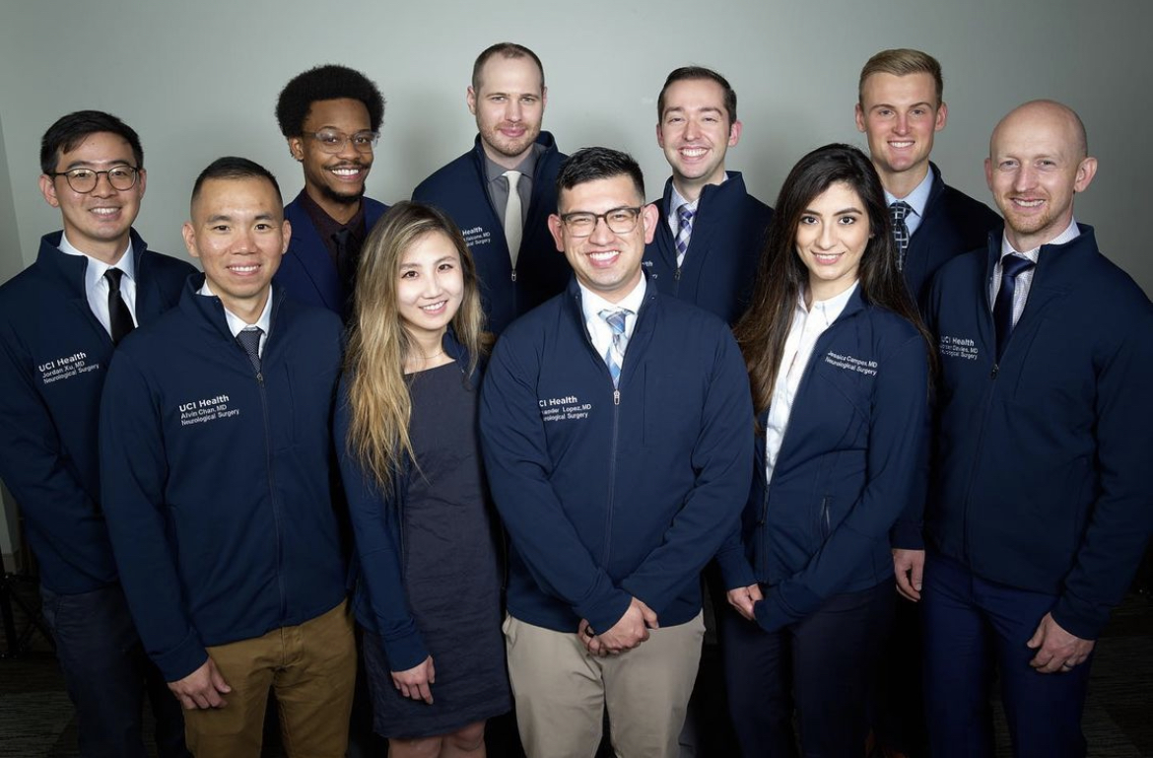
2022-2023 residents
Notes:
Please email Leslie Weterrings at lweterri@uci.edu with any questions or for more information.
Please email any of our residents to learn more about our program (today’s presenter: Alexander Lopez, PGY-4: amlopez1@uci.edu)

Slide 11
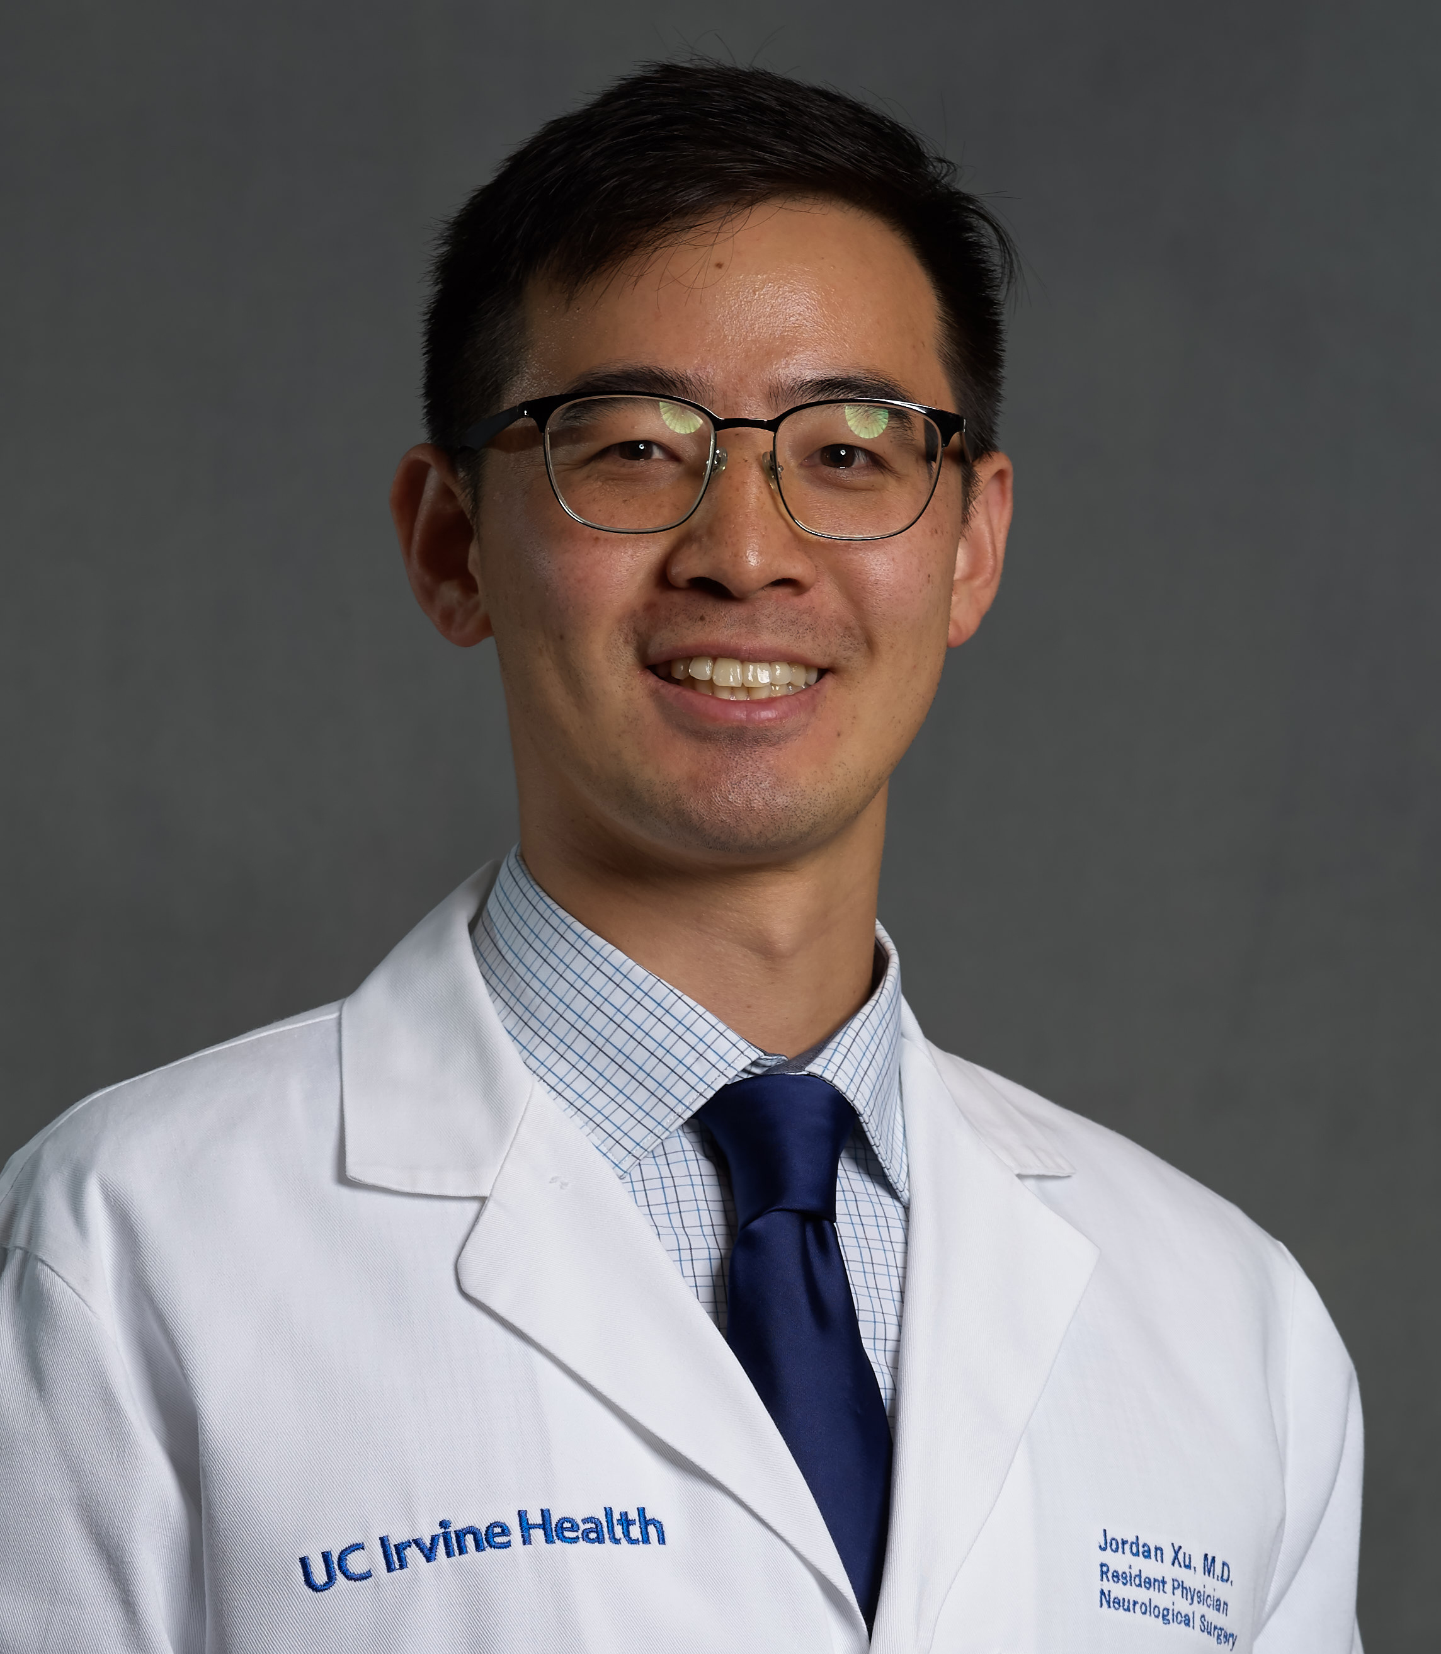
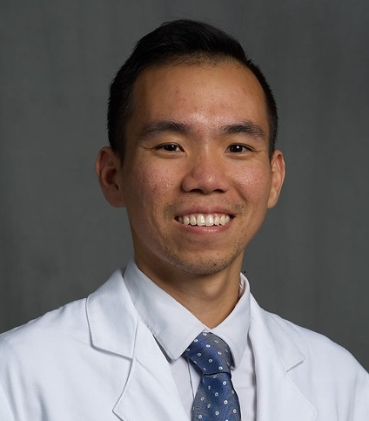
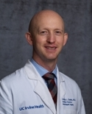
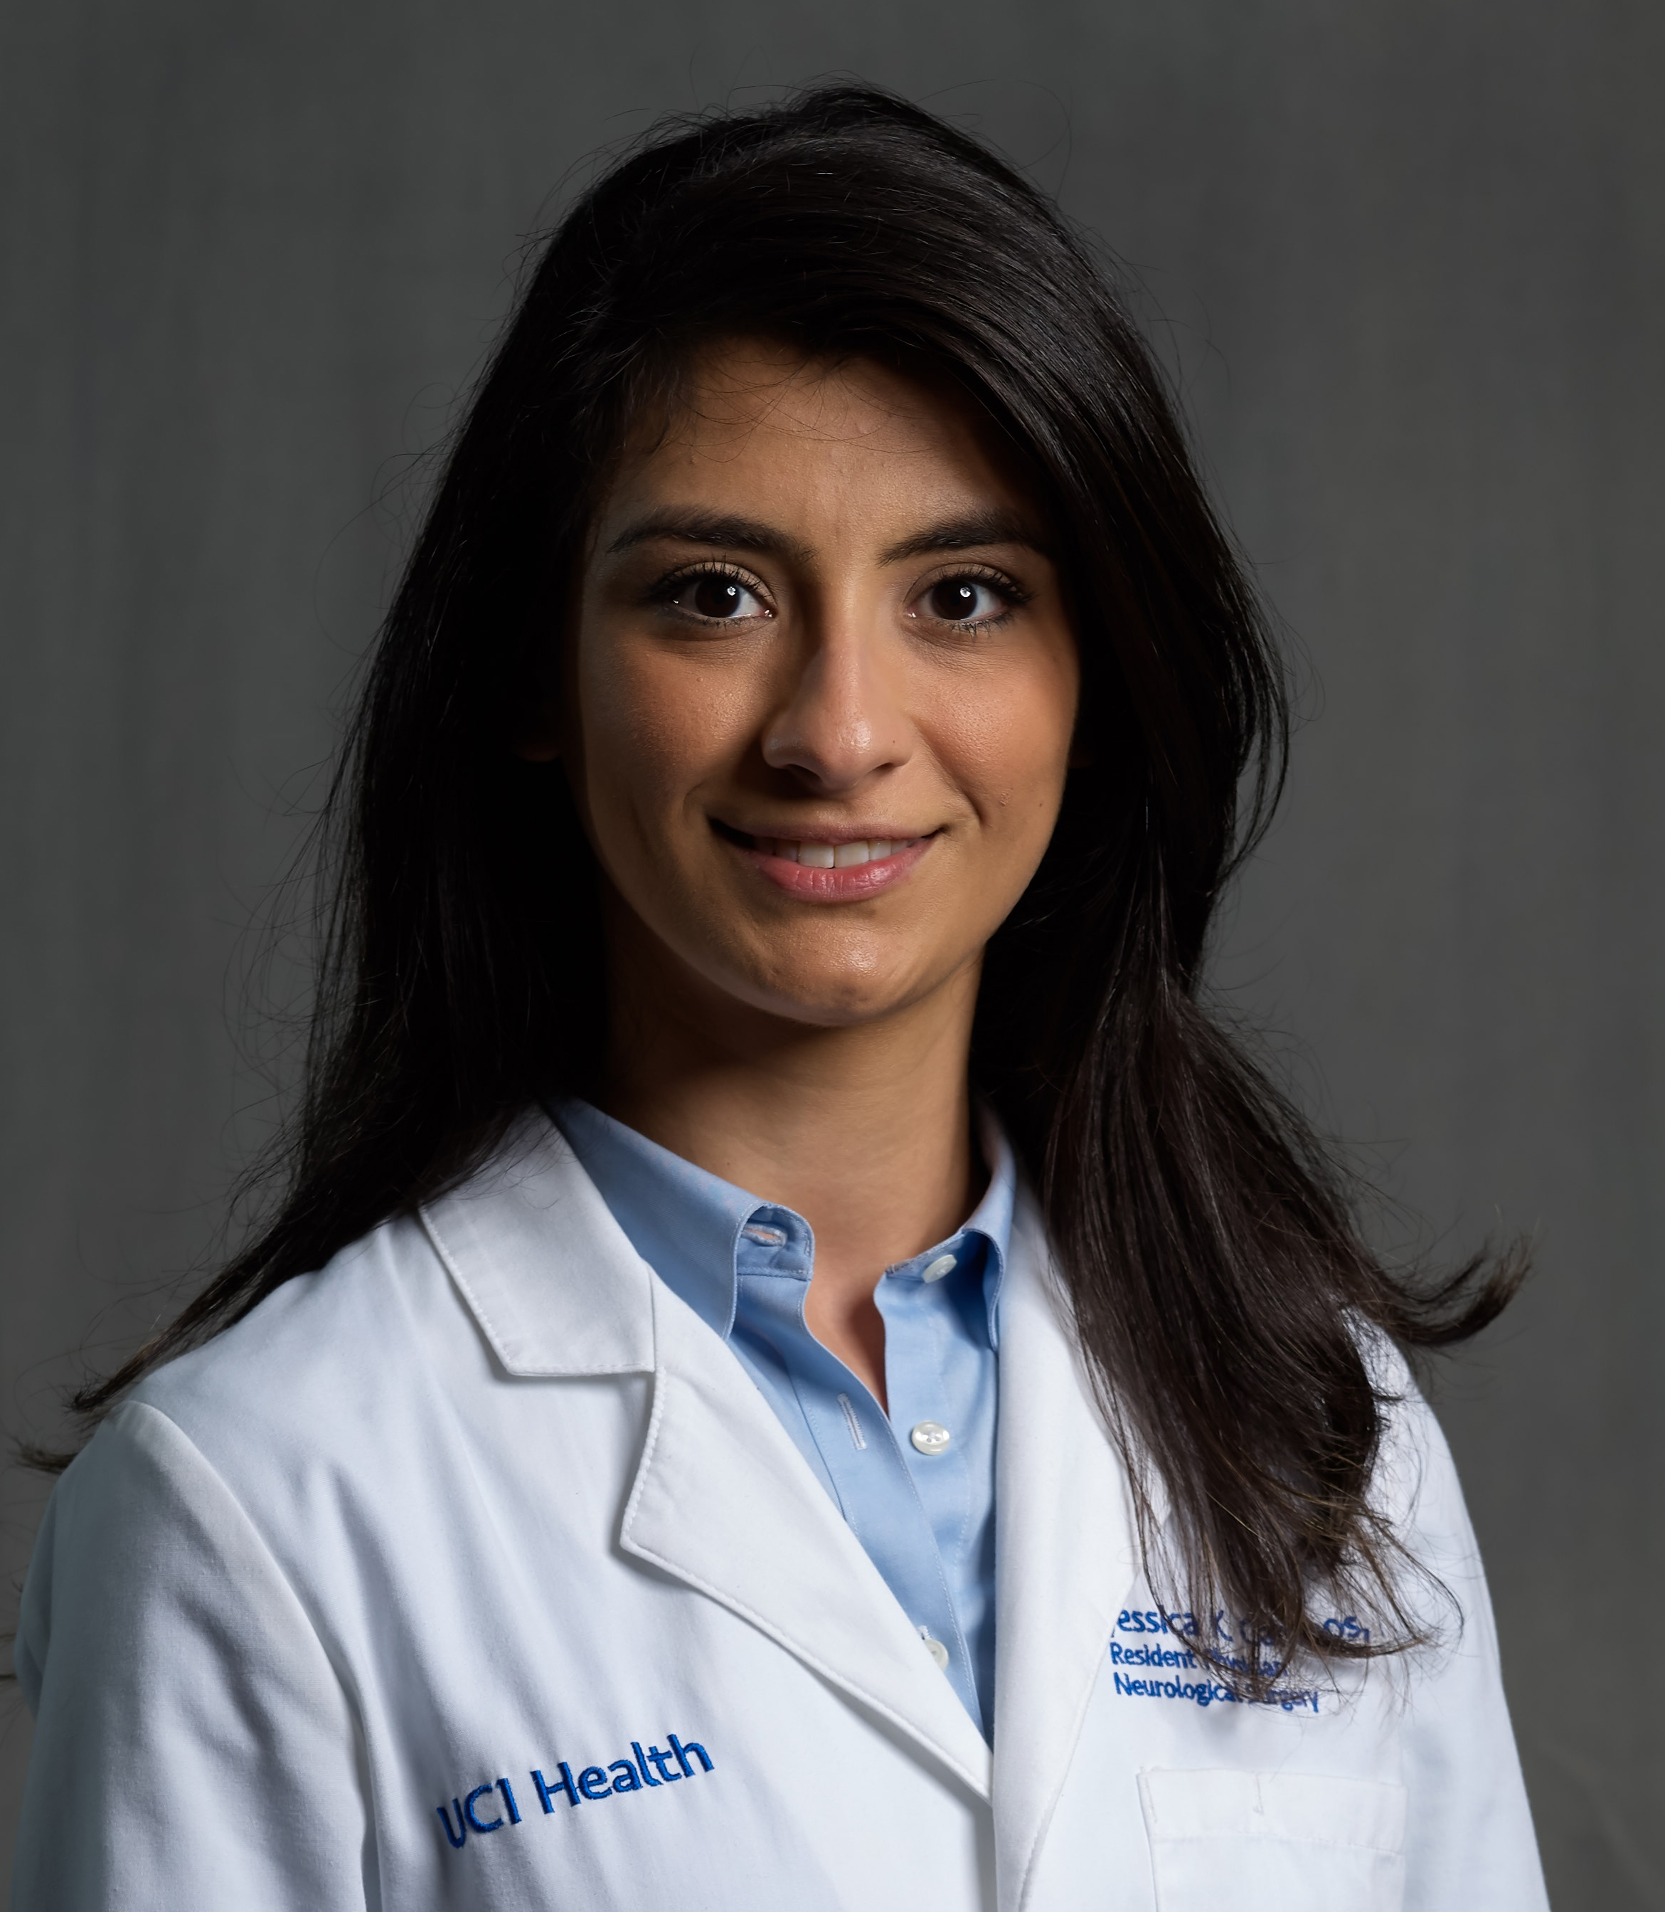
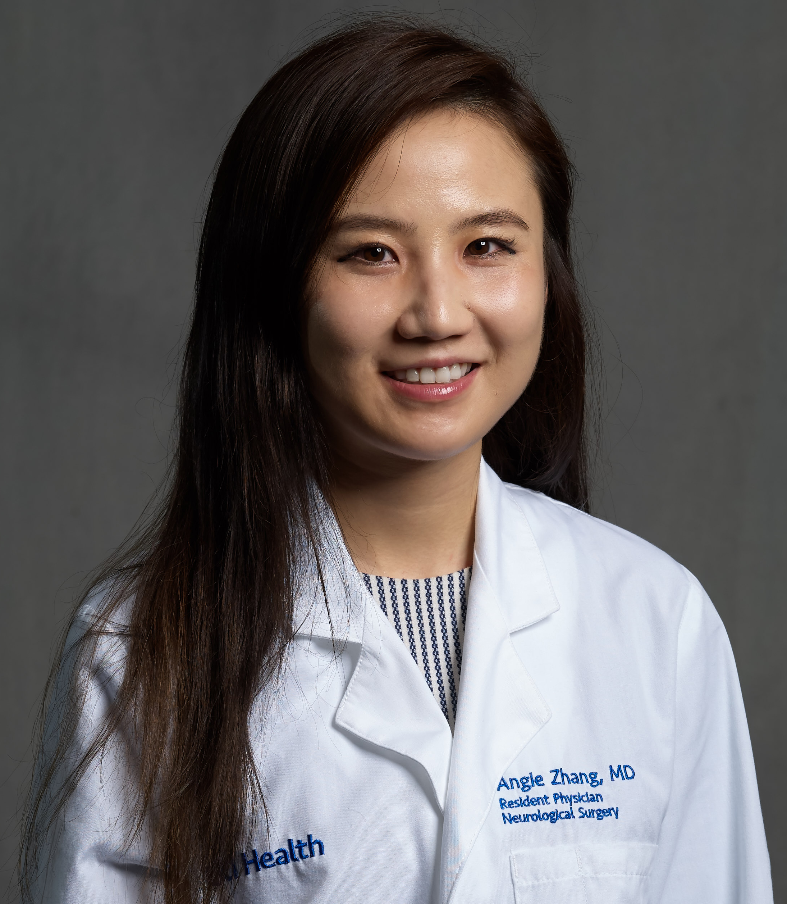
UC IRVINE Residents
PGY VII: Jordan Xu, MD
jcxu@hs.uci.edu
Interests: Cerebrovascular & Endovascular, Pediatrics
Pubmed
PGY VI: Alvin Chan, MD
alvinyc1@hs.uci.edu
Interests: Complex &
MIS Spine
Pubmed
PGY VI: Jordan Davies
jordad1@hs.uci.edu
Interests: Pediatrics, Functional/Epilepsy
Pubmed
PGY V: Jessica Campos, MD
camposjk@hs.uci.edu
Interests: Cerebrovascular &
Endovascular
Pubmed
PGY V: Angie Zhang, MD
zhanga1@hs.uci.edu
Interests: Tumor, Pediatrics
Pubmed
Notes:
Please email Leslie Weterrings at lweterri@uci.edu with any questions or for more information.
Please email any of our residents to learn more about our program (today’s presenter: Alexander Lopez, PGY-4: amlopez1@uci.edu)

Slide 12
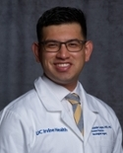
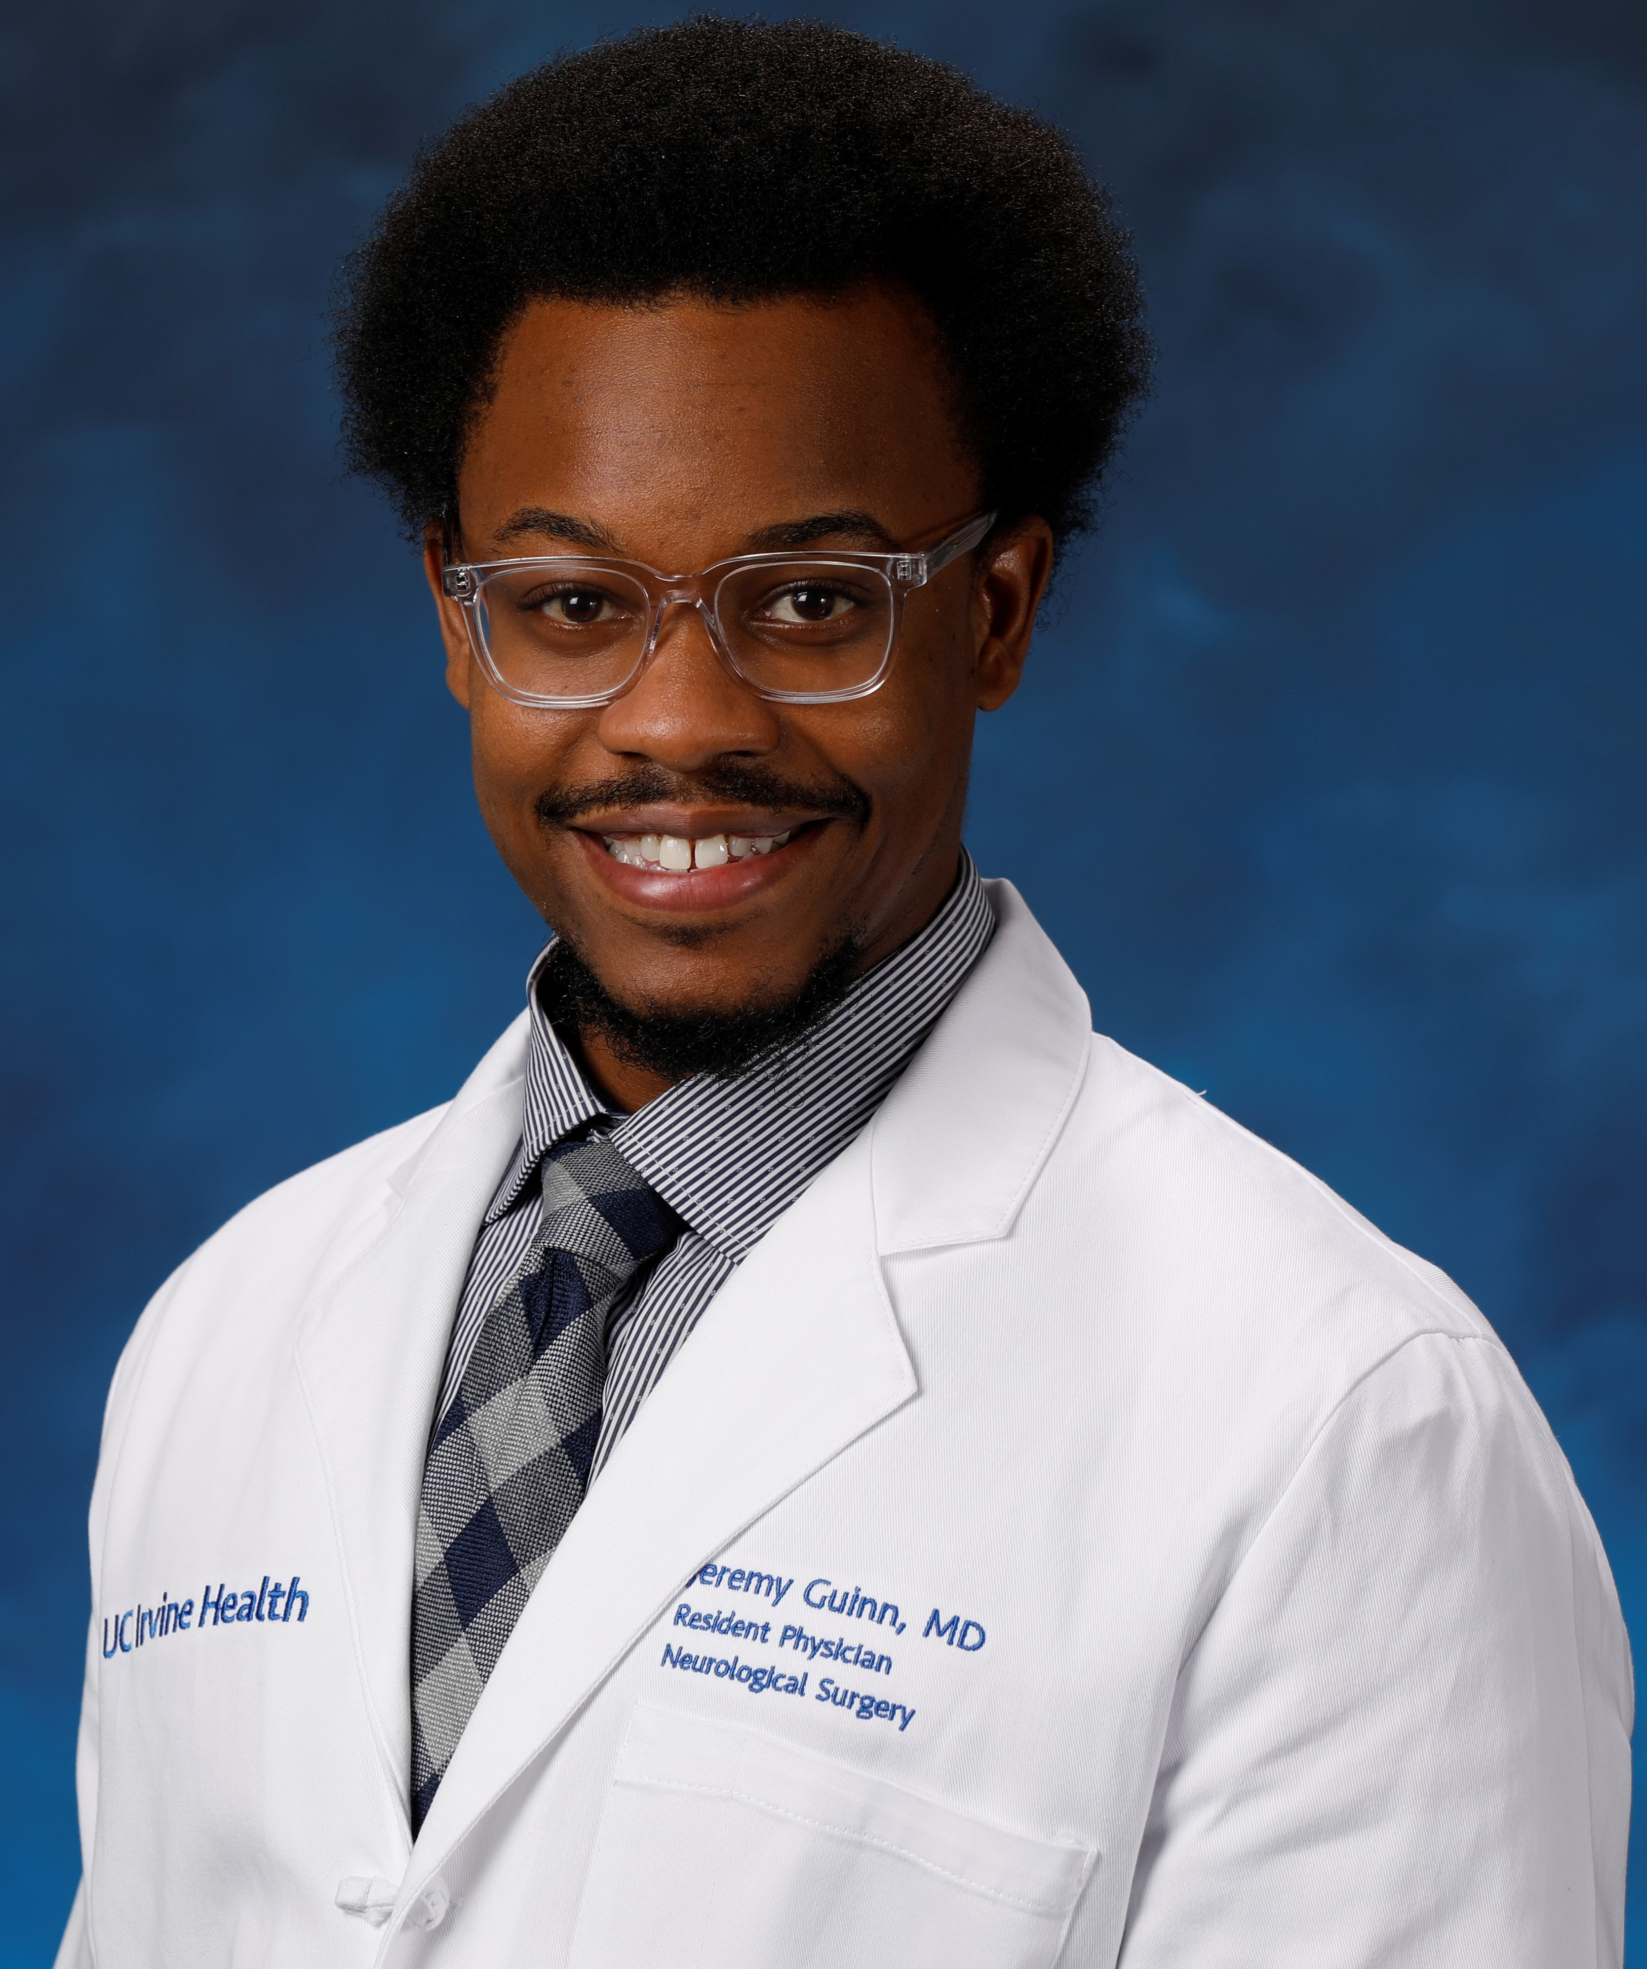
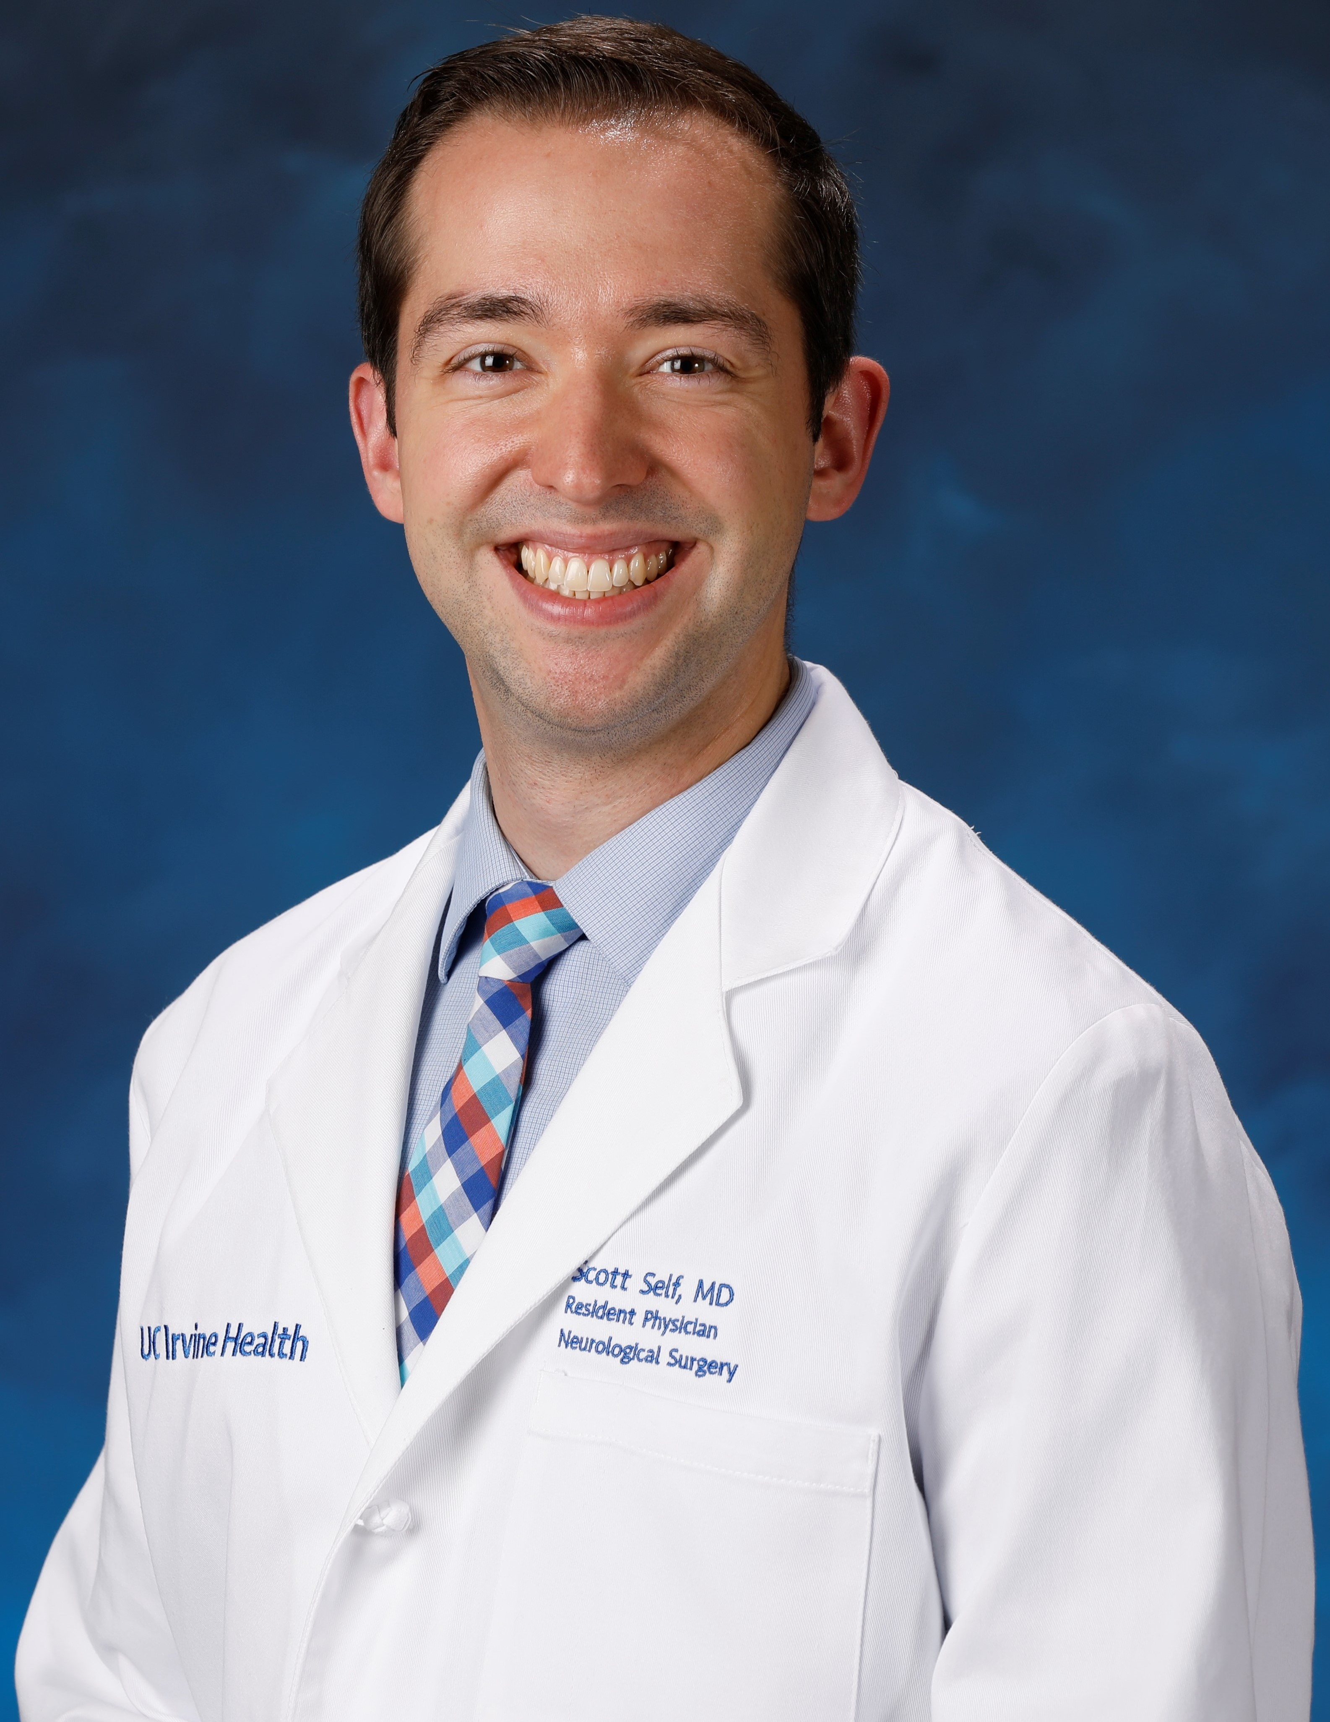
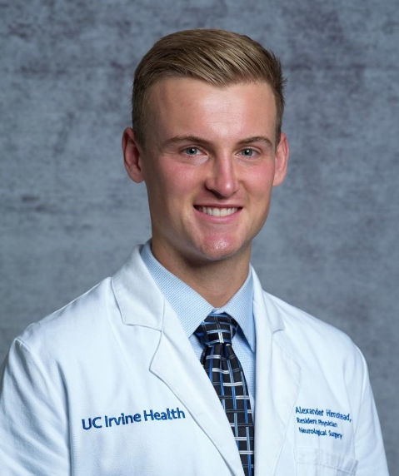
UC IRVINE Residents
PGY IV: Alexander Lopez, MD, MS
amlopez1@hs.uci.edu
Interests: Functional, Complex Spine
Pubmed
PGY III: Scott Self, MD
selfs@hs.uci.edu
Interests: Pediatrics
Pubmed
PGY III: Jeremy Guinn, MD
guinnj@hs.uci.edu
Interests: Skull base, Complex Spine
Pubmed
PGY II: Alexander Himstead, MD
ahimstea@hs.uci.edu
Interests: Skull base, tumor
Pubmed
Notes:
Please email Leslie Weterrings at lweterri@uci.edu with any questions or for more information.
Please email any of our residents to learn more about our program (today’s presenter: Alexander Lopez, PGY-4: amlopez1@uci.edu)

Slide 13
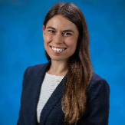
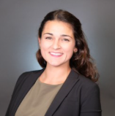
UC IRVINE Residents
PGY I: Gianna Fote, MD, Phd
gfote@hs.uci.edu
Interests: Pediatrics, Neurotrauma
Pubmed
PGY I: Isi Beach, MD
Ibeach@hs.uci.edu
Interests: Pediatrics & Functional
Pubmed
Notes:
Please email Leslie Weterrings at lweterri@uci.edu with any questions or for more information.
Please email any of our residents to learn more about our program (today’s presenter: Alexander Lopez, PGY-4: amlopez1@uci.edu)

Slide 14
Program overview - video
YouTube Video: https://youtu.be/Zahh3X9gYNs
Notes:
Please email Leslie Weterrings at lweterri@uci.edu with any questions or for more information.
Please email any of our residents to learn more about our program (today’s presenter: Alexander Lopez, PGY-4: amlopez1@uci.edu)

Slide 15
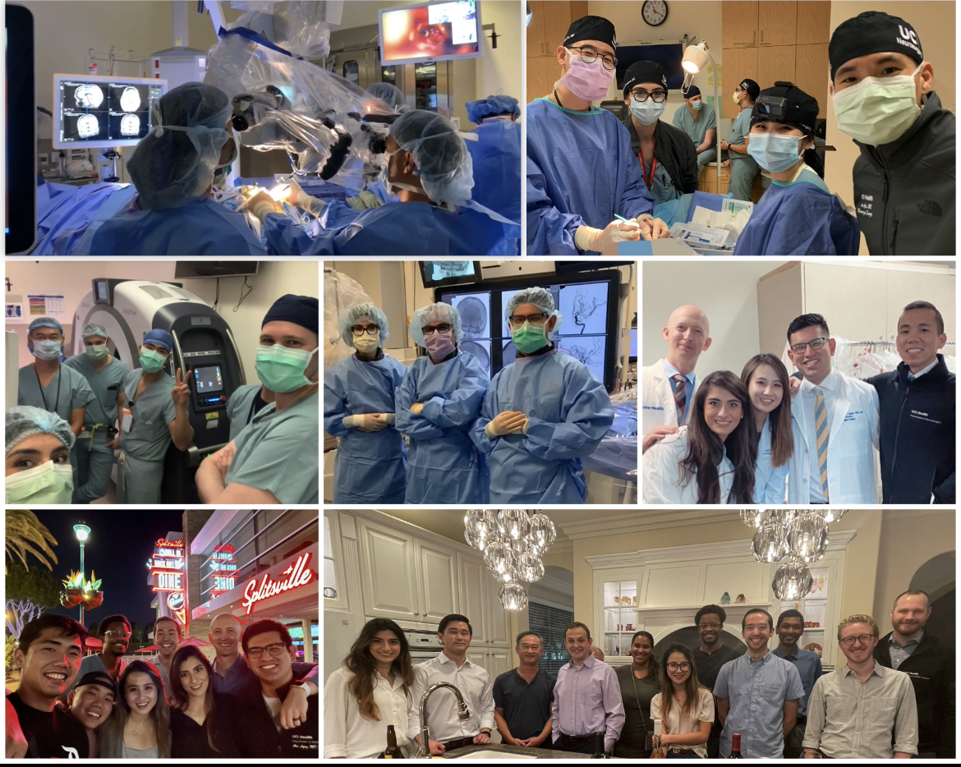
Resident Meet & greet
Follow us on social media for more details.
Notes:
Please email Leslie Weterrings at lweterri@uci.edu with any questions or for more information.
Please email any of our residents to learn more about our program (today’s presenter: Alexander Lopez, PGY-4: amlopez1@uci.edu)

Slide 16
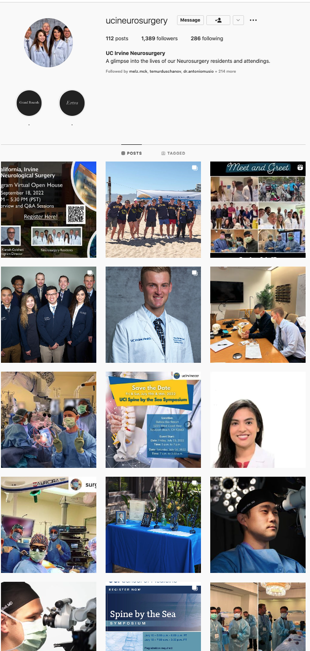
Social media
Website: https://neurosurgery.uci.edu/residency.asp
@ucineurosurgery
@UCIneurosurgery
Notes:
Please email Leslie Weterrings at lweterri@uci.edu with any questions or for more information.
Please email any of our residents to learn more about our program (today’s presenter: Alexander Lopez, PGY-4: amlopez1@uci.edu)

