Slide 1
MAYO CLINIC NEUROSURGERY RESIDENCY

Slide 2
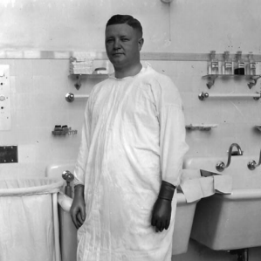

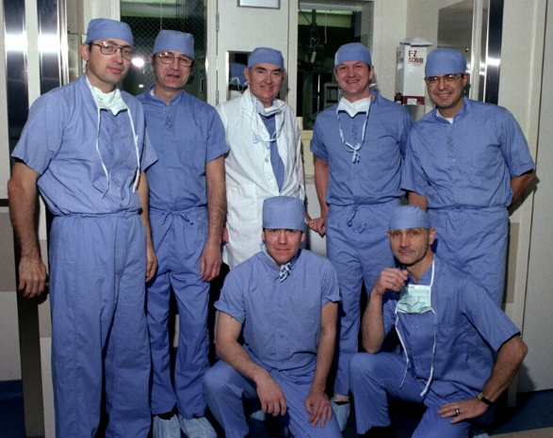
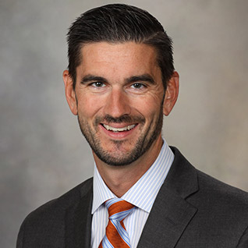
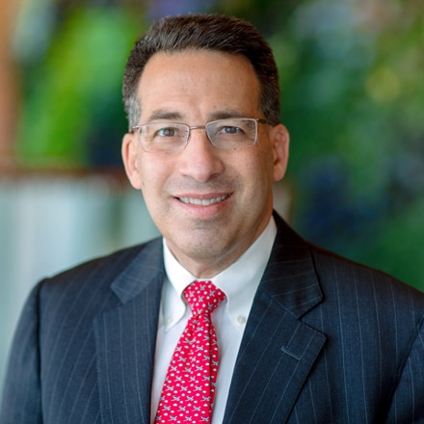
DEPARTMENT OVERVIEW
Quaternary academic medical center
  Learn from world experts
  Bread & butter plus zebras!
Rich neurosurgical history dating back to late 1800s
  Mayo, Adson, MacCarty, Sundt, Laws, Rhoton
Goal = train excellent neurosurgeons
  Academic & private practice
Continued conscious efforts to improve neurosurgical training
  Staff & resident driven

Slide 3
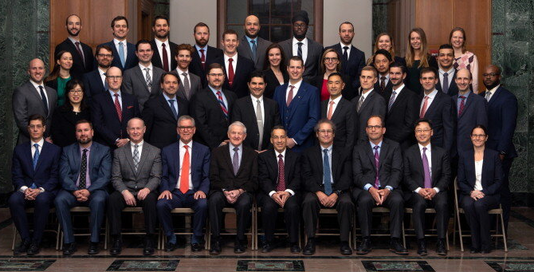
DEPARTMENT STATS
Consultants: 21
Residents: 4 per year
Daily start ORs: ≥12
Annual surgical volume: 5,000-5,500
  1000 brain tumor
  175 trauma
  325 open vascular (aneurysm, AVM, carotid, bypass)
  250 transsphenoidal operations (microscopic and endoscopic)
  400 functional disorders (epilepsy, movement, pain).
  325 peripheral nerve procedures
  1,350 spinal procedures (140 spine tumor and 350 complex spine)
  Excluding endovascular (~1000 cases)

Slide 4
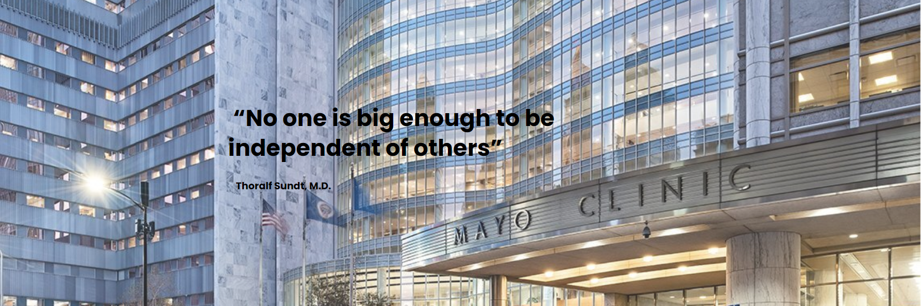
MENTORSHIP MODEL

Slide 5
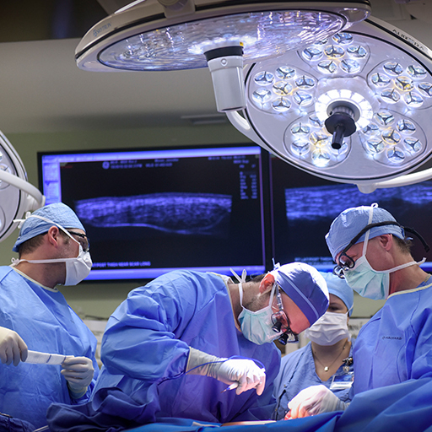
MENTORSHIP MODEL
The core of our training is the staff service rotations, residents spend 2 months with 1-2 staff:
  First assist in the OR every day
  Complete immersion in different areas of expertise
Staff becomes attuned to resident’s strengths, weaknesses, knowledge base, and goals.
Intimate relationship between staff and trainee fosters trust = rapid stepwise graduated autonomy.

Slide 6
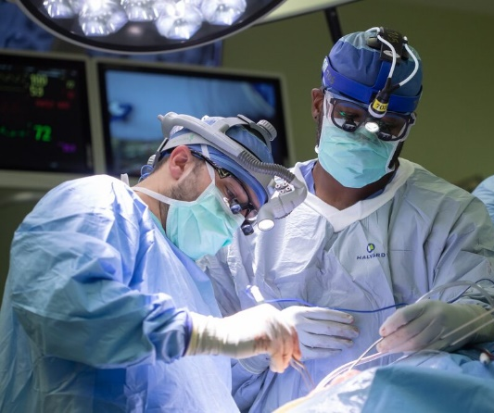
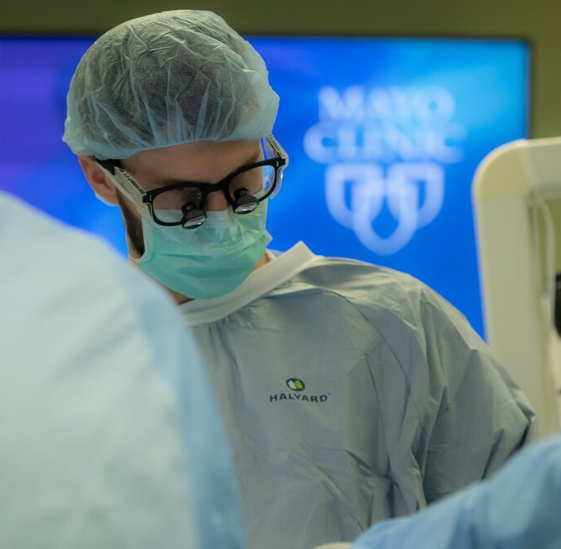
CURRICULUM HIGHLIGHTS
PGY-1:
  6 months neurosurgery (1st assist)
  3 months ICU
  1 month ea. neurooncology clinic, neuroanesthesia, neuro path
PGY-2:
  Chief junior year on neurosurgery
PGY-3&4:
  Consultant services
  Early exposure to complex cases
PGY-5&6:
  Professional development/Elective time
PGY-7: chief year

Slide 7
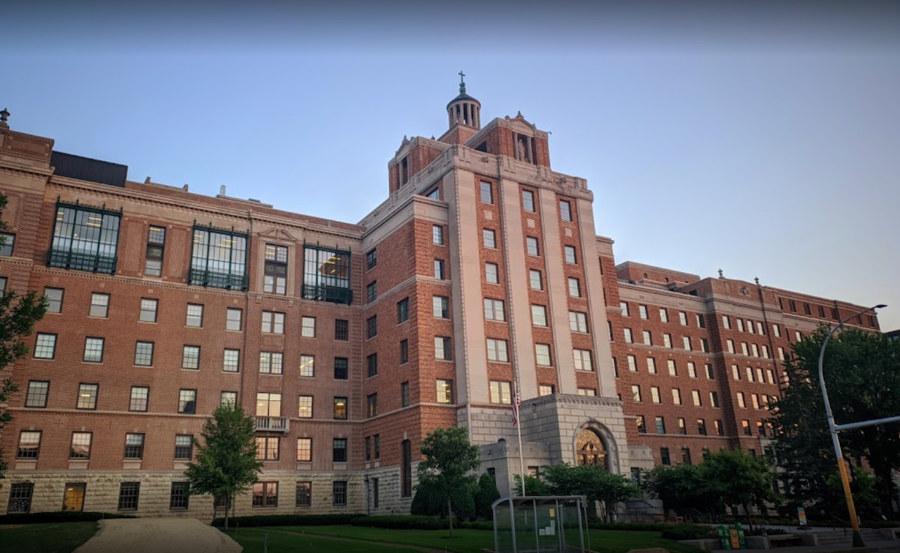
CALL OVERVIEW
Coverage need concentrated in one hospital - Saint Mary’s Hospital
  Level I trauma center and stroke center (1,265 beds)
  Reduced call frequency
No overnight call during PGY-1 year. PGY-2 take highest frequency of call.
Mentorship model call = continuous coverage throughout the week
  In house call (PGY 2-4) deal with emergency only
  Chief call (PGY5-7) home call
  Pro: better patient care, preps well, minimal sign outs
  Cons: continuous coverage throughout the week

Slide 8
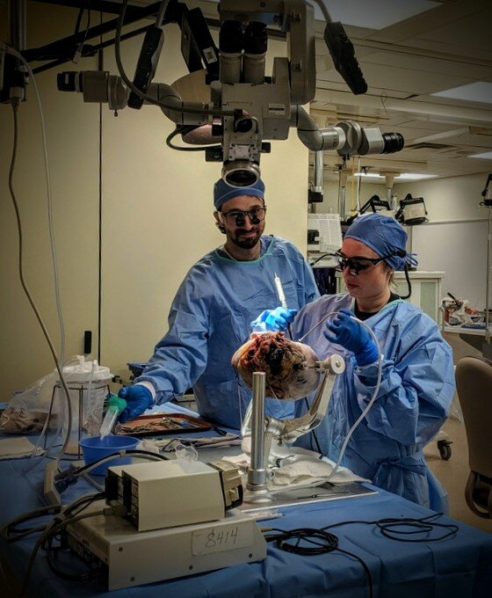
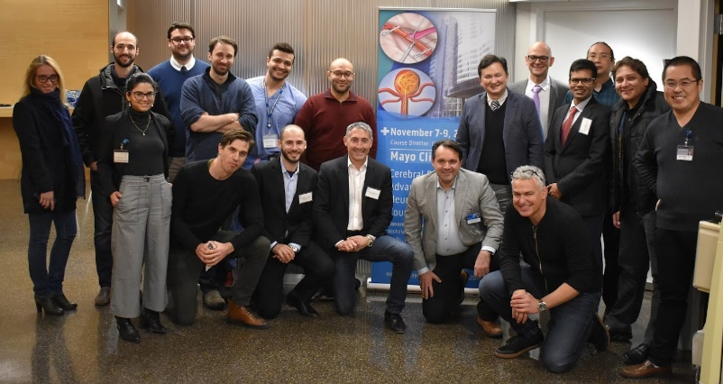
RESIDENT EDUCATION
Daily morning conferences (oral boards style, spine, tumor, peds, etc)
Structured anatomical dissection curriculum (PGY 1-4)
Surgical skill training:
  Open access anatomy and surgical skills lab
  Microvascular anastomosis training
Courses:
  Intern boot camp
  Cerebrovascular course
  Complex skull base (PGY 4-5) – Dr. Link
  Intraventricular approaches (PGY 4-5) – Dr. Daniels
  Peripheral nerve dissection (PGY4) – Dr. Spinner

Slide 9
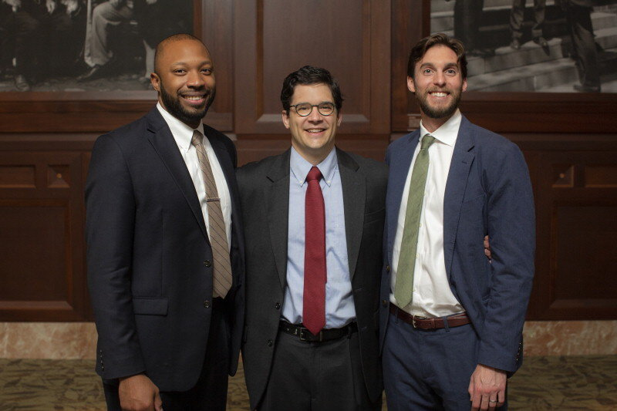
CHIEF YEAR

Slide 10
CHIEF YEAR EXPERIENCE
A unique opportunity to serve as a junior staff. Chief residents have:
  Their own service
  Their own team (PGY-2, intern, APP)
  Run their own clinic
  Manage follow up and prospective cases
  Oversee all trauma and hospital consults
A singular experience to gain considerable clinical decision-making skills and surgical autonomy.
Average chief operative caseload: 450 operations a year.

Slide 11
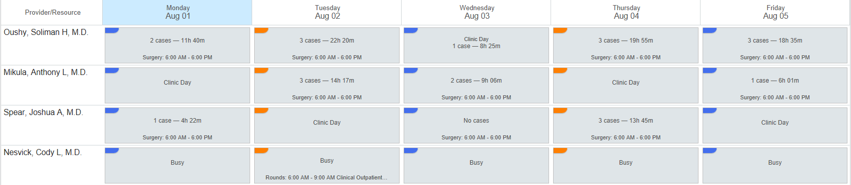
CHIEF YEAR EXPERIENCE
Four chief residents per year: 3 clinical and 1 admin chief
Admin chief has a flexible role

Slide 12
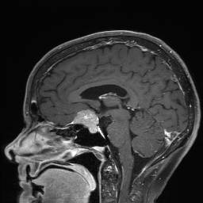
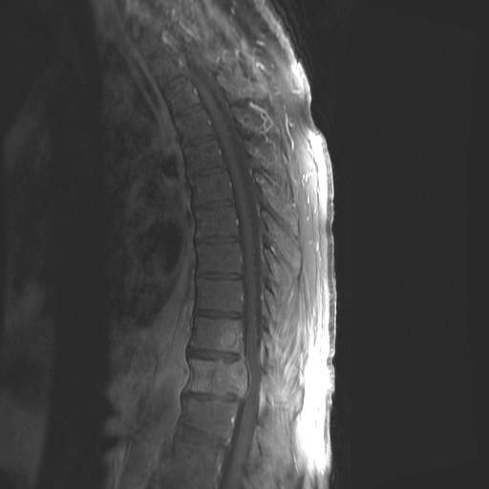
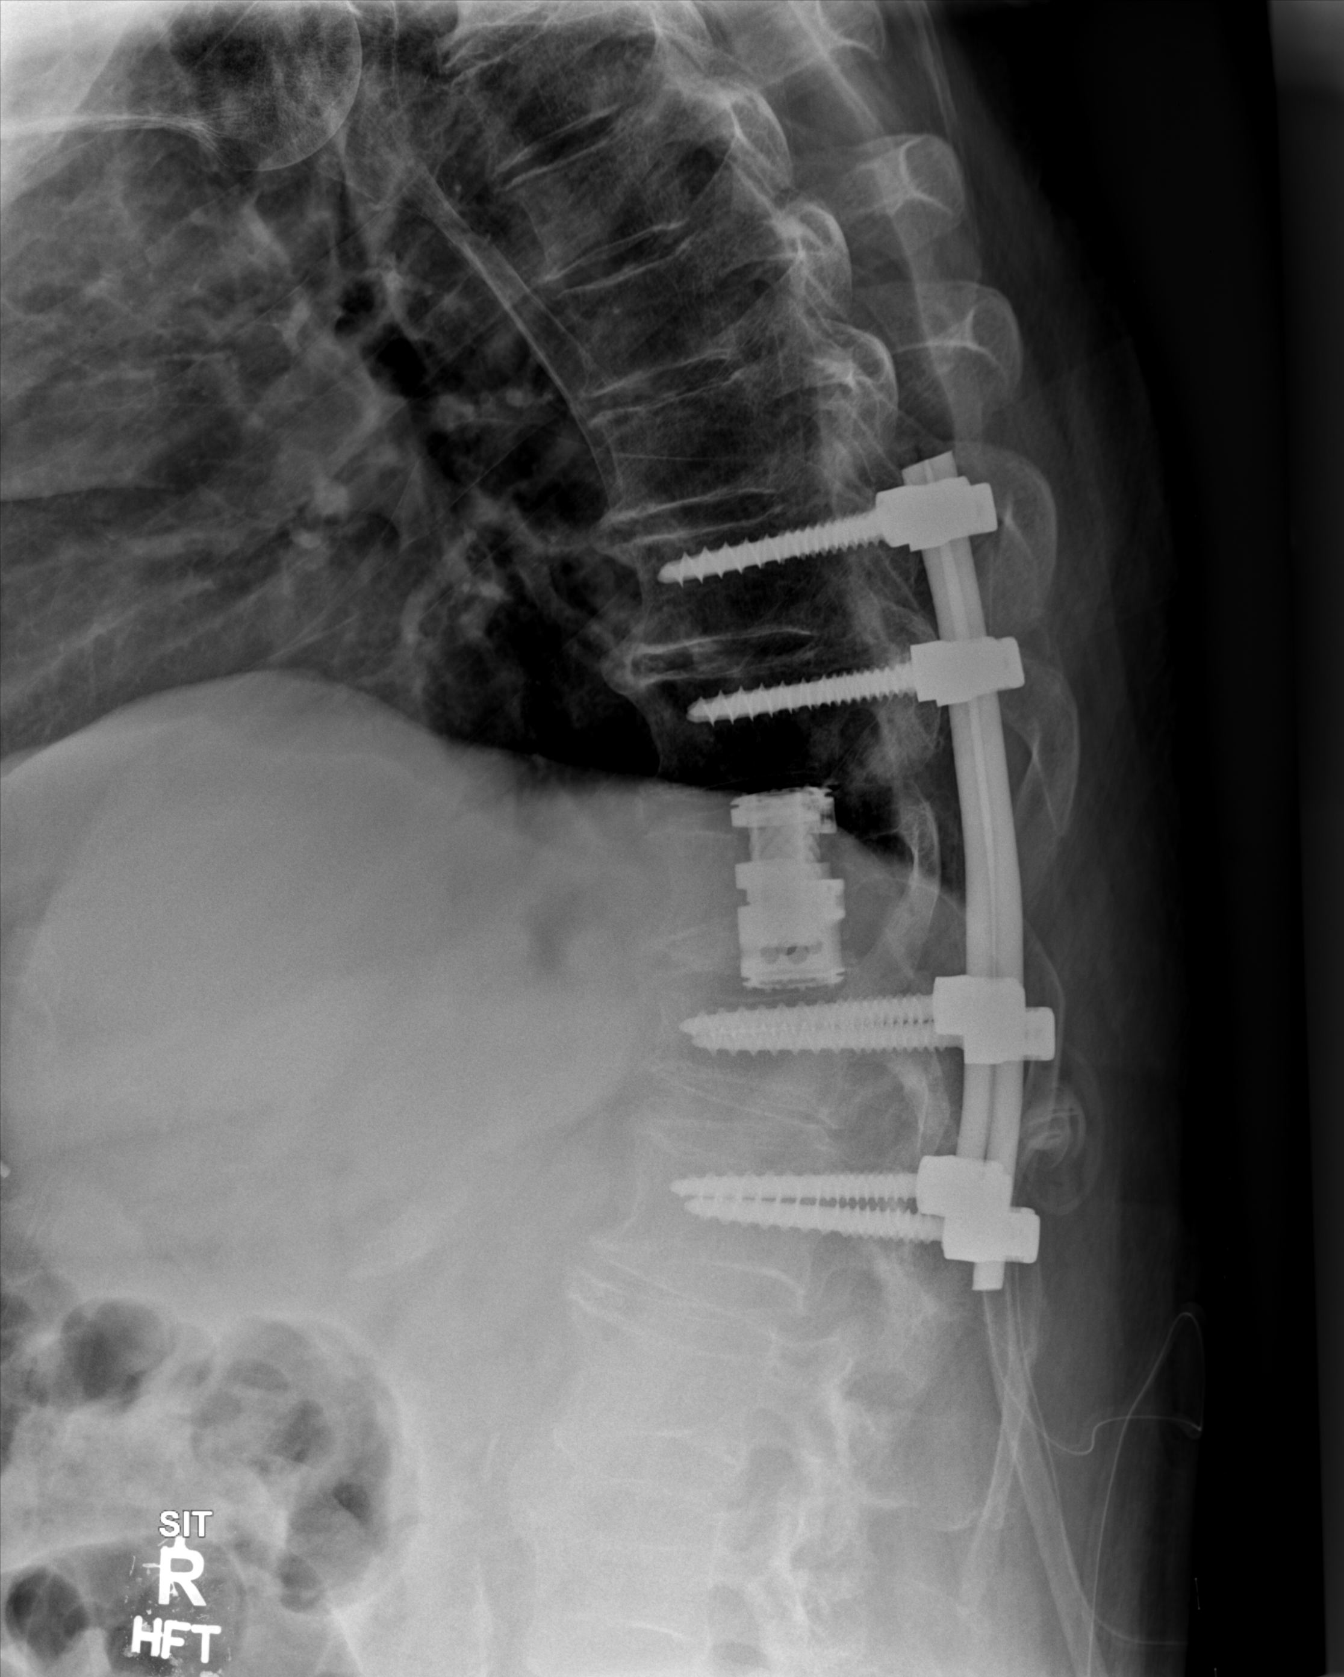
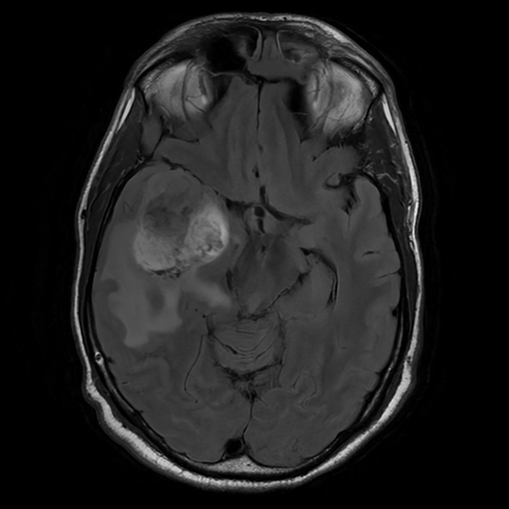
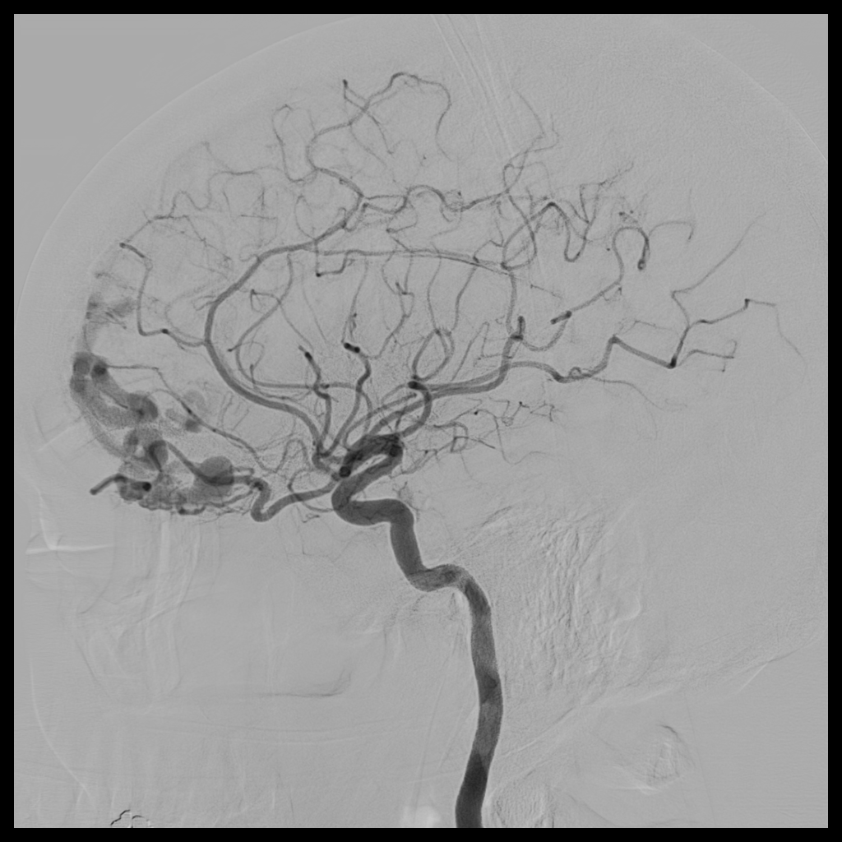
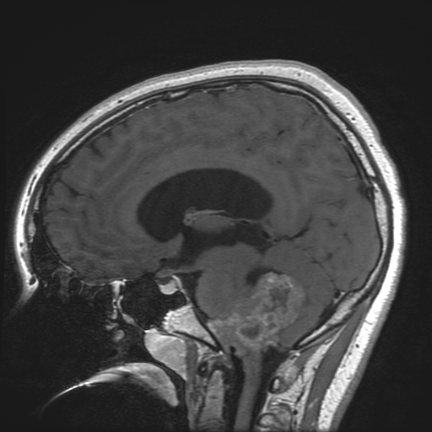
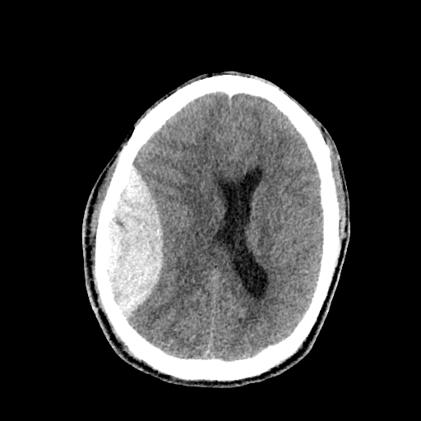
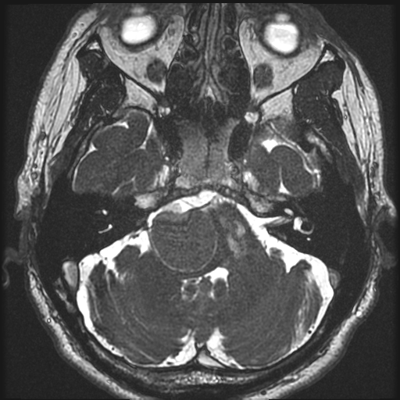
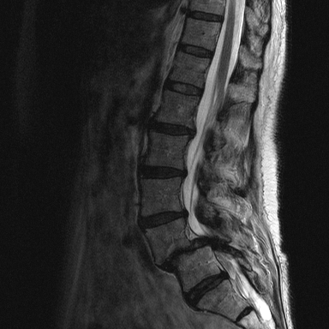
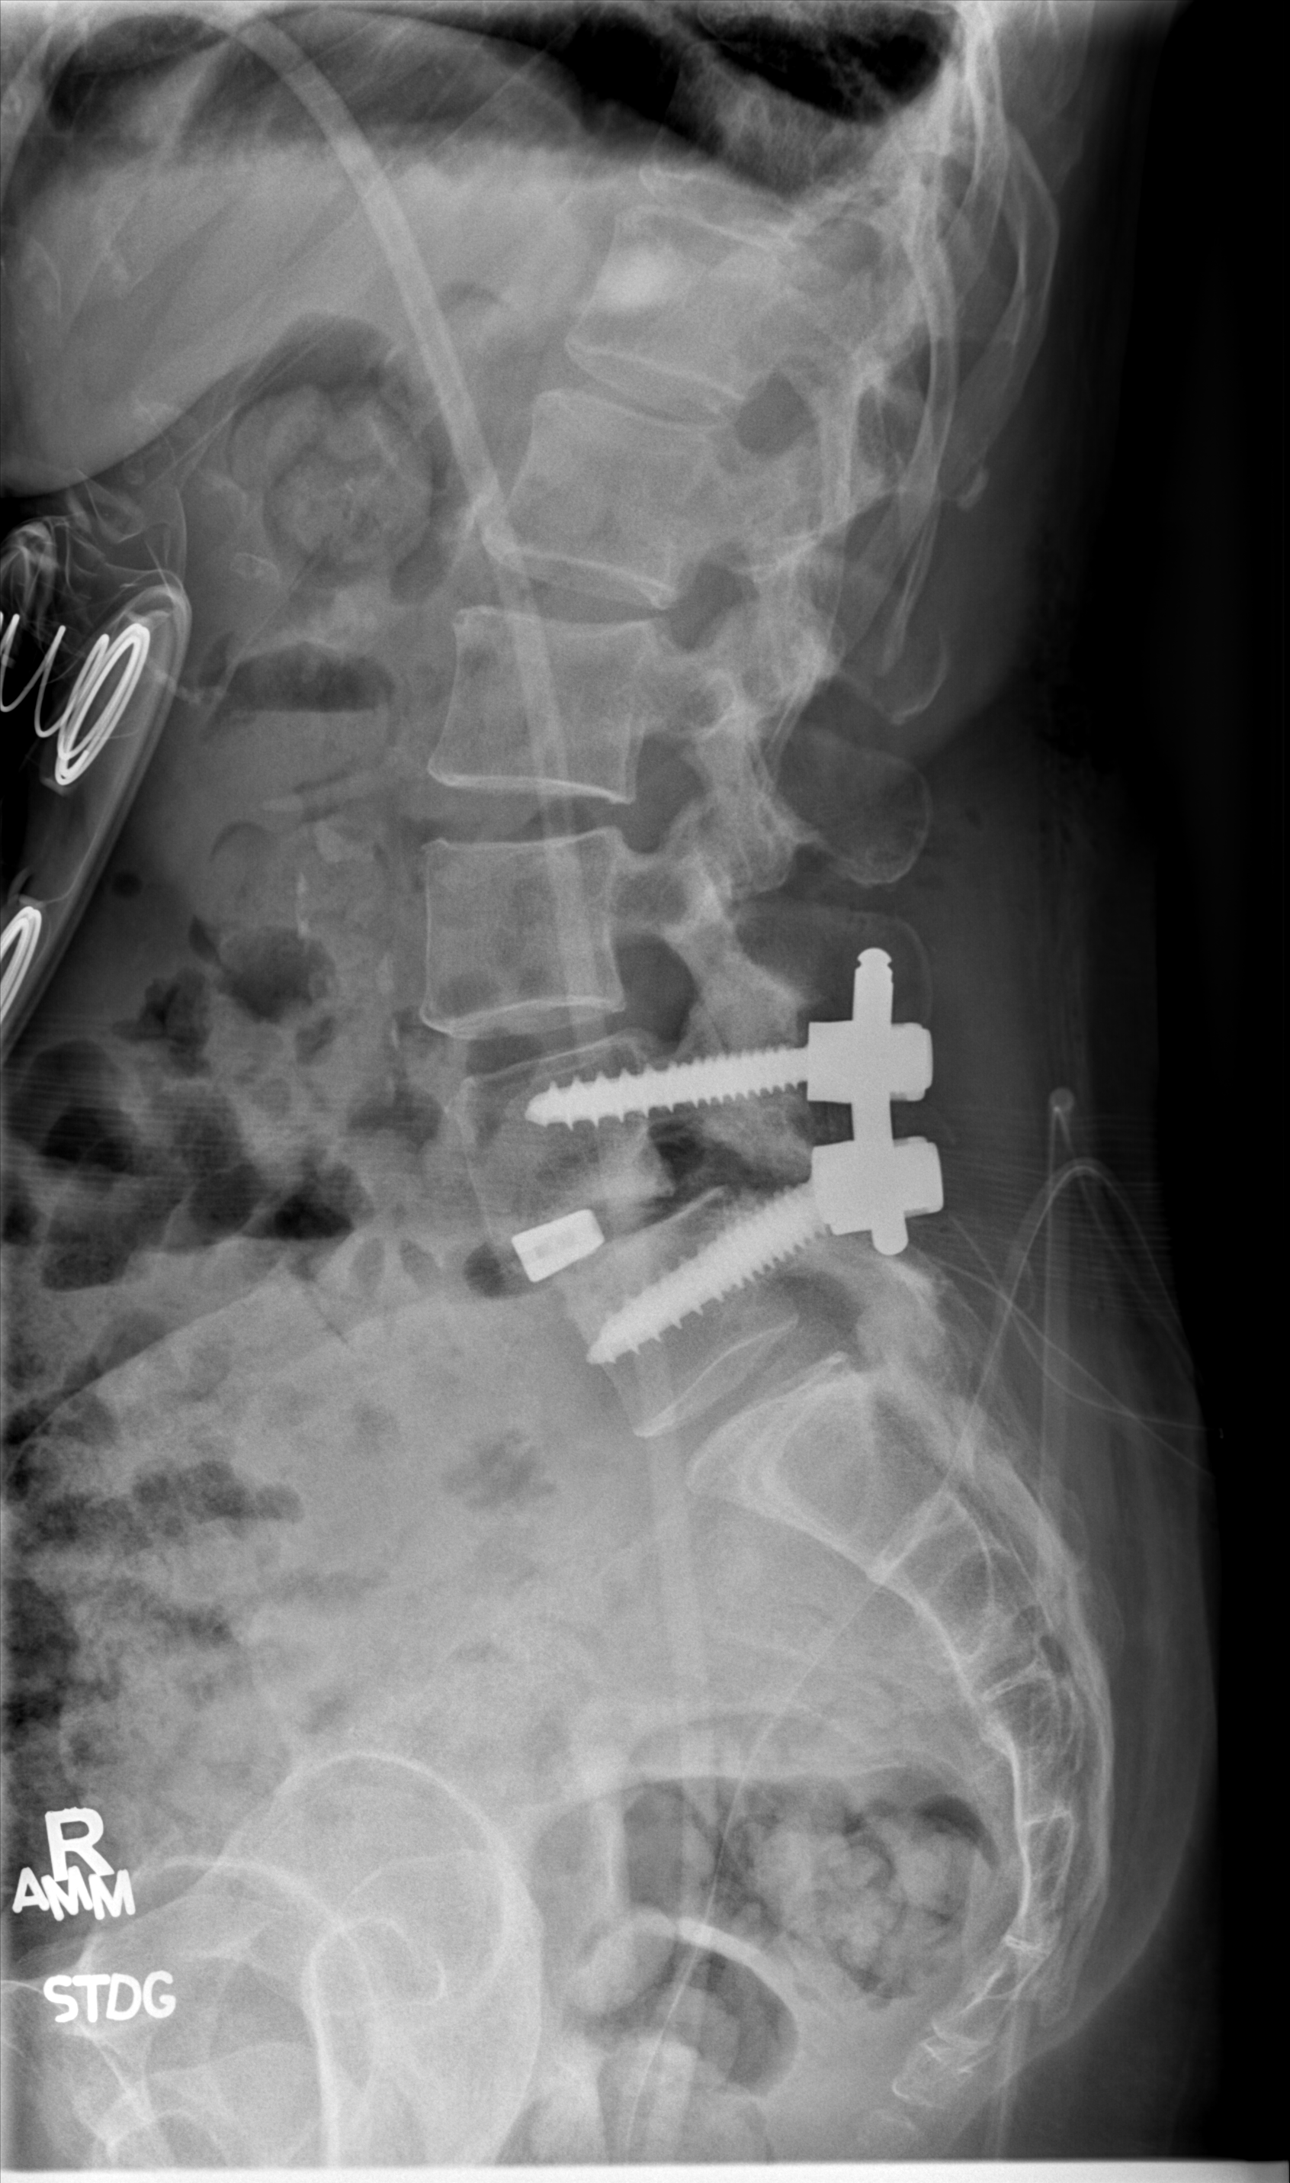

Slide 13
ELECTIVE TIME
Enfolded fellowships, research, advanced degree, etc.

Slide 14
ENFOLDED FELLOWSHIPS
Spine (CAST)
Skull base (CAST)
Peripheral nerve (CAST)
Neurosurgical oncology (CAST)
Neuro critical care (CAST)
Endovascular (informal)

Slide 15
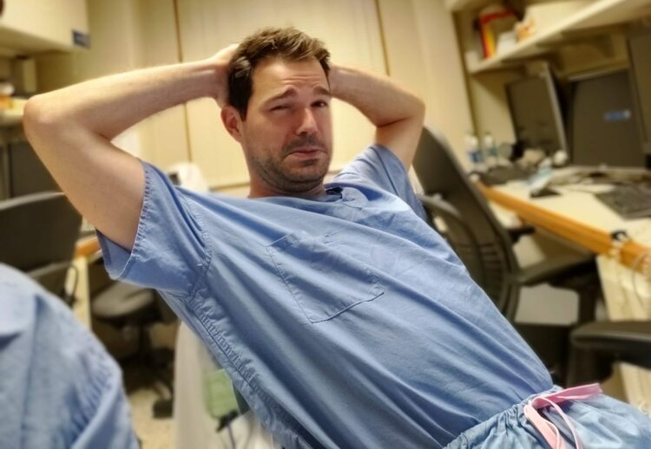
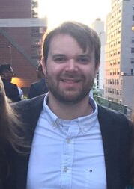
RESEARCH
Research is encouraged, NO annual publication obligation
High research productivity: >400 annual publications (>200 resident pubs)
Multiple staff NIH funding
Up to 2 years of protected elective time can be dedicated to research
  Cody Nesvick, MD
PhD track: get a PhD within residency (Mayo Clinic)
  Ben Himes, MD, PhD
  Panos Kerezoudis, MD, MS

Slide 16
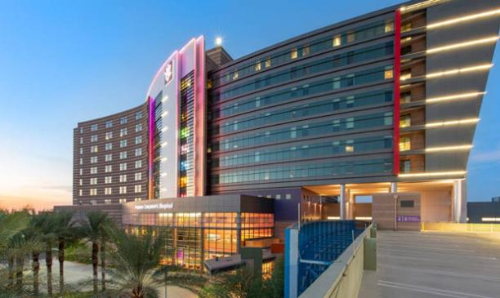
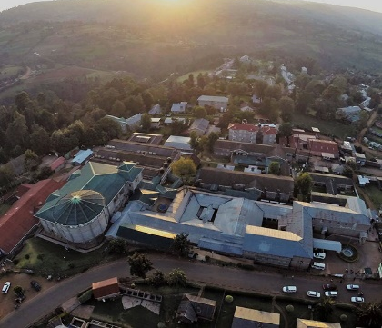
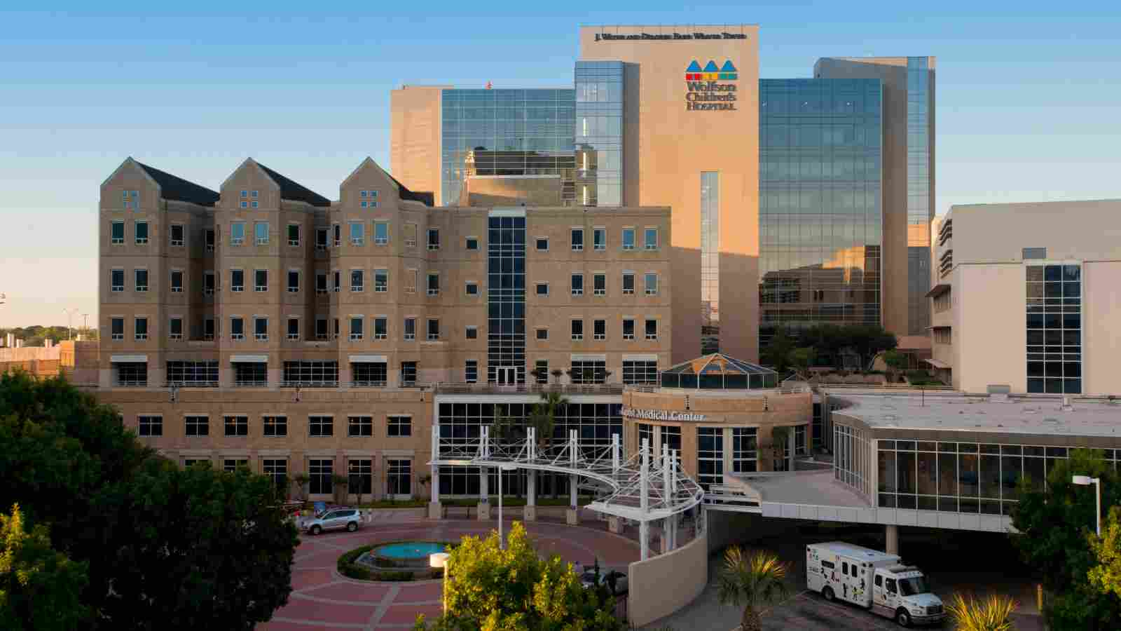
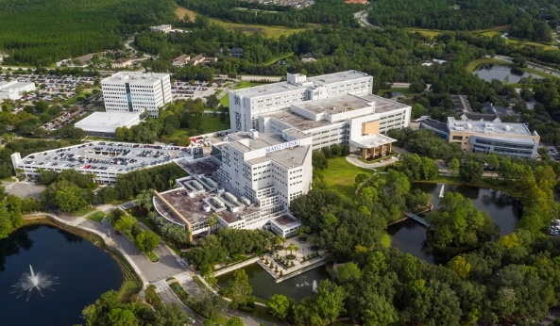
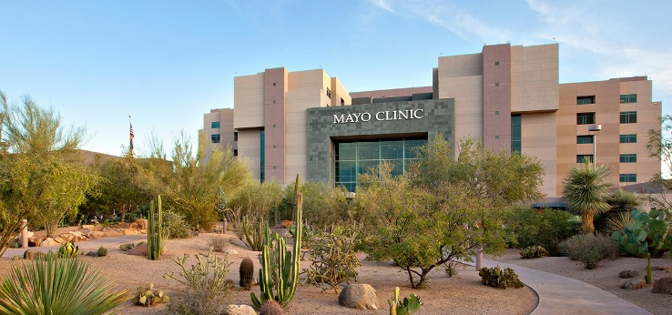
EXTERNAL ROTATIONS
Mayo Jacksonville & Scottsdale
Phoenix Children's Hospital
Tenwek Hospital, Bomet, Kenya
Custom rotations

Slide 17

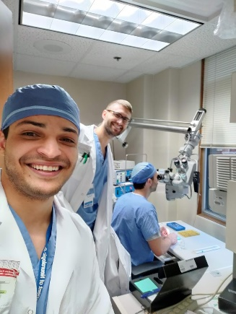
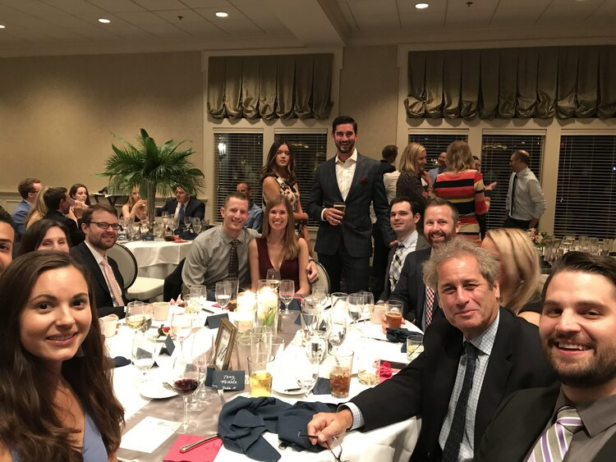
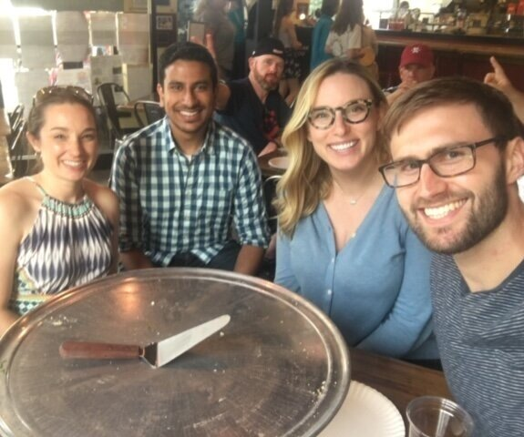
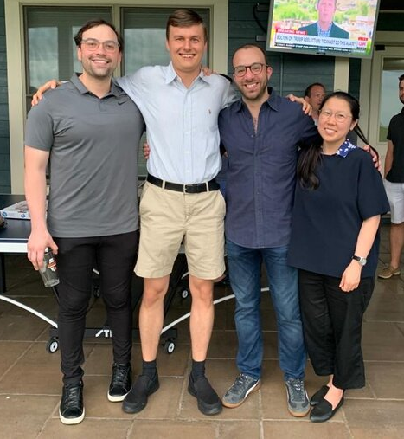
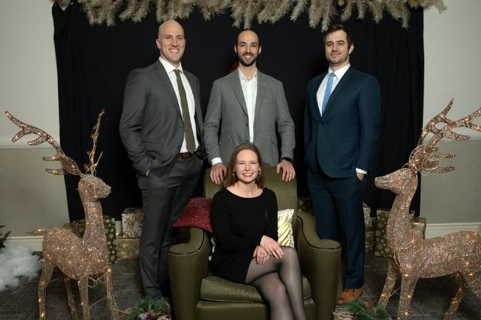
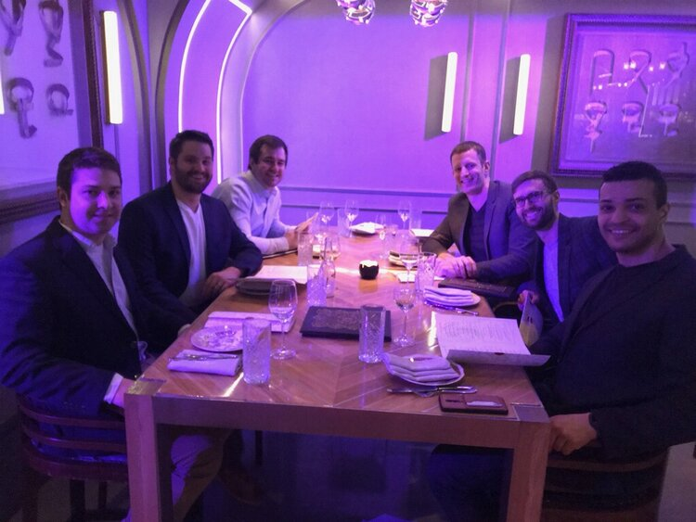
WHO IS A GOOD FIT?

Slide 18
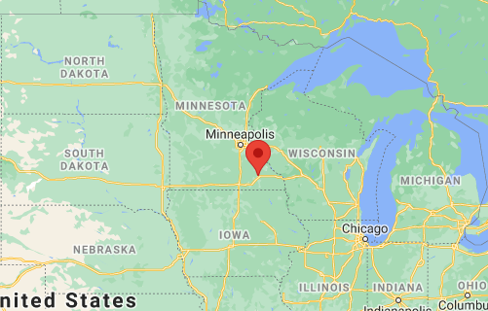
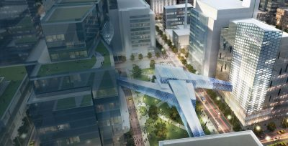
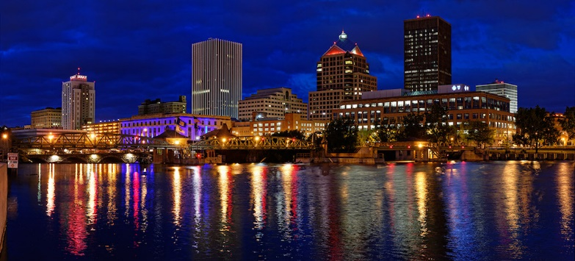
ROCHESTER, MN
Population: approximately 120K
Located in southeast Minnesota
Pros:
  Cheap cost of living
  No commute
  Ongoing big city revamp to “Destination Medical Center
Cons:
  Cold winters
  Minimal night life compared to NYC, SF, LA, etc.

Slide 19
WHY MAYO ROCHESTER NEUROSURGERY?
High volume, comprehensive neurosurgical training under one roof
Mentorship model, graduated autonomy beginning early in residency
Flexible, dedicated professional development time (2 yrs)
Extensive research opportunities (clinical, translational, basic)
Chief year
High quality of life as resident in Rochester

Slide 20
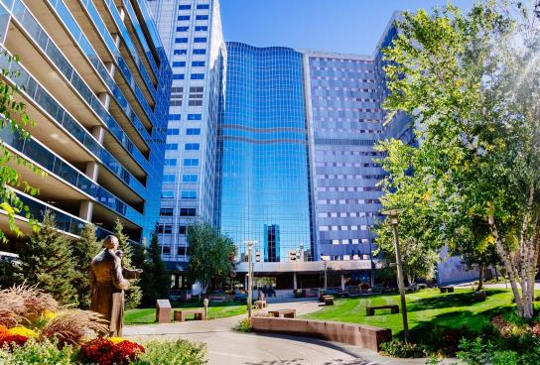
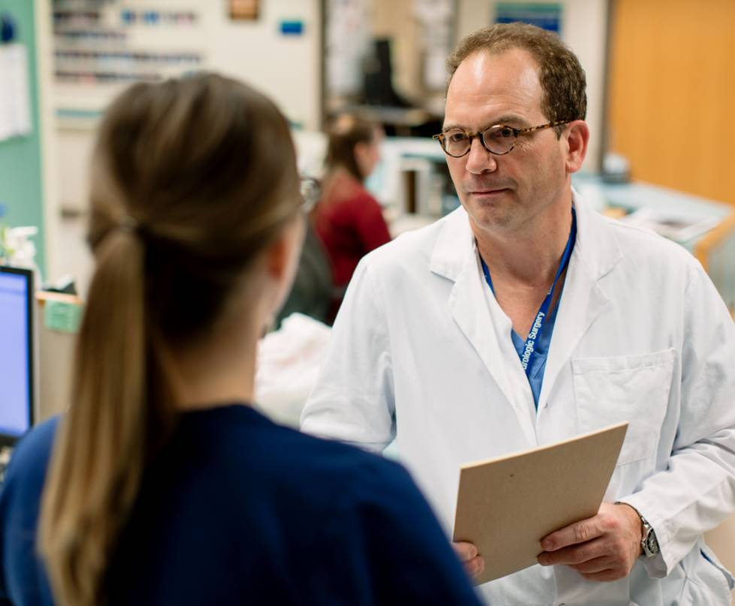
THANK YOU
Questions? Peters.pierce@mayo.edu

