Slide 1
The essential educational and professional development partner for neurosurgeons, trainees, and industry innovators.
Virtual Residency Fair:
UNMC Neurosurgery

Slide 2
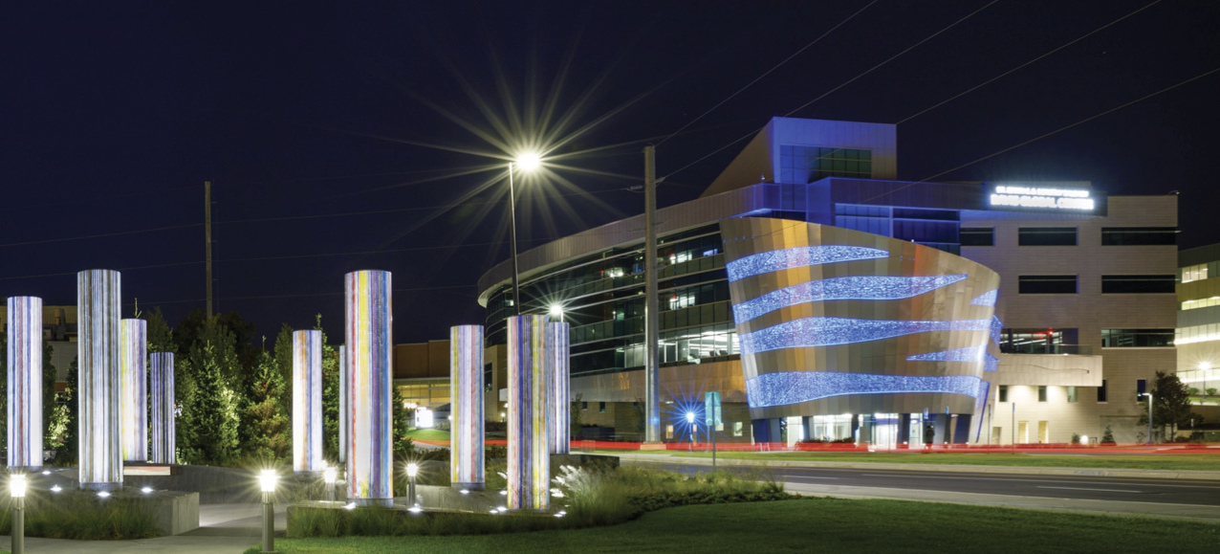

CNS Virtual Fair:
UNMC Neurosurgery Residency
Caroline Davidson and Luke Weisbrod
University of Nebraska Medical Center
Department of Neurosurgery

Slide 3


Program Overview
Training Sites
  University of Nebraska Medical Center
  Methodist Hospital
  Children’s Hospital

Slide 4
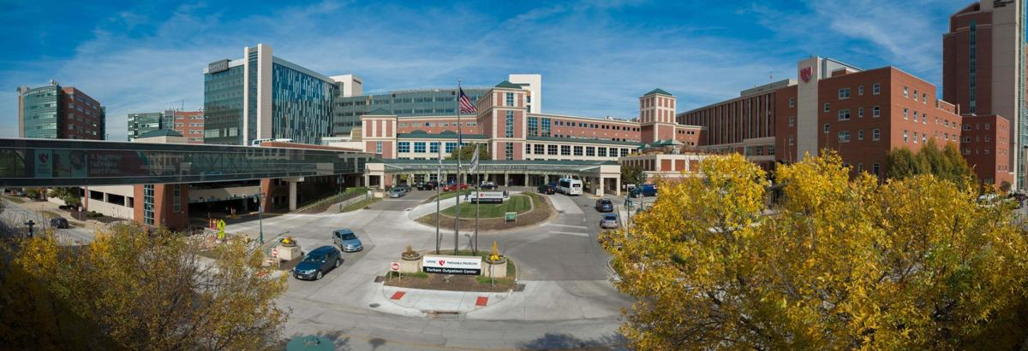
Program Overview
UNMC
Academic center
718 beds
Level 1 trauma center
Comprehensive stroke center

Slide 5
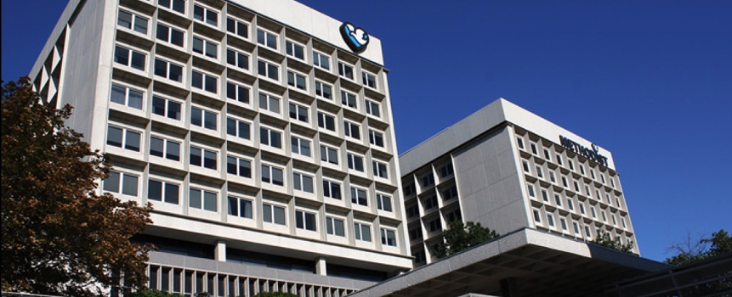
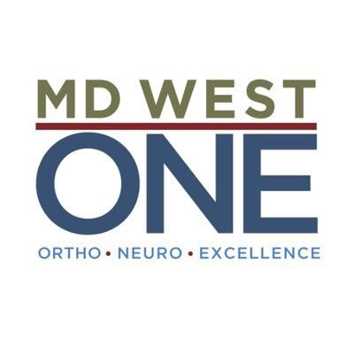
Program Overview
Methodist Hospital
Large volume of standard neurosurgical cases and tumors
Community Hospital
423 beds

Slide 6
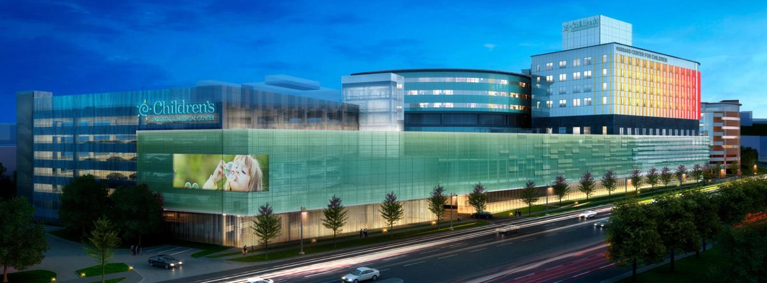
Program Overview
Children’s Hospital
New Hubbard Tower
New Operating Rooms
Intra-operative MRI
245 beds
Level II pediatric trauma center

Slide 7
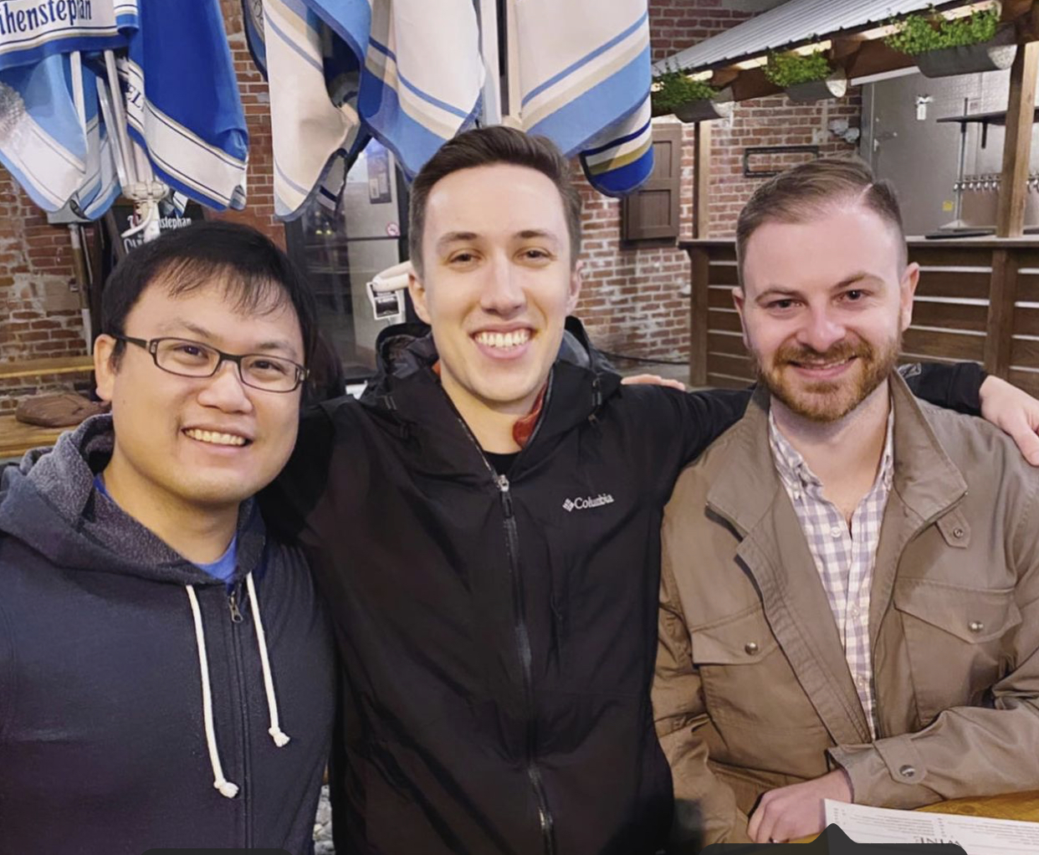
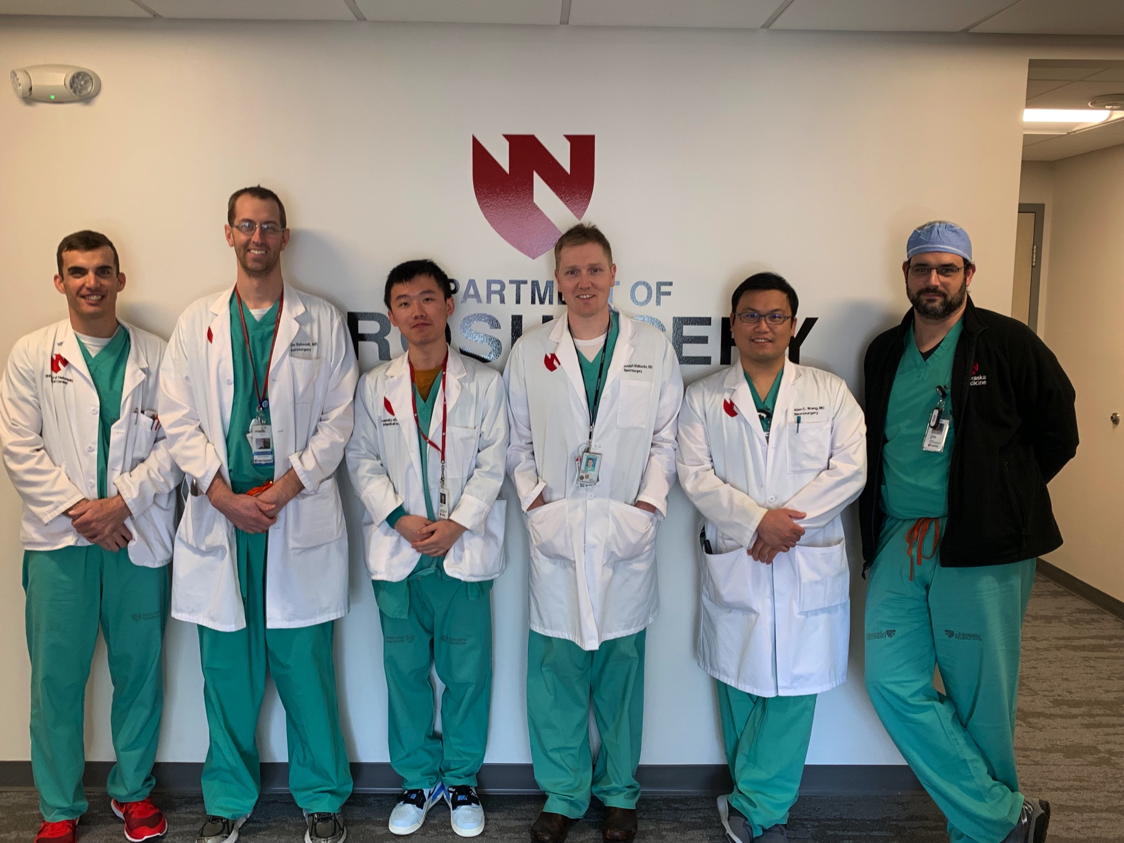
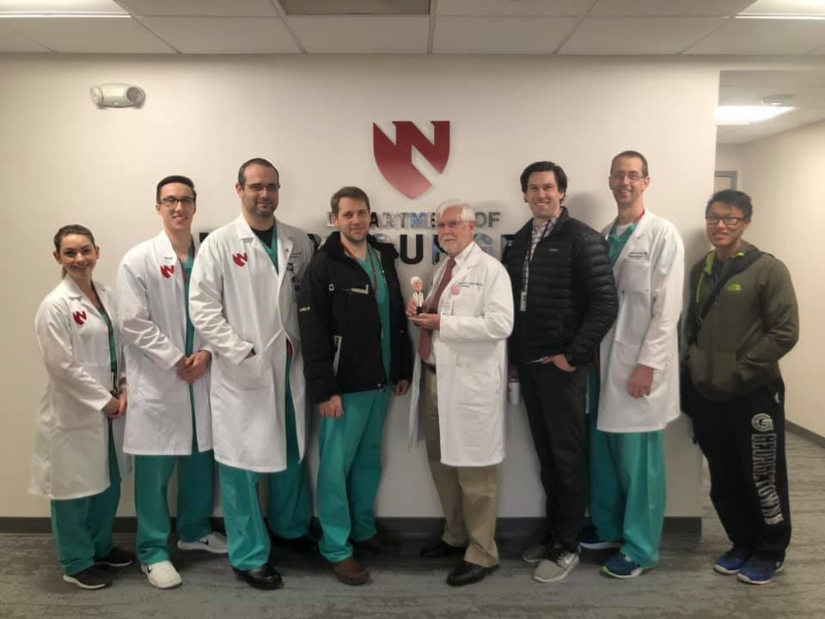
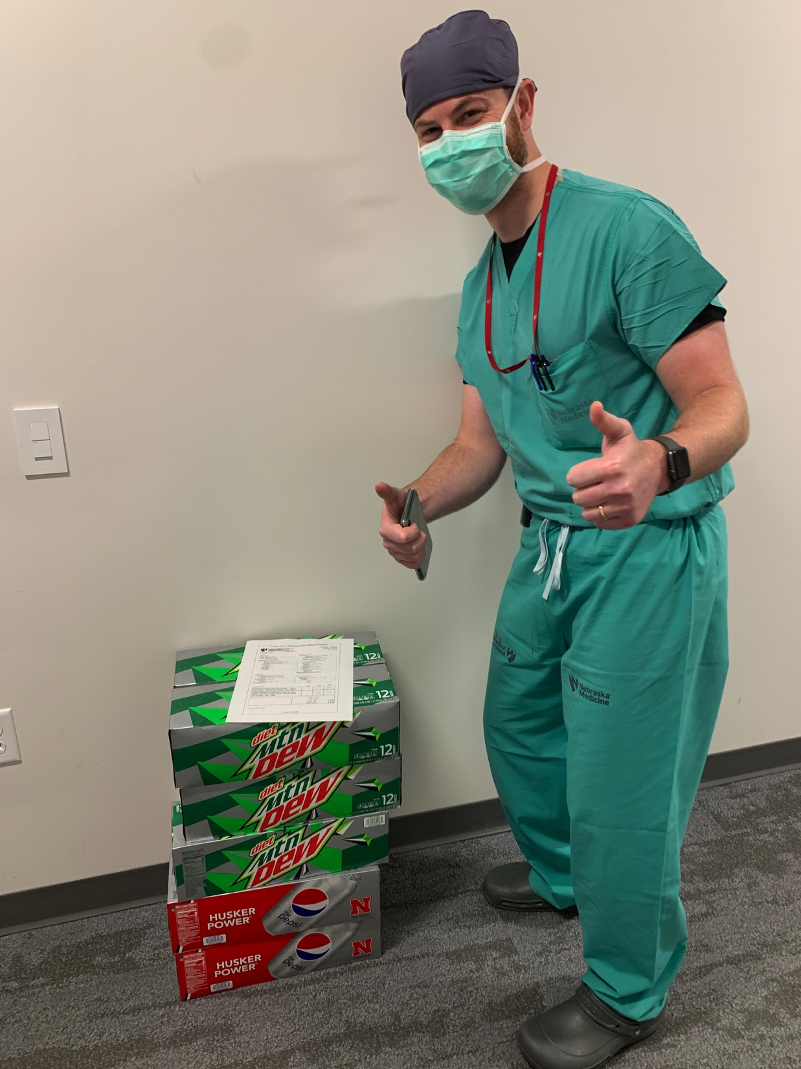
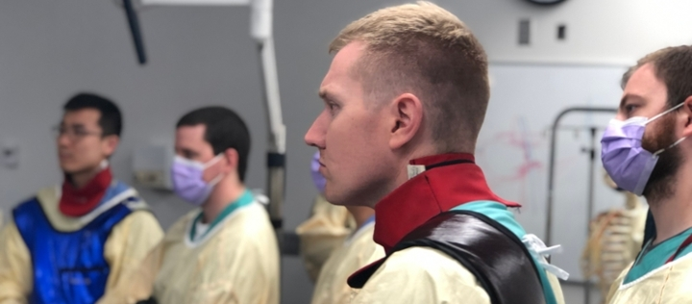
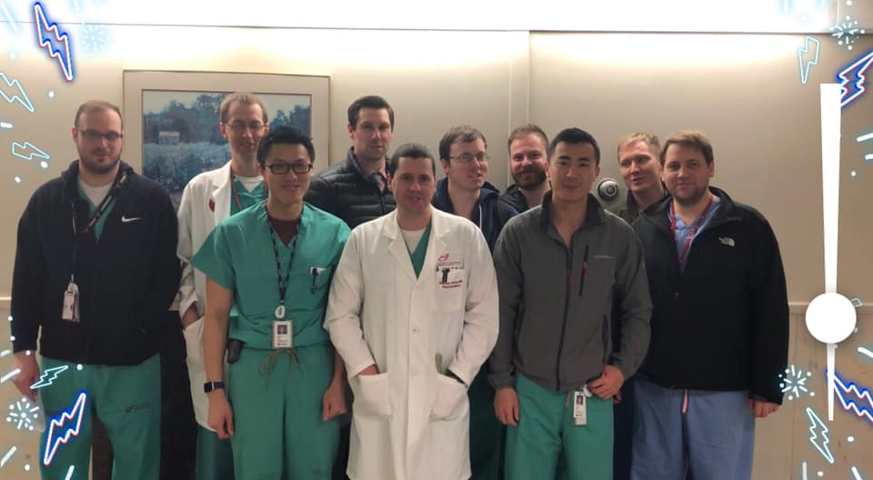
Program Overview
7 year program
2 residents per year
Culture and comradery (collegial supportive environment)

Slide 8
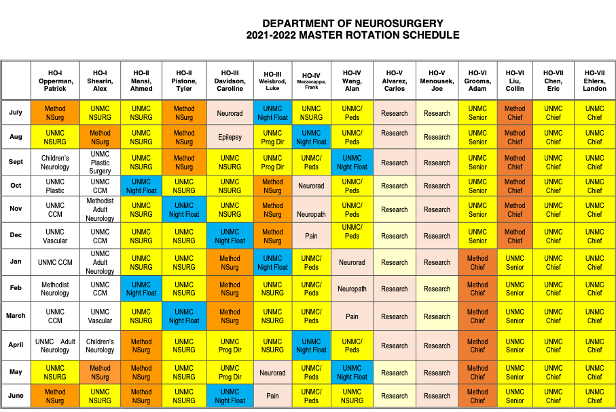
Program Overview
Sample rotation schedule

Slide 9
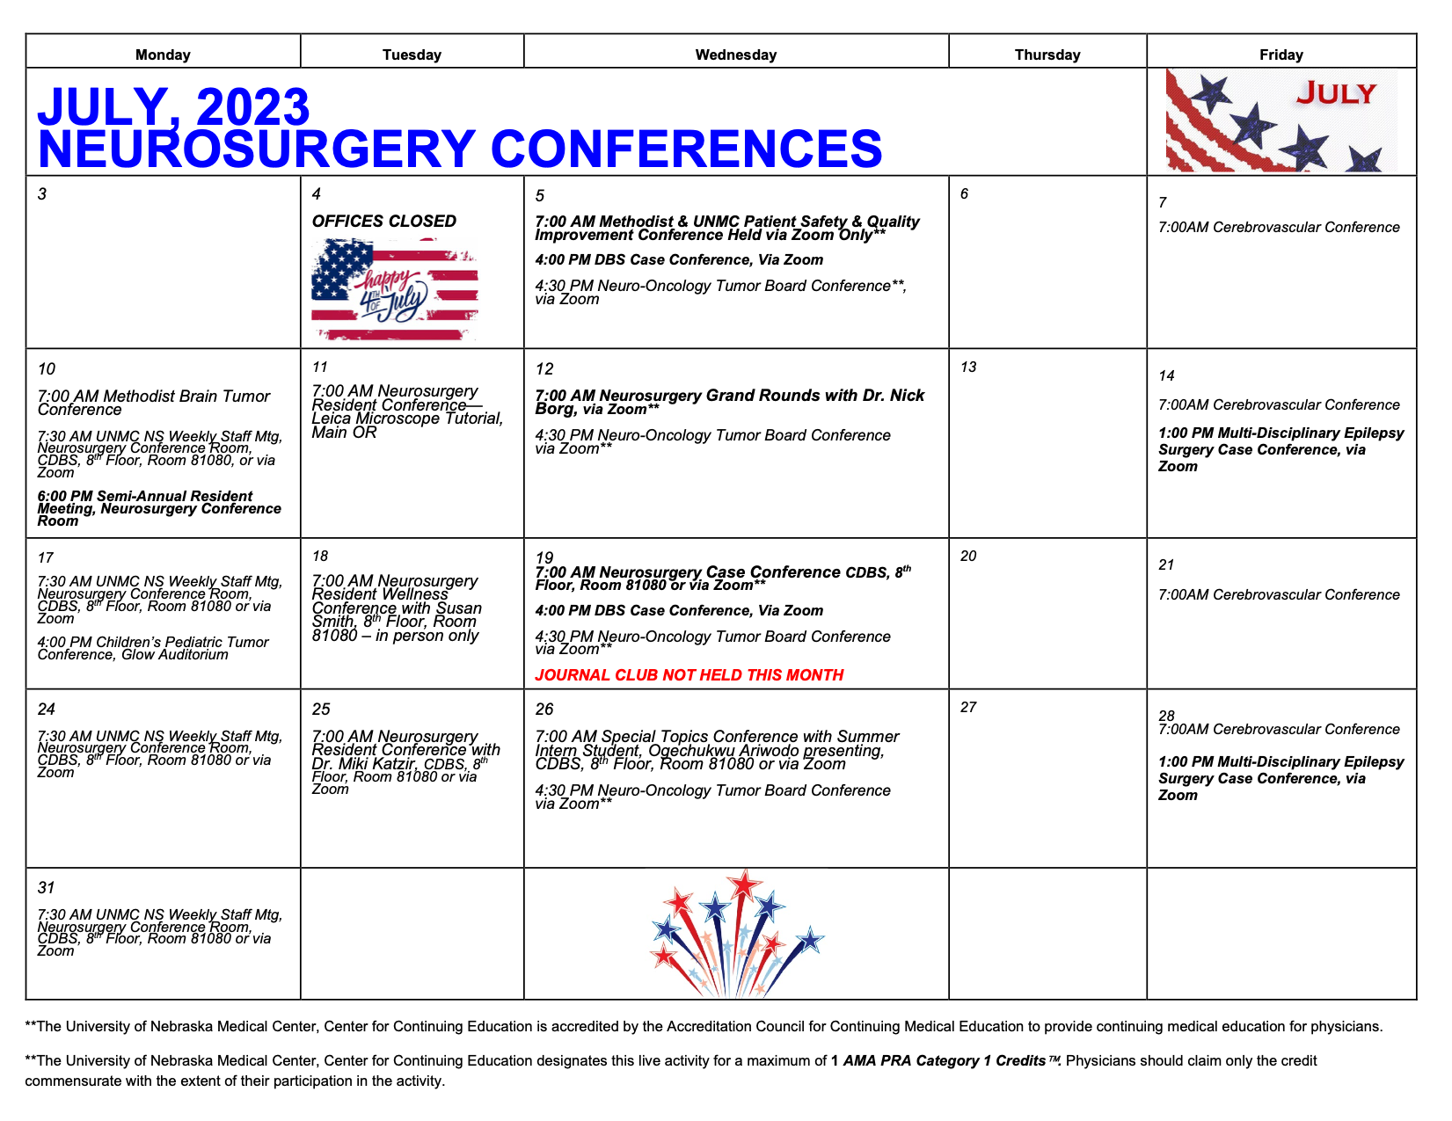
Program Overview
Conferences/Didactics

Slide 10

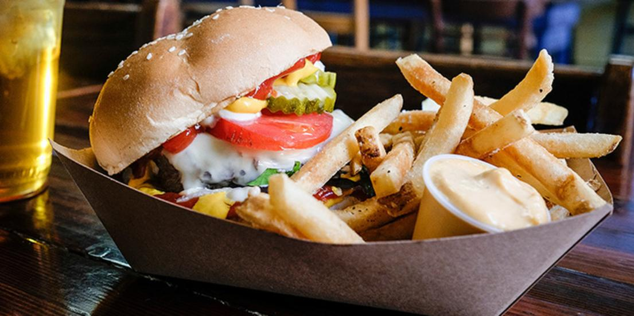
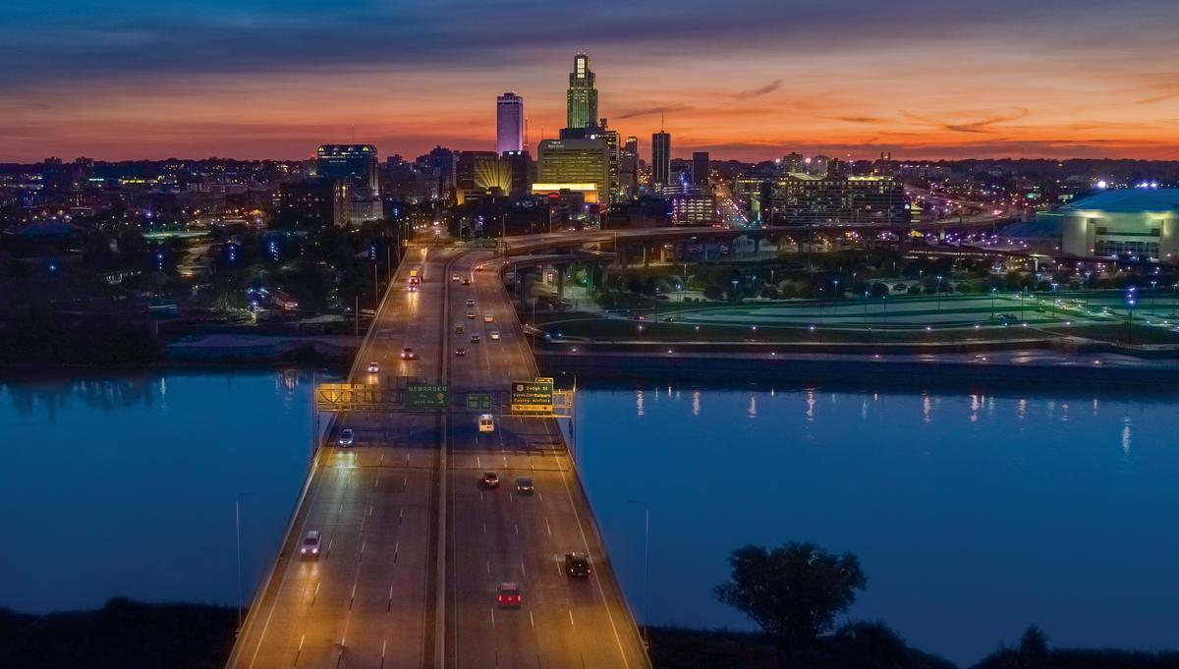

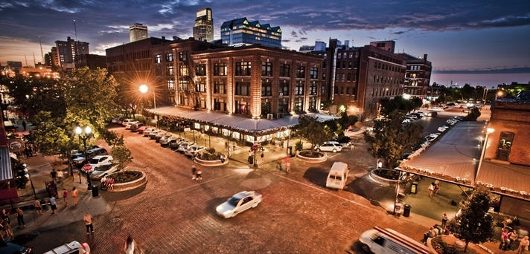

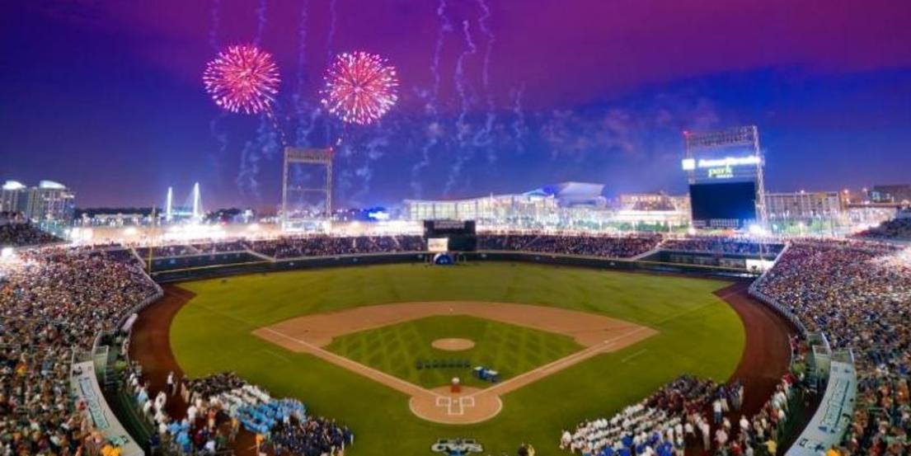
Omaha
1.3 million population in greater Omaha area
Affordable cost-of-living
Foodie City
Henry Doorly Zoo #1 Ranked Zoo in the US
Men’s College World Series

Slide 11
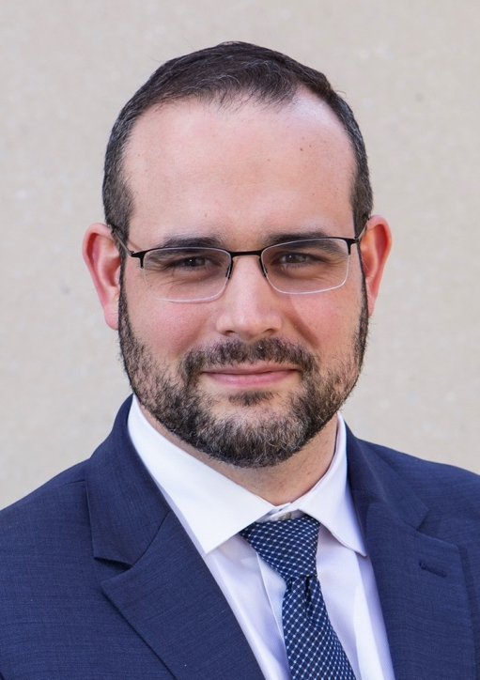
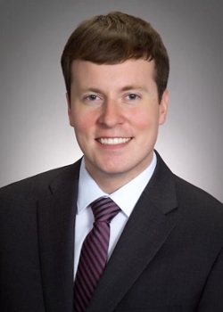
Current Residents
PGY-7
Dr. Carlos Alvarez
Dr. Joe Menousek

Slide 12
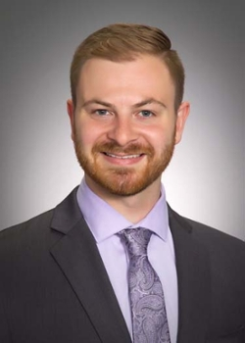
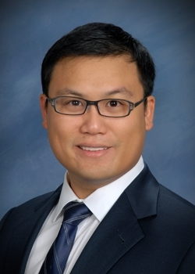
Current Residents
PGY-6
Dr. Frank Mezzacappa
Dr. Alan Wang

Slide 13
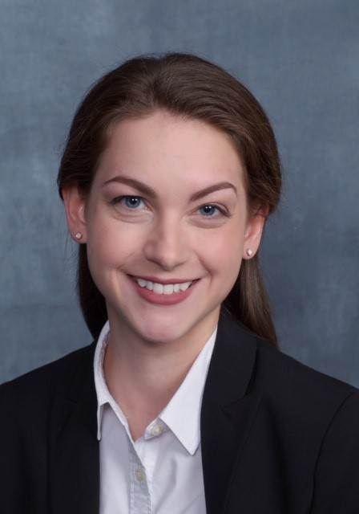
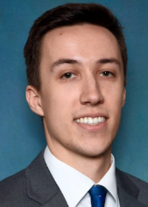
Current Residents
PGY-5
Dr. Caroline Davidson
Dr. Luke Weisbrod

Slide 14
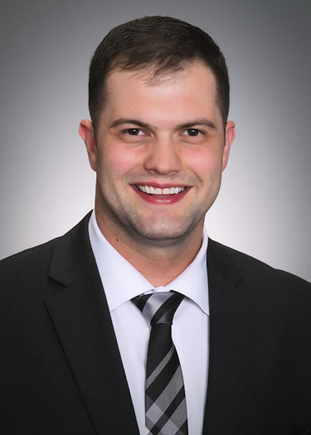
Current Residents
PGY-4
Dr. Tyler Pistone

Slide 15
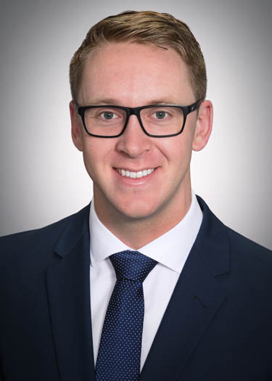
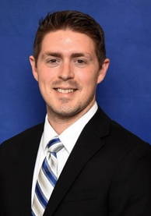
Current Residents
PGY-3
Dr. Patrick Opperman
Dr. Alex Shearin

Slide 16
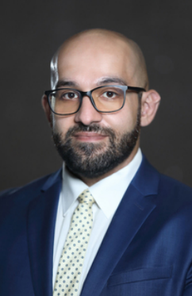
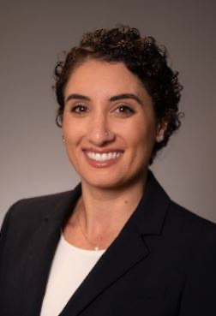
Current Residents
PGY-2
Dr. Pasha Lookian
Dr. Elhaum Rezaii

Slide 17
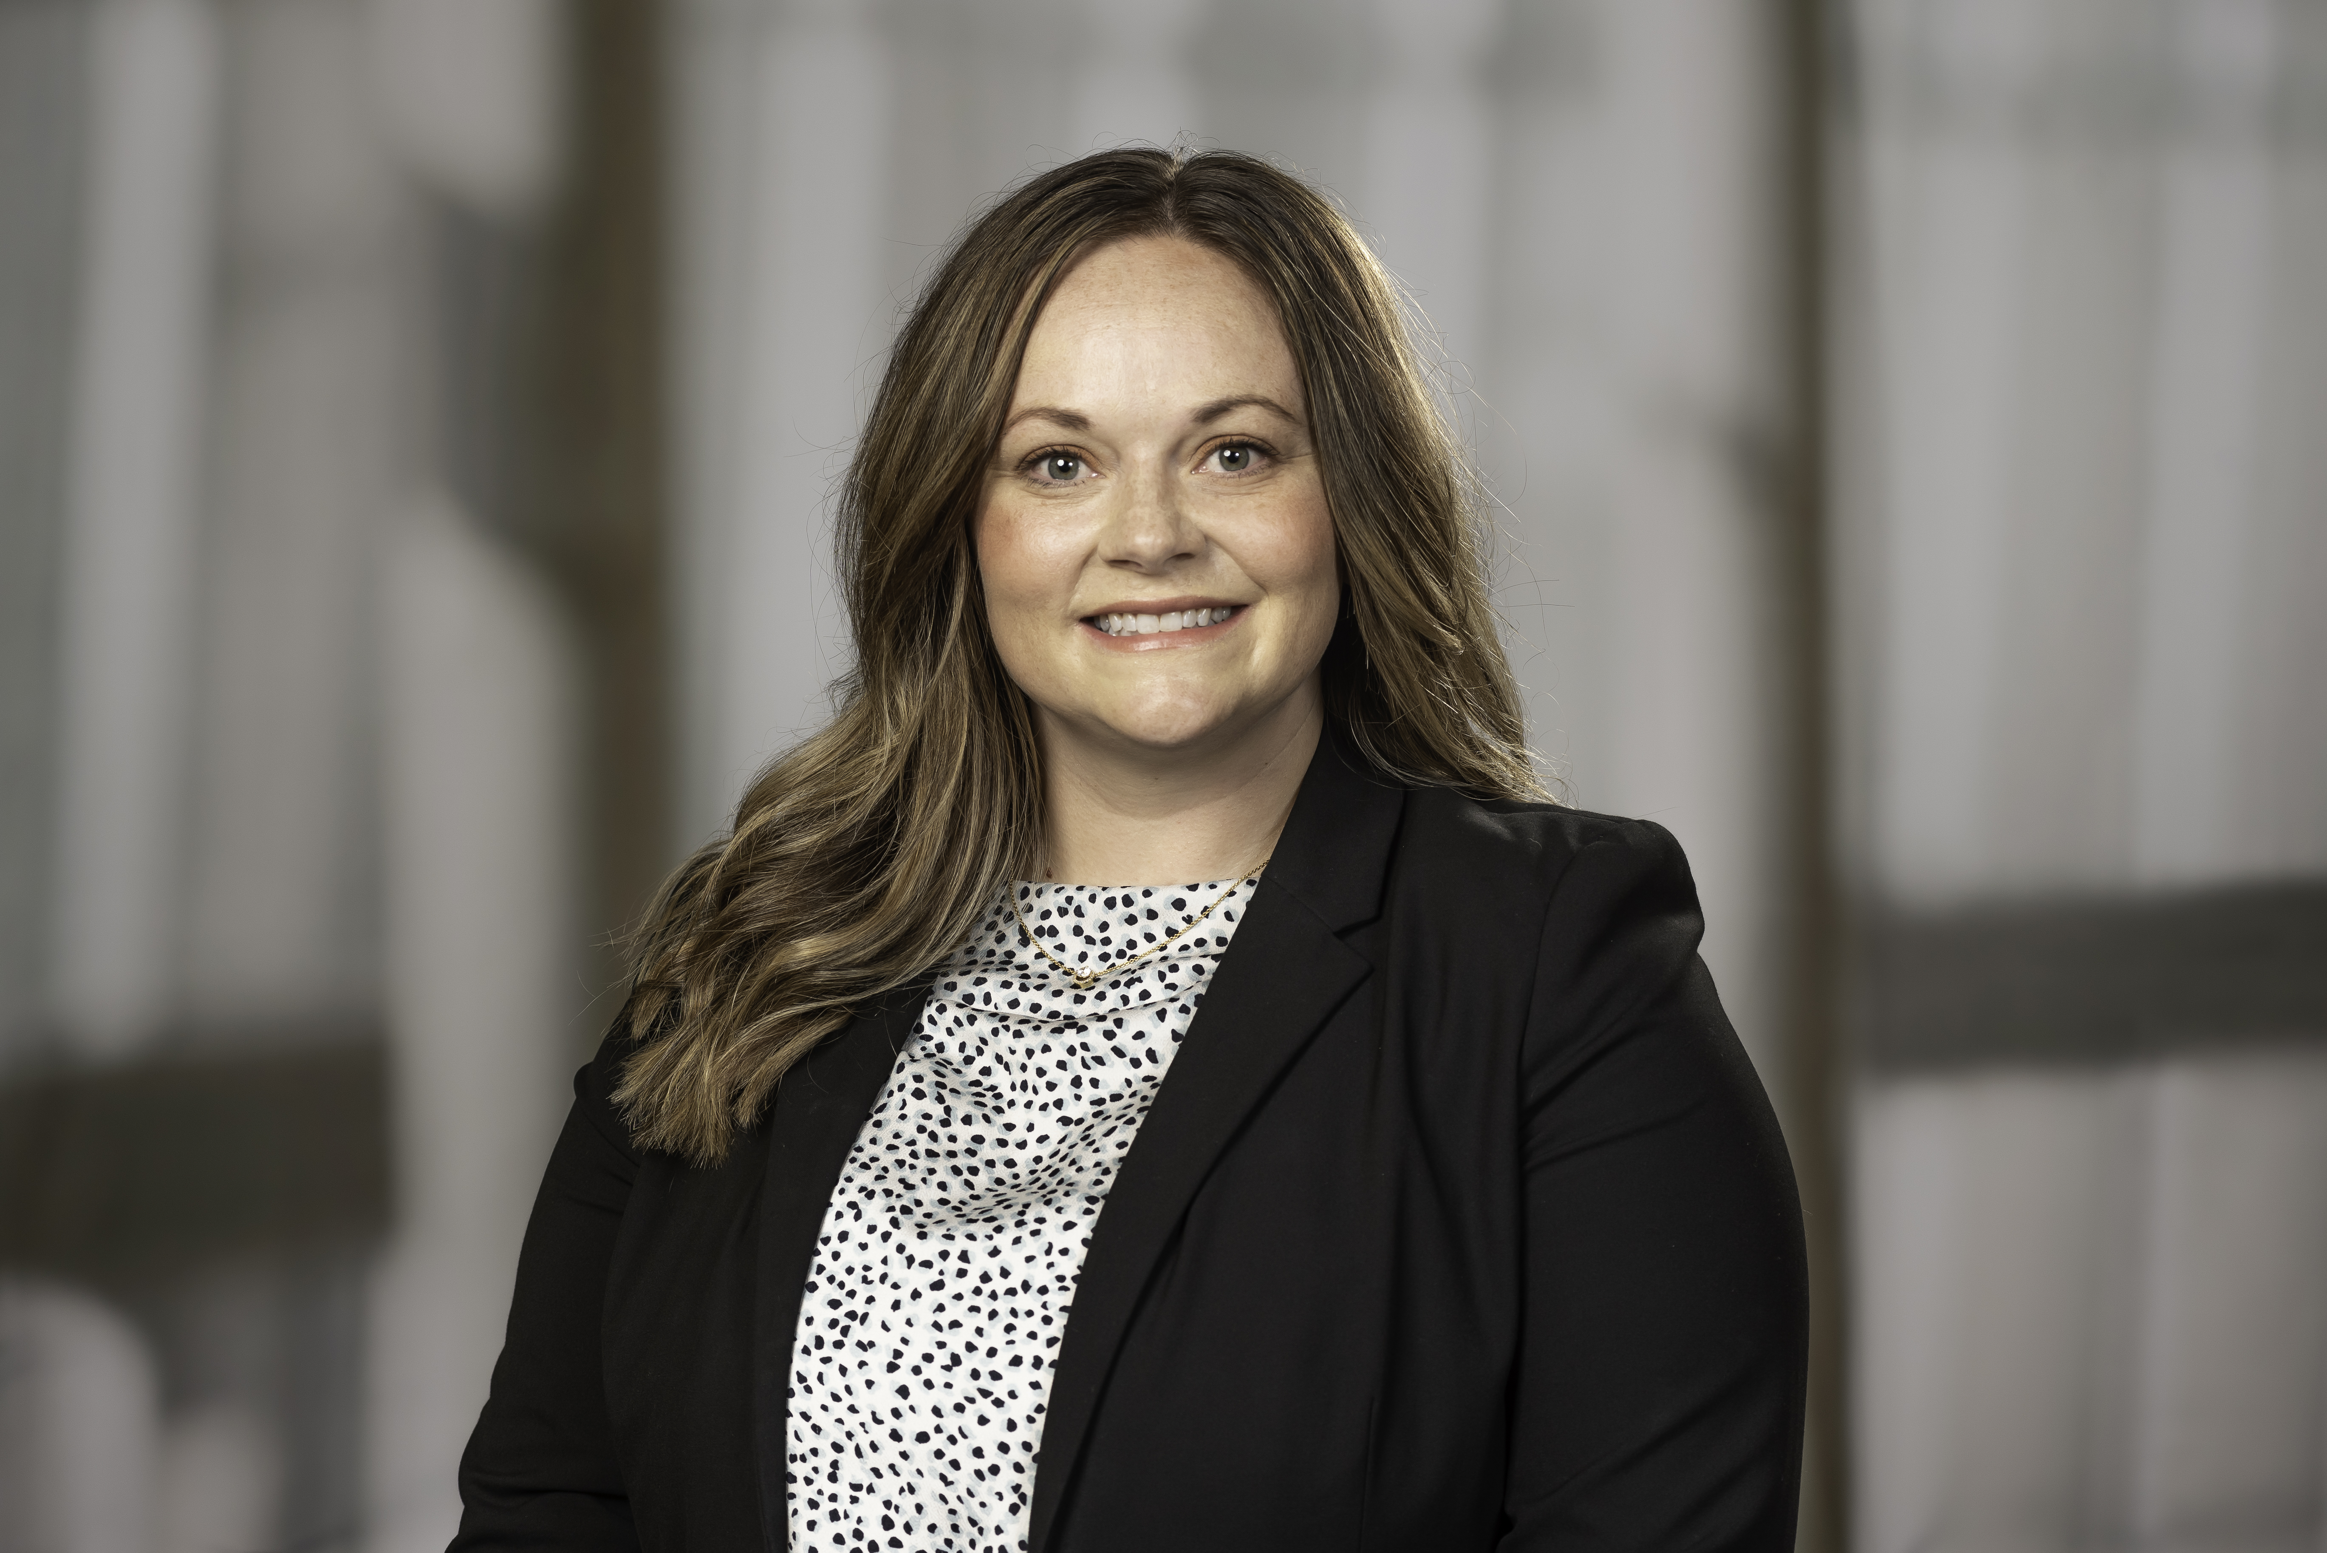
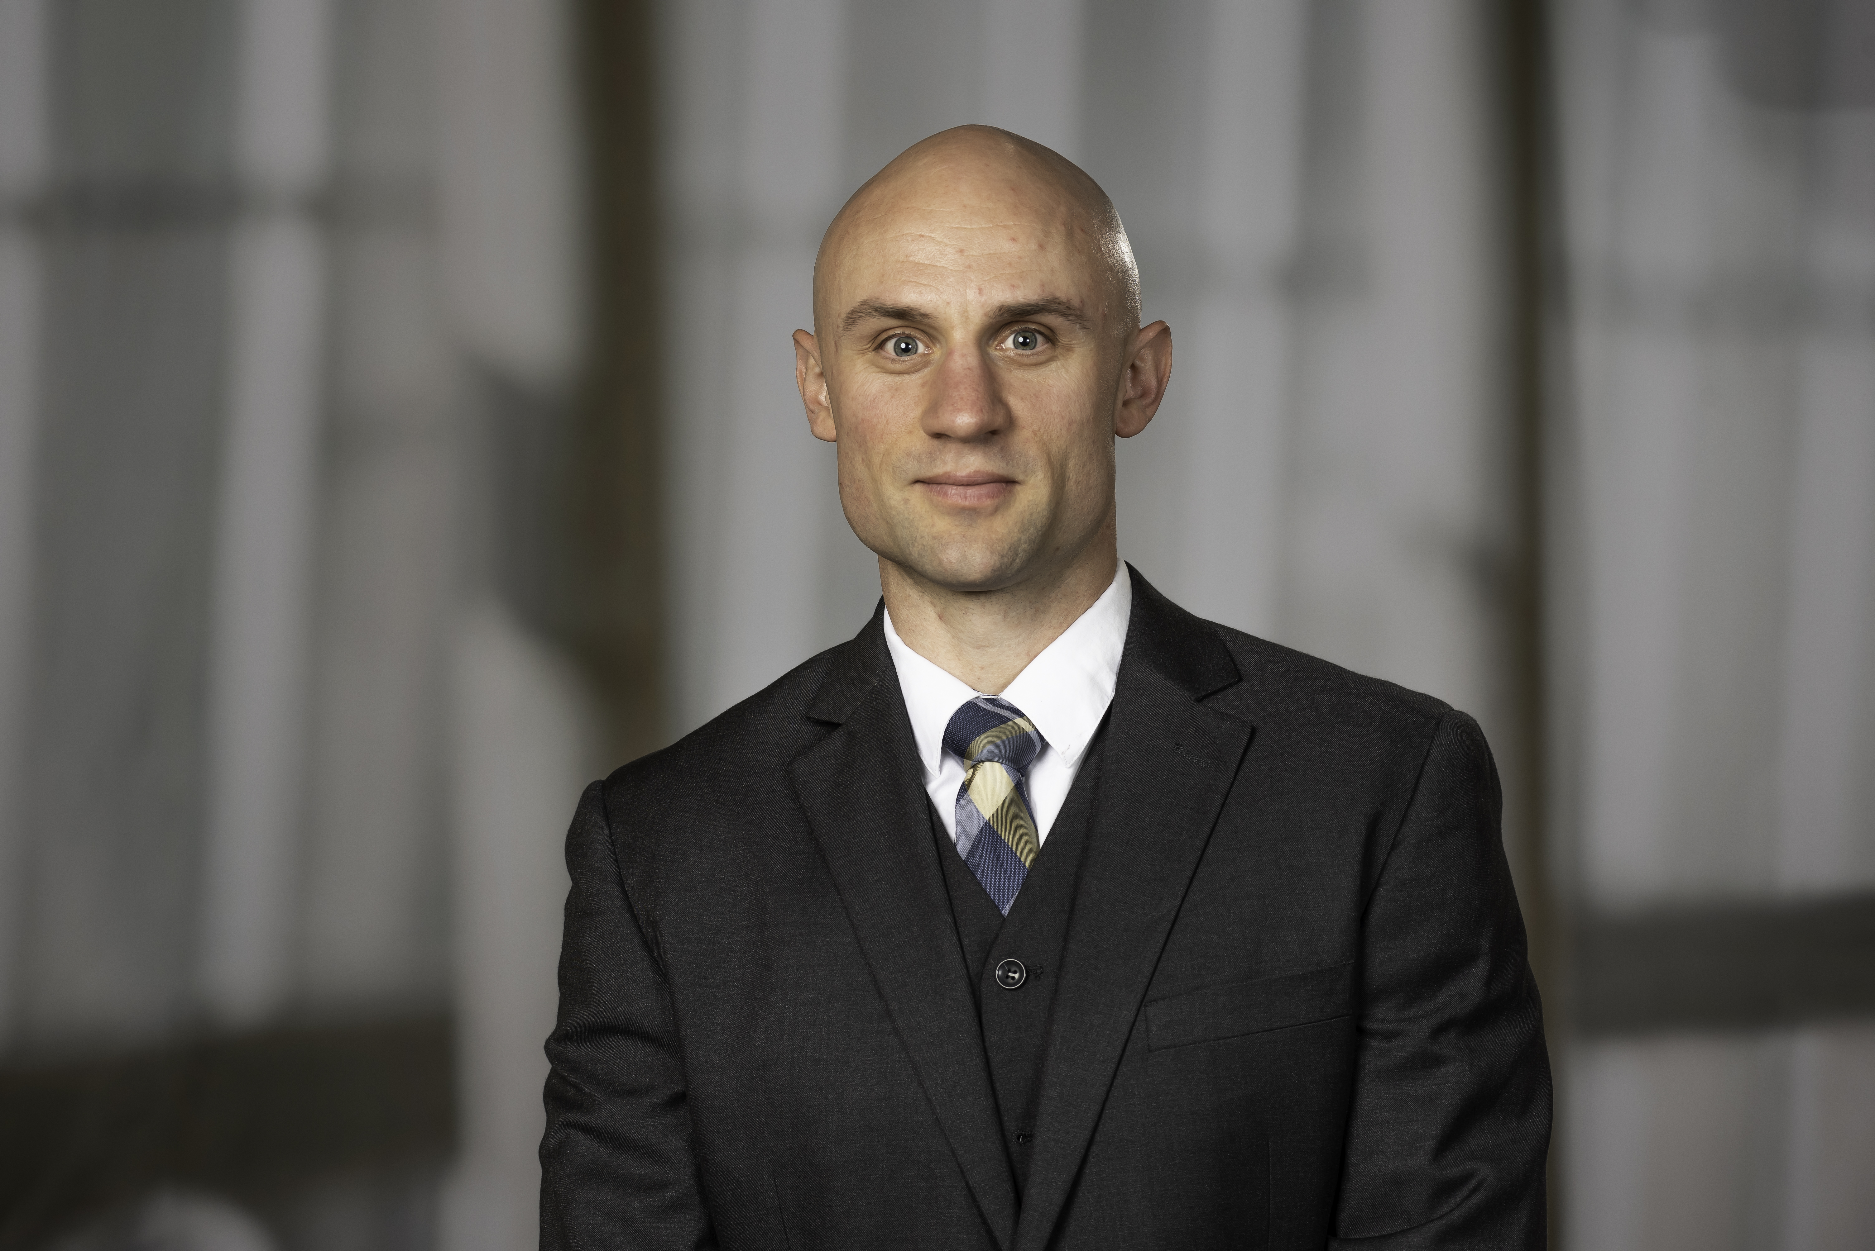
Current Residents
PGY-1
Dr. Susan Greni
Dr. Andrew Schmidt

Slide 18
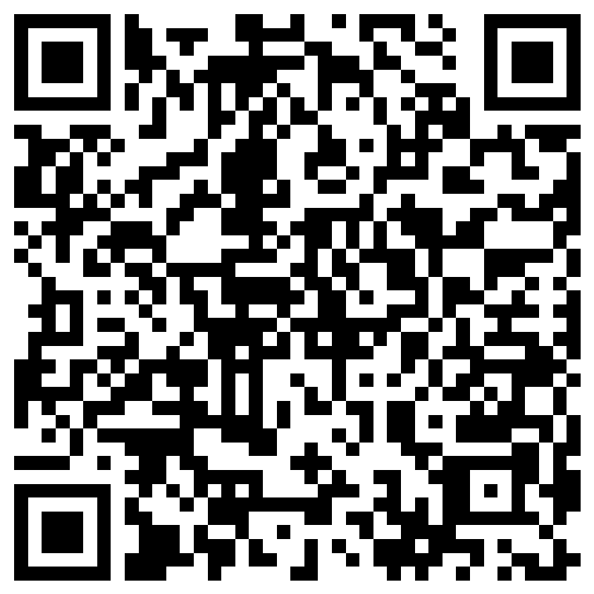
Join us for a virtual Q & A
Monday September 12, 2022 7 PM CST
Please use the QR code to sign up and a confirmation and Zoom link will be emailed to you

Slide 19
Questions?
Please email us with additional questions
  Kdevney@unmc.edu
  Alan.Wang@unmc.edu
  Frank.Mezzacappa@unmc.edu

