Slide 1
Neurosurgery Residency at the University of Chicago
Arjang Ahmadpour PGY6

Slide 2
Where we are

Slide 3
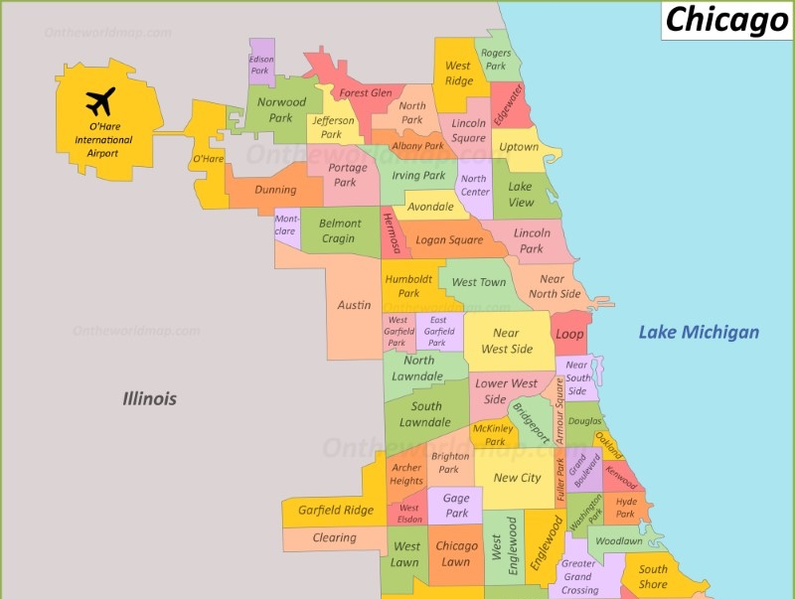
MDW International Airport

Slide 4
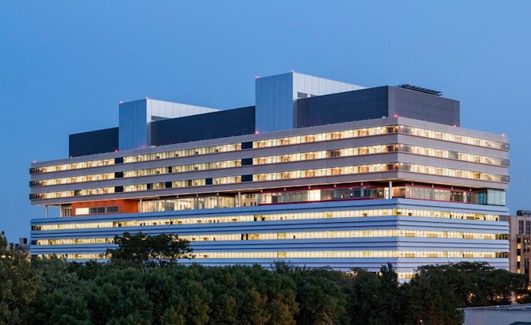
University of Chicago Medical Center
Primary training site
Level 1 trauma center
Level 4 epilepsy center
Comprehensive stroke center
Centers of excellence
Cerebral cavernous malformations
Hereditary hemorrhagic telangiectasia

Slide 5
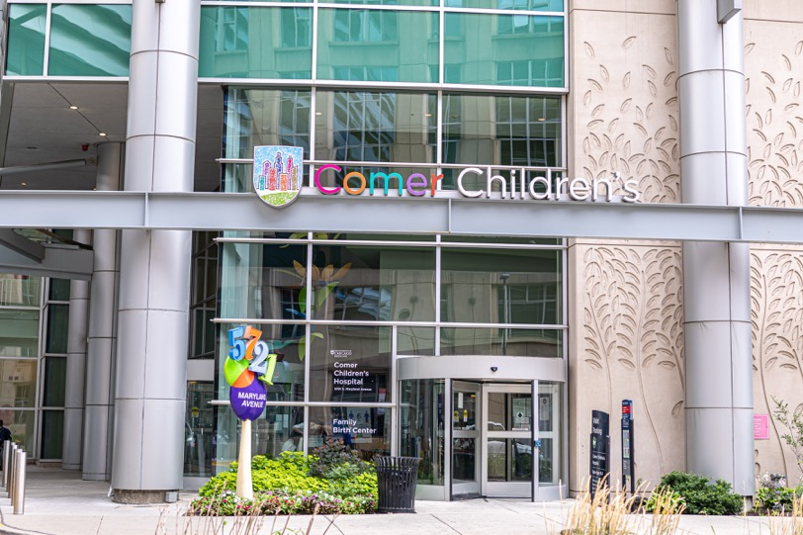
Comer Children’s Hospital
Across street from adult hospital
6-month dedicated rotation
Peds neurosurgery integrated throughout residency

Slide 6
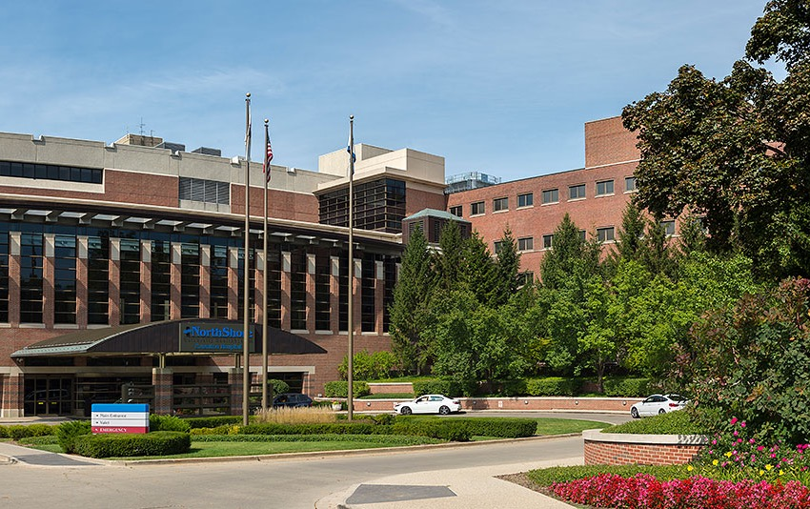
NorthShore satellite training campus
Rotate for ~18 months
In northern suburbs
4 hospital hub (Evanston Hospital) and spoke model
High-volume spine center (Skokie Hospital)

Slide 7
Faculty

Slide 8
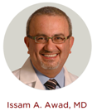
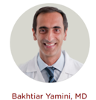
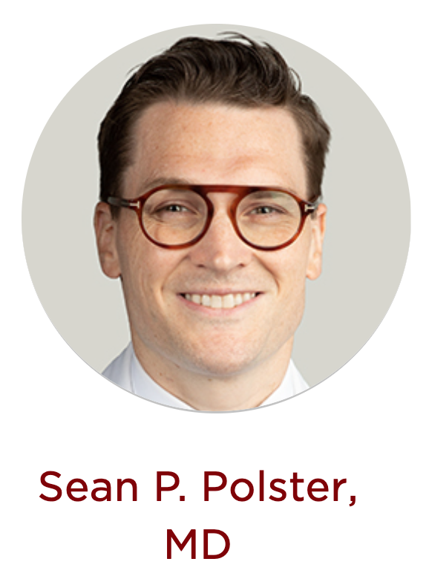
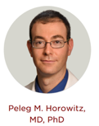
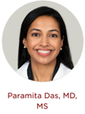
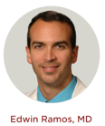
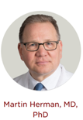
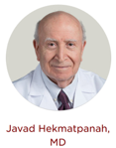
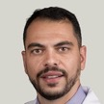
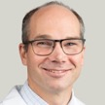
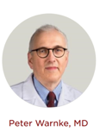
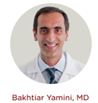
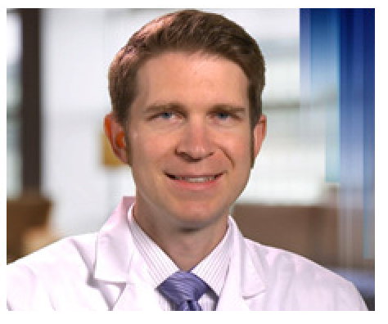
Faculty: UChicago
Open vascular
Skull base
Spine
Mentorship
Endovascular
Functional
Pediatric
Neurocritical care
Fernando Goldenberg
Christos Lazaridis
Tareq Kass-Hout
Michael Hurley
Eric Thompson, MD
Christopher Kramer
Ali
Mansour

Slide 9
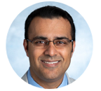
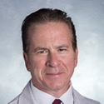
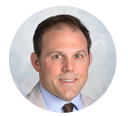
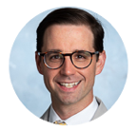
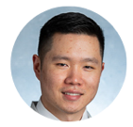
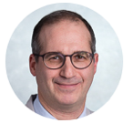
Faculty: NorthShore
Vascular/
endovascular
Skull base
Spine
Shakeel
Chowdhry, MD
Julian
Bailes, MD
Michael
Musacchio, MD
William
Ares, MD
Ricky
Wong, MD
Noam
Stadlan, MD

Slide 10
Residency Overview

Slide 11
Rotations
Year | Rotations |  | Call
PGY1 | Neurosurgery & NeuroICU | Anesthesia, Neurophys/Rad/Path, NICU, ENT, Neuro-Onc | 1 wknd day/wk
PGY2 | Stereotactic & functional | NorthShore junior | Q4
PGY3 | Pediatrics | Adult general
PGY4 | Spine | NorthShore senior
PGY5 | Elective / research |  | Home call 1 wknd/mo
PGY6 | Elective / research
PGY7 | UChicago chief | NorthShore chief | Home call 2 wknd/mo

Slide 12
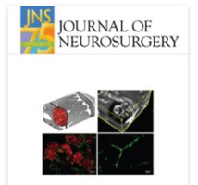
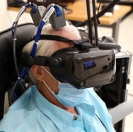
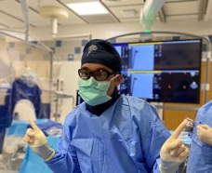
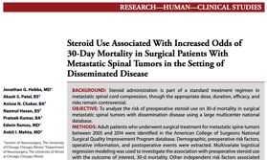
Elective years (PGY5-6): examples from the last decade
Lab
Clinical
Enfolded
Degrees
Epilepsy electrophysiology
Skull base anatomy
Craniofacial genetics
Vascular malformation biology
Glioma immunotherapy
Spinal oncology
Intracranial hemorrhage
Epilepsy surgery outcomes
Brain-computer interface
Trauma
Skull base
Spine
Endovascular
Master’s degree (stats/epidemiology)

Slide 13
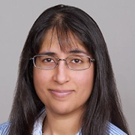
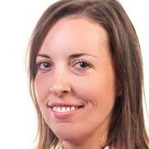
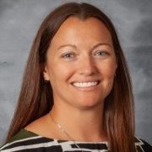
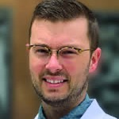
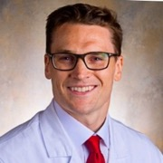
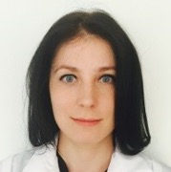
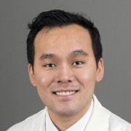
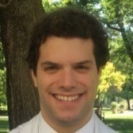
Fellowship and beyond
Anita Bhansali
Functional fellowship
(Swedish)
Melissa Stamates
Skull base fellowship
(NorthShore)
Ashley Ralston
Trauma fellowship (Miami)
Peds fellowship (Emory)
Jon Hobbs
Private practice (spine) in Indiana
Sean Polster
Skull base fellowship (Pitt)
Valentina Vasenina
Spine fellowship (NorthShore)
Jason Choi
Endovascular fellowship (UIC)
Open vascular fellowship (Stanford)
Andrew Platt
Spine fellowship (Rush)
Deformity fellowship (Columbia)
Notes:
AB- functiona, private practice DWF
MS- skull base, PP, Fayeteville NC
AR- peds, PP, corpus Christi
JH- spine, PP, Porter IN
SP- skull base, acad, Pitt
JC- vascular, stanfort
AP- spine, columbia

Slide 14
Education

Slide 15
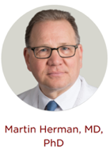
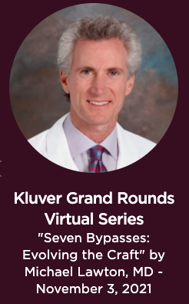
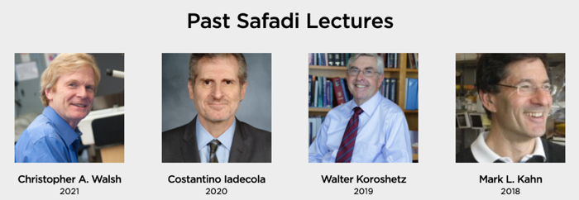
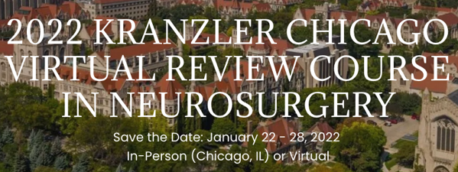
Resident education
Weekly conference
Grand Rounds, Resident Education, Oral Boards Prep
Weekly subspecialty conferences
Vascular, epilepsy, neuro-oncology, spine tumor, pediatric
Annual Chicago Review Course
1-week intensive course, free to UCH residents
Resident-led boards prep
Journal club

Slide 16
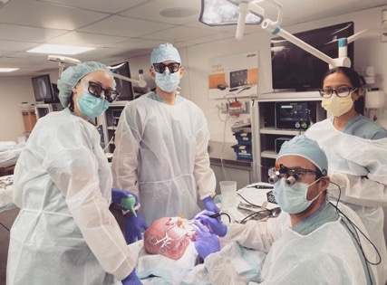
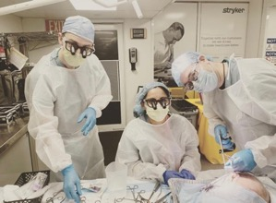
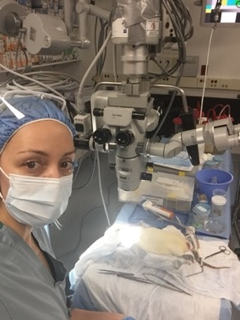
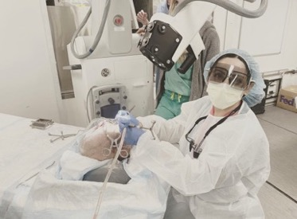
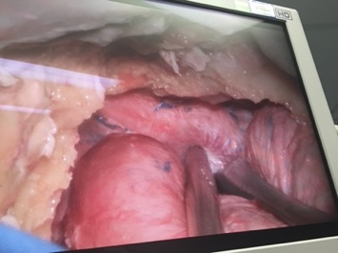
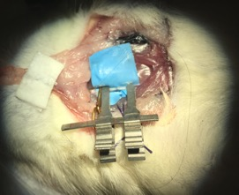
Cadaver Lab
UChicago
Skull base, endoscopic, spine
NorthShore
Annual Skull Base Course
State of the art facility
Cadaver heads & rats always available

Slide 17
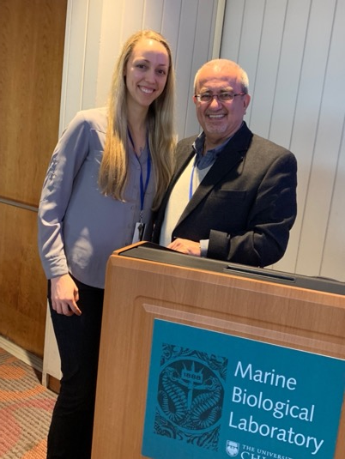
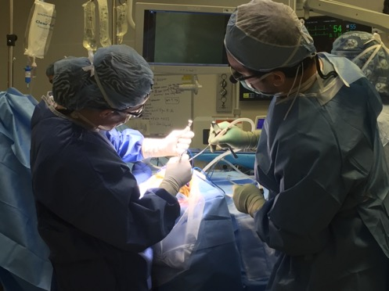
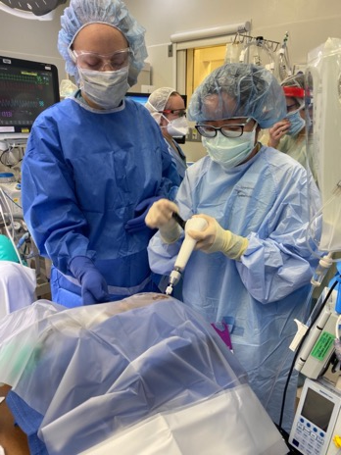
Mentorship
Residents paired with a faculty mentor
Continuous mentorship from senior residents

Slide 18
Get to Know Us

Slide 19
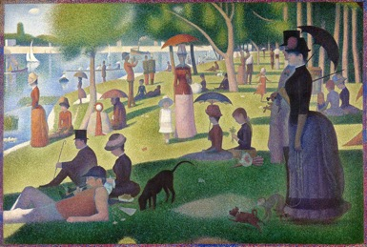
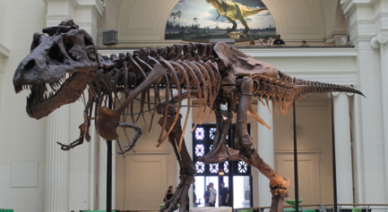
Chicago

Slide 20
Life in Chicago

Slide 21
Residents

Slide 22
Neurosurgical Family

Slide 23
Why come to UChicago
High case volume and complexity
Close faculty-resident relationships
Two flexible, dedicated elective years
Academic environment
Chicago

Slide 24
Thank You for Visiting
Website: neurosurgery.uchicago.edu
Instagram: @uchicagoneurosurgery
Email addresses:
Arjang Ahmadpour arjang.ahmadpour@uchospitals.edu

