Slide 1
An Introduction to University of Virginia Neurosurgery

Slide 2
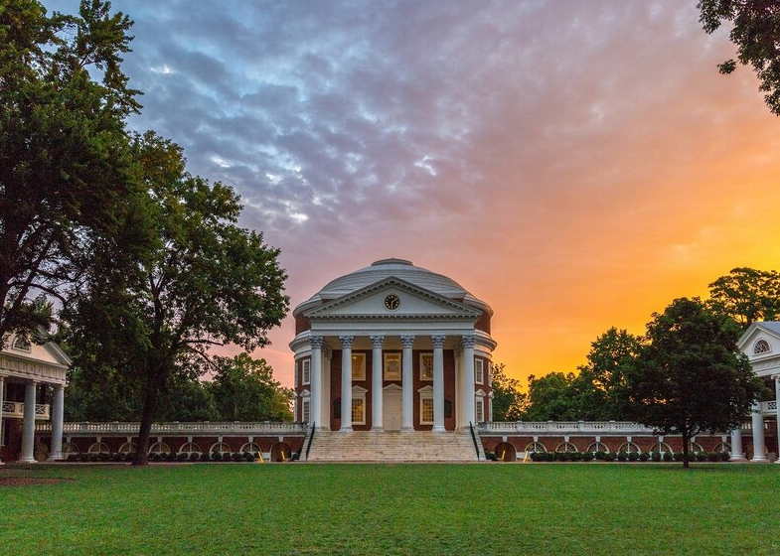
“… I am closing the last scene of my life by fashioning and fostering an establishment for the instruction of those who come after us. I hope that its influence on their virtue, freedom, fame, and happiness will be salutary and permanent.”
- Thomas Jefferson
Notes:
Thomas Jefferson modeled his concept of the University on the ancient greek practice of gathering students around a teacher and broadened the concept by having professors live among their students. This is the concept of the “academical village” of the Lawn and the buildings of UVA. The rotunda is modeled on the Pantheon in Rome. the two rows of pavillions on the sides of the lawn contain 54 student rooms, and in between each building is the Pavillion in which faculty lives. Dr Jane lived for many years in Pavillion V

Slide 3
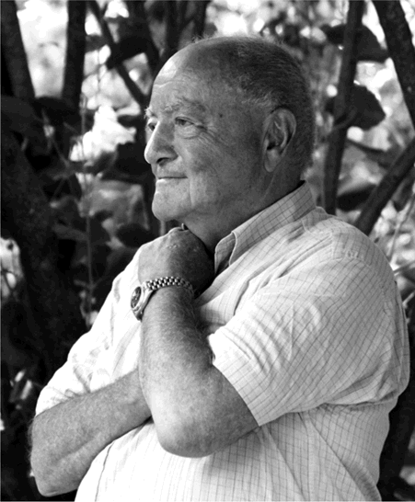
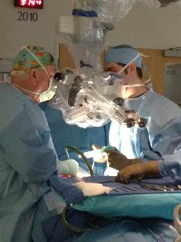
Notes:
Dr Jane
Neurosurgical residency at U Chicago
Studied at Montreal Neurological Institute as a Fellow in Neurophsiology and Neuropathology
Worked in 1961 with Wylie McKissock at Atkinson Morley’s and Queen’s Square in London
PhD at Duke under Irving T Diamond
Completed training under Eric Oldberg, one of the last trainees of Cushing
Started his career at Case Western - his early residents included Don Becker, Harold Young, and Martin Weiss
Editor of JNS from 1992-XXX

Slide 4
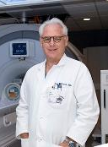
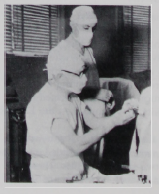
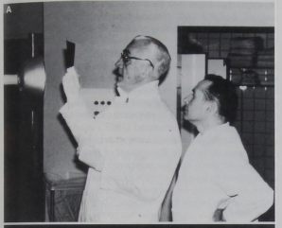
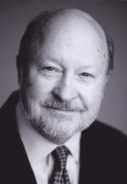
Kassell
Leksell & Steiner
Crutchfield
Oldfield
Laws
Notes:
Neal F Kassell joined in 1984
- Studied with Charles Drake
- instrumental in International cooperative study on the timing of aneurysm surgery
- pathophysiology and understanding of vasospasm
Ladislau Steiner
- studied with Lars Leksell in Karolinska Institue, Sweden
Developed gamma knife
devised the first titanium clip

Slide 5
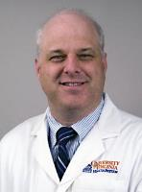
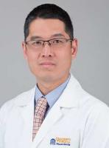
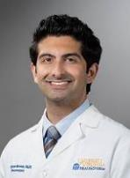
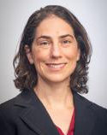
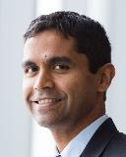
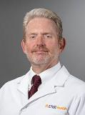
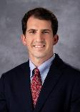
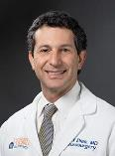
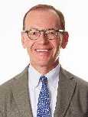
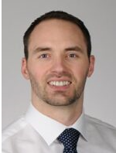
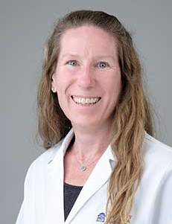
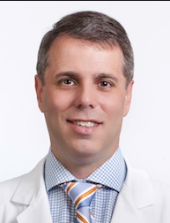
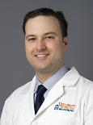
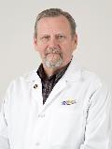
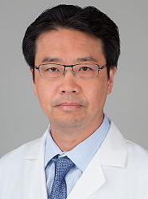
Current Faculty
Chair
Program Director
Associate PD
Associate PD

Slide 6
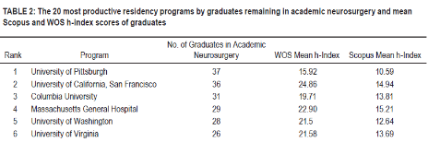
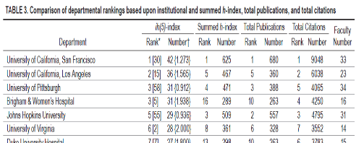

Slide 7
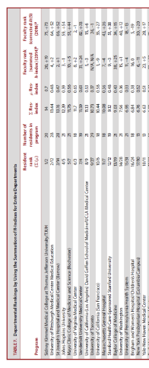
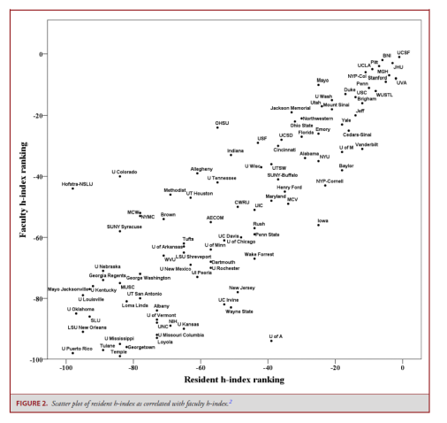
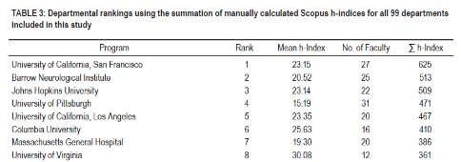

Slide 8
Past Graduates in Academics
Department Chairs
Mark Shaffrey (UVA)
Aaron Dumont (Tulane)
Nader Pouratian (UT Southwestern)
John Jane, Jr (Virginia Tech/Carilion Clinic)
John Persing (Plastic Surgery, Yale)
Louis Pobereskin (Plymouth General Hospital, England)
Dennis Vollmer (prior, UT San Antonio)
Johnny Delashaw (prior, UC Irvine)
H. Richard Winn (prior, U Washington)
Sean Grady (prior, U Penn)
Joseph Hahn (retired, Cleveland Clinic)
Albert Butler (retired, Northwestern)
Austin Colohan (retired, Loma Linda)
George Tyson (retired, Stony Brook)
Ralph Dacey (prior, Wash U)
Vice Chairs / Program Directors / Directors
Jason Sheehan (Director of Neurosciences, UVA)
Charles Sansur (PD, U Maryland)
D. Kojo Hamilton (PD, Pitt)
Oren Sagher (PD, U Michigan)
Jonas Sheehan (Prior, PD Penn State Hershey)
Professors
Chris Shaffrey (Duke)
Tae Sung Park (Wash U)
Giuseppe Lanzino (Mayo Clinic)
David Okonkwo (Pitt)
William Broaddus (VCU)
Jeff Elias (UVA)
Greg Helm (UVA)
Bobby Starke (U Miami)
Ashok Asthagiri (UVA)
Associate Professors
Tord Alden (Northwestern)
Hazem Ahmed Kazem (Duke)
Kai-Ming Fu (Cornell)
Nathan Simmons (Dartmouth)
Chun-Po Yen (UVA)
Christopher Cifarelli (WVU)
Webster Crowley (Rush)
Jonathan Sherman (WVU)
Dale Ding (U Louisville)
Assistant Professors
Dan Raper (UCSF)
Alex Ksendzovsky (U Maryland)
Matthew Shephard (Allegheny)
Tom Buell (Pitt)
Chin-Jen “Jared” Chen (UT Houston)
Rebecca Burke (Wake Forest)
Shayan Moosa (UVA)
Panos Mastorakos (UT Southwestern)

Slide 9
Recent Graduates
2022
Panos Mastorakos: Vascular Neurosurgery, UT Southwestern
Shayan Moosa: Functional Neurosurgery, UVA
Jen Sokolowski: Vascular Neurosurgeon, Anchorage Neurosurgical Associates
Saul Morales, Neuro-Oncology, Louisiana
2021
Jared Chen: Vascular Neurosurgery, UT Houston
Rebecca Burke: Pediatric Neurosurgery, Wake Forest
Davis Taylor: Lt. Commander, Portsmouth Naval Medical Center
2020
Matt Shepard: Neuro-Oncology, Director of Research, Allegheny General
Tom Buell: Spine Neurosurgery, University of Pittsburgh
Dominic Maggio: Neurosurgeon, Legacy Spine and Neurological Specialists
Tony Wang: Functional Neurosurgery, Swedish Neuroscience Institute
2019
Dan Raper: Vascular Neurosurgery, UCSF
Alex Ksendzovsky: Functional Neurosurgery, Univ of Maryland
James Nguyen: Neurosurgeon, Providence St. Joseph Medical Center
Peter Christensen: Neurosurgeon, Kaiser Permanente
2018
Aaron Bond: Functional Neurosurgery, UVA/Lynchburg
Paul Schmitt: Vascular Neurosurgery, UTMB Galveston/Corpus Christi
Winson Ho: Pediatric Neurosurgery, UCSF
50% of recent graduates in Academic Practice

Slide 10
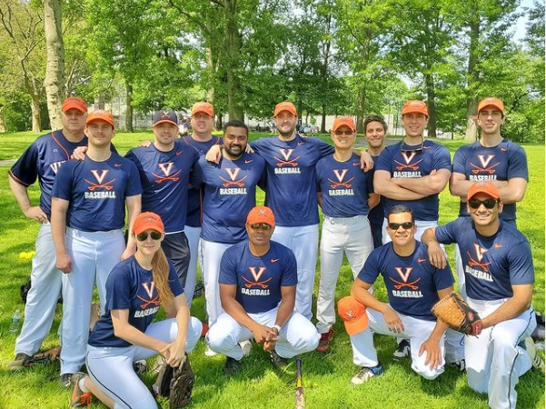
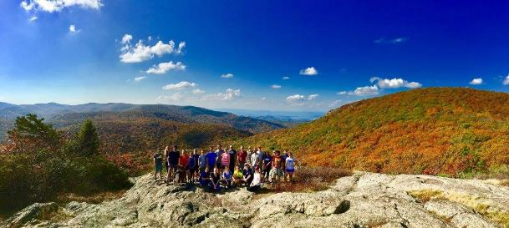
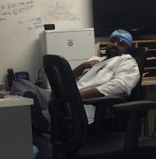
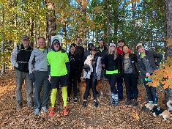
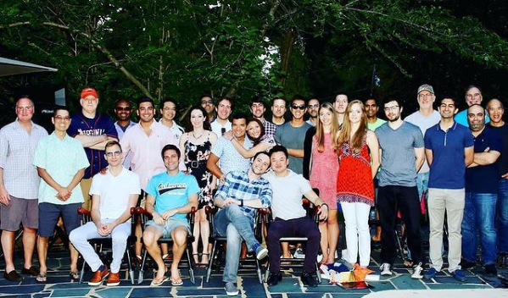
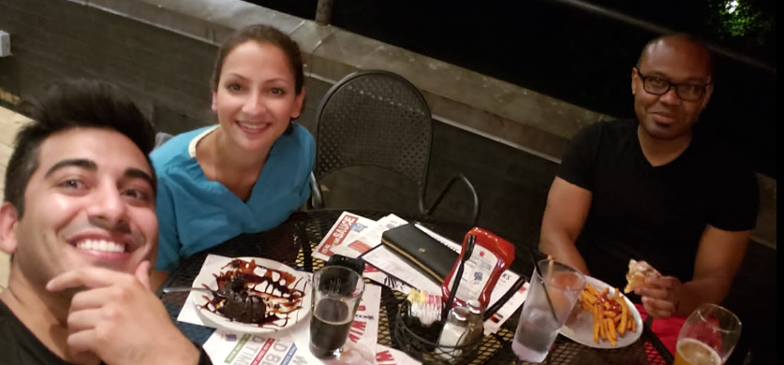
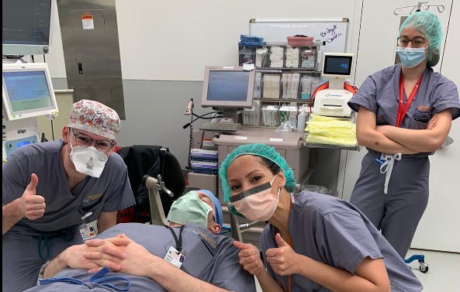
Current Residents

Slide 11
Program Structure - Apprenticeship
PGY 1: Internship
PGY 2 & 3: Junior Residency
-------------------------------------------------------
PGY 4: Lab / Enfolded Fellowship
PGY 5: New Zealand
PGY 6: Chief Residency
PGY 7: Transition to Practice / Enfolded Fellowship

Slide 12
PGY 1 - Internship
4 months operative neurosurgery
2 months neurosurgery floor
1 month endovascular neurosurgery
3 months neurosurgical ICU
1 month trauma ICU
1 month airway / neuropathology

Slide 13
PGY 2 & 3 – Junior Residency
4 month rotations
OR, clinic, general patient care, primary call
PGY 2
Spine / Tumor 1: Shaffrey, Mut
Functional / Radiosurgery: Elias, Moosa, Sheehan
Pediatrics: Grabb, Spader
PGY 3
Complex Spine: Smith, Yen, Sardi
Vascular / Endovascular: Park, Kellogg
Complex Tumor / Skull Base 2: Asthagiri, Catalino

Slide 14
PGY 4 / 7
Flexible based on personal goals
Clinical research
Laboratory research
Advanced degree(s)
Enfolded fellowships
Endovascular
Spine
Critical Care
Neuro-Oncology
Functional
Gamma Knife Radiosurgery
Backup call as PGY 4

Slide 15
PGY 5 – New Zealand
Auckland, Christchurch
Senior registrar
250-350 cases
Cranial (tumor, trauma)
Vascular
Pediatrics

Slide 18
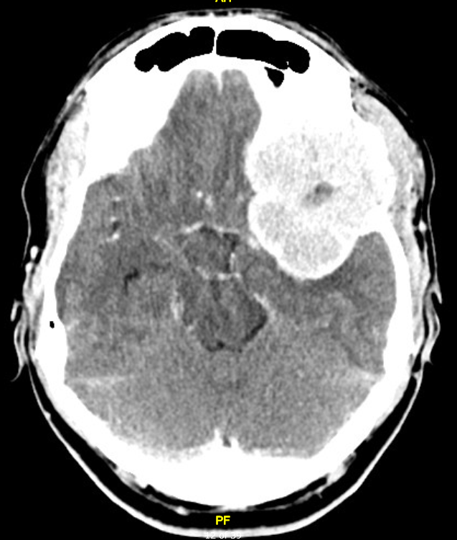
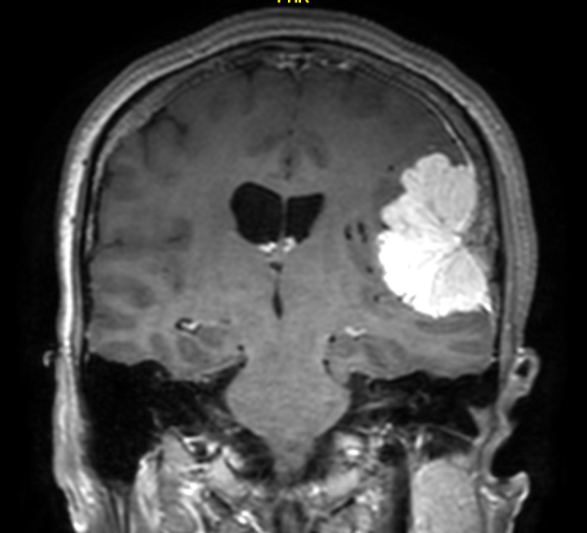
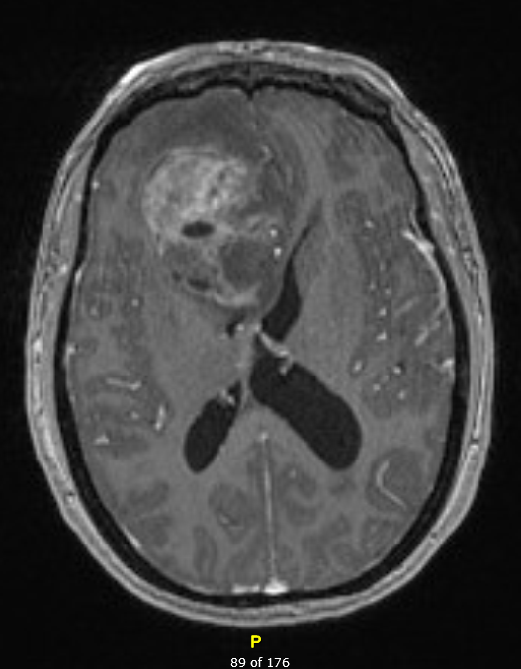
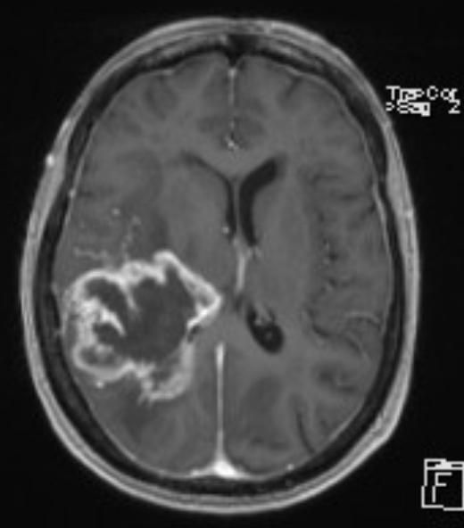
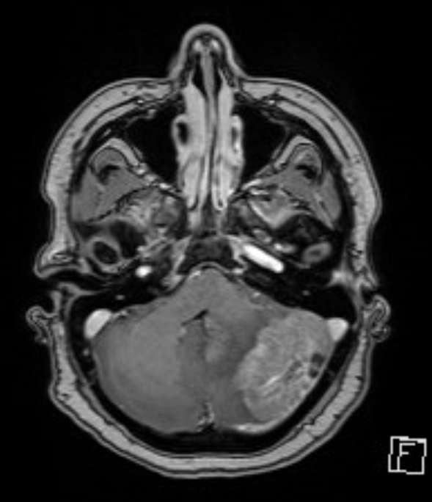
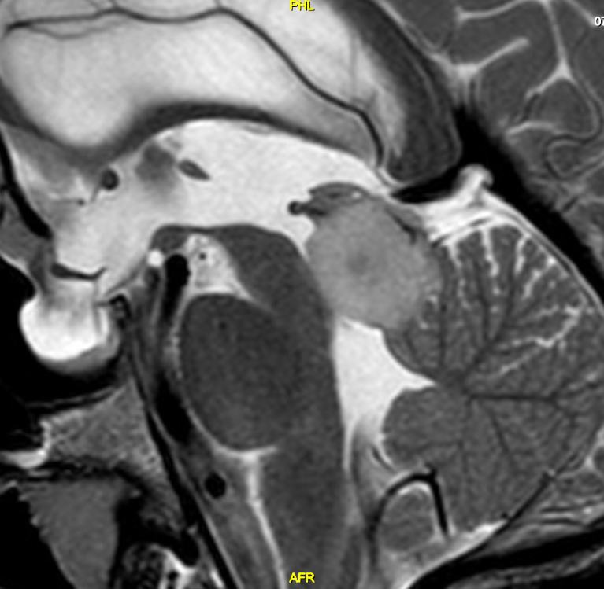
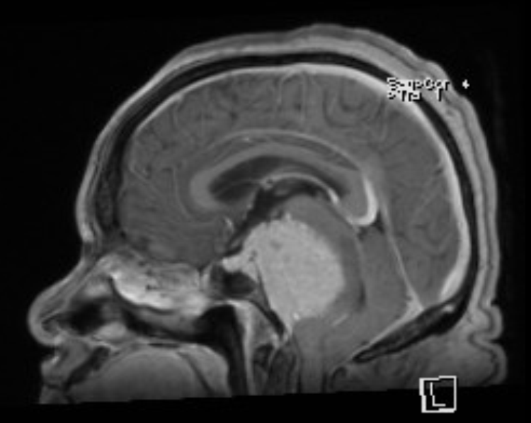

Slide 19
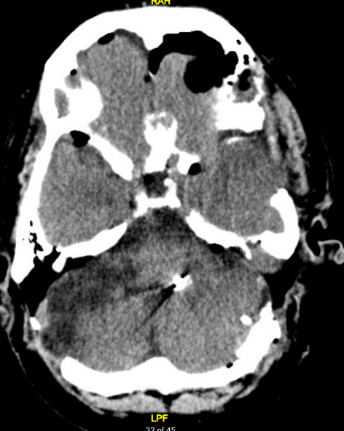
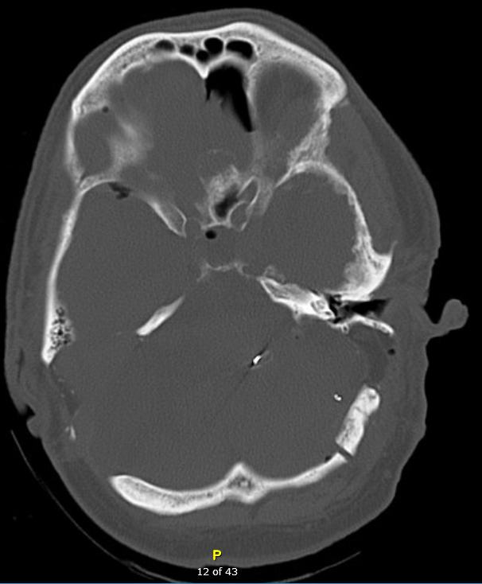

Slide 20
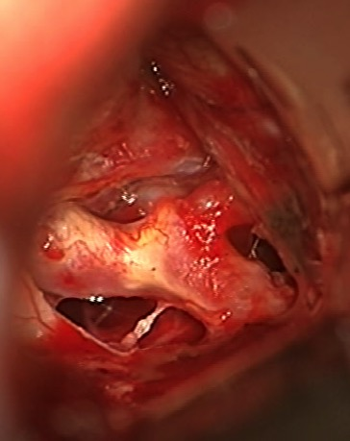
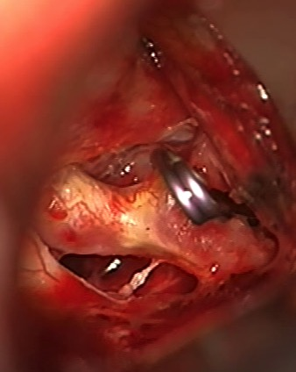
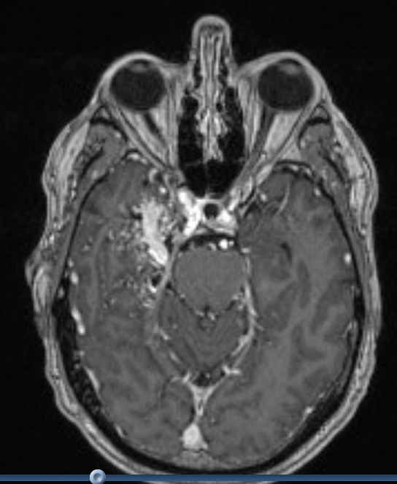
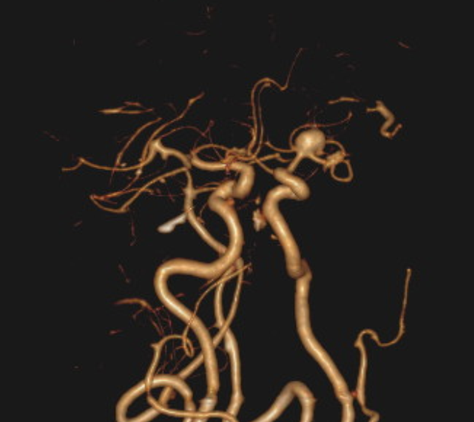
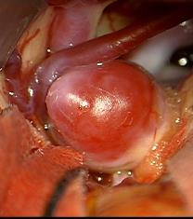
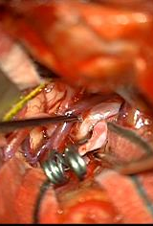

Slide 22
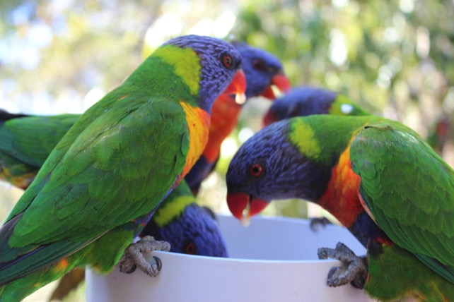

Slide 26
PGY 6 – Chief Residency
Spine / Vascular / Tumor / Functional / Peds
Manage service, operative schedule, resident/medical student education
Organize academic conferences

Slide 27
Operative Experience
Individual cases
PGY 1: Intern, 100-150
PGY 2: Junior resident, 150-200
PGY 3: Junior resident, 200-250
PGY 4: Lab resident, 75-150
PGY 5: New Zealand, 250-350
PGY 6: Chief Resident, 350-500
PGY 7: Enfolded Fellowship, 350-500
Estimated total cases 1475-2100

Slide 28
Call Schedule
PGY 2
In house call 1 in 7 + home backup call 1 in 7 (8 months); in house call 2 in 7 (4 months)
PGY 3
In house call 1 in 7; home backup call 1 in 7
PGY 4
Home backup call
*Strict adherence to 80h work week, 24+4, and required time off between shifts

Slide 29
Fellowship Opportunities
Neuro-oncology
Comprehensive Cancer Center
Neuro critical care
Neuro ICU staffed by fellowship trained physicians
Spine
Complex deformity, minimally invasive, and robotic surgeries
300+ surgeries/year
Functional
Pioneers in FUS
Radiosurgery
One of the busiest Gamma Knife centers in the country
Endovascular
2 dual trained neurosurgeons and 1 NIR
Comprehensive Stroke Center

Slide 30
Academic Conferences
Wednesday mornings, Thursday afternoons
Faculty lecture curriculum
Journal club
Chief-led conferences for upcoming cases
Microsurgical anatomy curriculum (monthly cranial + spine anatomy labs)

Slide 31
Research in the Neurosurgery Department
Dr. Justin Smith / Dr. Chun Po Yen / Dr. Mark Shaffrey
Outcomes from spinal deformity surgery
Dr. Jeff Elias / Dr. Shayan Moosa
MR guided FUS, LITT, pain modeling and interventions, advanced imaging techniques
Dr. Jason Sheehan
GKRS Outcomes of tumors and vascular disorders
Dr. Min Park / Dr. Ryan Kellogg
Endovascular outcomes and large trials
Cerebrovascular basic research laboratory led by Dr. Petr Tvrdik (cav mal and ischemic stroke)
Dr. Heather Spader / Dr. Paul Grabb
Pediatric disorders, Pediatric neurosurgical health care disparities
Drs. Asthagiri / Dr. Michael Catalino / Dr. Mel Mut Askun
Neuro-oncology outcomes, skull base, pituitary, endoscopic skull base, glioma

Slide 32
Collaborative Research Opportunities
Department of Neurosciences
Dr. Javier Provencio (Subarachnoid Hemorrhage)
Dr. Richard Price (Focused Ultrasound)
Department of Neuroanesthesia
Dr. Bhiken Naik
Department of Radiology
Department of Cardiology
Dr. Swapnil Sonkusare (Hypertension and Vascular Medicine)
UVA Graduate School, Biomedical Engineering
NIH

Slide 33
Life in Charlottesville/UVA
Notes:
College town. Lots of great sporting events and national championships in 2021 (Women’s swimming, women’s singles tennis, men’s lacrosse)
Downtown mall – Dining
Shenandoah National Park
Skiing – Snowshoe and Wintergreen Mountain
Mountain Biking
Wineries
Monticello
Annual Round the Rivanna Hiking Challenge

Slide 34
Contact and Follow Us!
Website: https://med.virginia.edu/neurosurgery
Instagram: www.instagram.com/uvansgy
Twitter: https://twitter.com/UVAneurosurg
YouTube: https://www.youtube.com/watch?v=P4m__vW90dU
Program Coordinator: Karen Saulle, kes4a@uvahealth.org Resident Contact: Mariam Ishaque, mi4fp@uvahealth.org

