Slide 1
Introduction to University of Washington Neurological Surgery Residency
DEPARTMENT OF NEUROLOGICAL SURGERY
CNS Virtual Residency Fair
Dr. Ali ravanpay, associate Program director
AUGUST 2, 2023

Slide 2
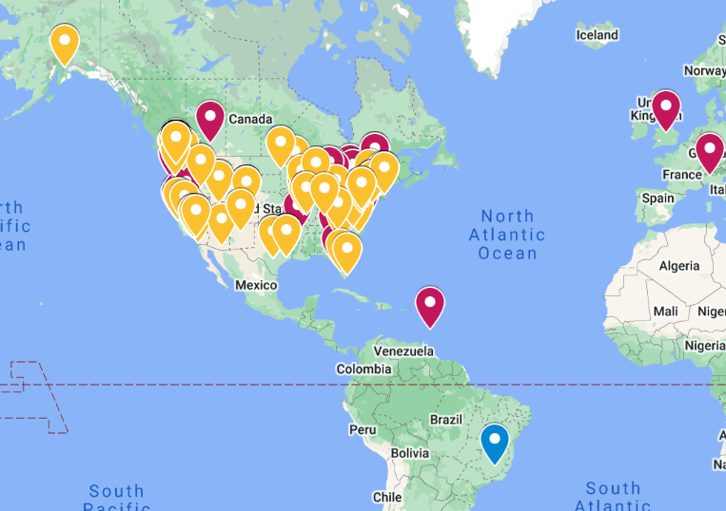
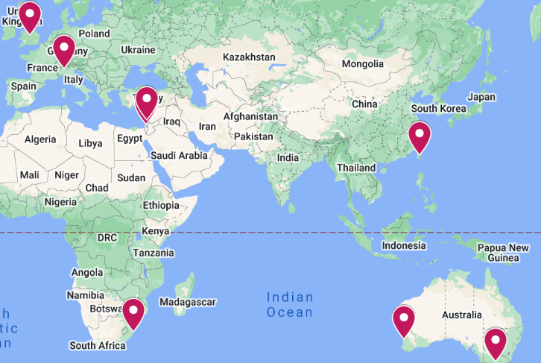
Residency Overview
3-10x more than ACGME required cases across all categories per resident
All residents 2017-2022 have gone on to Fellowship placement and academic appointments
Commitment to diversity in neurosurgery, with more than 2x number of female residents and residents of color compared to national average (ABNS)
("Where Are They Now" Residency Program Webpage, 2022)

Slide 3
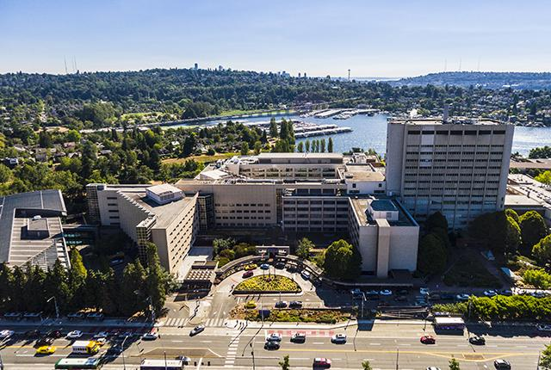
Where Our Residents Work
UW Dept. of Neurological Surgery has over 20,000 sq ft of dedicated laboratory research and office space.
All NS residents rotate at:
Harborview Medical Center
~6k trauma admissions per year; one of the highest-volume centers in US (only Level 1 Trauma Hospital in WA, WY, AK, MT, ID)
University of Washington Medical Center (Montlake Campus and NW Campus)
Seattle Children’s Hospital (8 months)
Seattle VA (4 months)
UWMC

Slide 4
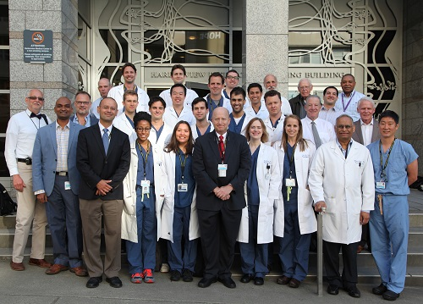
Faculty and Research
Our department has 26 neurosurgeons and 15 neuroscientists
6 Faculty/Resident research groups
Faculty devoted to NS Resident research
Senior Advisor for Research Education
Vice Chair of Research
$40 mil. in research support
36 Resident PubMed articles and 2 chapters
145 Faculty PubMed articles and 3 chapters
NIH R25 Training Grant
>50 Patents and innovations in NS

Slide 5
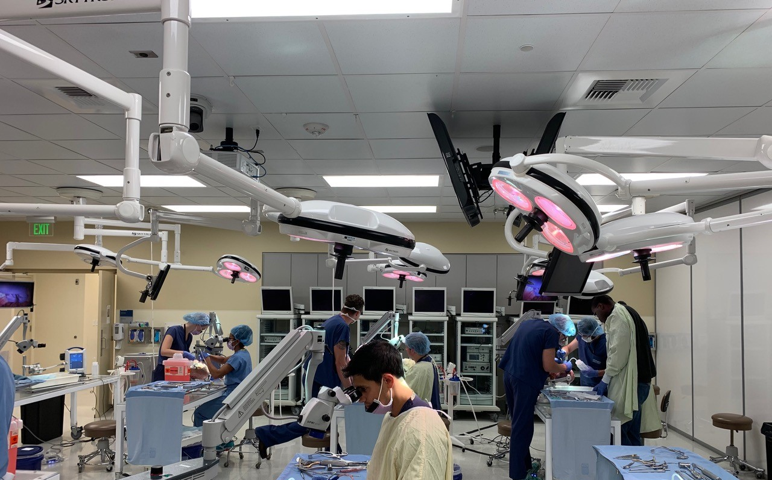
Cultivating Resident Success
Weekly didactic sessions and case conferences
WISH Courses (dissection surgical techniques)
Mock Oral Boards Semi-Annually
End of Rotation Evaluation Meetings
Research Meetings and protected research time
Resident and Faculty clinical mentorship
Professional development funds for meetings and conferences

Slide 6
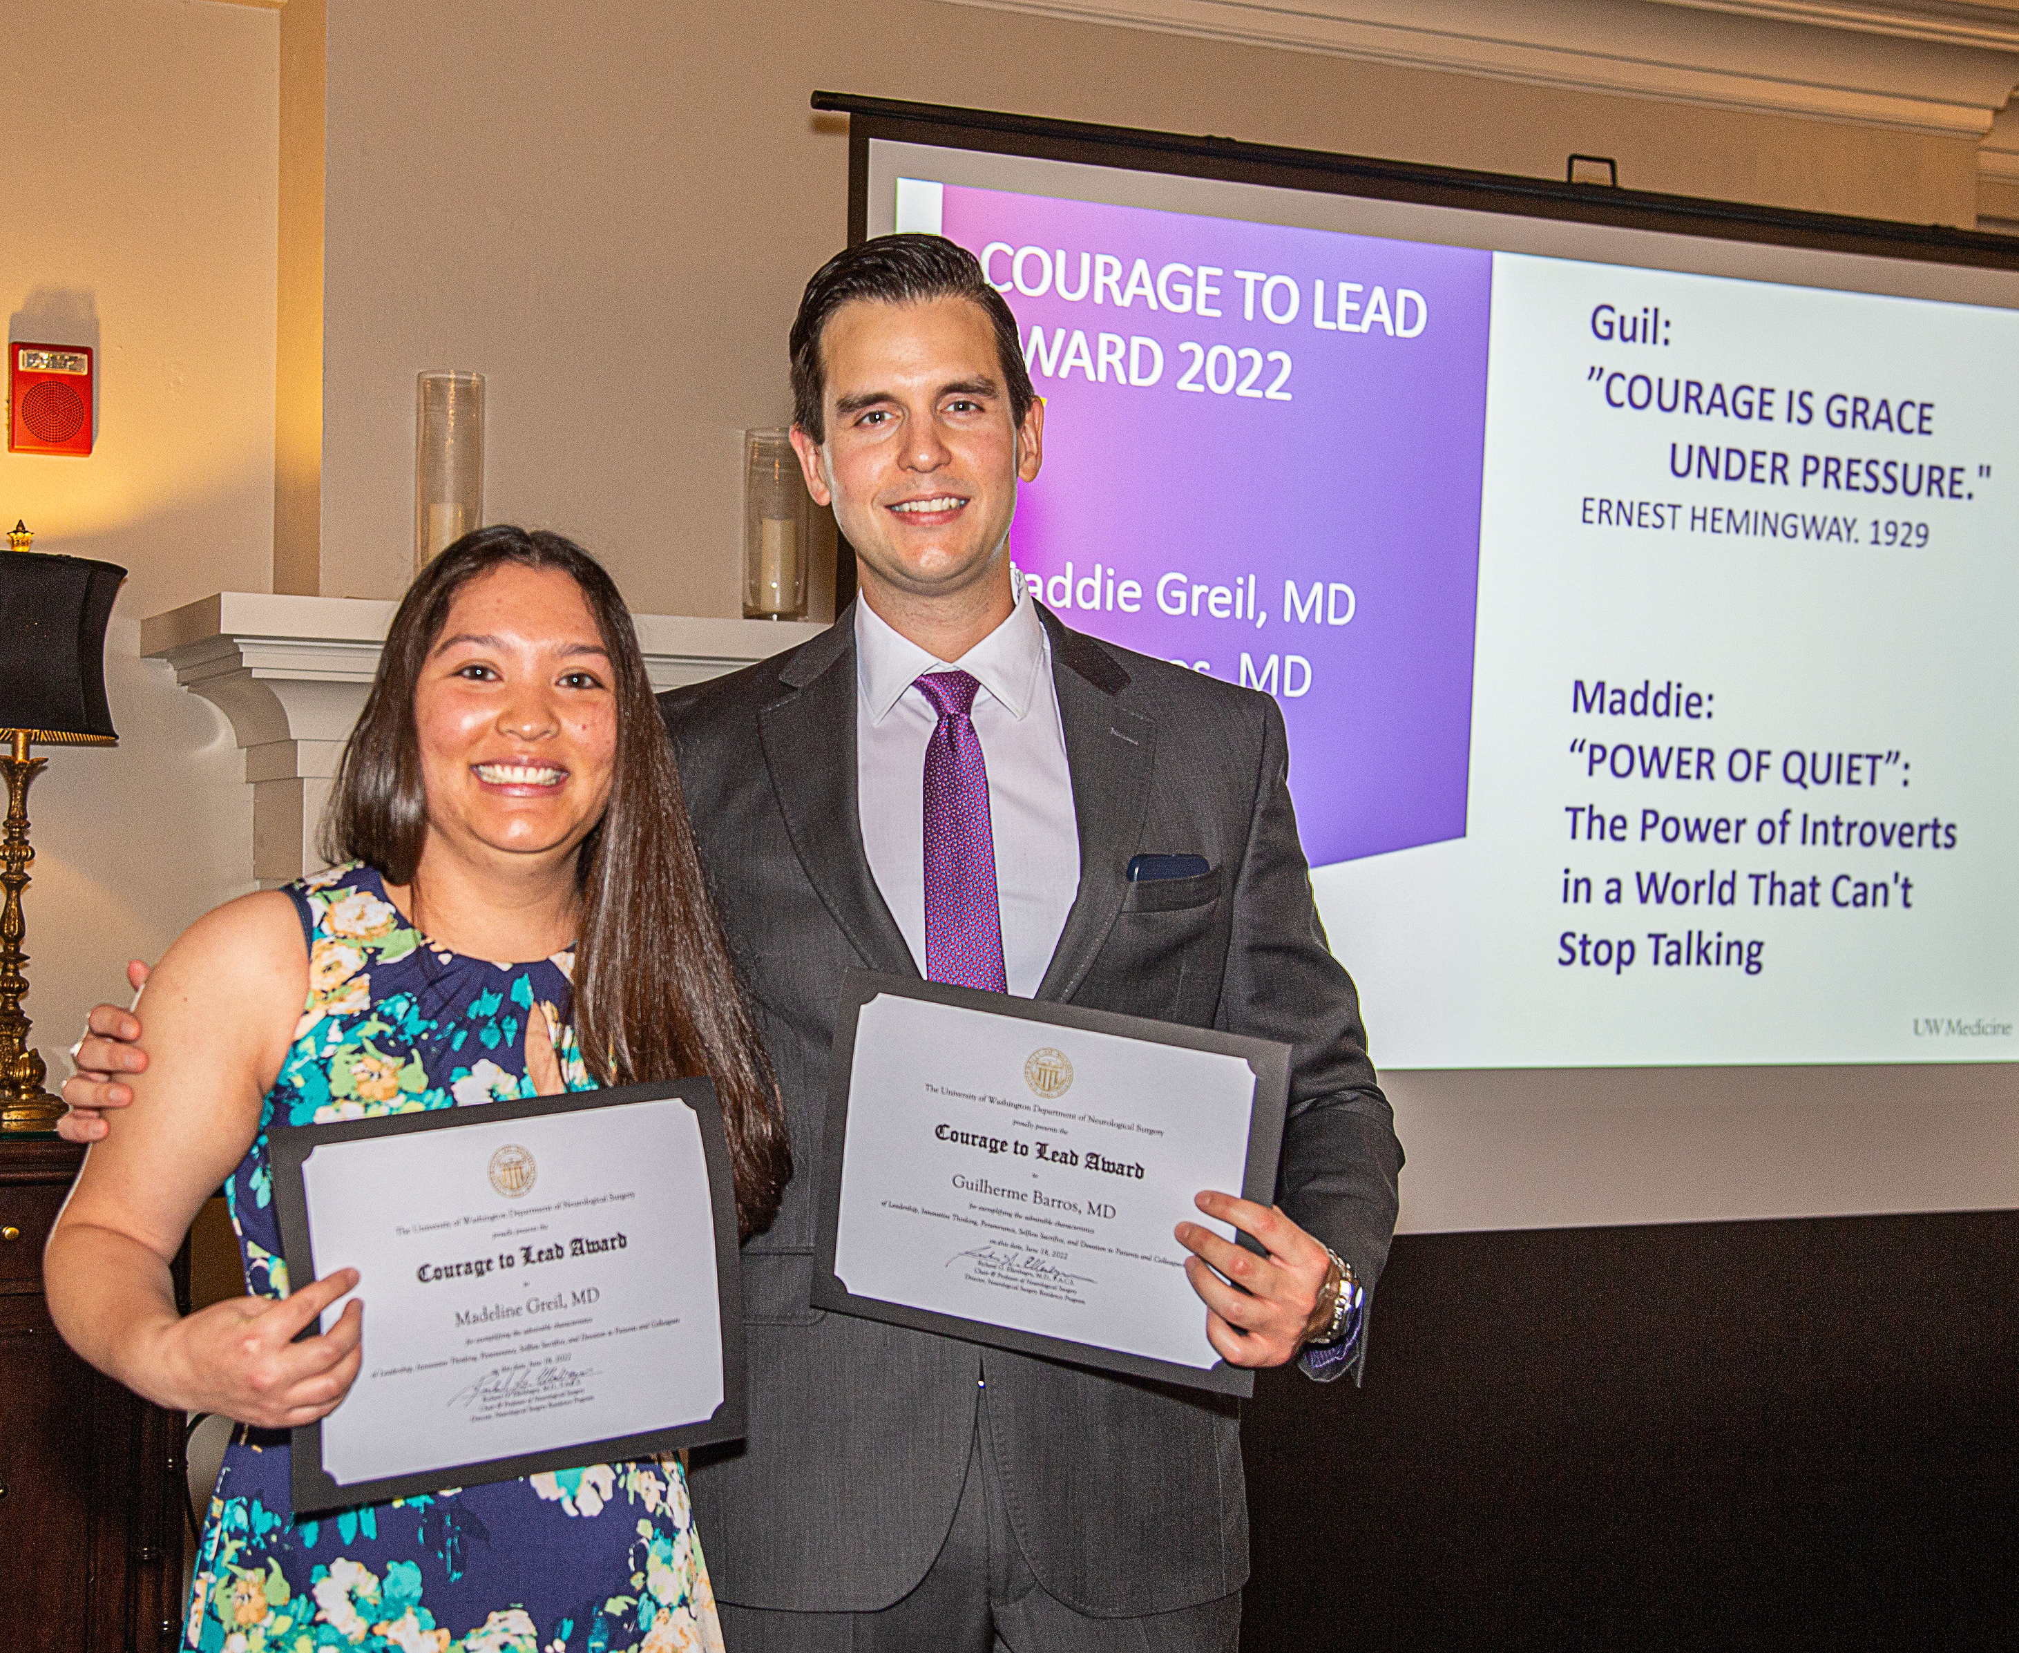
Cultivating Resident Success
Strong, centralized GME Office with 4 wellness counselors
UW consistently rated 5/5 on Campus Pride Index and Human Rights Campaign Foundation has awarded its LGBTQ Healthcare Equality Leader designation to UW Medicine's four hospitals
Annual Wellness Meetings with Program Director

Slide 7
Resident Benefits
July 2023 Stipend: $72,564.00 with annual increases
Role is unionized
Benefits include:
Excellent healthcare
4 weeks of paid vacation
Retirement plan matching
Unlimited transit pass
Home call stipend
Childcare fund
Meal credits
Professional development funds
Professional liability coverage
And much more

Slide 8
Resident Quotes
“We pride ourselves in a high-volume operative training program with extensive opportunities for clinical and basic science research. Every aspect of neurosurgery has a solid representation within our department, and your academic interests will certainly be fostered during your time here.”
"Based at a high volume, complex pathology, quaternary referral center, and under unparalleled mentorship from a diverse, world renown multidisciplinary faculty, the University of Washington/Harborview Medical Center neurosurgical residency program is committed to producing precision trained academic neurosurgeons both technically and scientifically."
"We had a good comradery and this tone was set at the top."

Slide 9
Living in Seattle
Seattle is well-known for its strong coffee culture, culinary prowess, historic markets, outstanding outdoor recreation, dog-friendliness, professional sports teams, and maritime presence
27-mile paved bike path--much of it along the 200 miles of Seattle shoreline
400 city parks with gardens, sports fields, water access, and off-leash dog areas
Large number of events and cultural group gatherings
Convenient domestic and international travel options through airport hub and WA ferry system

Slide 10
Staying Connected
YouTube: https://www.youtube.com/user/UWNeurosurgery
Department Twitter: https://twitter.com/uwneurosurgery?lang=en
Residency Twitter: https://twitter.com/uw_nsg_res
Residency Website: https://neurosurgery.uw.edu/education/residency-program
For questions about our residency program, please contact Residency Program Coordinator Megan Osika-Dass at resns@uw.edu.
For specific questions for Dr. Ali Ravanpay, please email ravanpay@uw.edu.

