Slide 1



University of Texas Health San Antonio
2023 CNS VIRTUAL RESIDENCY FAIR

Slide 2

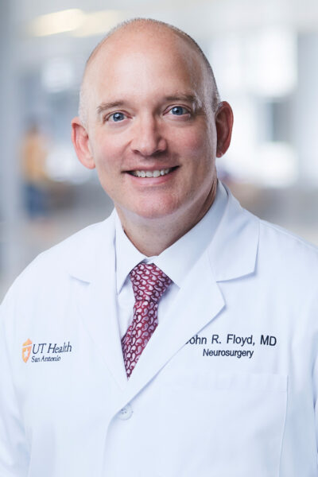
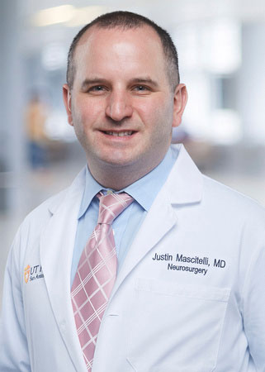
Program personnel
John Floyd, MD, FAANS - Chair
Justin Mascitelli, MD, FAANS – Program Director

Slide 3
Program personnel
Core Faculty (9)
  Fadi Al-Saiegh, MD
  Lee Birnbaum, MD, MS
  John Floyd, MD, FAANS
  Cristian Gragnaniello, MD, PhD
  Justin Mascitelli, MD, FAANS
  Michael McGinity, MD
  Fassil Mesfin, MD, PhD
  Alexander Papanastassiou, MD
  Izabela Tarasiewicz, MD
Adjunct Faculty
  Grant Mallory, MD (SAMMC, VA)
  Ryan McDermott, MD (SAMMC, UT)
  Ian McDougall (SAMMC)
  Ryan Morton, MD (SAMMC)
  Frank Fichtel, MD (private)
SAMMC Faculty
  Jason Hall, MD
  Grant Mallory, MD
  Ryan McDermott, MD
  Ian McDougall
  Ryan Morton, MD
  Victor Sabourin, MD
Neuroscience Intensive Care Unit
  Kevin Chen, MD
  Paola Martinez, MD
  Ali Seifi, MD

Slide 4
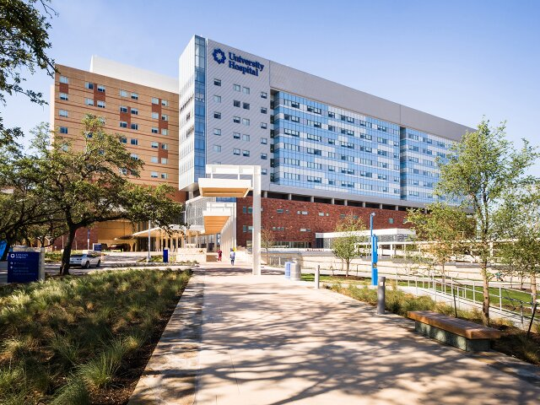
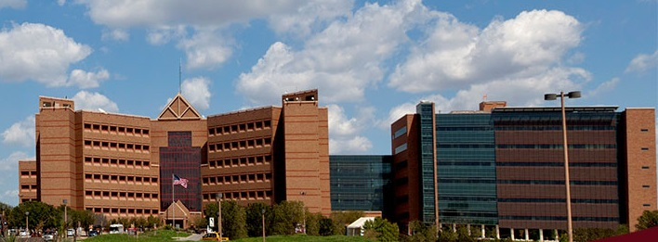
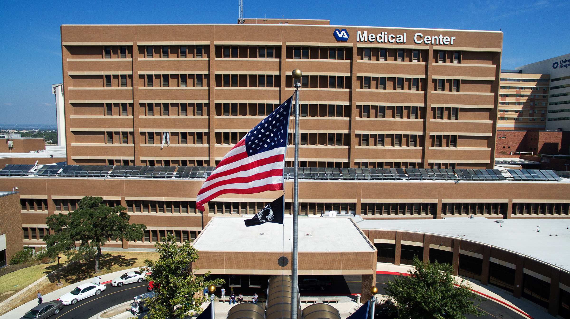
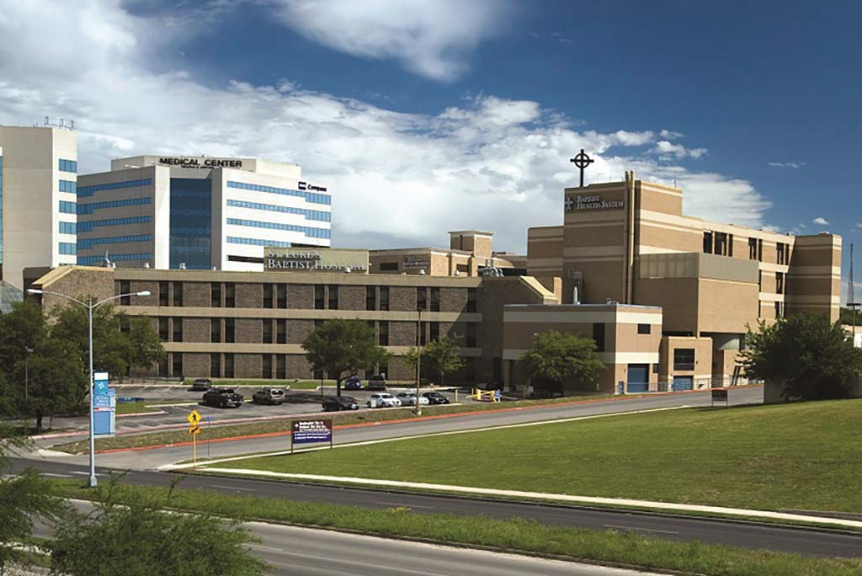
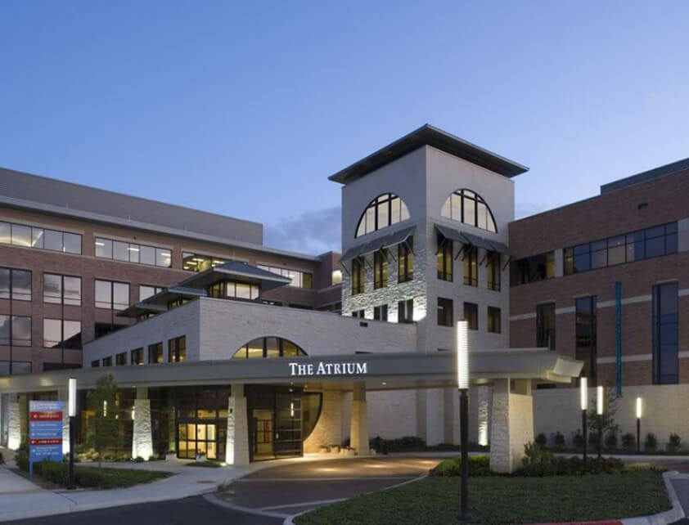
Training sites
San Antonio Military Medical Center
University Hospital
”Flagship”
North Central Baptist
Hospital
St. Luke’s
Baptist Hospital
South Texas VA

Slide 5
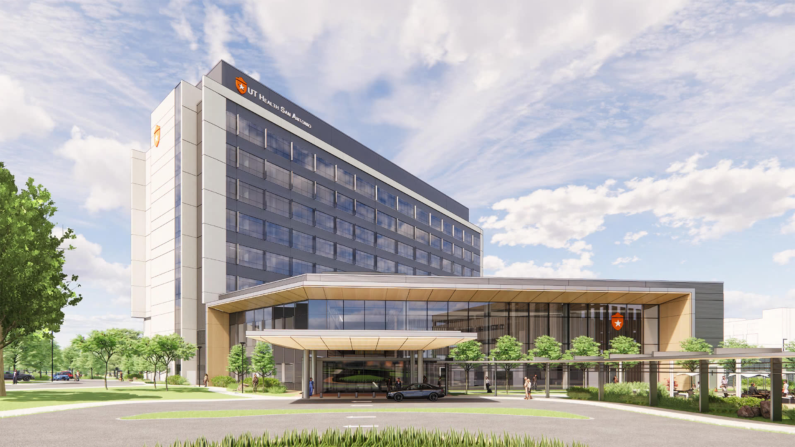
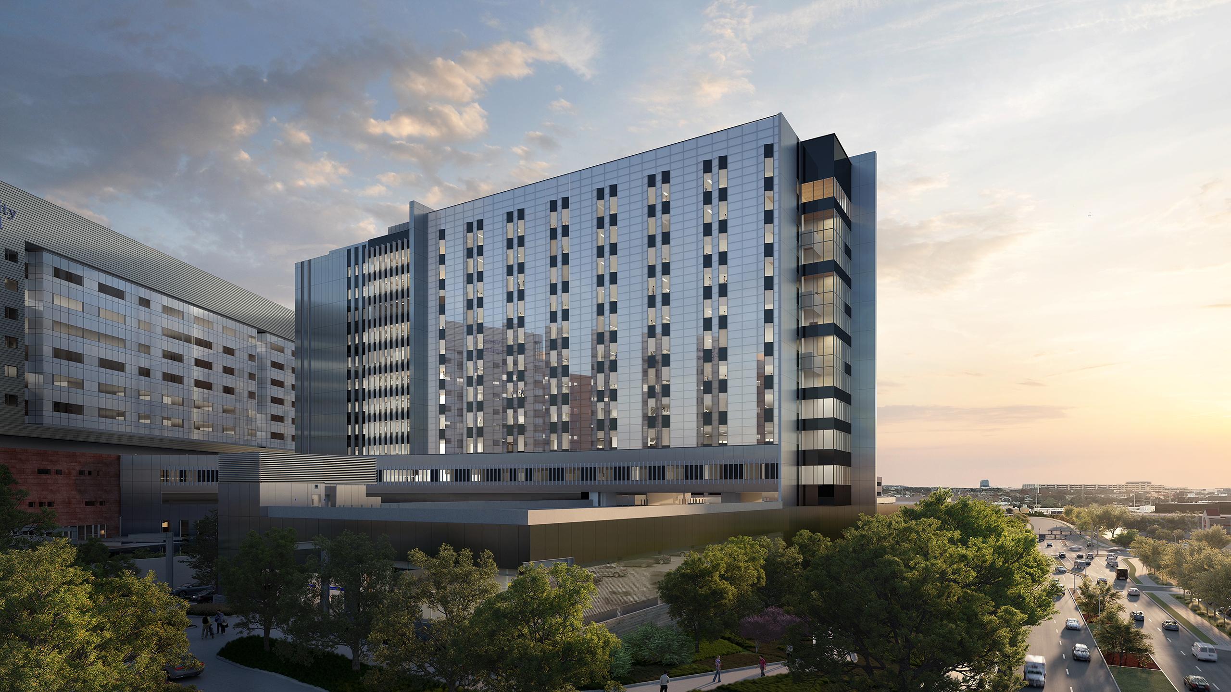
Coming soon!
UT Health San Antonio
Multispecialty and Research Hospital
Scheduled for 2024 opening
University Hospital
Women’s and Children’s Tower
Scheduled for 2023 opening

Slide 6
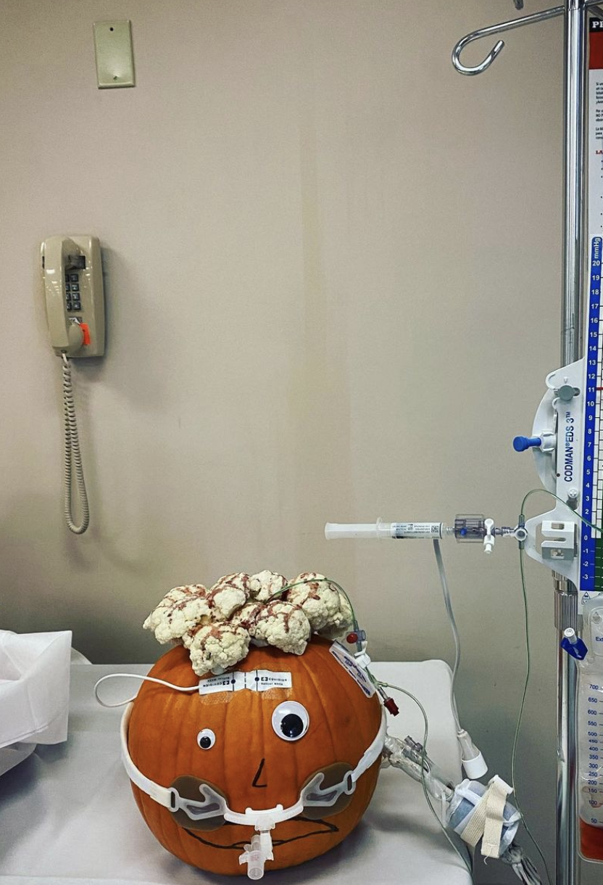
Approx. Annual Case volume
UHS: 2000
Baptist Hospital System: 1000
VA: 400
SAMMC: 1000

Slide 7
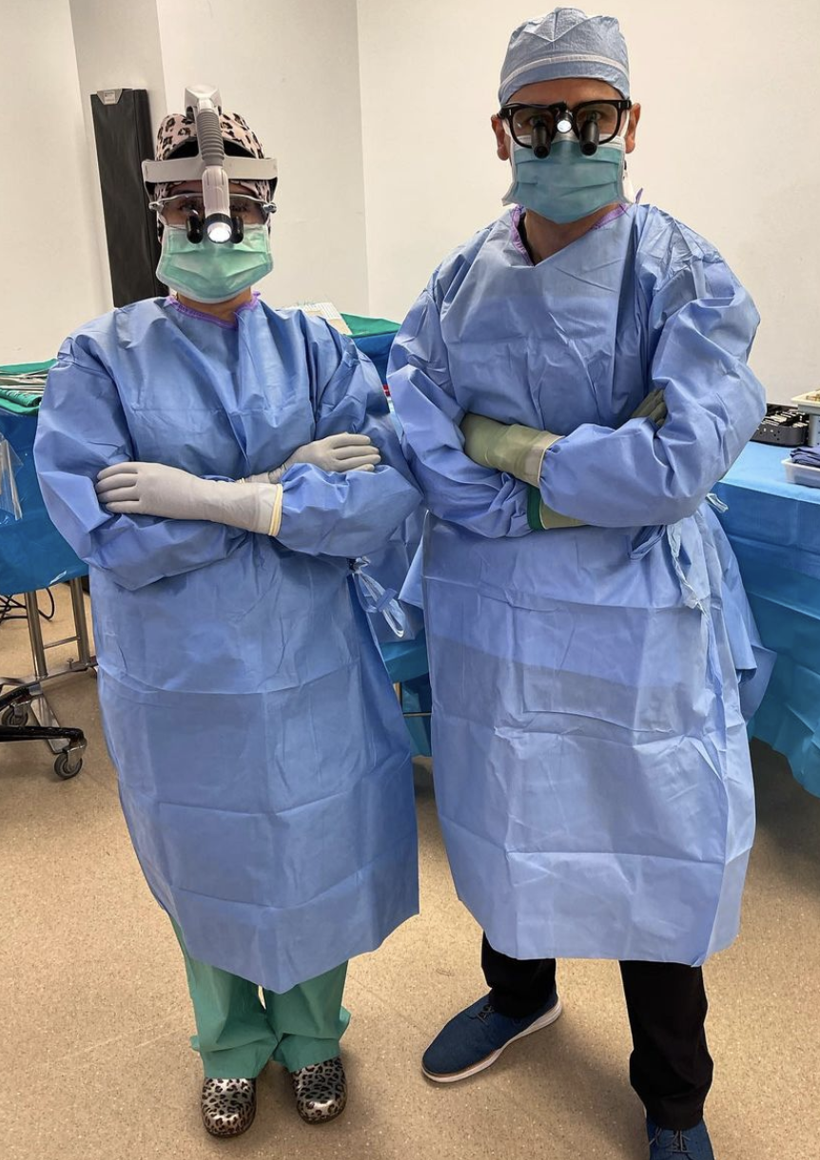
Residency overview
17 Residents
  1-2 per year
  +/- 1 military-sponsored resident
CAST Accredited Neurocritical Care Fellowship
  ~2 spots
New CNS Endovascular Fellowship
PGY-5: dedicated research year
Multi-center midlevel practitioner support

Slide 8
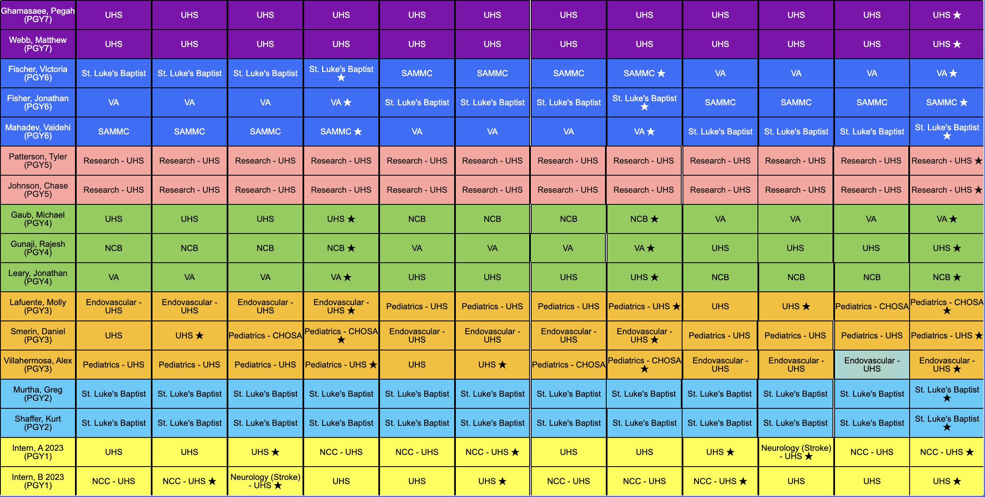
2023-2024 Block Schedule

Slide 9

Life in san antonio
1.48 million people (2023)
Metroplex: ~2.5 million
Average 1-bedroom rental: $1044
  Austin: $1565
  Denver: $1661
  Miami: $2950
  NYC: $3450

Slide 10



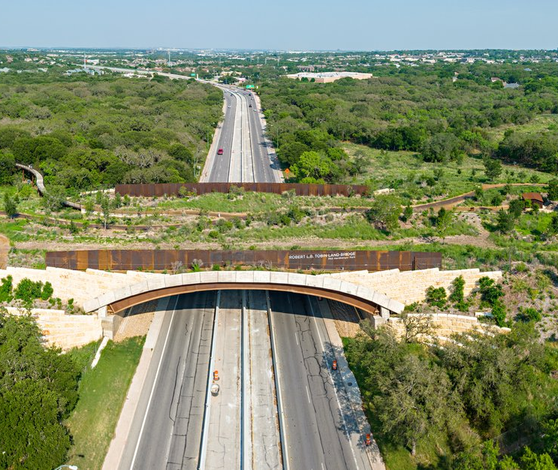

Come join our program, and see for yourself!

Slide 11


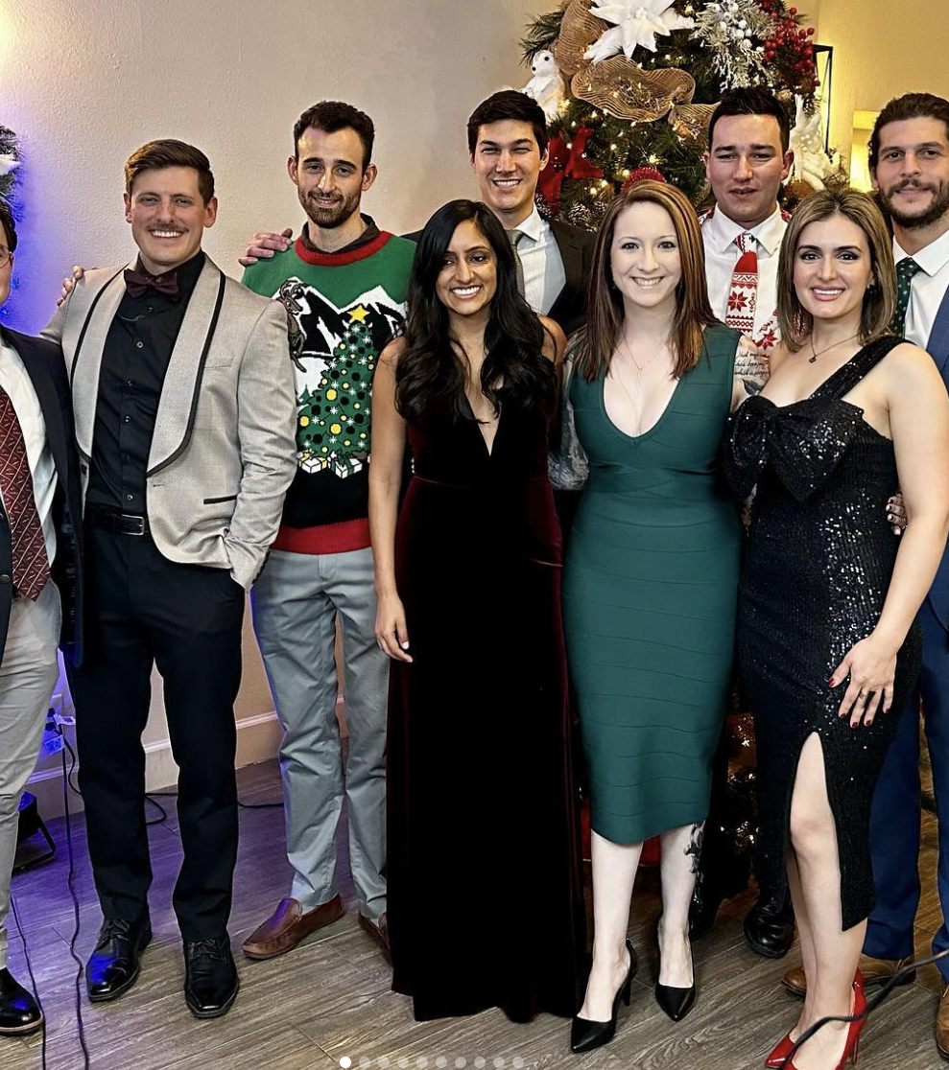
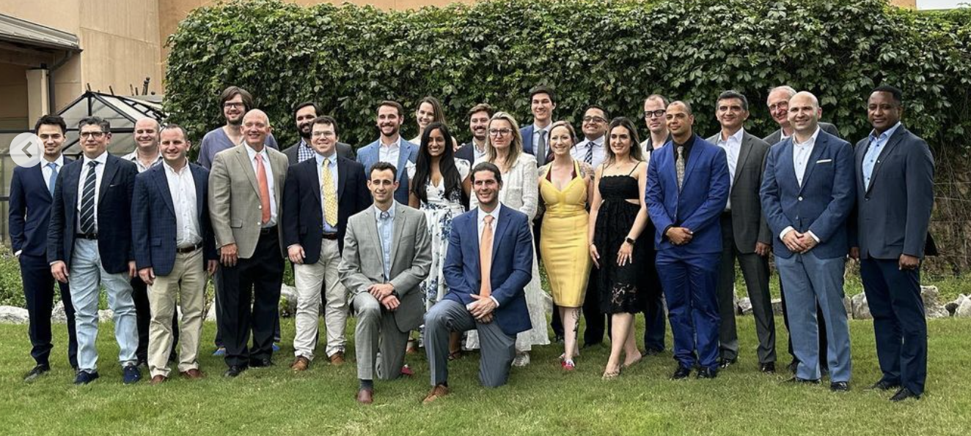
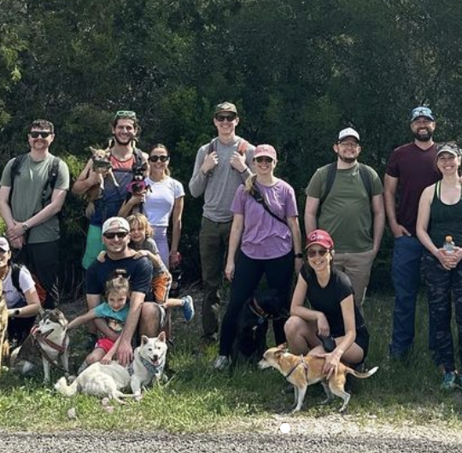
Thank you!!
Questions?

