Slide 1
BNI Neurosurgery Residency Program
CNS Virtual Residency Fair
Zar Zavala, PGY-5 Neurosurgery Resident
baltazar.zavala2@barrowneurosurgery.org
Joelle Hartke, PGY-5 Neurosurgery Resident
joelle.hartke@barrowneurosurgery.org
August 3, 2023

Slide 2
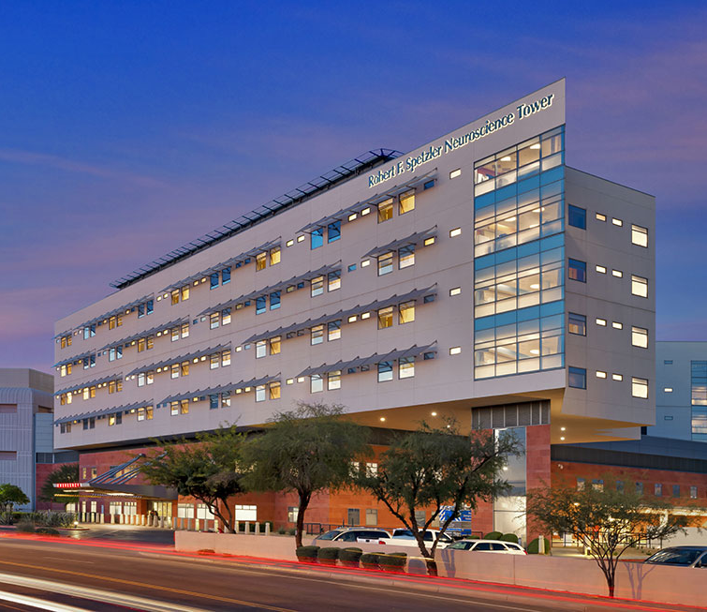
Welcome to the BNI!

Slide 3
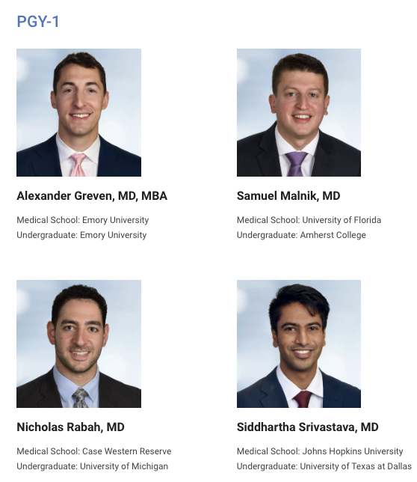
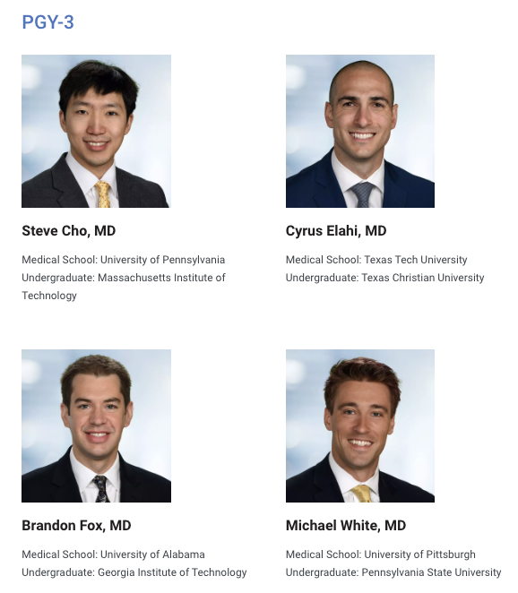
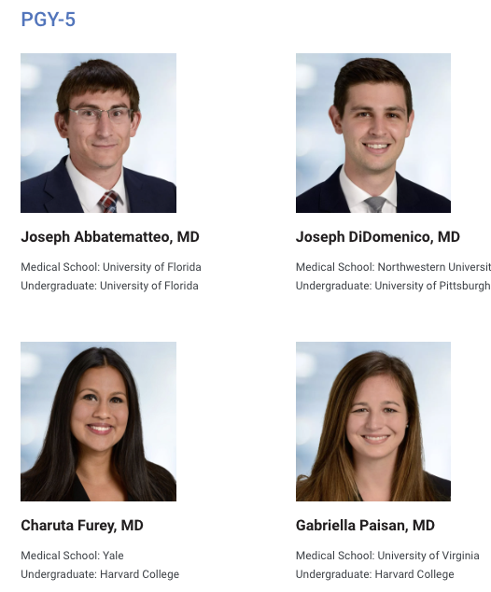
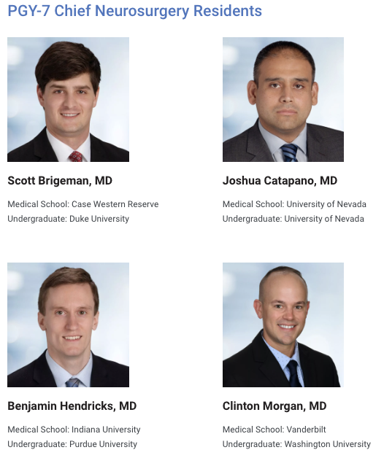
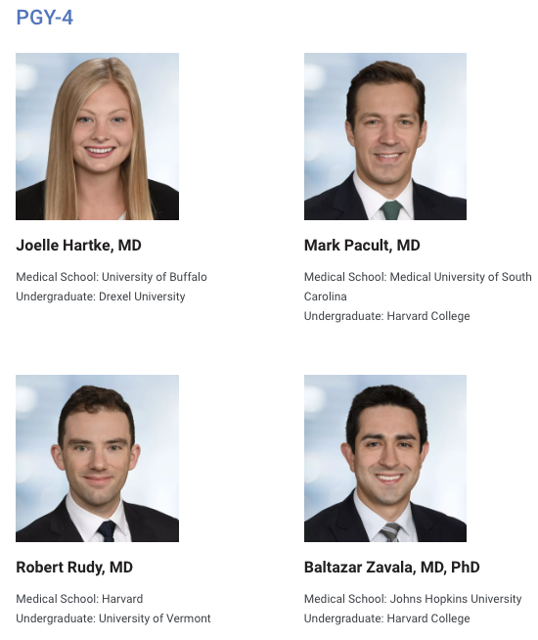
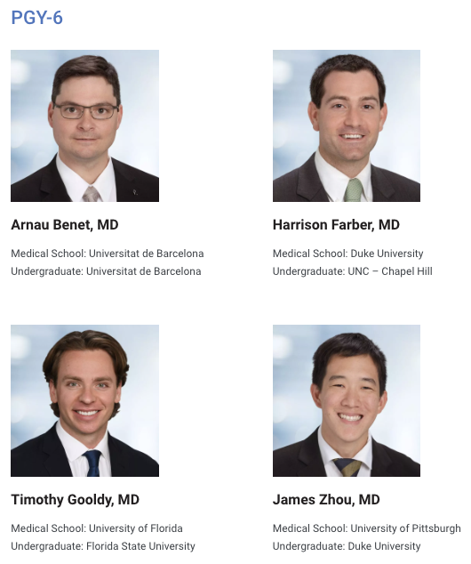
BNI Neurosurgery Residents

Slide 4
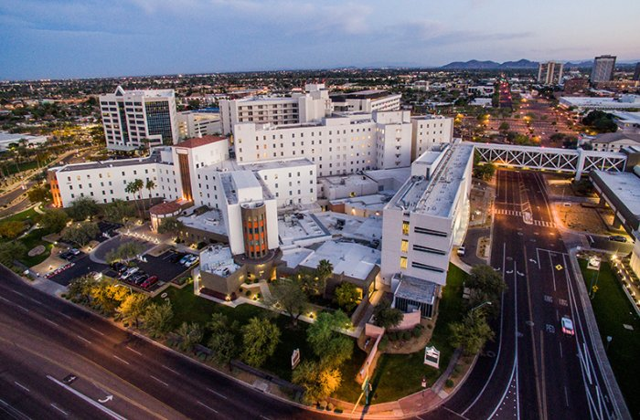
General Overview
7-year training program
4 residents per year
18 months off-service
Fully paid & call protected
All training at the BNI except for:
3 months at Phoenix Children’s Hospital (PGY3 Pediatrics Rotation)

Slide 5
BNI Ethos: Produce World Class Neurosurgeons
Goals of training at the BNI:
Surgical excellence
Clinical and operative independence
Junior Residency (PGY 1-2)
Operating starting on day one: building the surgical foundation
All ICU rounding, primary call responsibilities, neurosurgical emergencies
Senior Residency (PGY 3-6)
Call-protected OR time
Proficiency in all general neurosurgery operative techniques
Senior ‘back up’ call at night
18 months of paid, call-protected elective time to pursue your interests
Chief Residency (PGY 7)
Master complex operative techniques
Round with junior residents

Slide 6
Facilities & Resources
Spetzler Neuroscience Tower, Barrow Neuroplex & Ivy Brain Tumor Center

Slide 7
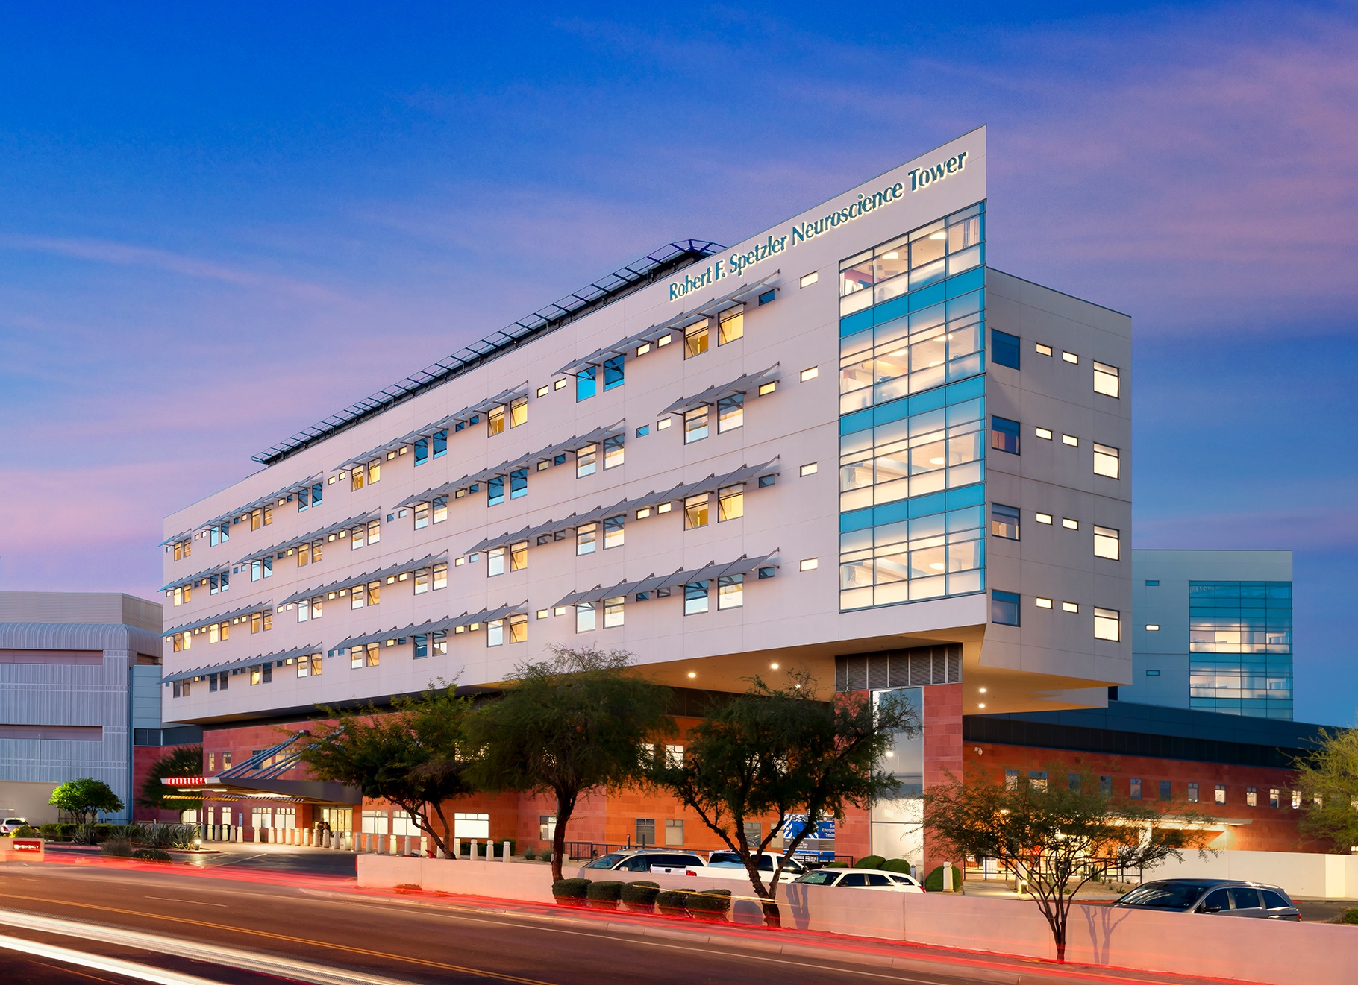
The Robert F. Spetzler Neuroscience Tower
Largest, state-of-the-art neurosurgical facility
11 dedicated neurosurgery operating rooms
3T intraoperative MRI
64 Neuro-ICU beds
112 neuroscience floor beds
176 bed dedicated neuroscience hospital

Slide 8
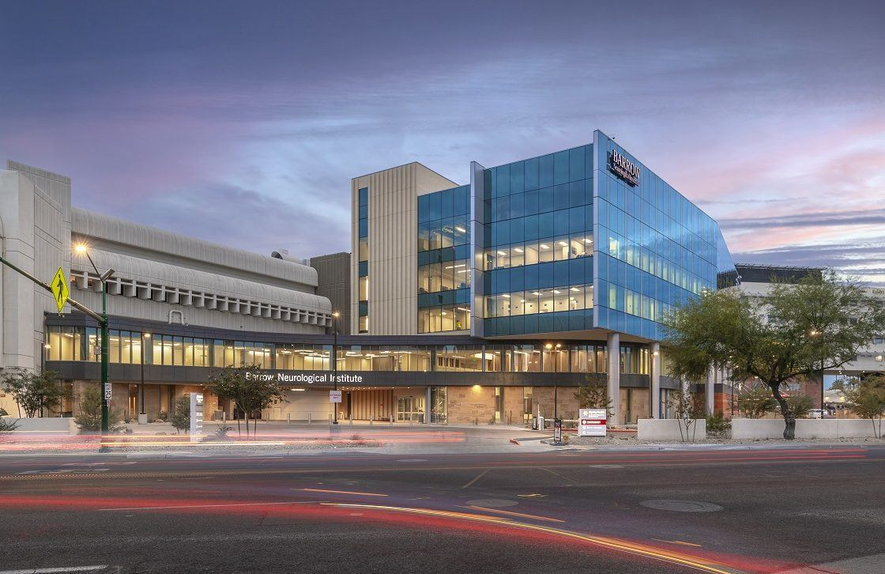
Barrow Neuroplex
5-story building with a multidisciplinary clinic space, new office space, as well as an ambulatory surgery center
New, centralized space for outpatient clinics, office areas, as well as the Barrow Innovation Center and other centers for excellence at the BNI

Slide 9
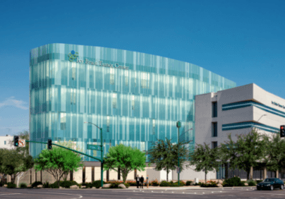
Ivy Brain Tumor Center
75,000-square-foot headquarters for the Ivy Brain Tumor Center
Five-story building that will be the largest translational research center dedicated to brain tumor drug development in the world
11 clinical trials in the last three years

Slide 10
BNI Financial Standing & Funding
Equipment:
OR: Standard Loupes, ALA-Loupes, Lead, Latest Zeiss KINEVO 900 and CONVIVO Microscopes, stealth stations and dedicated stealth staff
Personal laptops & dedicated office space for each resident
Research:
Generous funding for projects through the Barrow Innovation Center, Barrow Neurological Foundation Grants, & Ivy Foundation
Trips:
Funding for meetings, courses, international missions & social events (e.g., NYC Softball & Rim-to-Rim)
Mid-level providers (NPs / PAs)
Ancillary staff (BNI Neuro-publications Department, EVD staff)

Slide 11
Detailed curriculum
Schedule breakdown by post-graduate year

Slide 12
PGY-1: Internship
6 months of neurosurgery
24-hour call shifts
When not on call, in the OR (DBS, shunts, biopsies, pumps, simple spine)
3 months of endovascular neurosurgery (no call)
6 weeks of neurology (no call)
6 weeks of critical care (no call)
Intern bootcamp in July of PGY-1
Junior bootcamp at the end of PGY-1
Weekend Rounding Assist (~12 total weekends)
During Neurology and Critical Care rotations
Round on part of the ICU and a portion of weekend floor beds

Slide 13
PGY-2: Junior Residency
Time split between operating and primary call
Busiest year for call: five, 24-hour junior calls per month
ICU critical care, ER consults, trauma bay, floor coverage, everything runs by you
~150-200 bedside procedures: e.g. EVDs, subdural drains, halos
Complex neurocritical care becomes second nature
300-350 OR Cases
VP Shunts, Laminectomies, ACDFs, Subdural hematomas & trauma cranis, Cranioplasties, DBS
Independently: shunts, subdurals, DBS placements

Slide 14
PGY-3: Beginning Senior Residency
3 months Chairman vascular service (Dr. Lawton)
3 months Pediatric Service (Phoenix Children’s Hospital)
3 months Tumor Service (Dr. Sanai)
3 months General Service
Operating Independently:
ACDFs, Laminectomies, Posterior Cervical / Lumbar Fusions
Senior call (5 senior calls per month except when on pediatrics)

Slide 15
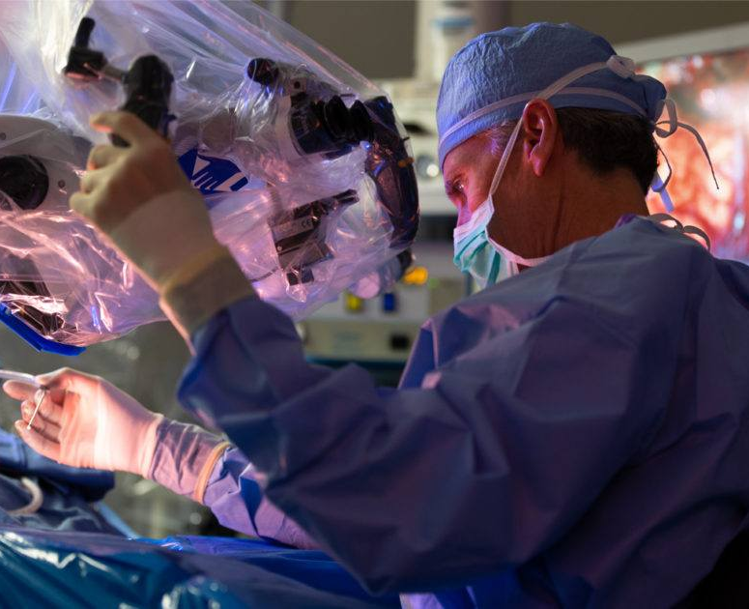
PGY-3: Chairman Service
Full responsible for the clinical life of ‘The Boss’
Manage complex vascular ICU and floor patients with junior residents and NPs
Lead and run film review & teaching rounds
Run outpatient clinic
Manage all phone call and patient inquiries
Work daily with Dr. Lawton, chief resident and vascular fellow

Slide 16
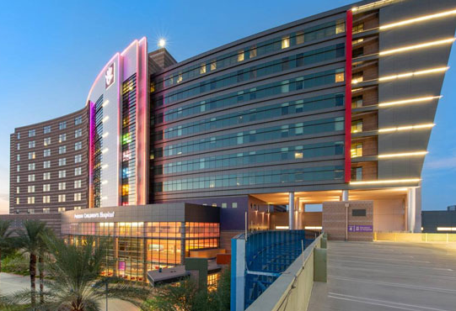
PGY-3: Pediatrics Service
Three months at Phoenix Children’s Hospital
10 minutes away from the BNI
Great operative experience
Bristol (tumor, trauma, cranial remodeling)
Ronecker (tumor, trauma, general spine)
Shafron (general, spasticity)
McClendon (scoliosis, general spine)
ICU rounding in the morning
NPs responsible for floor rounding, managing inpatient census and seeing clinic patients
Home call for PCH only (no BNI call responsibilities)

Slide 17
PGY-3: Tumor Service
Three months with Dr. Nader Sanai
Running his clinic as well as multi-disciplinary tumor board
Attending Ivy Center lab and trial meetings with Dr. Sanai
By the end of the rotation, be able to take out basic intra-axial gliomas and metastases independently and perform workhorse cranial tumor approaches (pterional, interhemispheric)

Slide 18
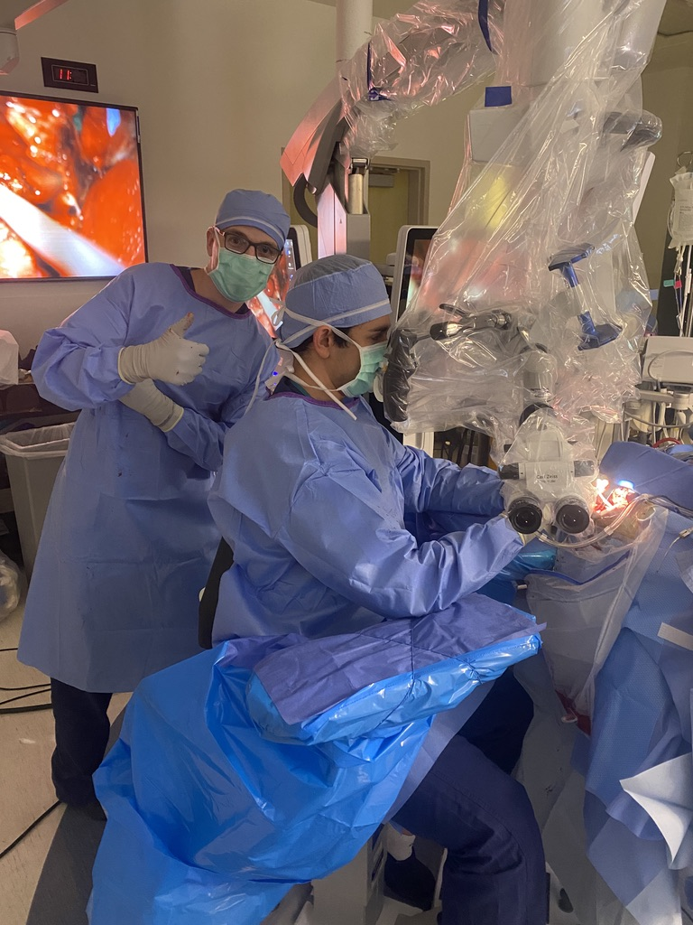
PGY-4: Complex Spine & Cranial
9 months of general neurosurgery
3 months of complex deformity spine
Dr. Kakarla or Dr. Turner
Operative every day when on service
300+ cases
3 senior calls/month
3-4 weekends off each month
Independently able to perform cervical, thoracic, and lumbar fusions of all types as well as intra- and extra-axial tumors

Slide 19
PGY-5
6 months on-service & 6 months off-service
On-service time: Pick complex operative cases behind the chiefs
Skull base tumors
EC-IC bypass
Carotid endarterectomy
Complex spinal deformity correction
Spinal tumors
Off-service
To be used at your discretion for electives, enfolded fellowships or research
Senior call responsibilities: 12 over the entire year (average 1 per month)

Slide 20
Elective Time: PGY-5 & PGY-6
18 months of elective time
Paid
Full benefits
No call responsibilities
The BNI does not have an archetypal resident: we want you to pursue your goals and build your own career
Common uses of elective time:
Research electives
Enfolded clinical fellowships
MBA, Masters, Socioeconomic fellowships

Slide 21
Enfolded clinical fellowships at BNI
Endovascular fellowship (Dr. Albuquerque, Dr. Ducruet, Dr. Jadhav)
Adult deformity correction (Dr. Kakarla, Dr. Turner, Dr. Uribe)
Minimally Invasive Spine (Dr. Uribe, Dr. Snyder, Dr. Turner)
Endoscopy and Skull Base (Dr. Little)
MIS Scottsdale (Dr. Tumialan)
DBS and Functional (Dr. Ponce)
Tumor and Epilepsy (Dr. Smith, Dr. Sanai)

Slide 22
Enfolded fellowships at other institutions
Endovascular fellowship (Buffalo, Florida)
Skull Base Surgery (Brigham, Australia, Colorado, Ohio State)
MIS Spine (San Diego, Chicago)
Adult deformity correction (Miami, San Diego, Seattle, Philadelphia)
Functional (Toronto)
Neuro-oncology (MD Anderson)
Epilepsy (Cleveland Clinic, Yale)
Peripheral nerve (Mayo)
Neuro-otology (House)
Radiosurgery (Sweden)
Medical missions (Nicaragua, Tanzania, Peru)

Slide 23
Research Electives
Glioma molecular biology & trials (Ivy Brain Tumor Center - Sanai)
AVM genetics and animal models (Hashimoto & Oh)
Spine biomechanics lab (Turner)
Vascular physiology and stroke (Ducruet & Jadhav)
Skull base anatomy lab – state-of-the-art facility with numerous courses
Barrow Innovation Center
3D Printing / Prototyping Laboratory
Barrow Global
Spinal cord perfusion and injury
Neuroimaging (PET, fMRI, SPECT, DTI)

Slide 24
Chief Residency
Primary responsibility: to become a world-class neurosurgeon
Hone clinical decision making
Choosing surgical approaches
Knowing when to / when not to operate
Perform and master the most complex operative cases on a daily basis
Clinical duties:
Operate
See post-operative patients
Round every morning with the juniors in the ICU

Slide 25
Fellows
Fellows pick after the chief residents
Operative fellows:
Lawton fellow (1; open vascular and skull base)
Uribe fellows (2; MIS spine and deformity)
Endovascular fellows (2)
Sanai tumor fellow (1; starting 2023)
Fellows are an asset to the program

Slide 26
Call at the BNI
Call is not simply something to be dreaded or endured
Learning value in making acute neurosurgical decisions for complex patients
Clinical care and decision making rather than ‘scut’ work
Every junior resident emerges with the ability to medically manage the sickest neurosurgical patients in any hospital

Slide 27
Call Expectations at BNI
Junior call (Interns & PGY-2s in 24-hour shifts)
Primary person for all acute clinical care on the neurosurgery service, including consults, traumas, ICU neuro changes, & transfers
All bedside procedures, including EVDs, subdural drains, & halos
Average: 15-30 consults per call
Senior call (PGY 3-5 in 24-hour shifts)
Regular operating day without interruption from OR cases
Assist junior resident with complex management issues as needed
Responsible for all operative cases during the night
Next day (post call day) is completely off
Chief call (PGY-7)
Back up for in-house senior resident

Slide 28
You are not cheap labor.
You are a neurosurgeon.
Primary responsibility: operate and manage neurosurgical issues
Communicate directly with consulting attending physicians
Medically manage ICU patients with critical care team
You are responsible for neurosurgical care, not menial tasks
i.e. lines, transport, prepping patients for procedures are not your responsibility
Army of Incredible Nurse Practitioners
Round on all floor patients during the week, split floor rounds on the weekends

Slide 29
Ancillary Staff
PCTs and nurses prepare your procedures in the ICU
EVDs, ICP wires, etc
BNI data suggest this is more efficient and safer (Fusco et al.)
Central lines, a-lines, intubations, perc trachs and bronchoscopies will be performed during critical care and trauma rotations, otherwise these are performed by other services at your request
Wand / neuronavigation staff (full-time)
One-on-one first name basis interactions with consulting physicians
Dedicated BNI Neuropublications Office & Editorial Staff

Slide 30
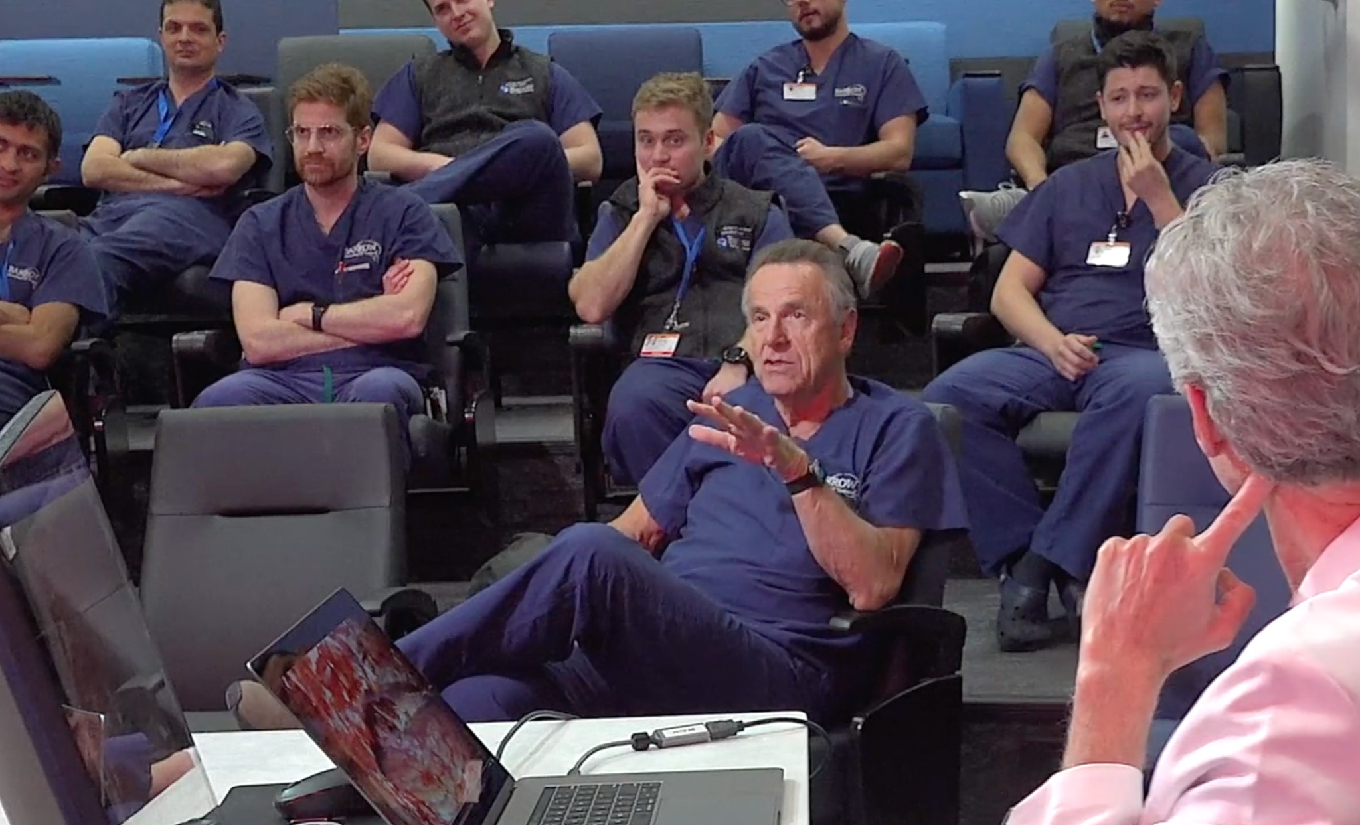
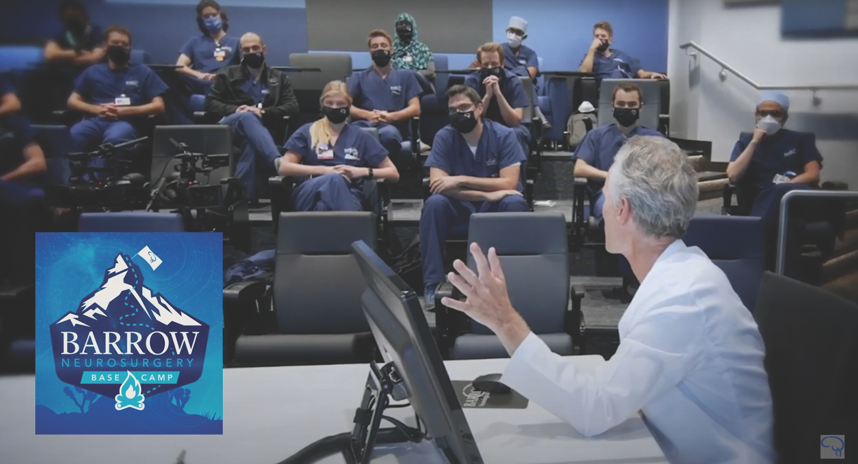
Teaching Rounds
Daily teaching and film rounds
Vascular rounds with Dr. Lawton on Mondays, Tuesdays & Thursdays
MIS and deformity spine rounds with Dr. Uribe on Wednesdays
Complex deformity spine rounds with Dr. Kakarla on Fridays
Academic protection for Friday grand rounds and clinical conference as well as Wednesday morning board review conference

Slide 31
BNI Events & Life in Phoenix

Slide 32
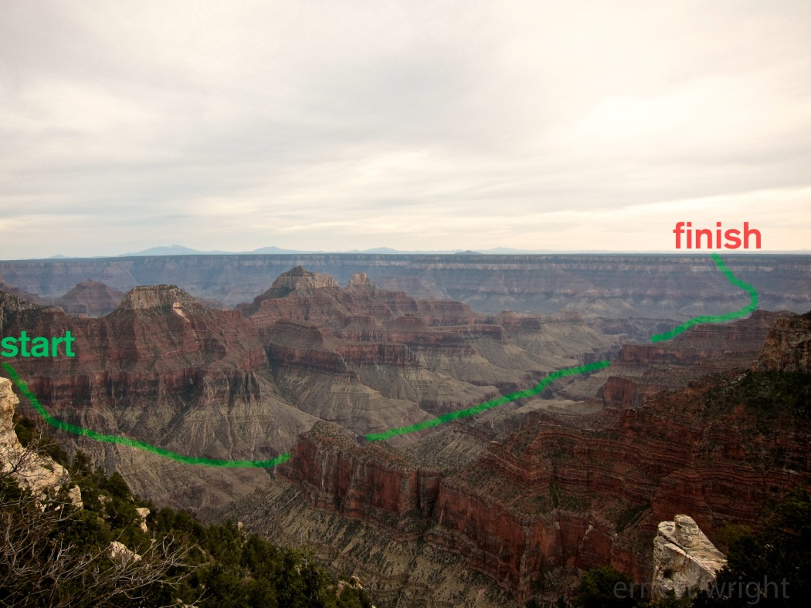
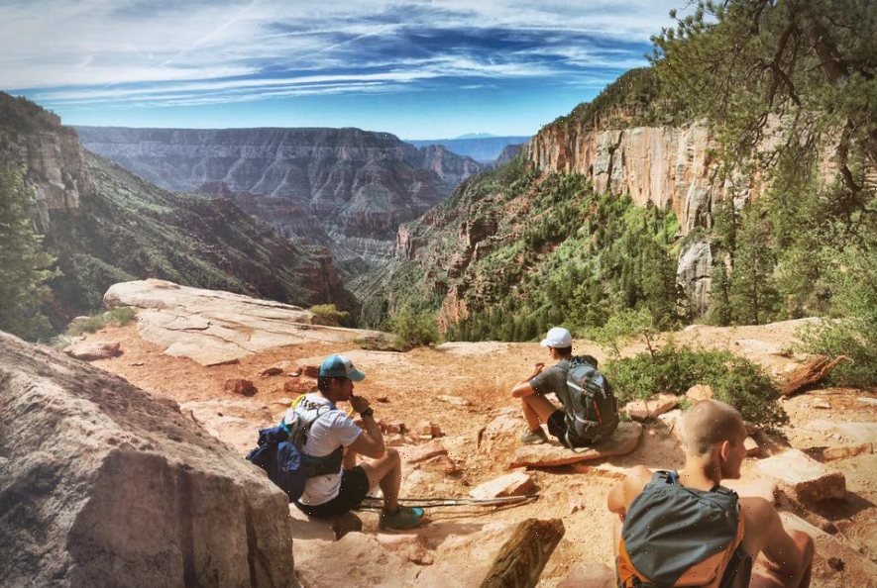
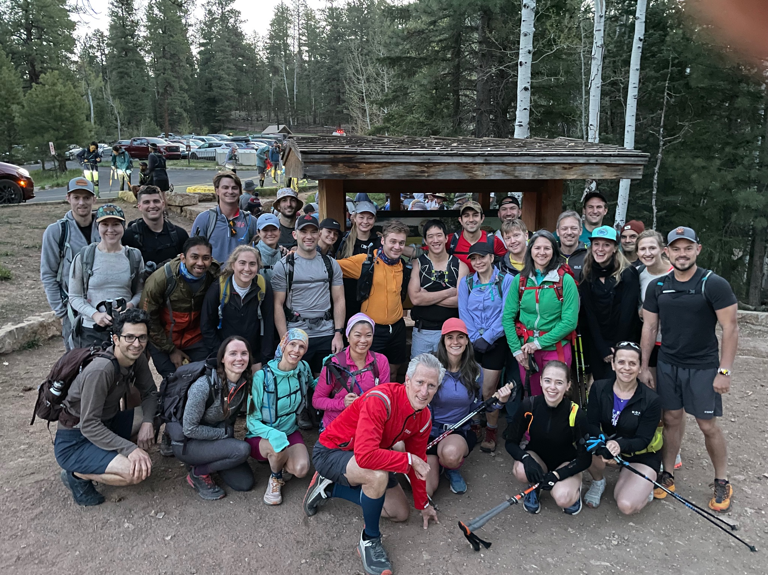
Rim to Rim: The Grand Canyon

Slide 33
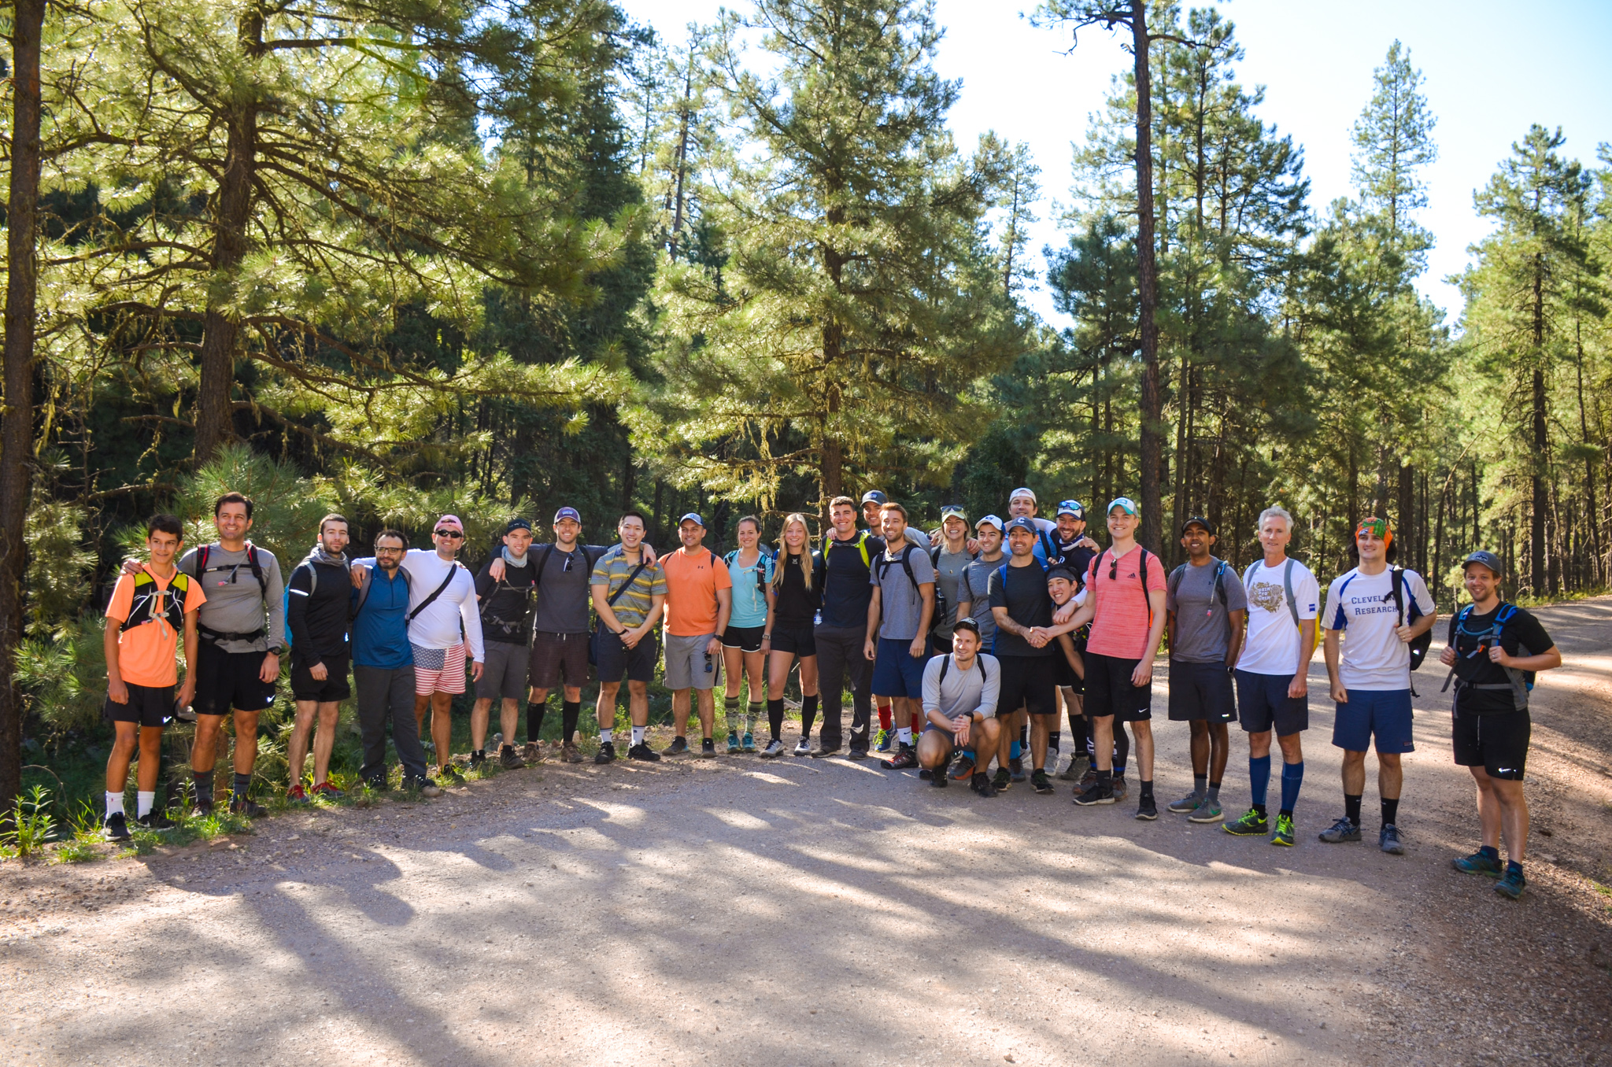
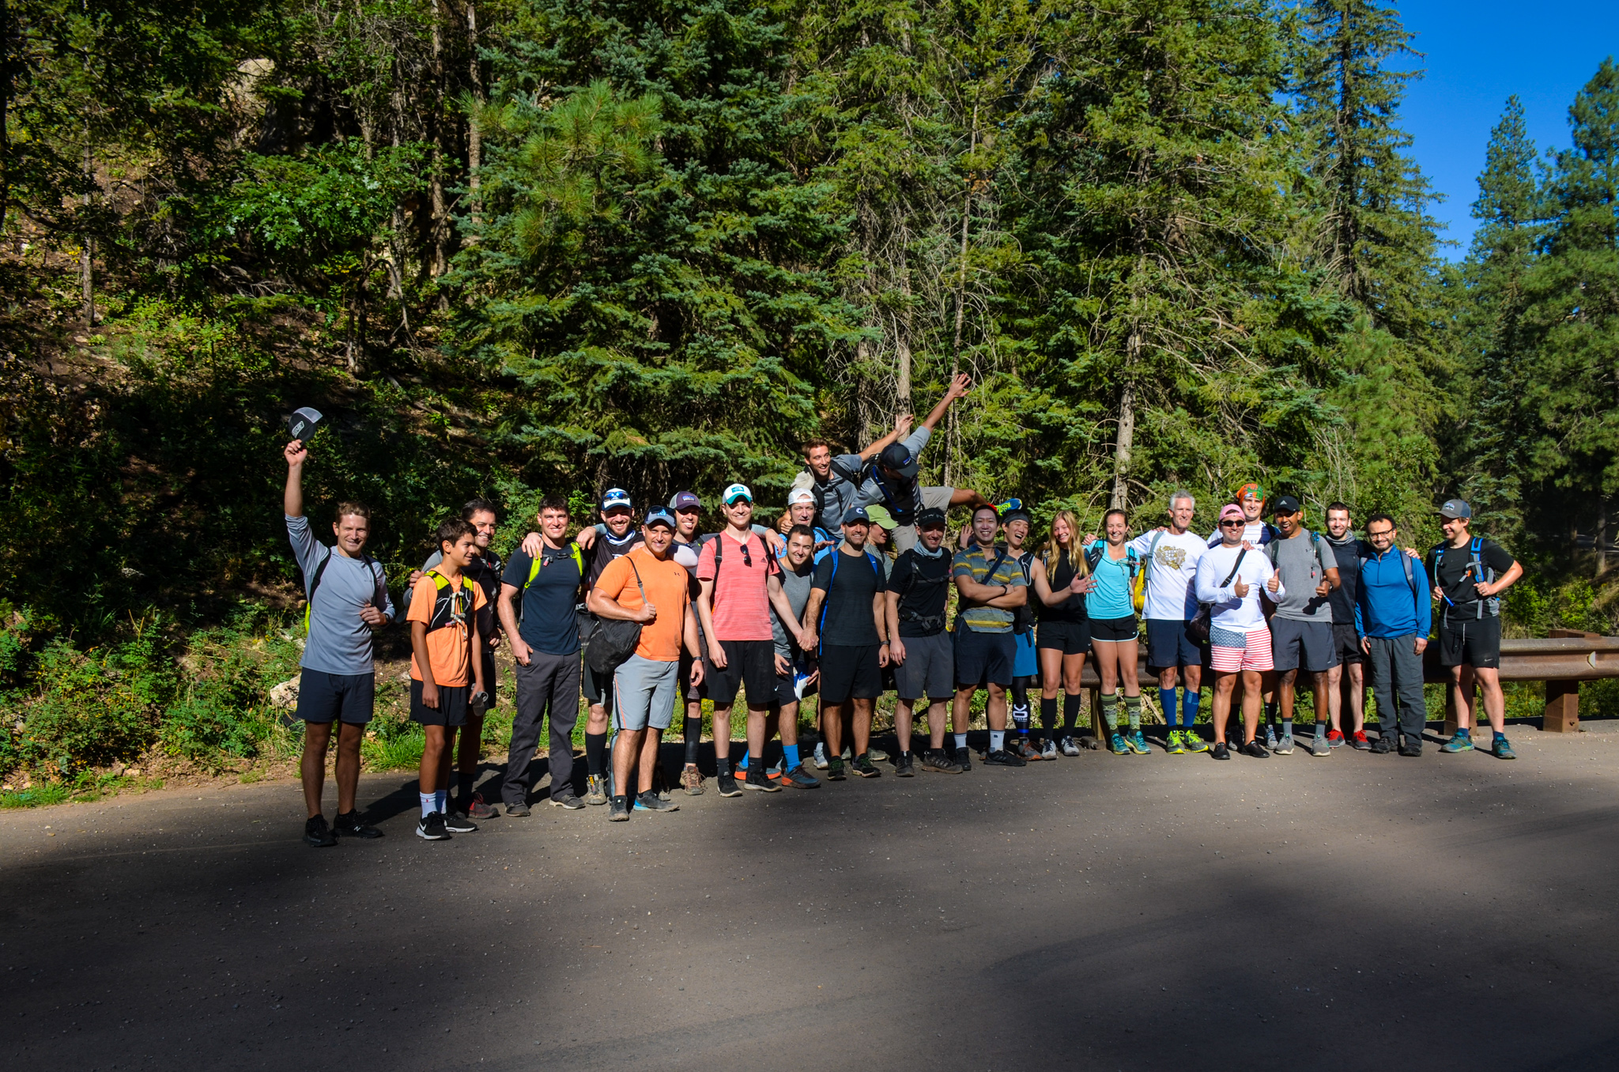
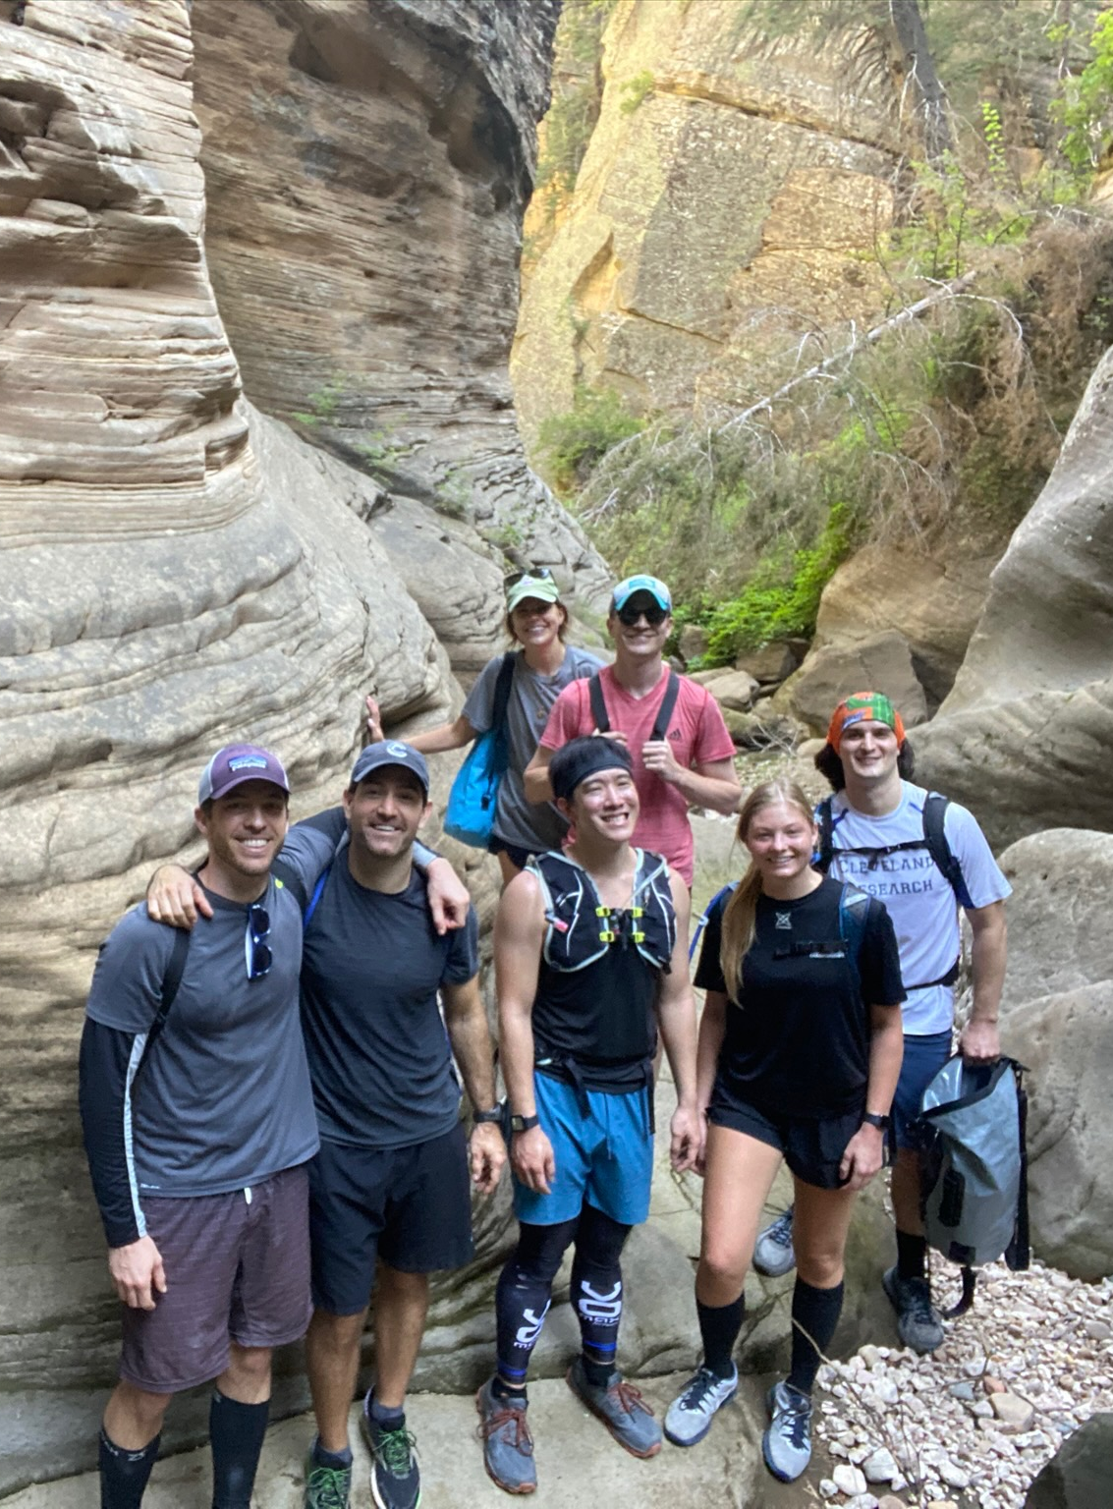
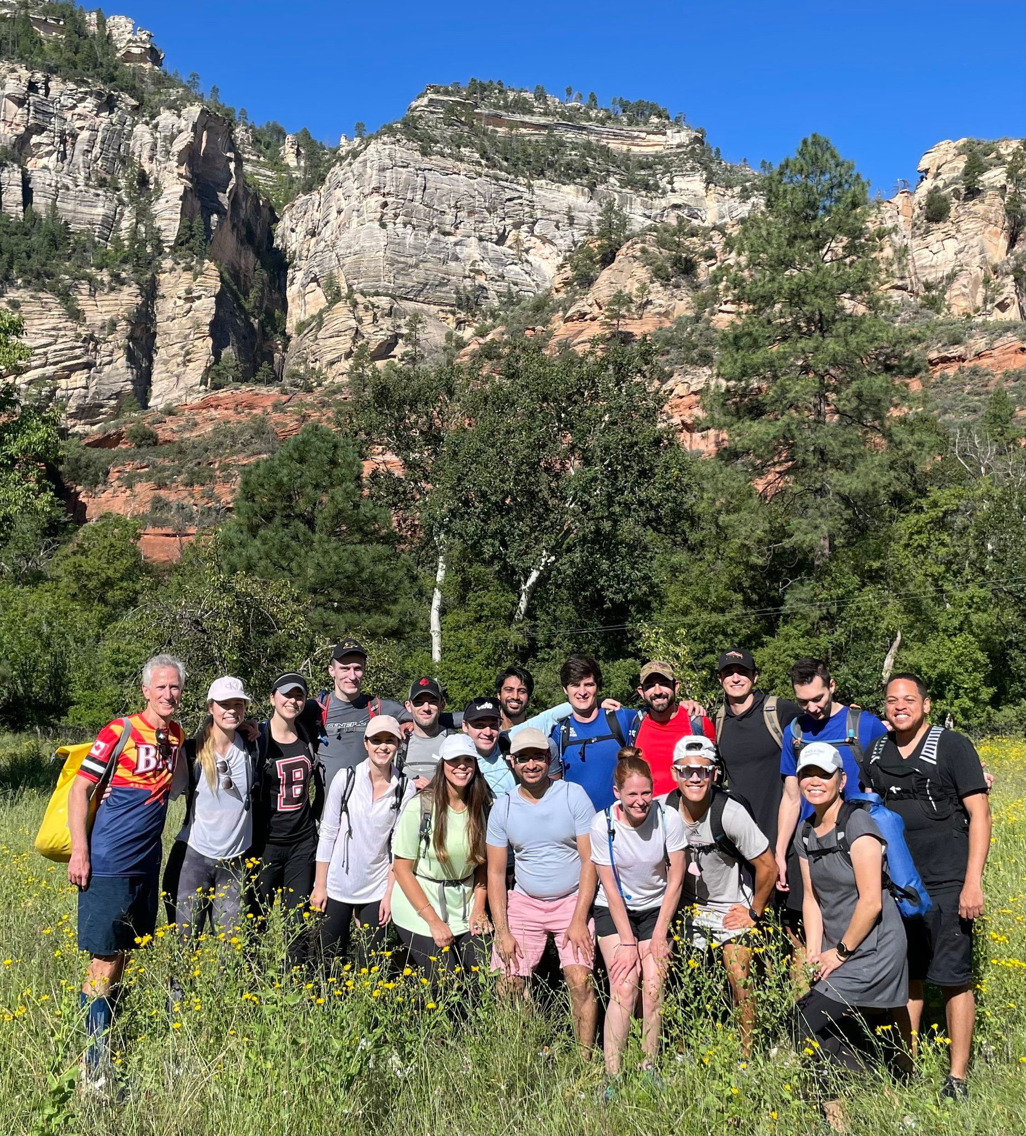
Hike from Hell: Sedona, AZ

Slide 34
Barrow Boat Day

Slide 35
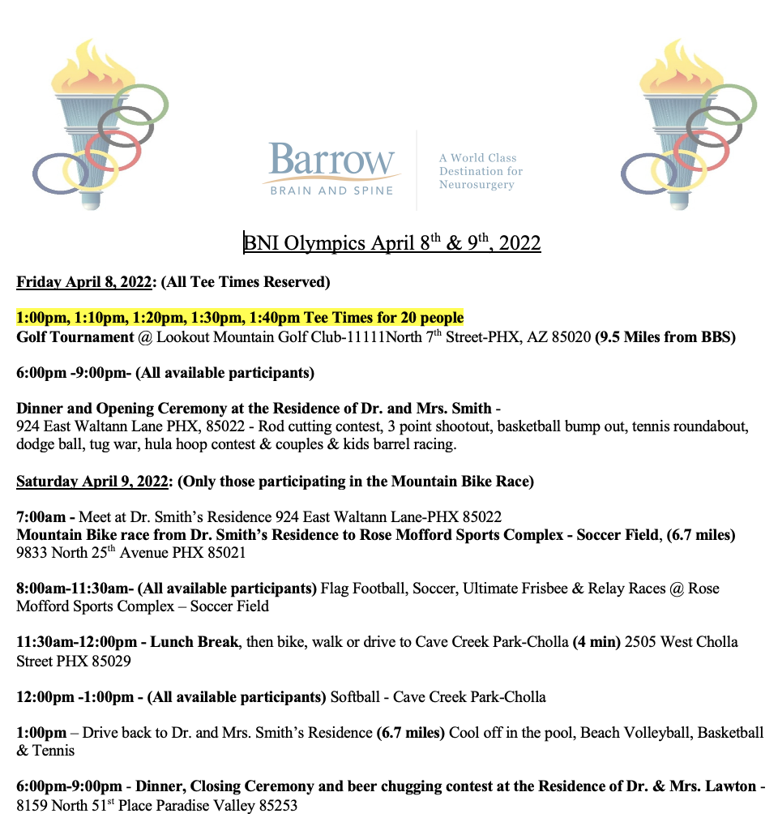
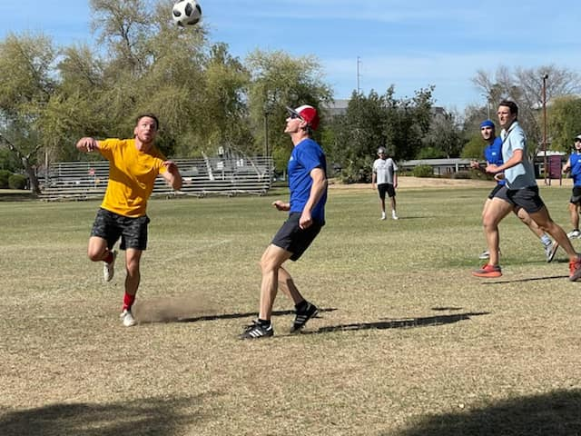
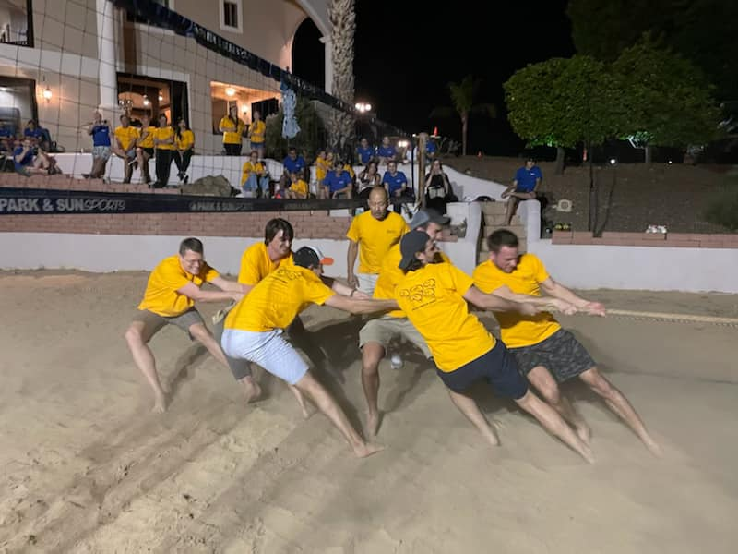
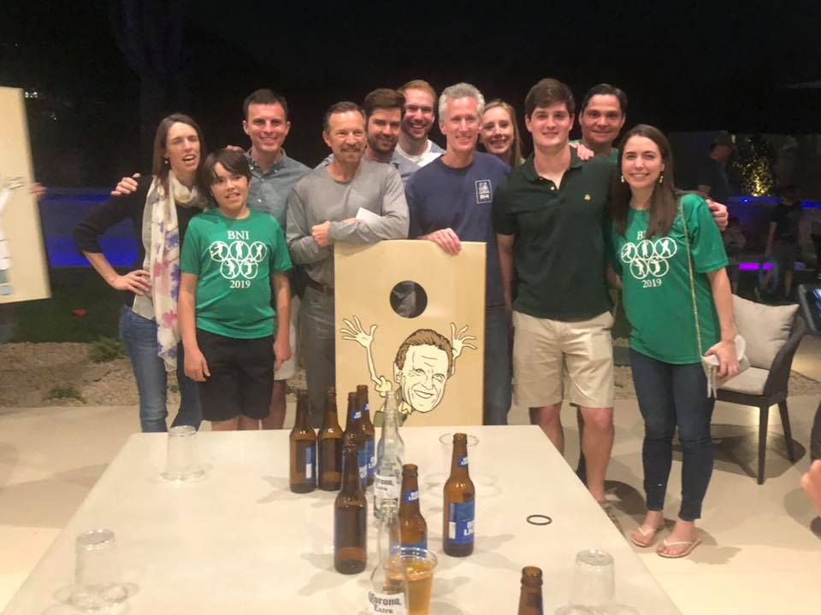
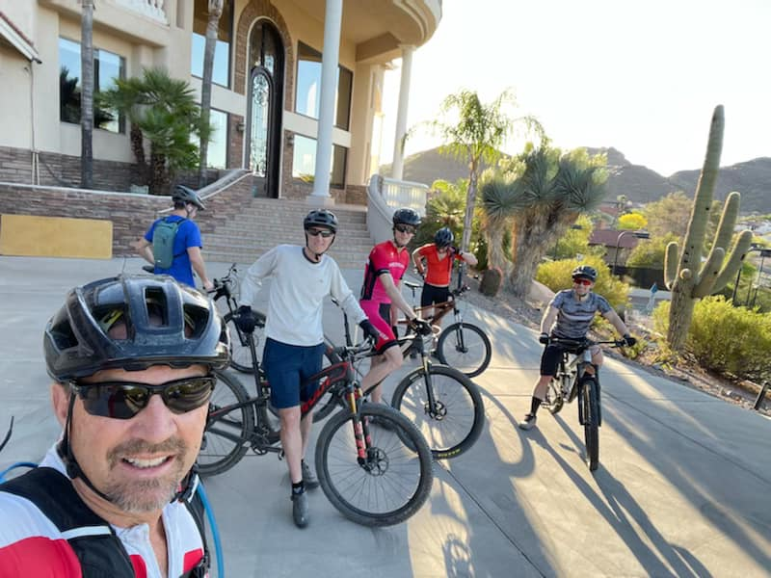
BNI Olympics

Slide 36
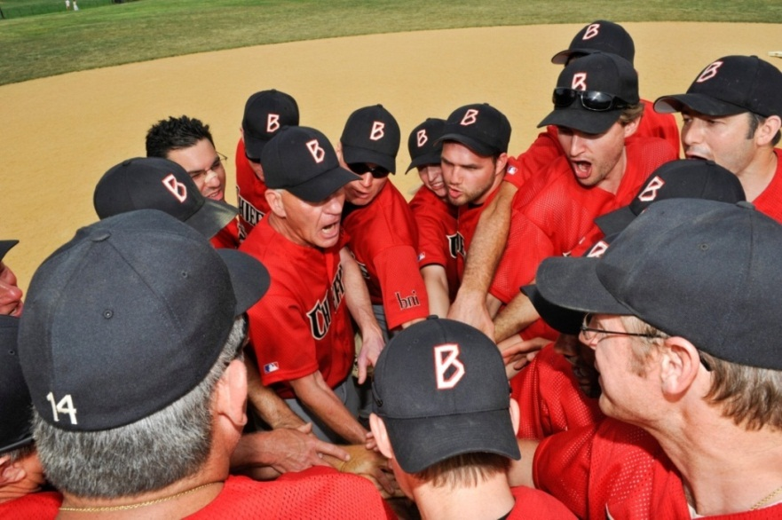
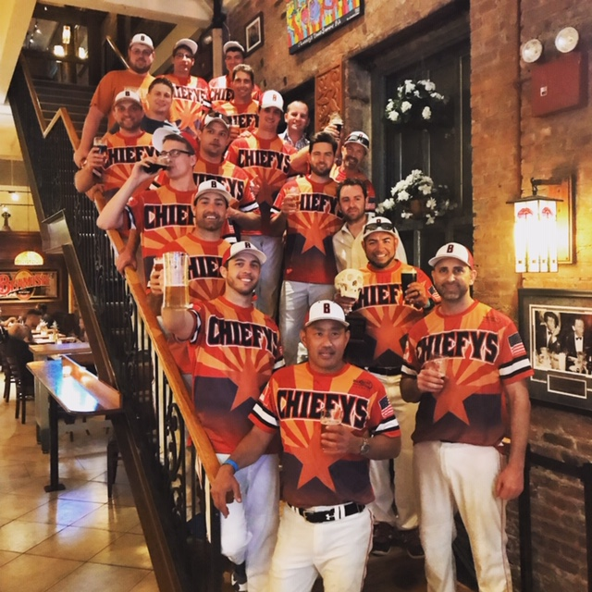
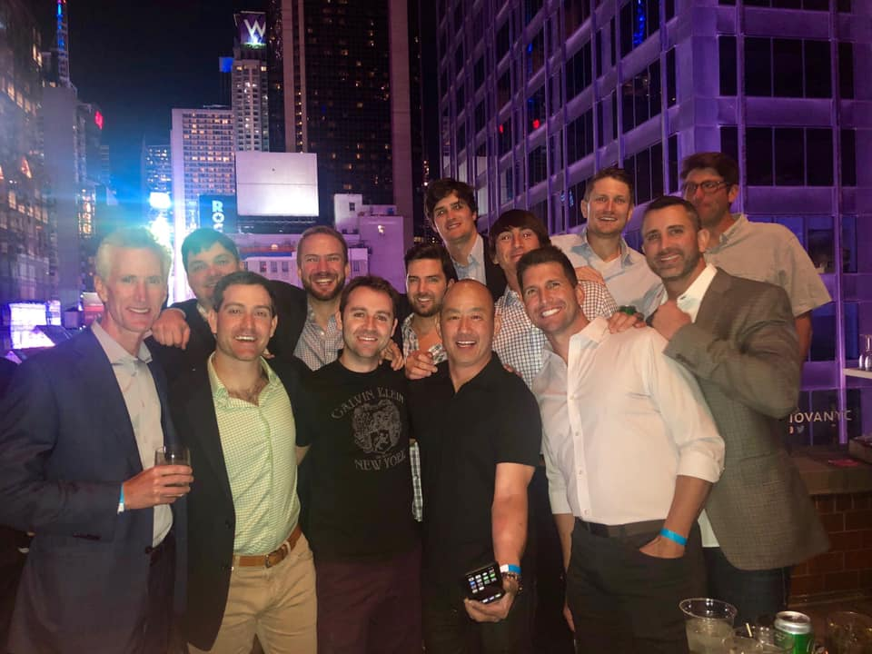
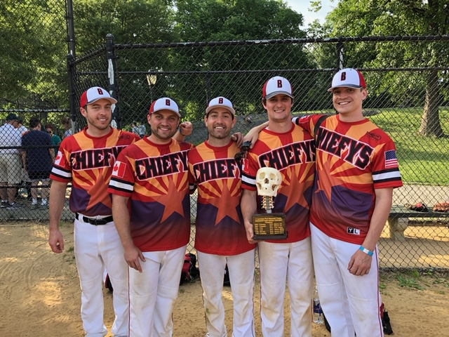
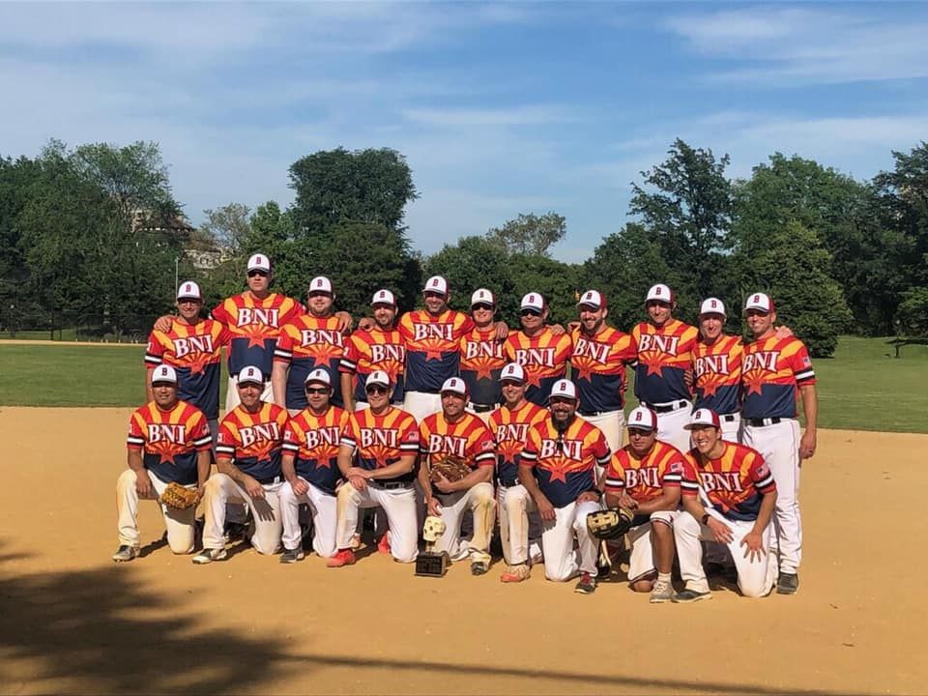
NYC Softball Champions 2010, 2011, 2013, 2014, 2015, 2018, 2019, 2022, 2023

Slide 37
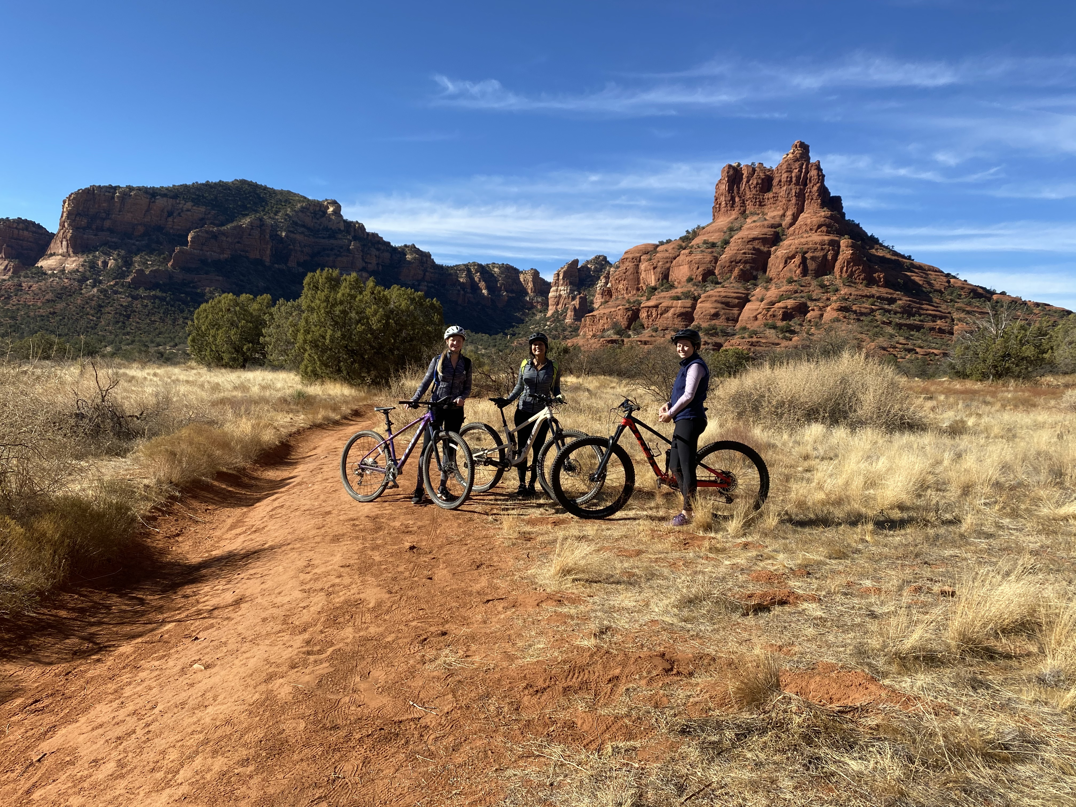
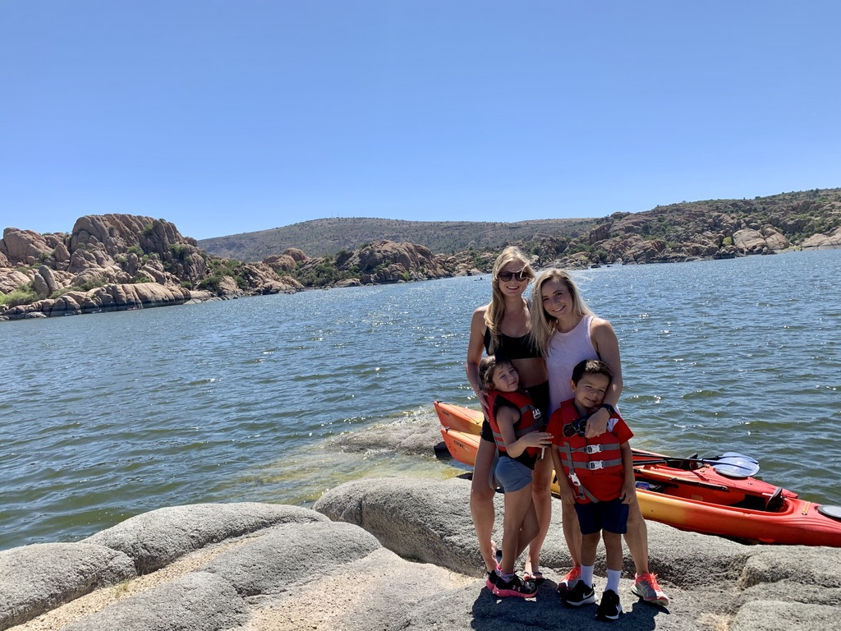
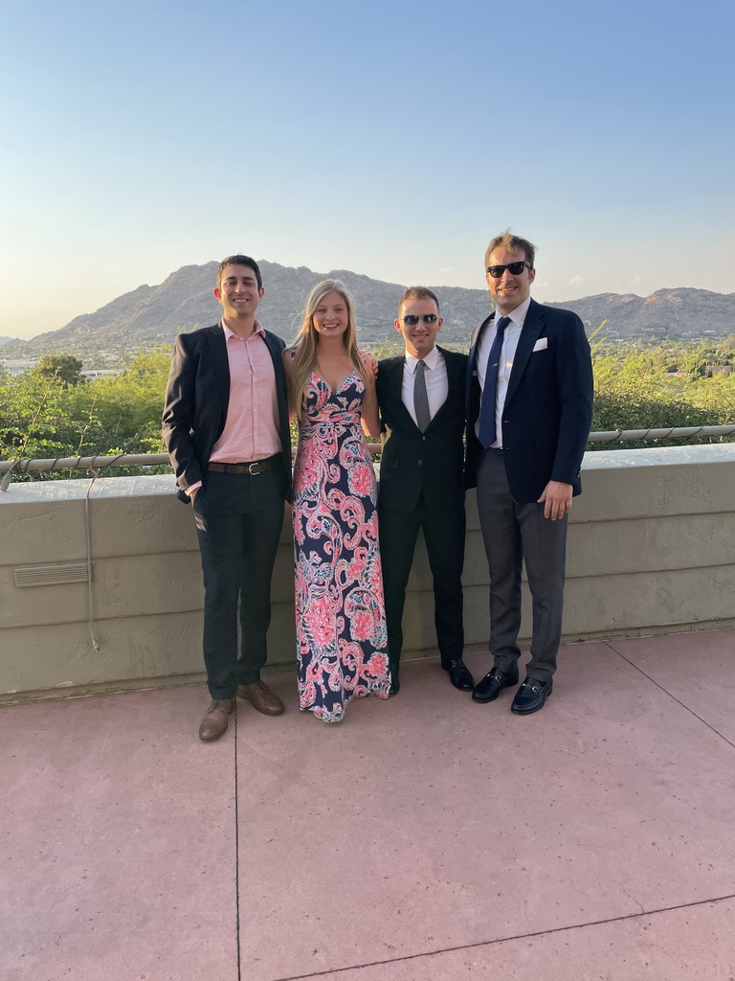
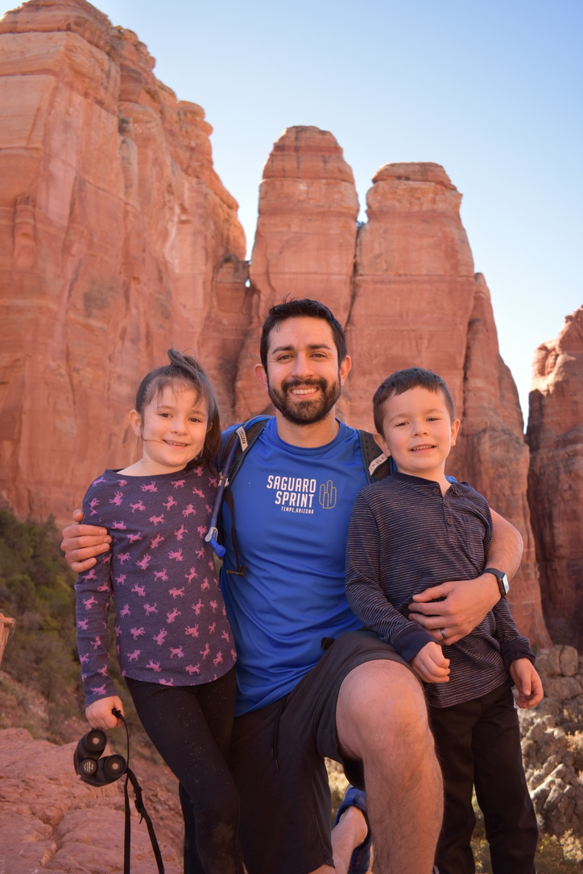
Life in Phoenix

Slide 38
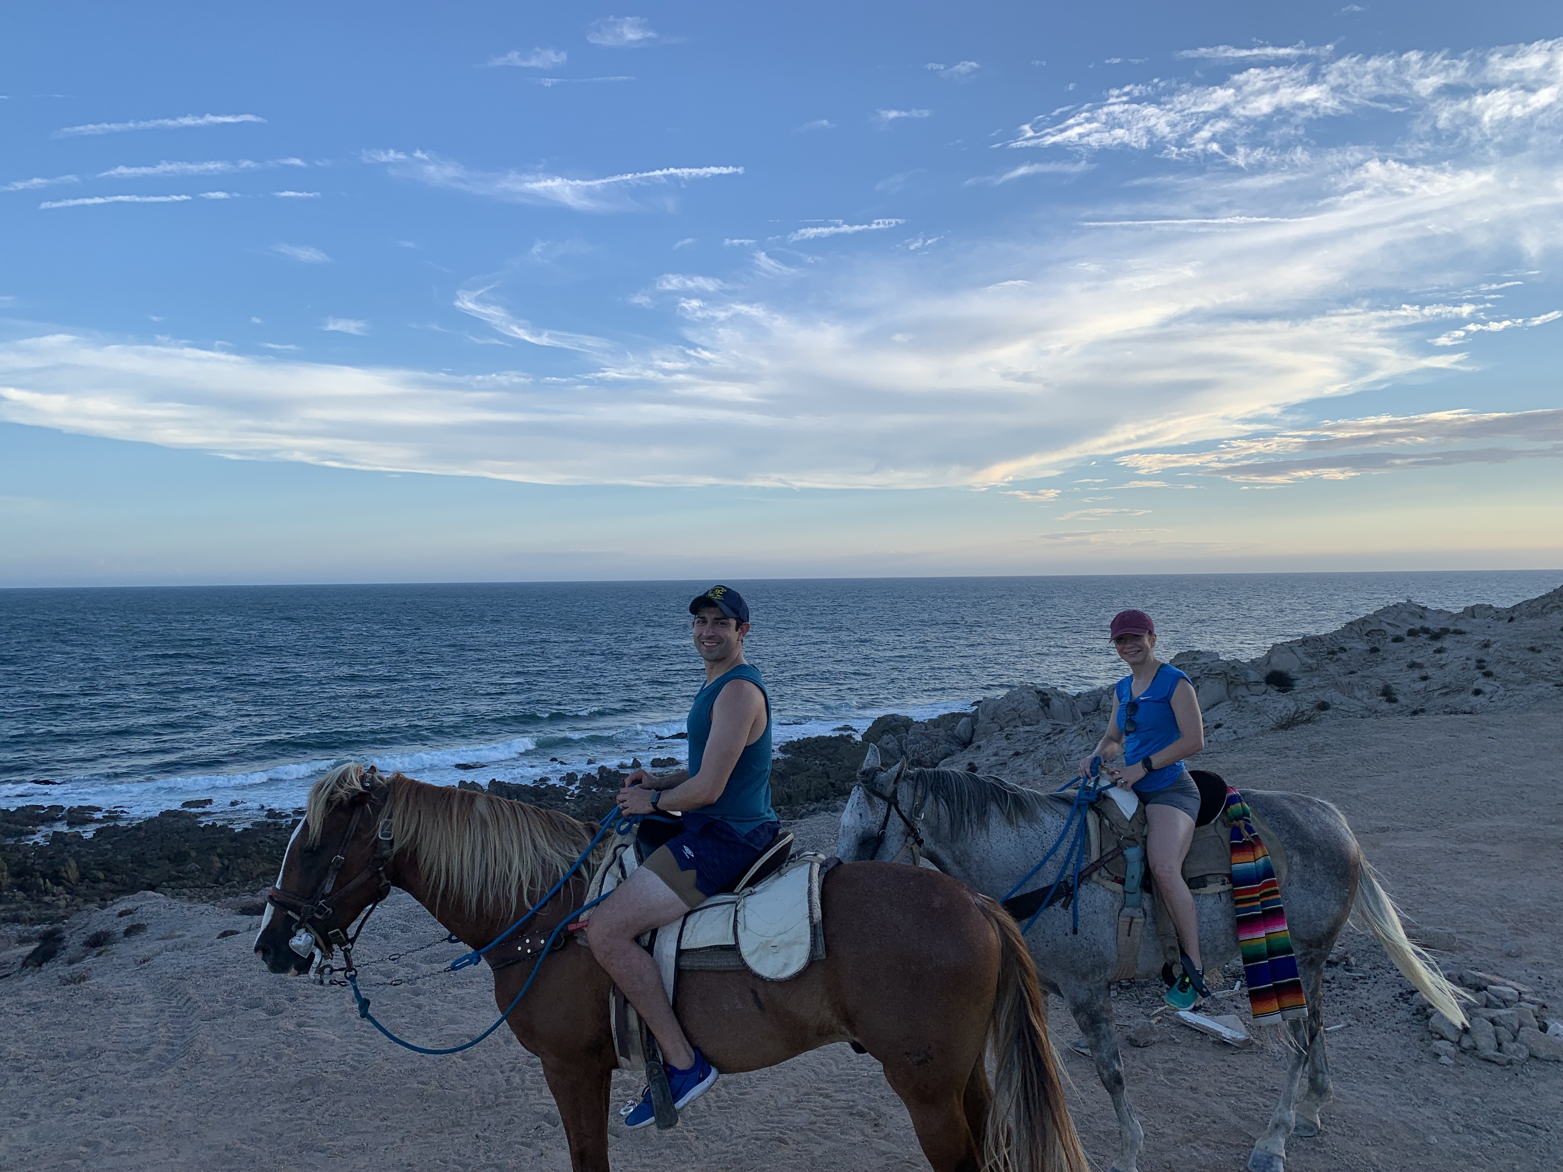
Arizona

Slide 39
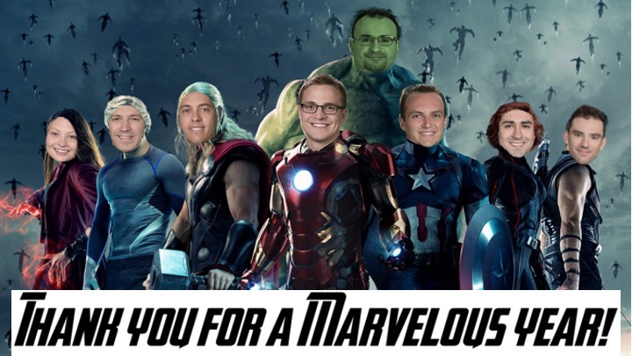
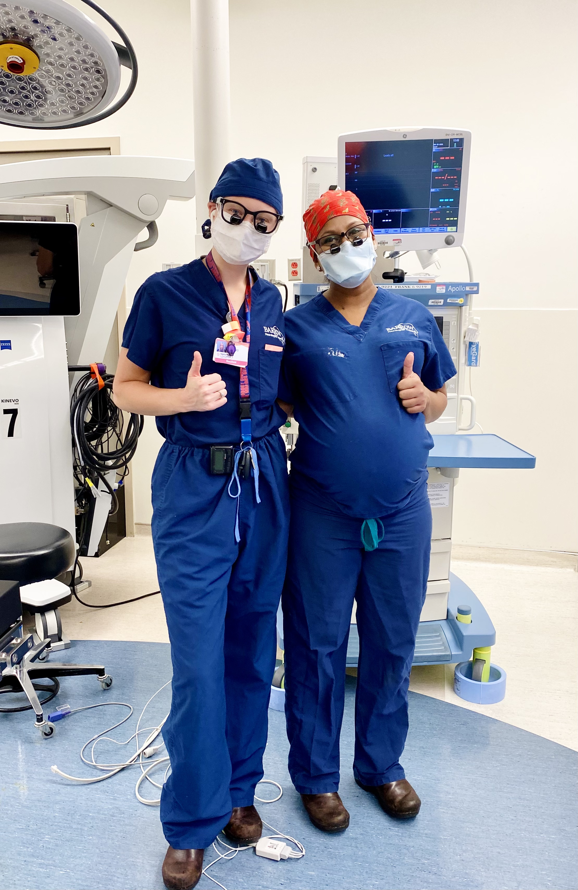
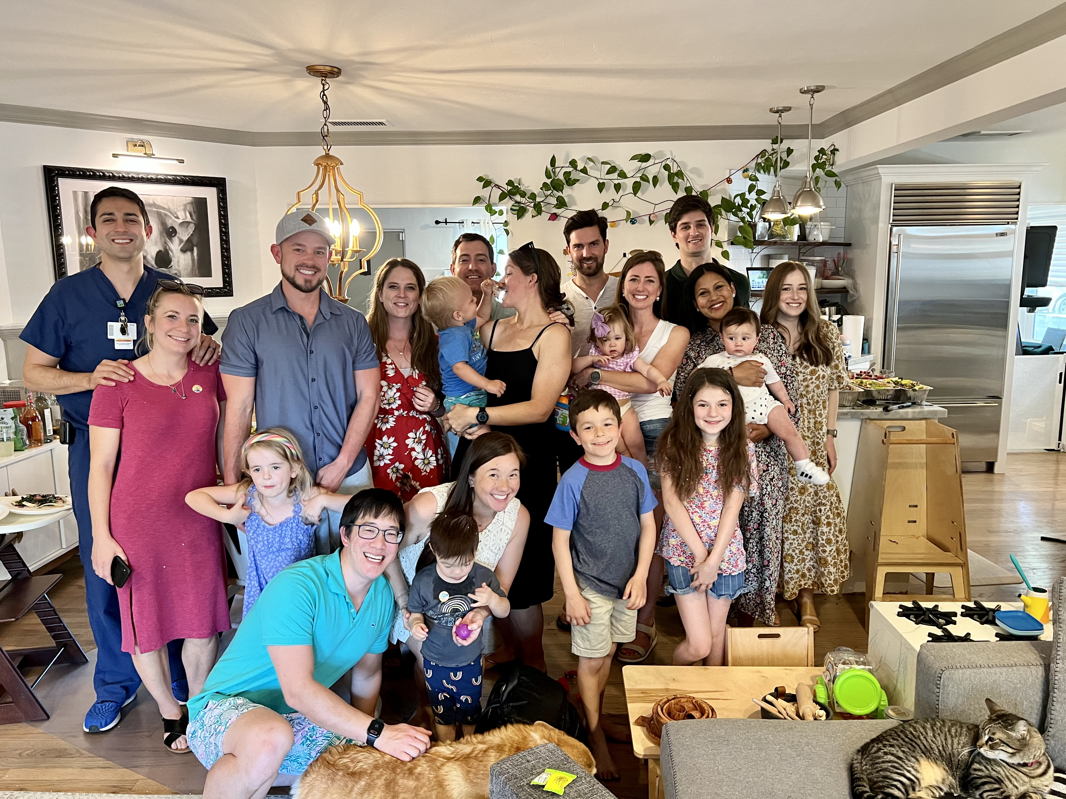
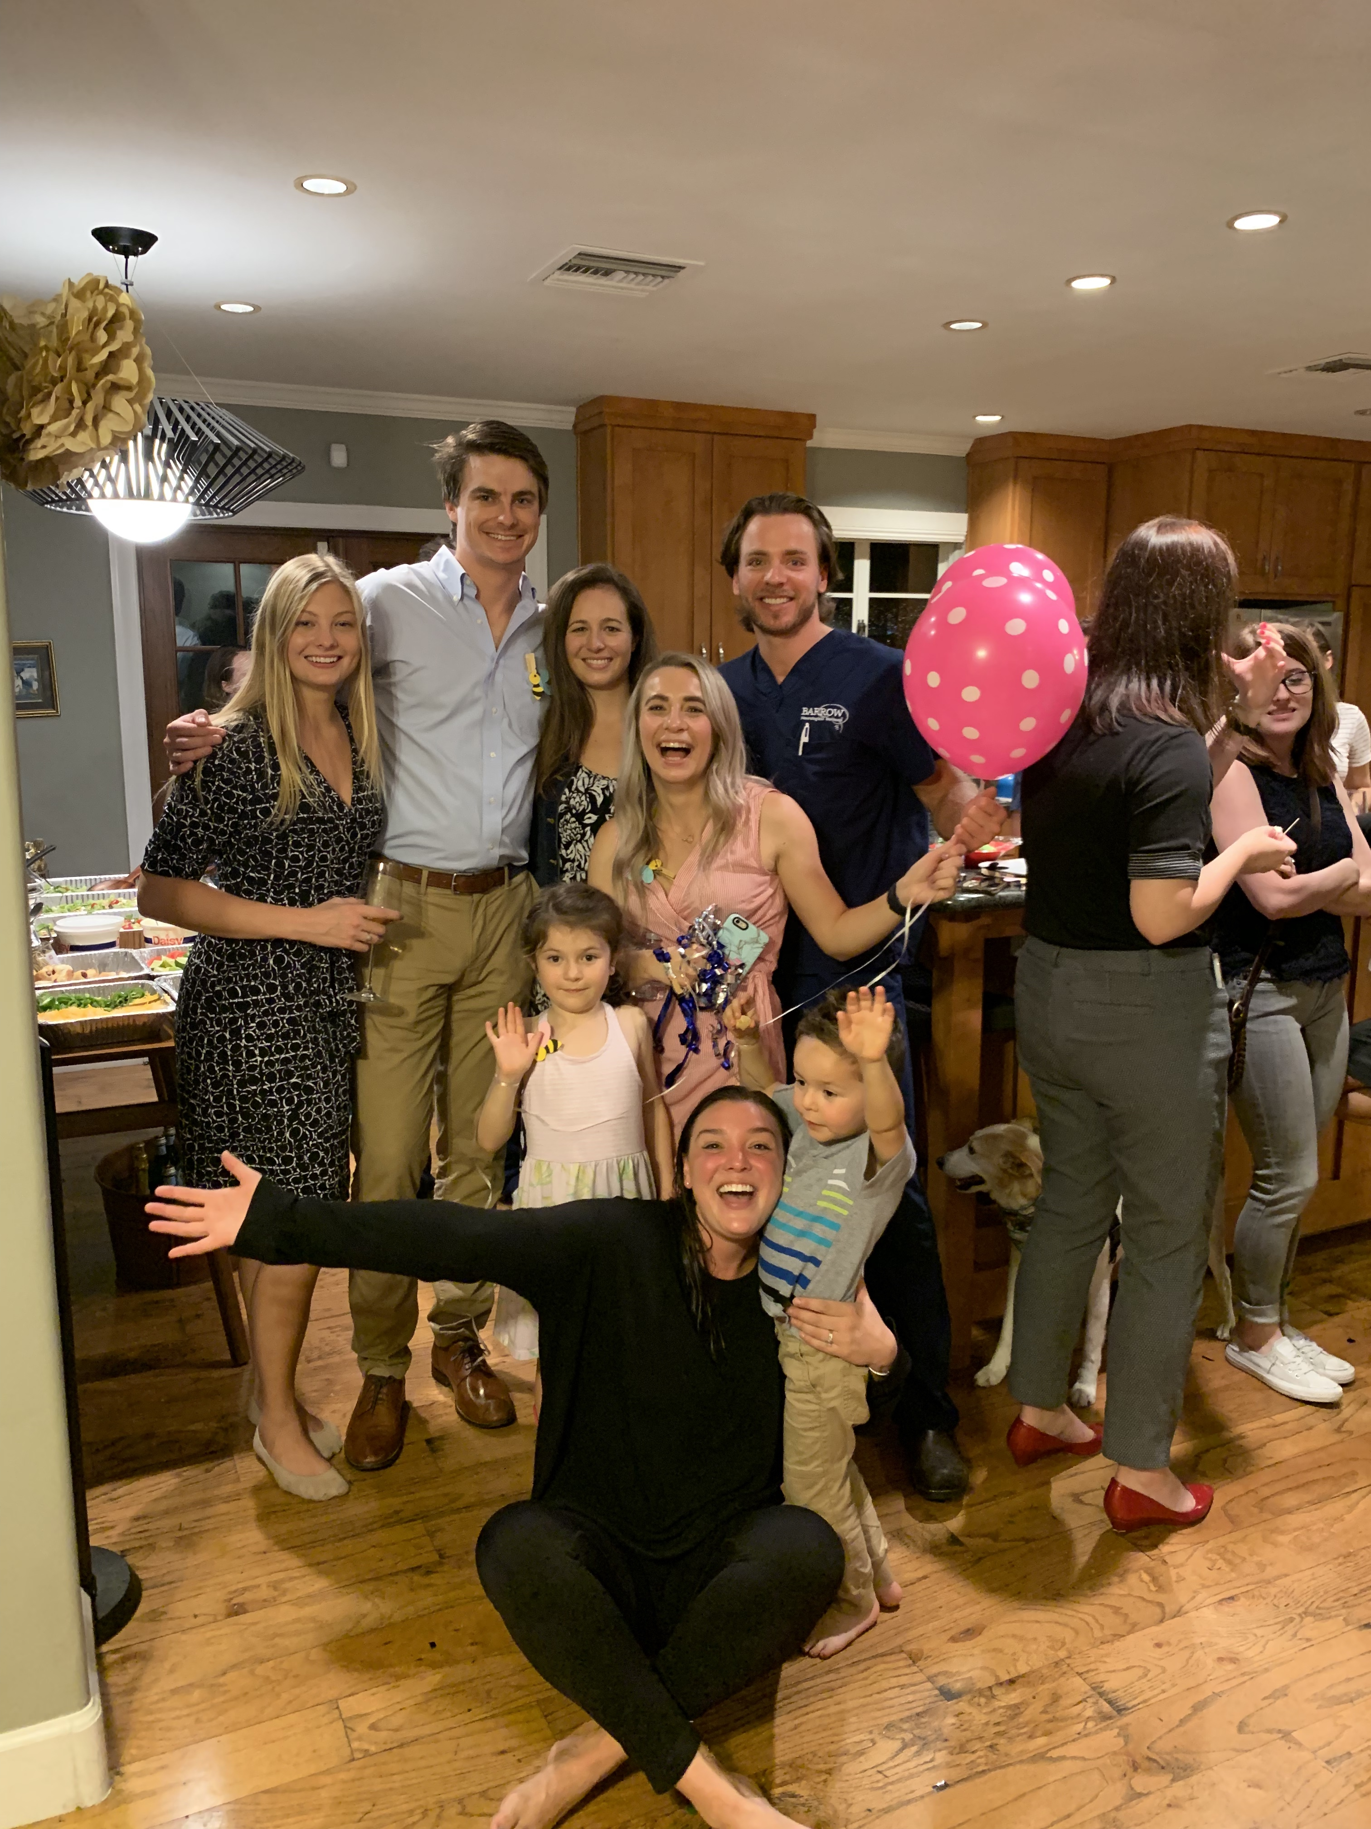
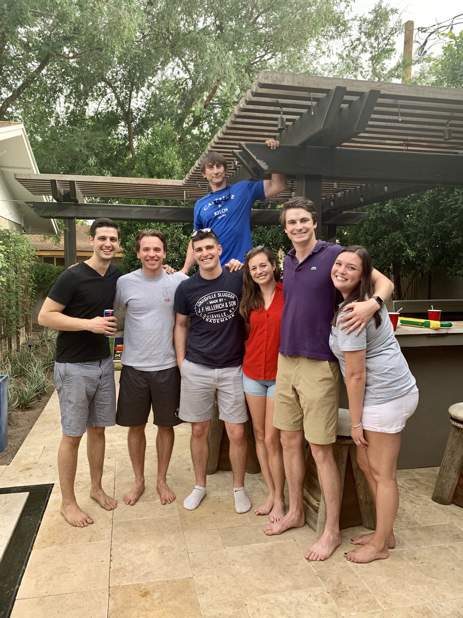
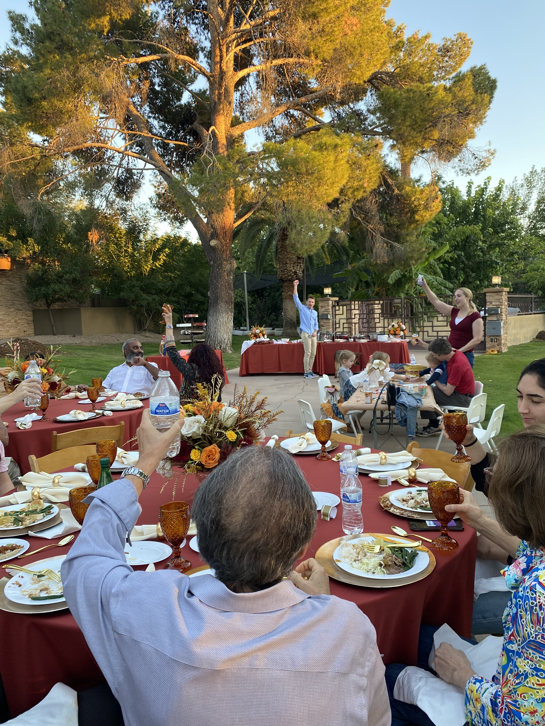
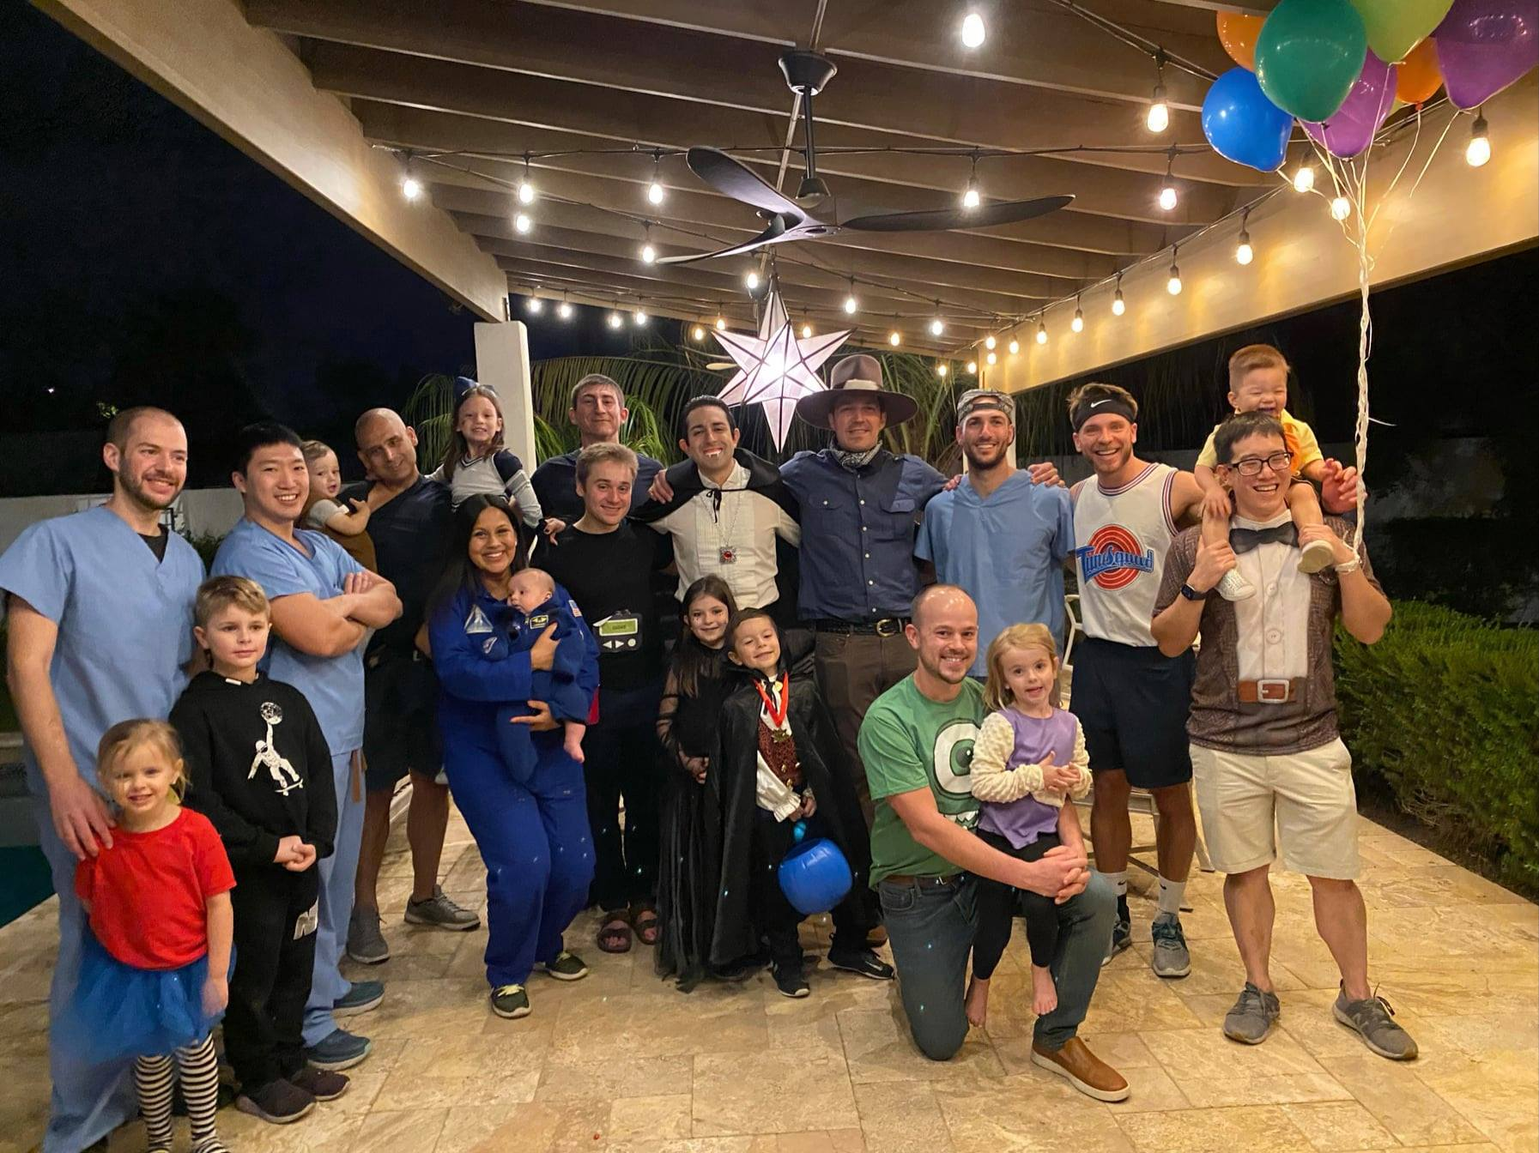
The BNI Family

