Slide 1

University of Kentucky
Neurosurgery Training Program
Contact: Mrs. Soma Chakraborty Patra, Program Coordinator
Email: sch270@uky.edu
https://neurosurgery.med.uky.edu/

Slide 2


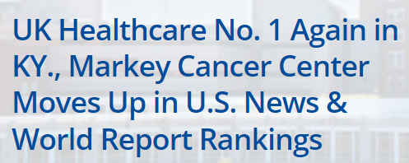
University of Kentucky Hospital
We're No. 1 in Kentucky for 4th-straight year
Nationally ranked in cancer care

Slide 3
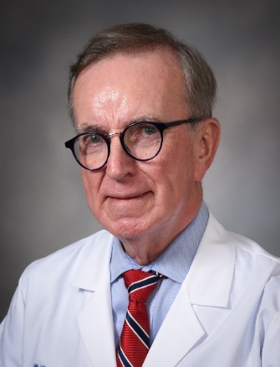
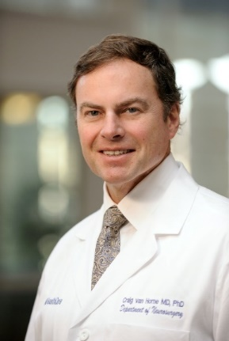
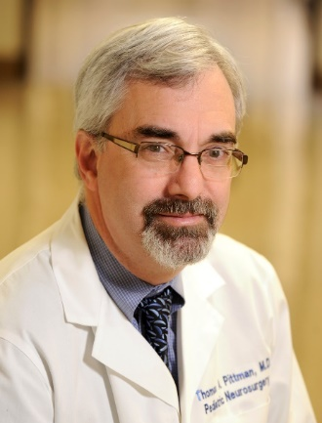
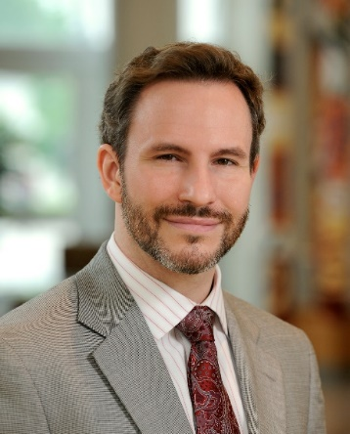
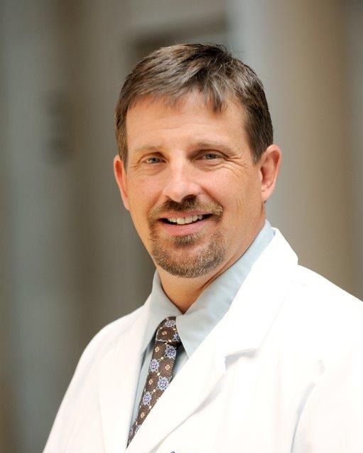
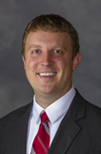
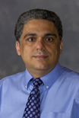
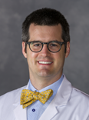
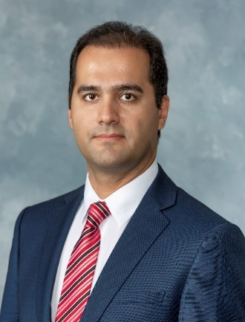
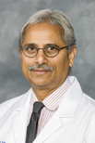


Phillip Tibbs, MD
Craig van Horne, MD PhD
Thomas Pittman, MD
Justin Fraser, MD
Greg Wheeler, MD
Professor & Former Chair
Director, UK Spine Center
Chair, Professor
Co-Director, BRC
Professor & Program Director
Co-Director, Gamma Knife
Associate Professor & Vice Chair
Endovascular Neurosurgery
Assistant Professor
Chief, VA Neurosurgery
David Dornbos III, MD
H.Francis Farhadi, MD PhD
Ryan Hofler, MD
Rouzbeh Motiei, MD
Haran Ramachandran, MD
Farhan A. Mirza, M.D.
Assistant Professor
Epilepsy Surgery & Student Clerkship Director
Assistant Professor
Vascular Neurosurgeon
Associate Professor
Spine Deformity Fellowship Director
Assistant Professor
MIS Spine
Assistant Professor
Complex Spinal Surgery
Assistant Professor

Slide 4
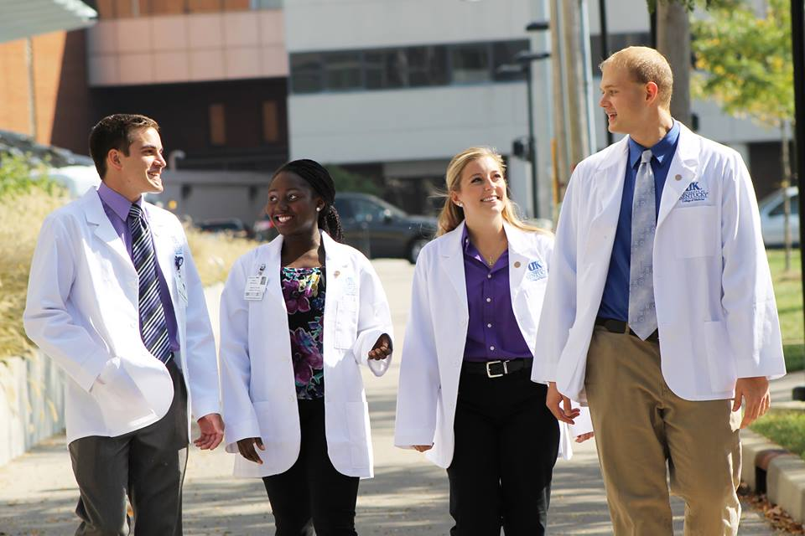
Medical Schools
Thirteen US graduates and one IMGs:
  Marshall University, Rutgers SOM, University of Aleppo, University of Louisville, East Tennessee State University COM, Northeast Ohio Medical, University of Kentucky, Albany SOM, The Brody SOM, and West Virginia SOM

Slide 5
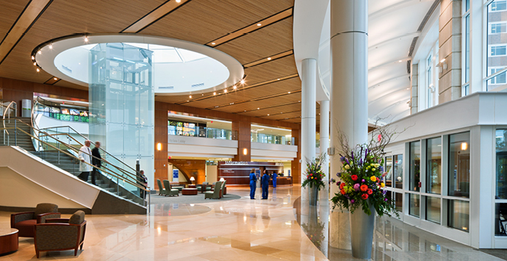
University of Kentucky Hospital lobby

Slide 6
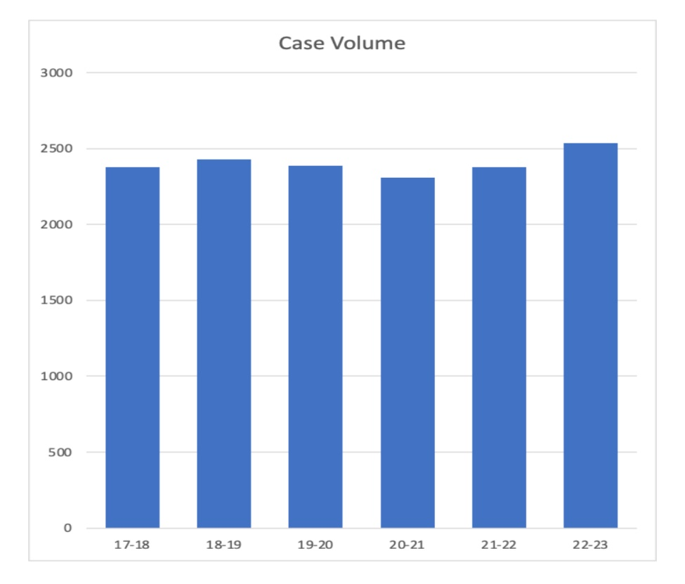
Operative Experience
Senior level residents are assigned to the tumor and trauma cases while mid-level residents are assigned spine, endovascular, and pediatrics. PGY2-3 will be assigned PN and functional cases as well as Gamma Knife. Your field of interest will also determine the amount of exposure to cases.
2022-23 Graduating Resident
Adult Pediatric
Cranial – 1106
Spine – 1021 505
Critical Care – 431

Slide 7
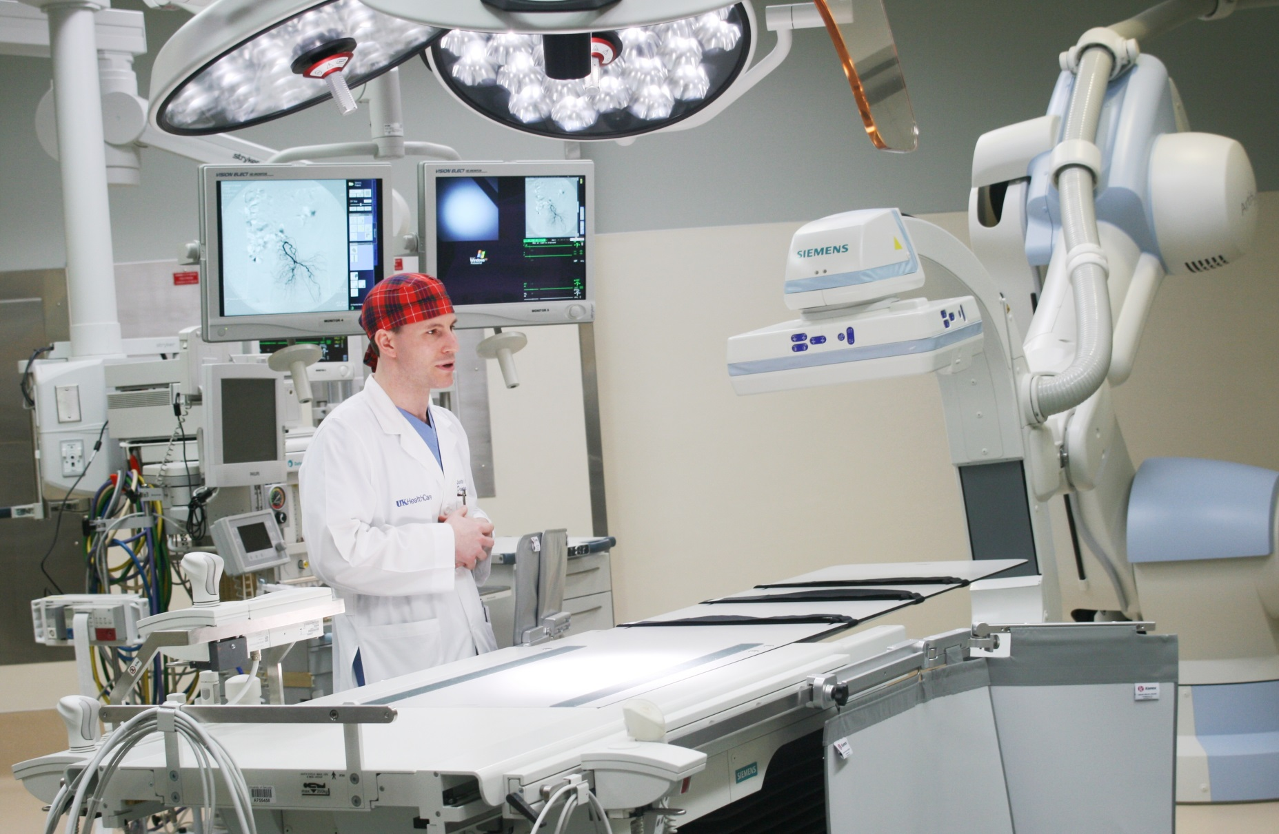
Hybrid Zeego operating room

Slide 8
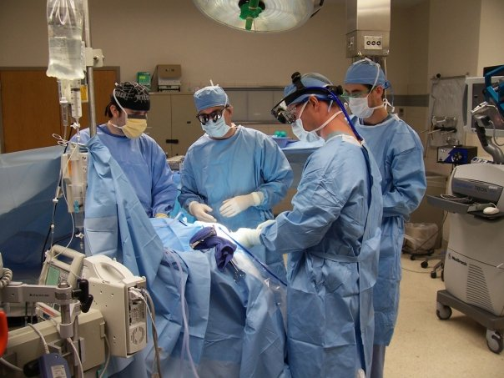

Slide 9
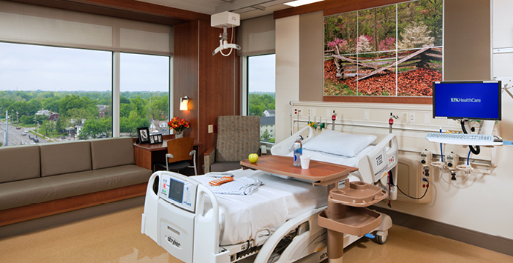
University of Kentucky patient room

Slide 10
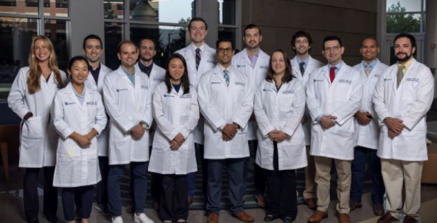
Program Overview
Seven Years of Training
  1 year: Neurosurgery and Neurosciences
  6 years: Neurosurgery Residency

Slide 11
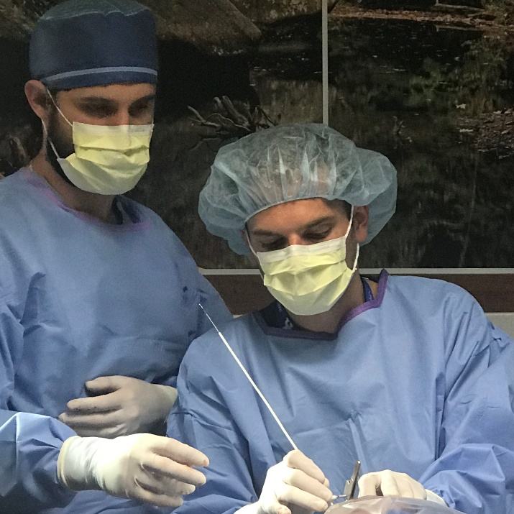
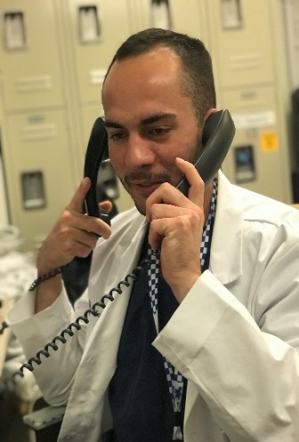
Program Overview
PGY-1
Clinical Neurosciences
Neurology – 1 month
Neuroanatomy & Neuropathology – 1 month
  Teach the Neuroanatomy course in February/March The month is split between the two services
Neurosurgery – 6 months
Neuro Critical Care – 3 months
Neuroradiology – 1 months
Attend the Society of Neurological Surgeons Intern boot camp in July and Junior boot camp in April

Slide 12
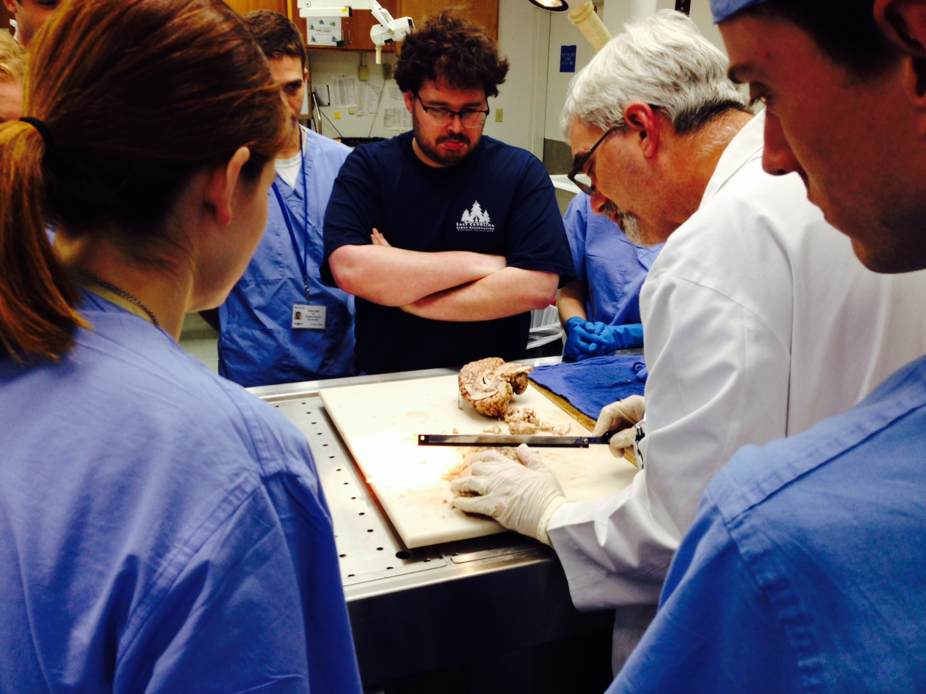

Slide 13
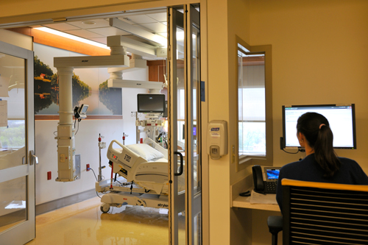
Program Overview
PGY-2 and PGY-3
Adult and Pediatric Neurosurgery at UKMC
  Neuropathology (1 month; PGY2 & 3)
  Neuro Interventional Radiology (PGY3, 1 month)

Slide 14
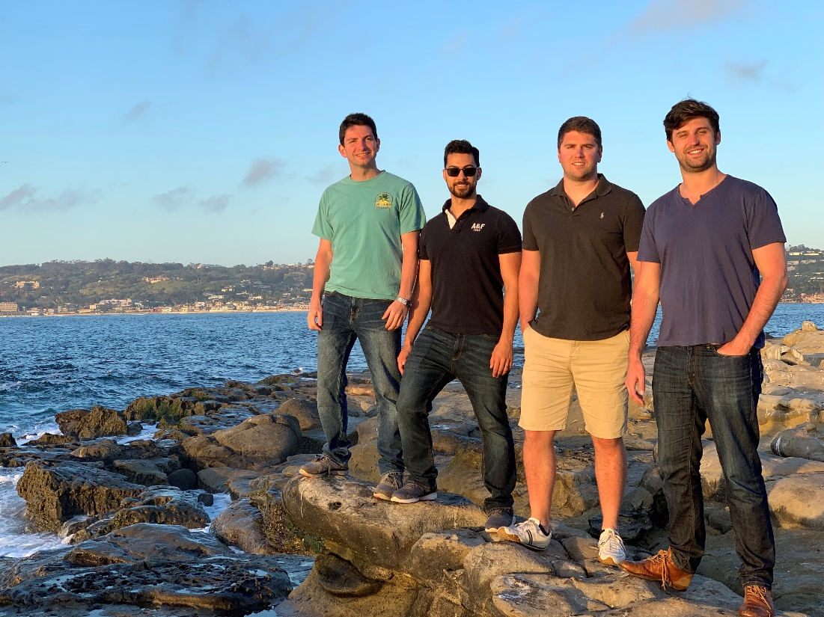
Program Overview
PGY-4
“Floor chief”
Q4 call with PGY2 residents
Select research project & mentor
  Attend one national Neurosurgery meeting (AANS/CNS/Southern)
    Attend Society of Neurological Surgeons Research Update in Neuroscience for Neurosurgeons meeting in Woods Hole, MA

Slide 15
Program Overview
PGY-5 and PGY-6
PGY5
  6 months at VA Hospital
    Every aspect of VA NS service managed by PGY5
  6 months on research
    Research mentor selected, if not already done
    Must write & publish chapter/article and present at regional/national meeting
      Attend one national Neurosurgery meeting (AANS/CNS/Southern)
PGY6
  6 months at UK
  6 months subspecialty training or research
    Subspecialty training can be done at another institution *must make request one year in advance*
    Attend one national Neurosurgery meeting (AANS/CNS/Southern)

Slide 16
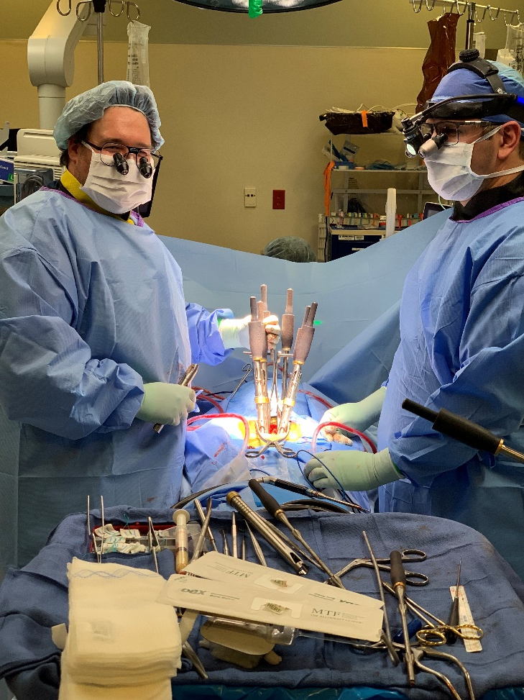
Program Overview
PGY-7
Chief Resident/Senior Year
  Alternate administrative duties
    Call schedules, resident assignments, and assumes overall ownership of UK neurosurgery service
  Knowledgeable of entire patient census
  Attend one national Neurosurgery meeting (AANS/CNS/Southern)

Slide 17
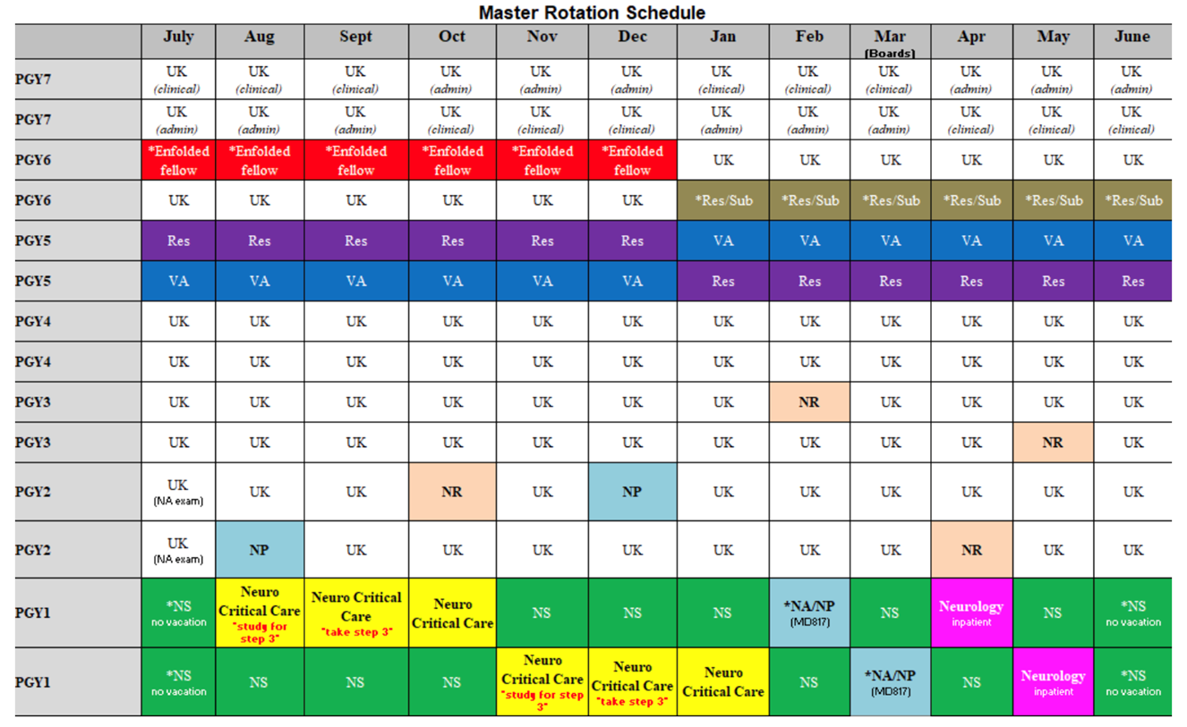
Residency Structure

Slide 18
Research Opportunities
Clinical research
Vascular clinical trials: EMBOLISE, MIND, BACTRAC
Functional/DBS
Epilepsy
Tumor
Spine
Basic/translational research
Robust translational stroke science center
Parkinson’s disease

Slide 19
Enfolded Fellowship Opportunities
Extramural rotations
MD Anderson
Barrow
Sick Kids/Toronto
Enfolded fellowships
Functional
Endovascular
Complex spine
Routine spine

Slide 20
Didactics
  Tuesdays at 6:45 AM
    1st – Neuropathology Conference
    2nd – Spine Conference
    3rd – Vascular Conference
    4th – Movement Disorder & NSG Leadership Conference
  Wednesdays at 6:45 AM
    2nd – Morbidity and Mortality Conference
    1st, 3rd, 4^{th,} Grand Rounds
    5:00 PM Vascular Case Discussion
  Thursdays at 6:45 AM
    1st – Journal Club Conference
    2nd – Critical Care Conference
    3rd – NSG/ Ortho spine Discussion
    4th – Epilepsy Surgery Conference
    5th – Quality Improvement Conference
    2nd – Faculty Meeting
  Thursdays at 5:00 AM
  1st & 3rd – Case Discussion
  4th – Anatomy lab session

Slide 21
Alumni
  1970 Lloyd Megison
  1972 Fred Christensen
  Richard Mortara
  William Brooks
  John Hackman
  John McCloskey
  William Madauss
  1973-1979 Phillip Tibbs
  1980 James Bean
  1982 John Smithson & George Guidry
  1983 David Eggers
  1984 Kenneth Rice
  1985 Richard McKenzie
  1986 James Oexmann
  1987 Frank Holladay
  1988 Arthur Daus
  1989 Kathleen Meyer
1990 John Gilbert
1991 Marcus Schmitz
1994 William Lu & Arnold Salotto
Terry Smith
Timothy Kriss

Slide 22
Alumni
  1997 Warren Boling (Texas Tech) – Redlands, CA
  John Johnson (University of Alabama) – Huntsville, Alabama
  Thomas Becherer (University of Kentucky) – Louisville, Kentucky
  Richard Broderick (Loyola University) – Arlington Heights, IL
  Victor Freund (East Carolina University) – High Point, NC
  Nathan Avery (University of Arizona) – Flagstaff, AZ *deceased*
  David Sacco (Loyola University) – Dallas, TX
  Reza Shahim (University of Arkansas) – Little Rock, AR
  Bradley Nicol (Medical College of Wisconsin) – Flagstaff, AZ
  Thad Jackson (Indiana University) – Elizabethtown, KY
  Thomas Anderson (University of South Carolina) – Mt. Pleasant, SC
  Shaad Bidiwala (University of Louisville) – Dallas, TX
  David Weaver (University of Kentucky) – Newburgh, IN
  Robert Owen (Indiana University) – Lexington, KY
  John Cole (University of Kentucky) – Louisville, KY

Slide 23
Alumni
  2007 Christopher Neumann (University of Illinois) – Cincinnati, OH
  Christian Ramsey (University of Kentucky) – Lexington, KY
  Heather Hedstrom (Indiana University) – Panama City, FL
  Matthew Werthammer (Marshall University) – Barboursville, WV
  Matthew Tutt (University of Kentucky) – Lexington, KY
  Eric Goebel (Indiana University) – Evansville, IN
  Joel Norman (East Tennessee State) – Knoxville, TN
  Justin Whitlow (University of South Florida) – Salina, KS
  Justin Davis (University of Kansas) – Overland Park, KS
  Lindsey Tyler (Brody School of Medicine) – Rocky Mountain, NC
  Wissam Asfahani (American University of Beirut) – Sioux Falls, SD
  Barrett Brown (University of Kentucky) – Knoxville, TN
  Jonathan Mannas (University of Oklahoma) – Lubbock, TX
  Stephen Grupke (New York Medical College) – Lexington, KY

Slide 24
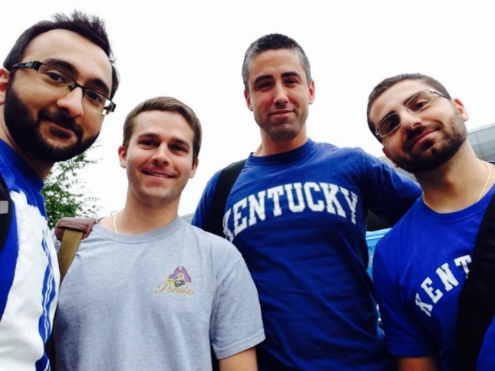
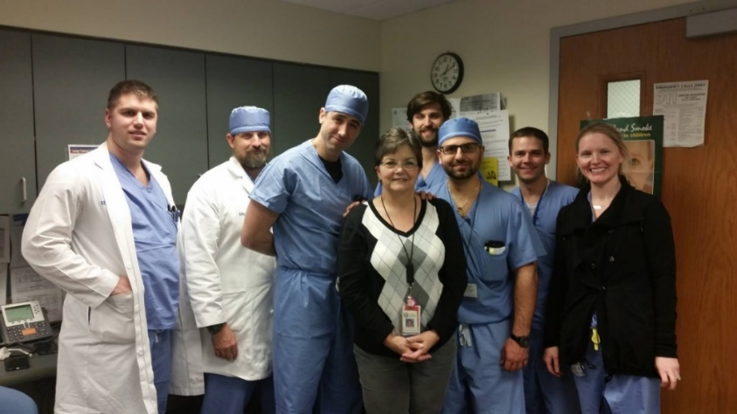
Alumni
  Laith Khoury (Jordan University, Amman Jordan) – Raleigh, NC
  James Smith (Brody School of Medicine) – Lexington, KY
  Nessa Timoney (Trinity School of Medicine, Ireland) – Bowling Green, KY
  Farhan A. Mirza (Aga Khan University) – Quebec, Canada
  William Dillen & John Richard Lamm
  Brian Snyder & Jason Hall
  Benjamin Motley & Thomas Hines
  Catherine Wang & Christopher Spears

Slide 25
Centers of Excellence

Slide 26
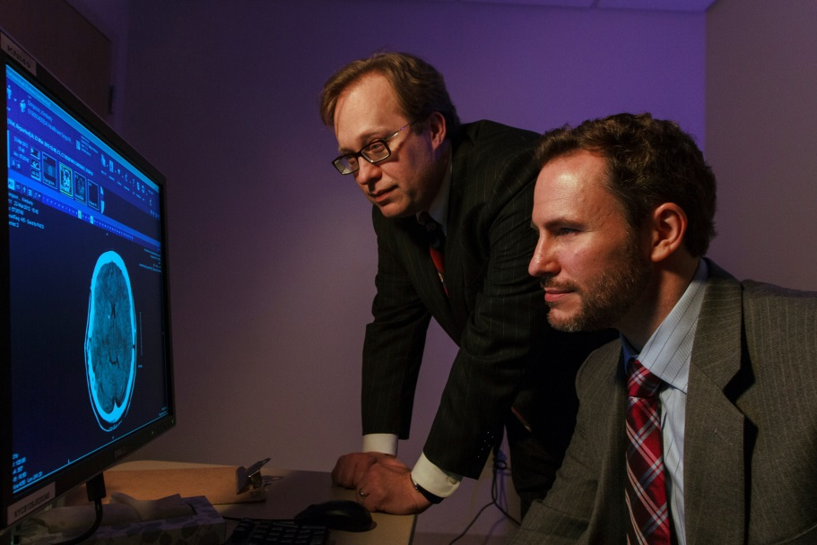
Comprehensive Stroke Center
UK HealthCare is one of more than 60 U.S. institutions and the only in Lexington to be awarded this designation, which is the highest honor The Joint Commission awards to stroke centers.
Comprehensive Stroke Center Certification recognizes those hospitals that have state-of-the-art infrastructure, staff and training to receive and treat patients with the most complex strokes, including advanced imaging capabilities, 24/7 availability of specialized treatments, and staff with the unique education and competencies to care for complex stroke patients.

Slide 27
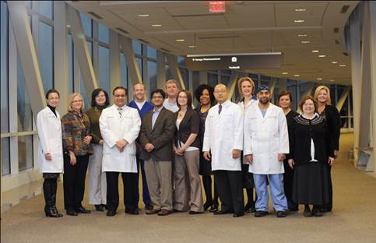
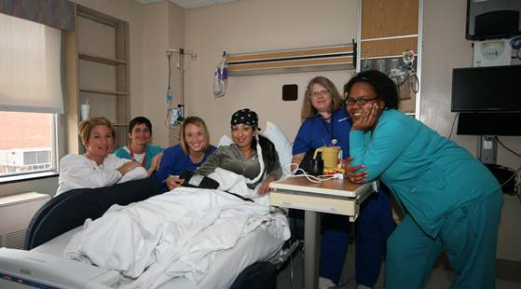
Comprehensive Epilepsy Center
UK HealthCare Comprehensive Epilepsy Center is recognized by the NAEC as a level 4 epilepsy center
Multidisciplinary team – EMUs, neurosurgeon, neuroradiologist, nurse, and neuropsychologist
Adult and peds epilepsy monitoring unit, capability to monitor remotely (brain telemetry)
Upcoming 24/7 EEG tech coverage
Diagnosis surgery clinical trial

Slide 28
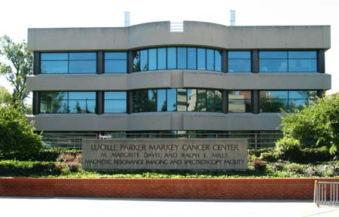
NCI Center Designation
Kentucky’s only National Cancer Institute-designate cancer center
NCI-designated centers offer more treatment options and 25% better survival rates.
Our patients will have access to clinical trials and new drugs offered only at NCI centers.

Slide 29
Research Centers

Slide 30
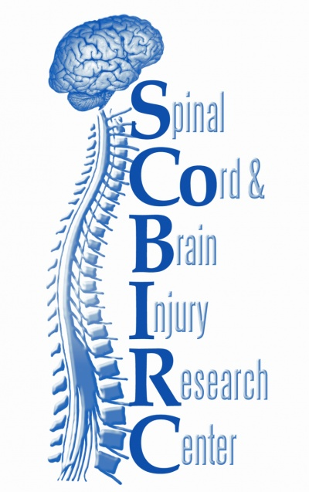
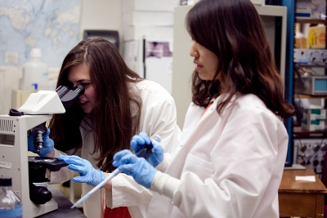
Spinal Cord and Brain Injury Research Center
(SCoBIRC)
Established in 1999 to promote individual and collaborative studies on injuries to the spinal cord and brain that result in paralysis or other loss of neurologic function.

Slide 31
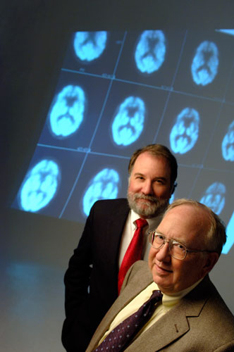
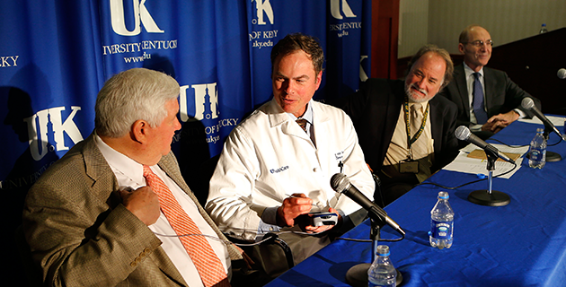
Morris K. Udall Center of Excellence for Parkinson’s Disease Research
Research Team
Craig van Horne, Greg Gerhardt, and Jorge Quintero
While DBS is effective in managing symptoms, it does not change the course or outcome of the disease. This clinical trial is exploring a possible way to alter the course of the disease by supplementing the DBS procedure with a patient’s own peripheral nerves with a nerve graft.

Slide 32
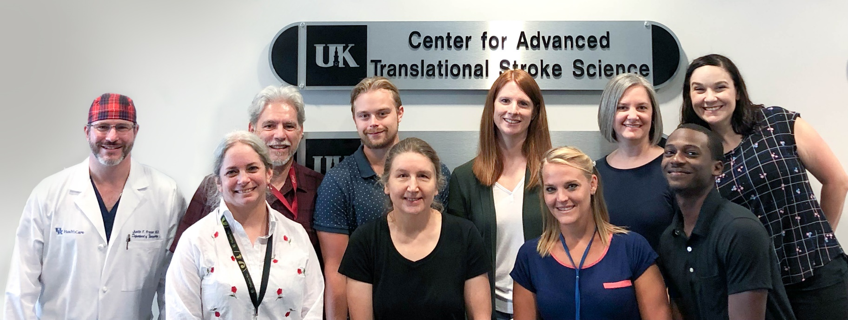
Center for Advanced Translational Stroke Science
Research Faculty: Keith Pennypacker, Ann Stowe, Justin Fraser, Jill Roberts, Doug Lukins
Selected Projects
  BACTRAC Thrombectomy Tissue Bank
  Inflammatory cascades in ischemic stroke
  CBD in Subarachnoid Hemorrhage
  Animal model and tissue bank for moyamoya syndrome

Slide 33
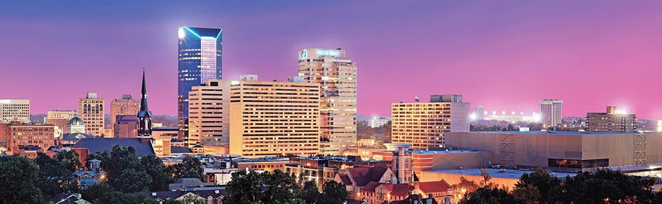
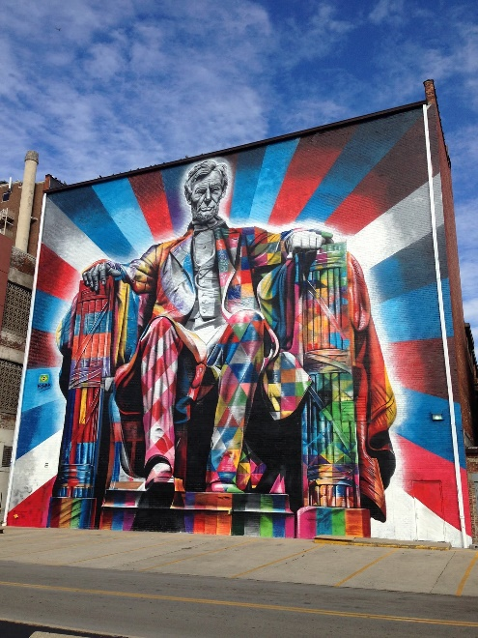
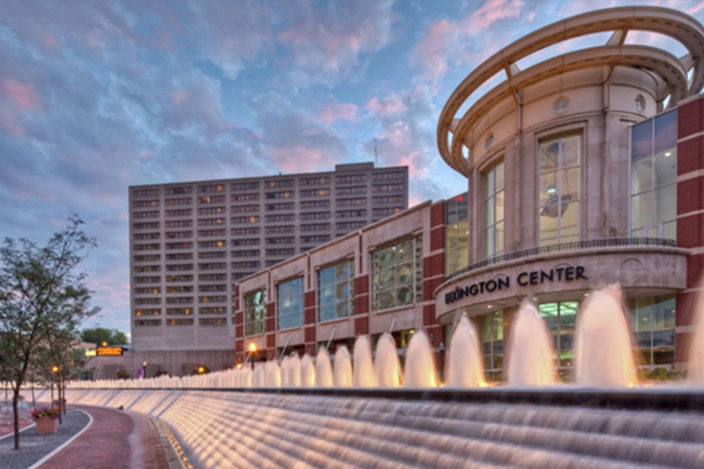
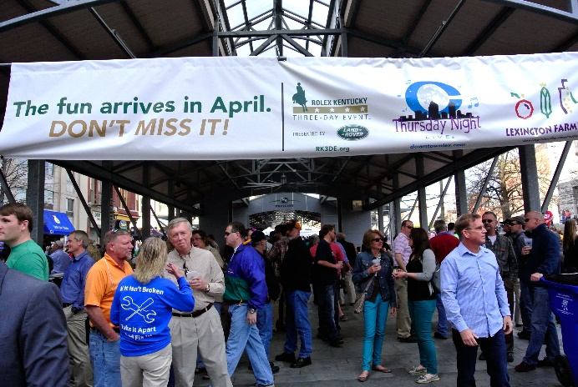
LEXINGTON

Slide 34
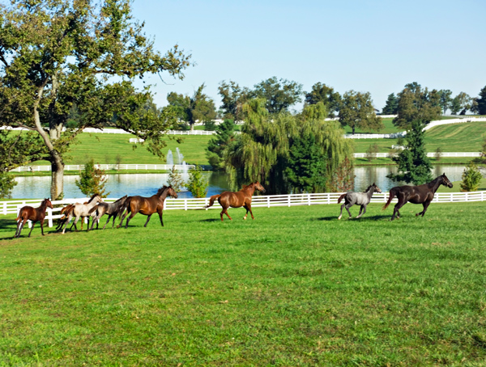
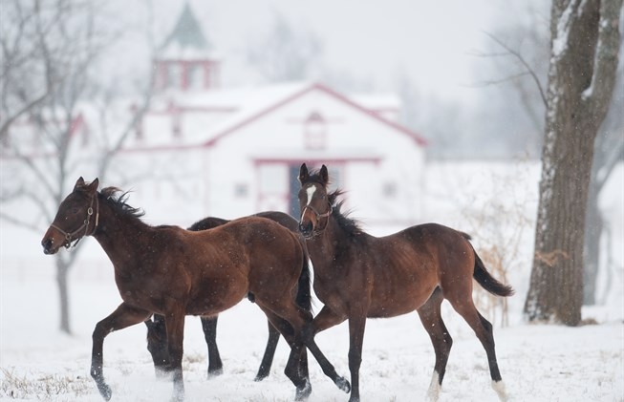
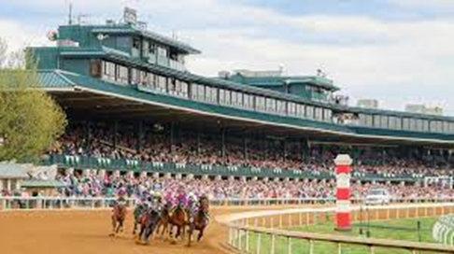
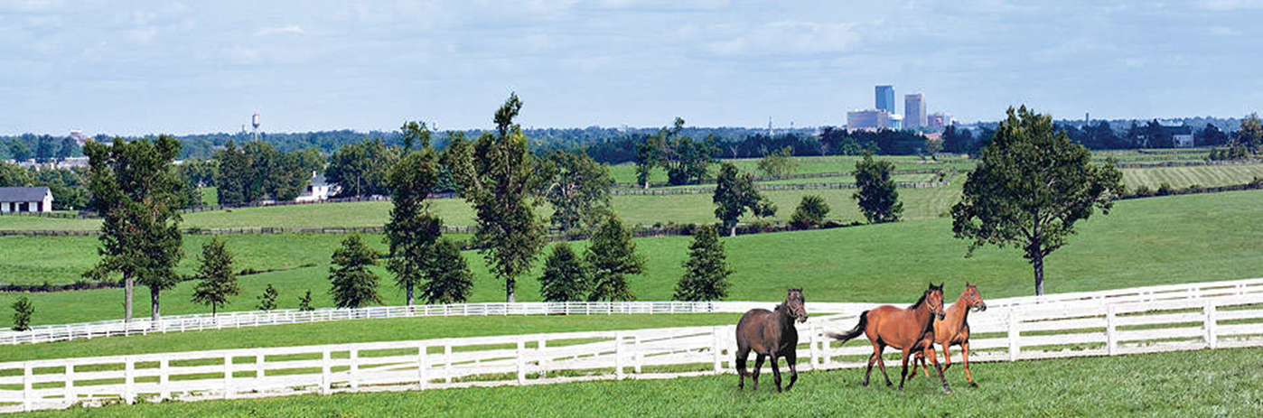
Horse Capital of the World
Lexington-Fayette County Weather
Population estimate is 323,780 Spring: 55-80°
Summer: 74-89°
Fall: 44-79°
Winter: 25-66°

Slide 35
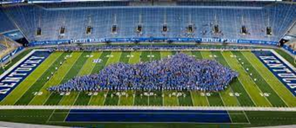

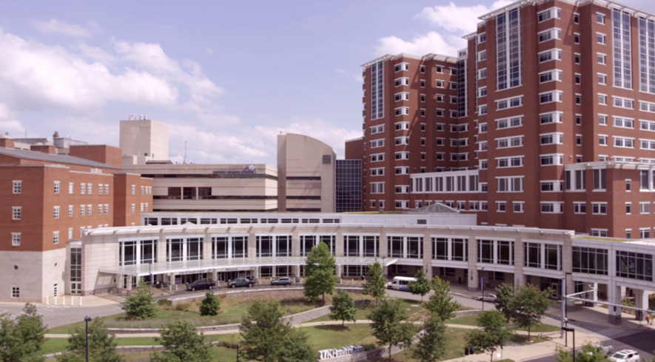
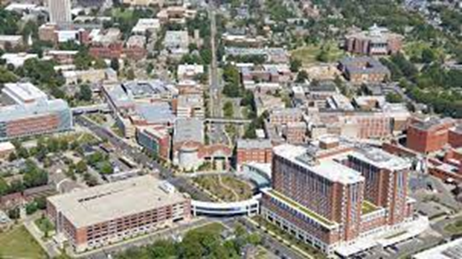
The University
Top 20 NIH funded
Collaborations throughout
Med Center
Neurocritical care
Emergency department
Neuroscience institute
University
Basic and translational stroke science
Incentivized collaboration

Slide 36
Childcare
  http://www.uky.edu/hr/work-life/resources-for-parents/childcare-options
The UK Early Childhood Laboratory (ECL)
Woodland Early Learning Center at the University of Kentucky
Child Development Center of the Bluegrass
  UK does not endorse any of the child care providers on this site. We provide the link as a tool to help you make a selection

Slide 37
Fayette County Schools
Public
www.fcps.net
37 elementary schools
12 middle schools
7 high schools
Magnet schools
Gifted & Talented Accelerated Programs in Tates Creek, Ashland & Meadowthorpe Elementary, Tates Creek & Winburn Middle & Henry Clay High
Maxwell Spanish Immersion
Paul Laurence Dunbar HS (MSTC Program)
Lexington Traditional
Dixie Elementary
Lafayette HS (Pre-Engineering)
Frederick Douglas HS (Biomedical Sciences)
Tates Creek HS (International Baccalaureate)
Henry Clay HS (Liberal Arts Academy)
Private
http://www.privateschoolreview.com/county_private_schools/stateid/KY/county/21067#!all
The Lexington School
Sayre School
Other
  Clays Mill Road Christian Academy
  Lexington Christian Academy
  Trinity Christian Academy
  Christ The King Catholic School
  Lexington Catholic School
  Mary Queen Of The Holy Rosary School
  Ss. Peter & Paul Catholic School
  Seton Catholic School

Slide 38

