Slide 1
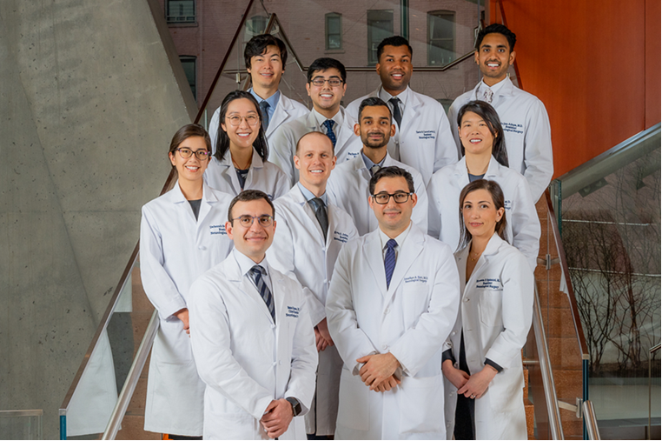
Virtual Residency Fair ‘23
Columbia Neurosurgery Residency Program

Slide 2
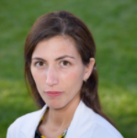
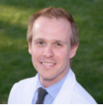
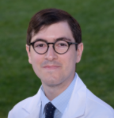
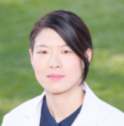
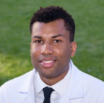
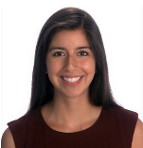
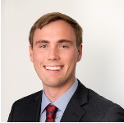
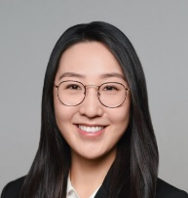
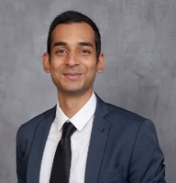
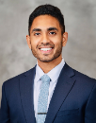
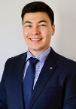
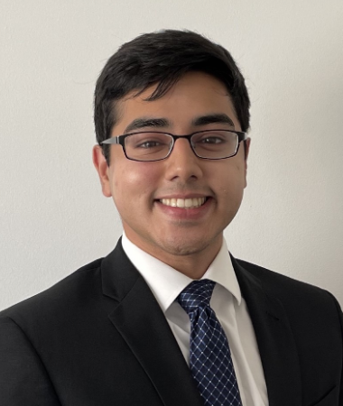
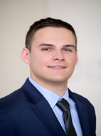
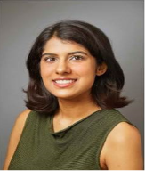
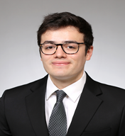
2023 – 2024 Neurosurgery Residents
NS 7 – Chiefs
Eleonora Spinazzi, MD
Evan Joiner, MD
NS 6 – Senior
NS 5 – Seniors
Zachary Englander, MD
Nina Yoh, MD
Travis CreveCoeur, MD
NS 4 – Seniors
NS 3 – Juniors
Deborah Boyett, MD
Nathan Winans, MD
Linda Wang, MD
Pavan Upadhyayula, MD
NS 2 – Juniors
NS 1 – Interns
Arjun Adapa, MD
Alex Agopyan-Miu, MD
Farhan Khan, MD
Michael Argenziano, MD
Amrita Singh, MD
Adrian Jimenez, MD
Copyright © 2023 Columbia University Department of Neurological Surgery

Slide 3
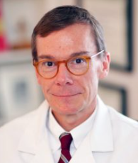
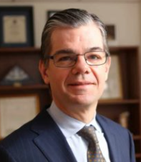
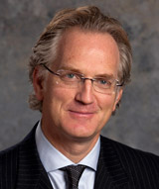
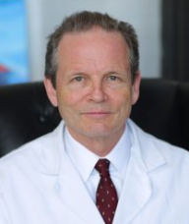
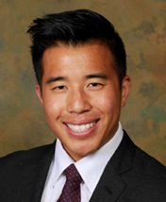
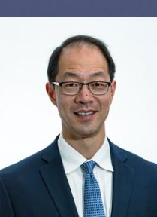
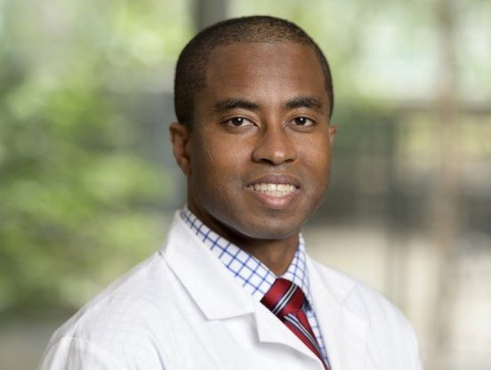
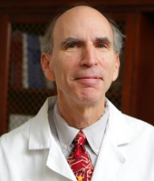
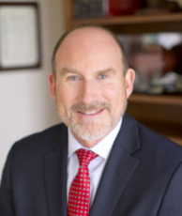
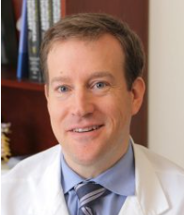
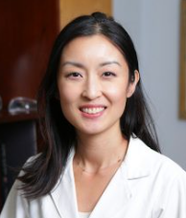
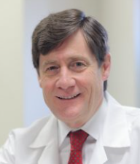
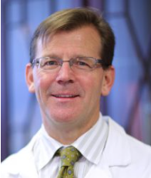
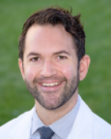
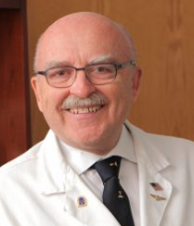
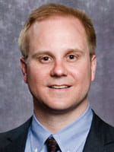
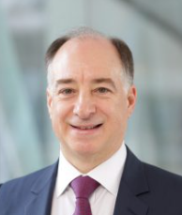
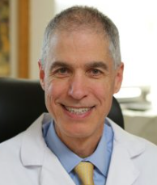
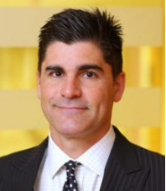
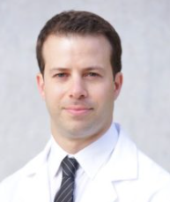
Neurosurgery Faculty
E. Sander Connolly, Jr., MD
Chairman
Peter Angevine, MD
Gordon Baltuch, MD
Jeffrey Bruce, MD
Andrew Chan, MD
Dean Chou, MD
Brian Gill, MD
Neil Feldstein, MD
Sean Lavine, MD
Christopher Mandigo, MD
Grace Mandigo, MD
Paul McCormick, MD
Guy McKhann II, MD
Justin Neira, MD
Donald Quest, MD
Raymond Sekula, Jr. MD
Michael Sisti, MD
Robert Solomon, MD
Christopher Winfree, MD
Brett Youngerman, MD

Slide 4
Residency Program Overview
YEAR 1
Internship. Interns spend four months in Neurosurgery, three months in the Neuro ICU and three months of basic neuroscience including Neuropathology, Neuro-anesthesia and Neuroradiology. Time is also spent in plastic surgery and ED. Interns take the written ABNS examination.
YEAR 2
YEAR 3
Clinical neurosurgery year. Junior resident level.
Clinical neurosurgery year. Junior resident level.
YEAR 4
YEAR 5
Research year. Residents work in neurosurgery laboratories or develop collaborations in Columbia laboratories outside of the department. Residents may choose any combination of clinical and basic science research.
Neurosurgery Research Laboratories
Neuro-Oncology
  Dr. Jeffrey N. Bruce
Cerebrovascular
  Dr. E. Sander Connolly Jr.
Epilepsy/Neurophysiology
  Dr. Guy M. McKhann, II
This research year is also an excellent opportunity to attend a variety of conferences, including the AANS, CNS, subspecialty meetings, and the Wood’s Hole Basic Neuroscience Course.
Elective year. Residents may choose to dedicate the entire year to clinical and/or basic science research. Some elect to pursue an advanced degree at Columbia University (e.g. MPH, MBA, etc.). Alternatively, they may choose to spend up to one year on our International Neurosurgery rotation in London, UK.
YEAR 6
Clinical neurosurgery year.
Senior resident level.
Chief of their respective services.
YEAR 7
Clinical neurosurgery year.
Chief resident level.
Chief of their respective services, administrative chief of the residency and advanced care providers.

Slide 5
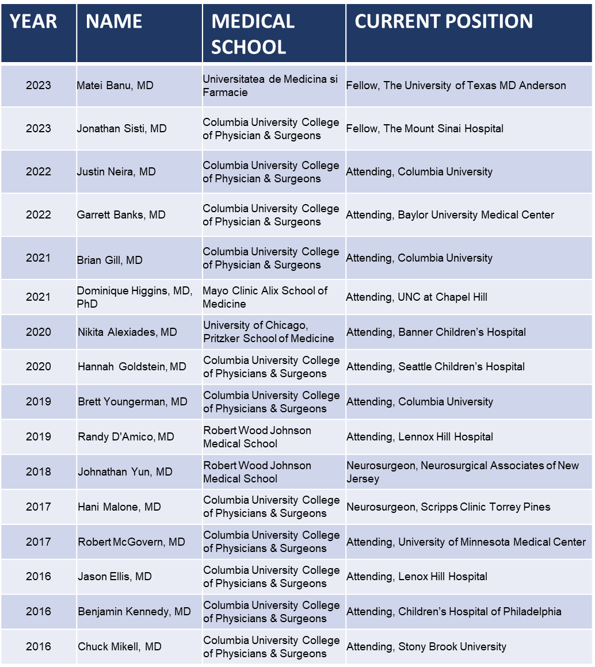
Graduates where are they now?
15 out of 18
Attendings
+ 1 in fellowship
89%

Slide 6
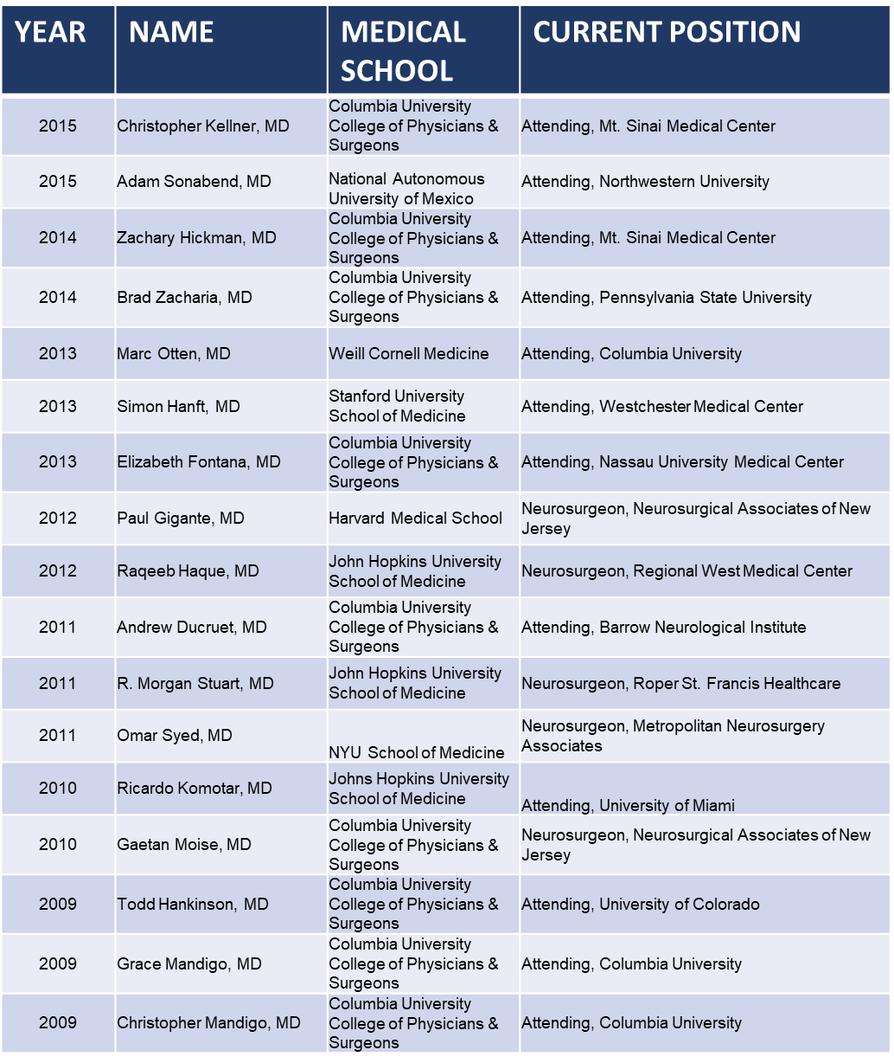
Graduates where are they now?
15 out of 18
Attendings
+ 1 in fellowship
89%

Slide 7
Questions/Points of Contact
Lab Senior Residents:
Lab Senior Resident
Deborah Boyett, PGY-4
ny2219@cumc.columbia.edu
Lab Senior Resident
Nathan Winans, PGY-4
Njw2130@cumc.columbia.edu
6th Year Resident:
Senior Resident
Zackary Englander, PGY-6
zke2000@cumc.columbia.edu
Chief Resident
Evan Joiner, PGY-7
efj2107@cumc.columbia.edu
Chief Resident
Eleonora Spinazzi, PGY-7
efs2110@cumc.columbia.edu

