Slide 1
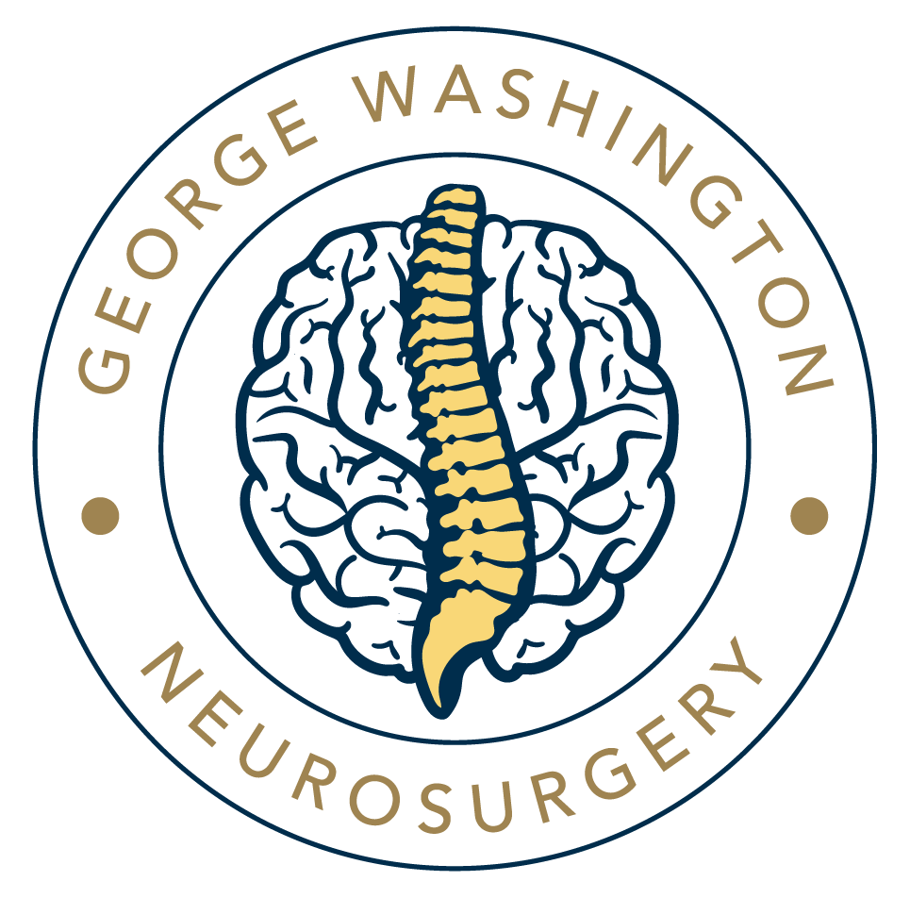

Slide 2
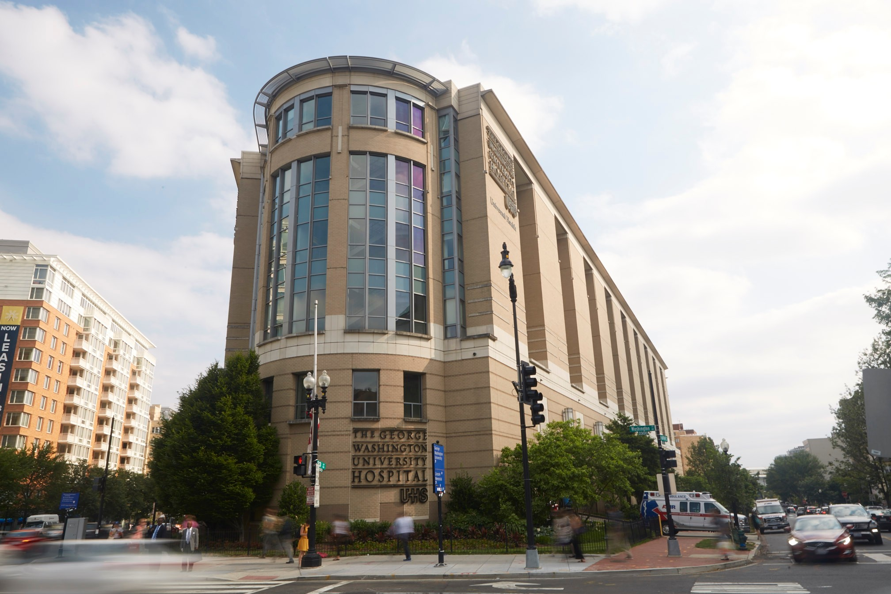
GW Neurosurgery Today
Resident compliment of 11 (1-2-1), currently with 9 residents active and 1 new PGY1 starting July 1, 2024.
(Interim) Chair Michael Rosner, MD
Dedicated core faculty with ongoing recruitment
Robust clinical, surgical, didactic education

Slide 3





Sites, Rotations, Fellowships
CAST accredited enfolded endovascular and complex spinal deformity fellowships available
Research opportunities at the NIH, GW, and Children's National
All graduates in last 10 years have matched first or second choice fellowship

Slide 4
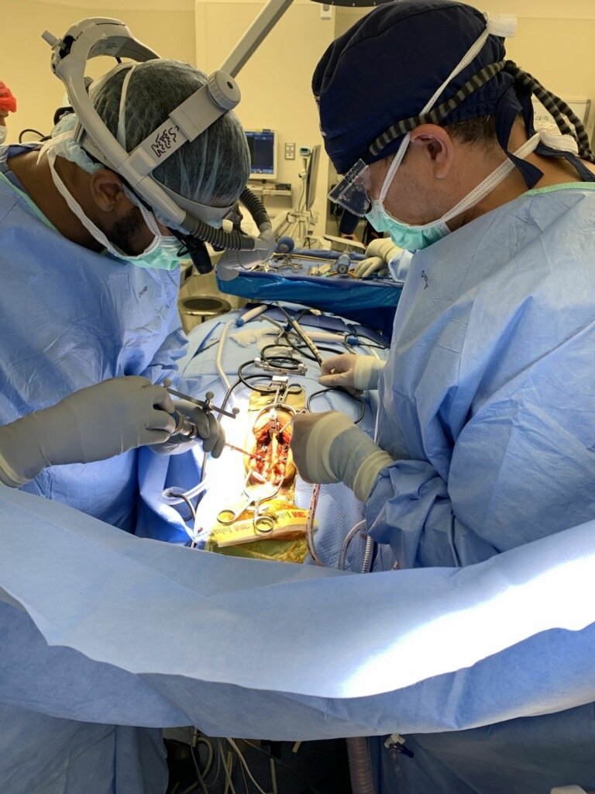
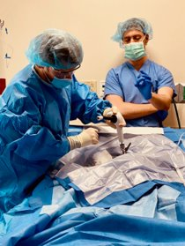
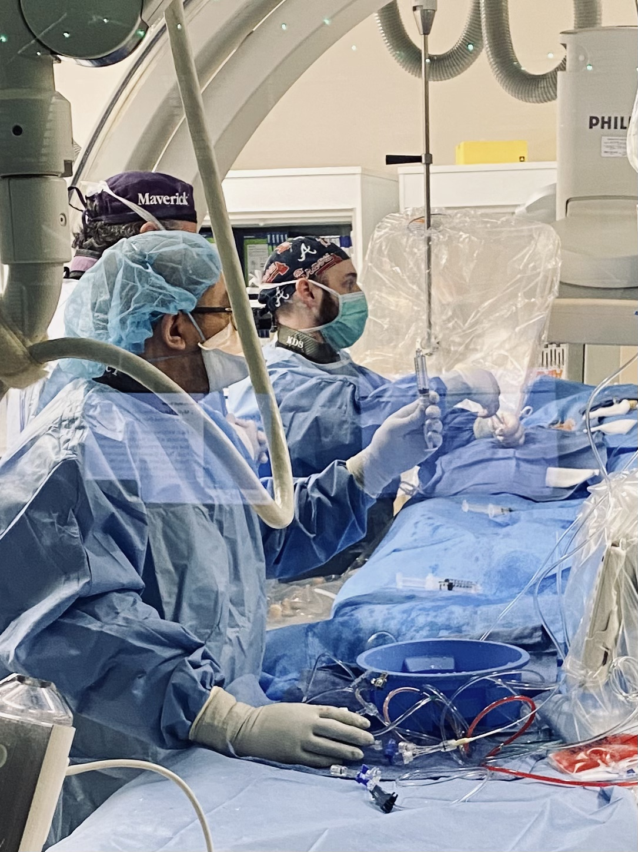
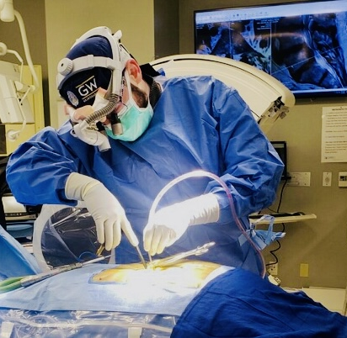
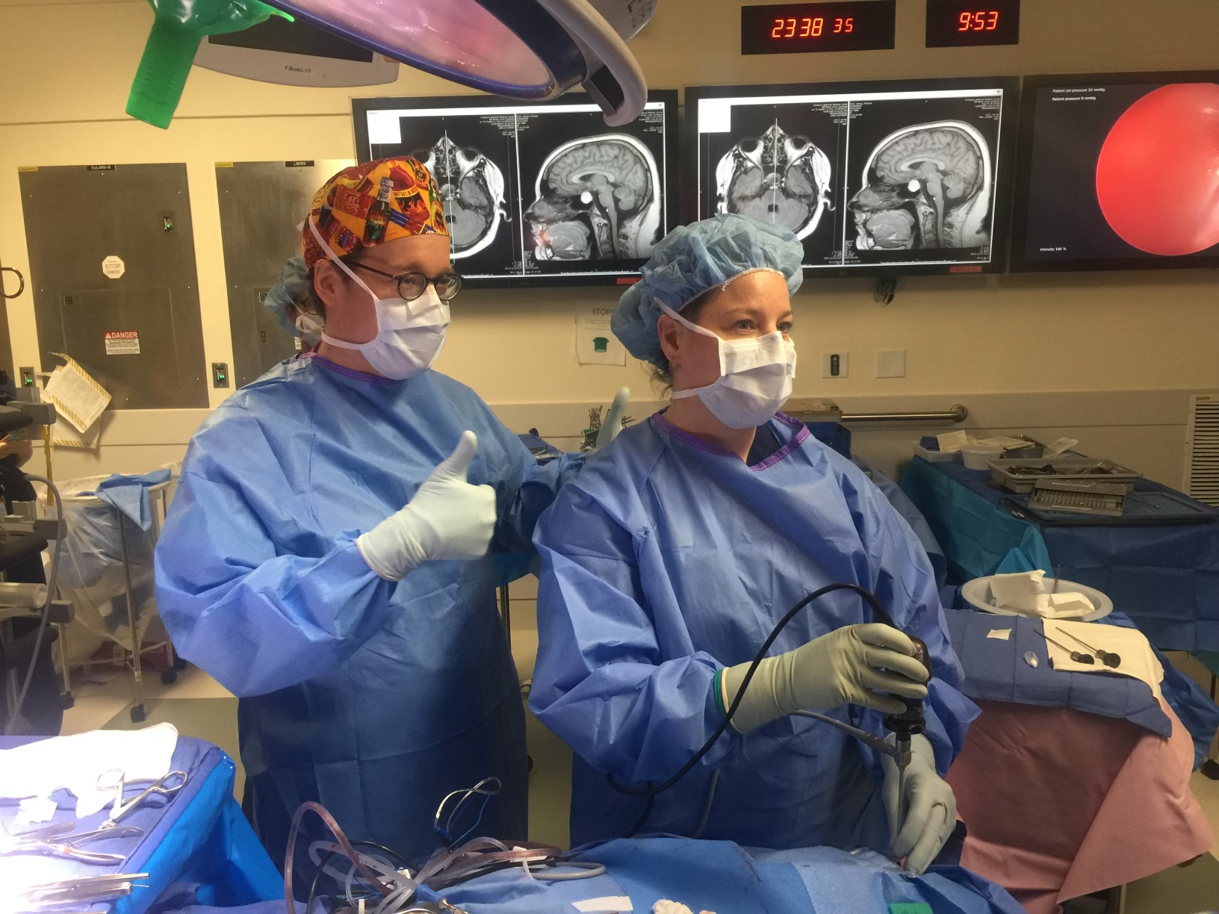
GW Neurosurgery Residency
PGY-1: 6mos ICU, 6mos NSGY
PGY-2: GWU inpatient, OR, IR
PGY-3: 6mos CNMC, 6mos GWU
PGY-4: 6mos Vascular/Cranial, 6mos Spine
PGY-5: 6mos HCH (functional/MIS spine), 6mos LVHN (skull base/vascular)
PGY-6: Chief Year
PGY-7: Fellowship/Research flex

Slide 5
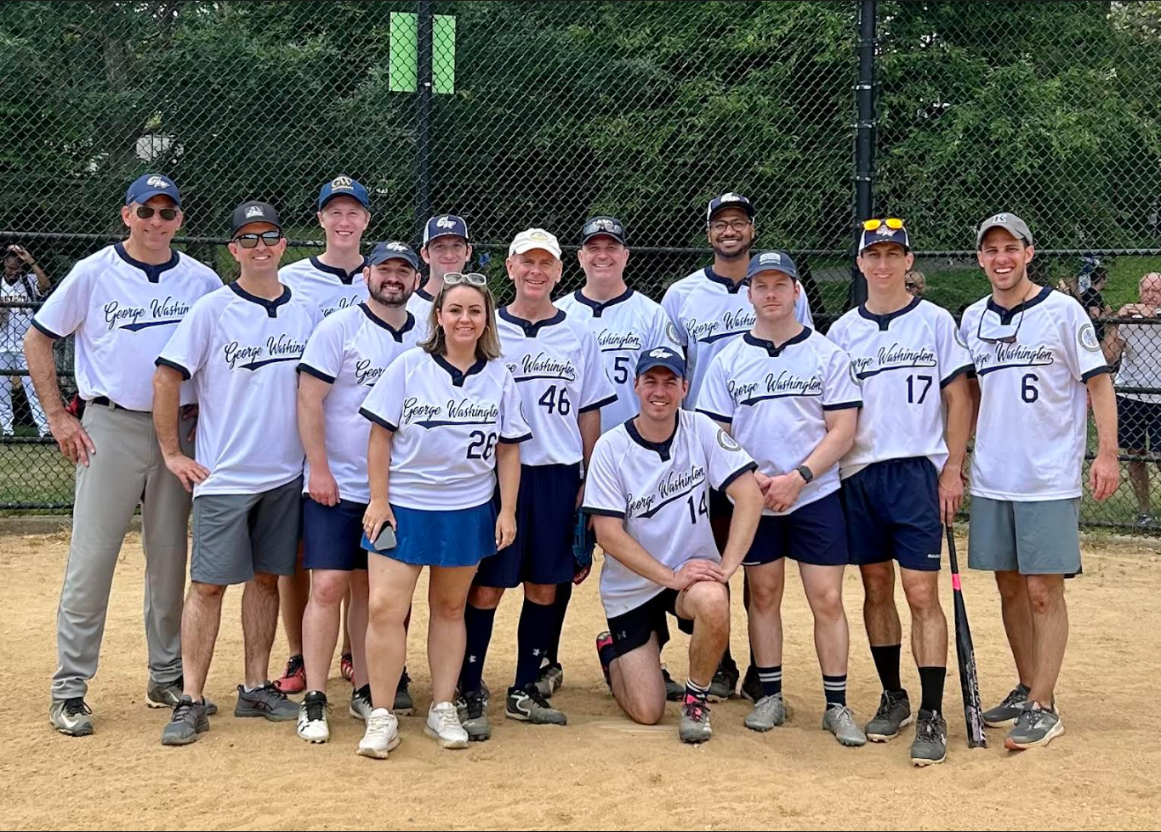
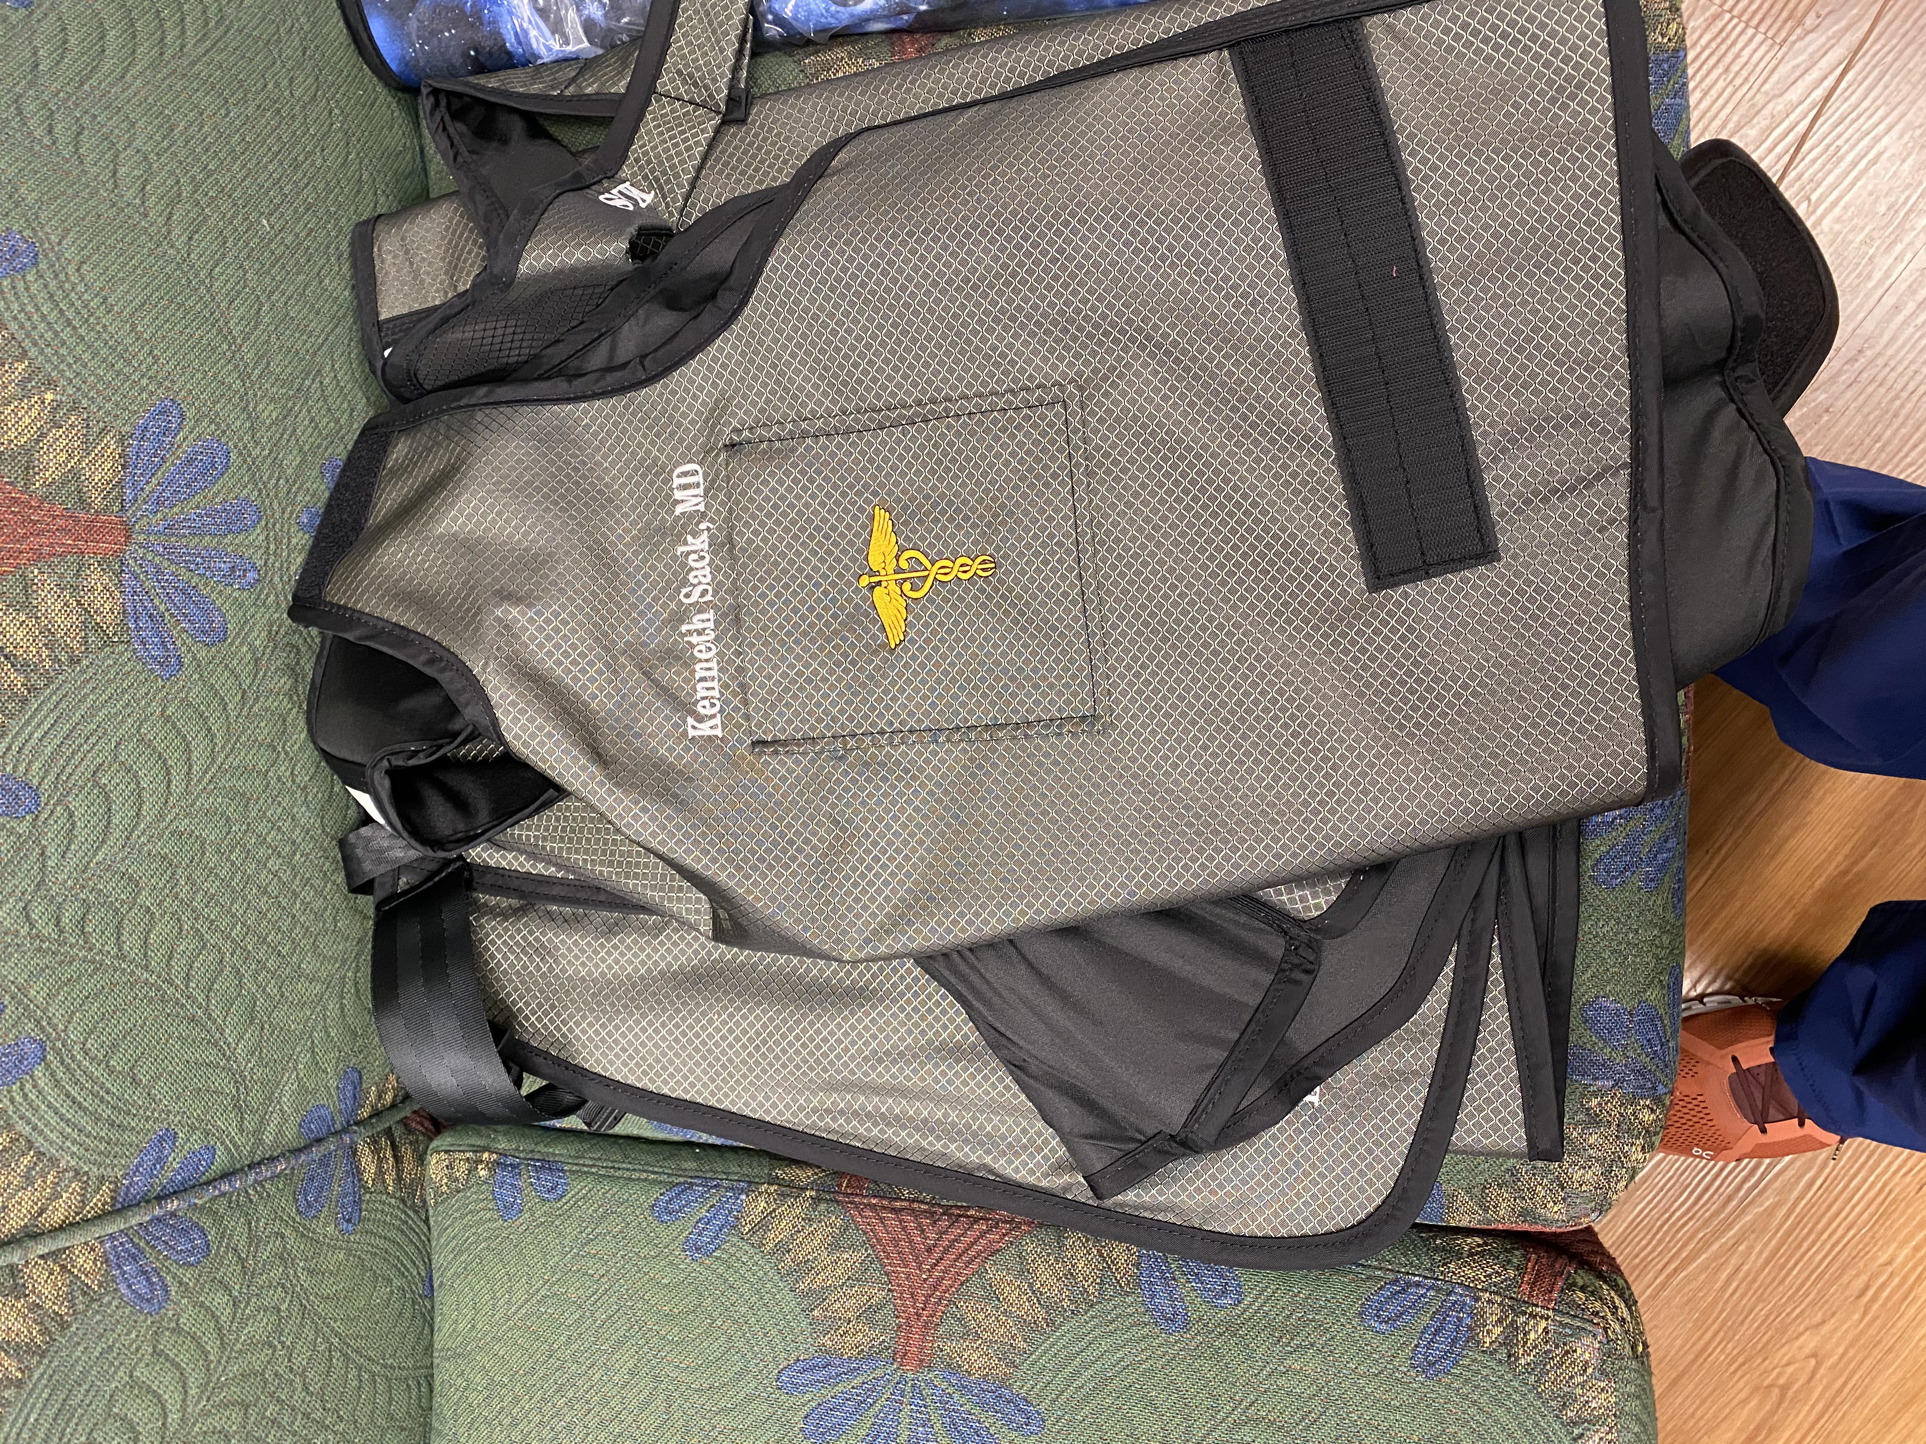
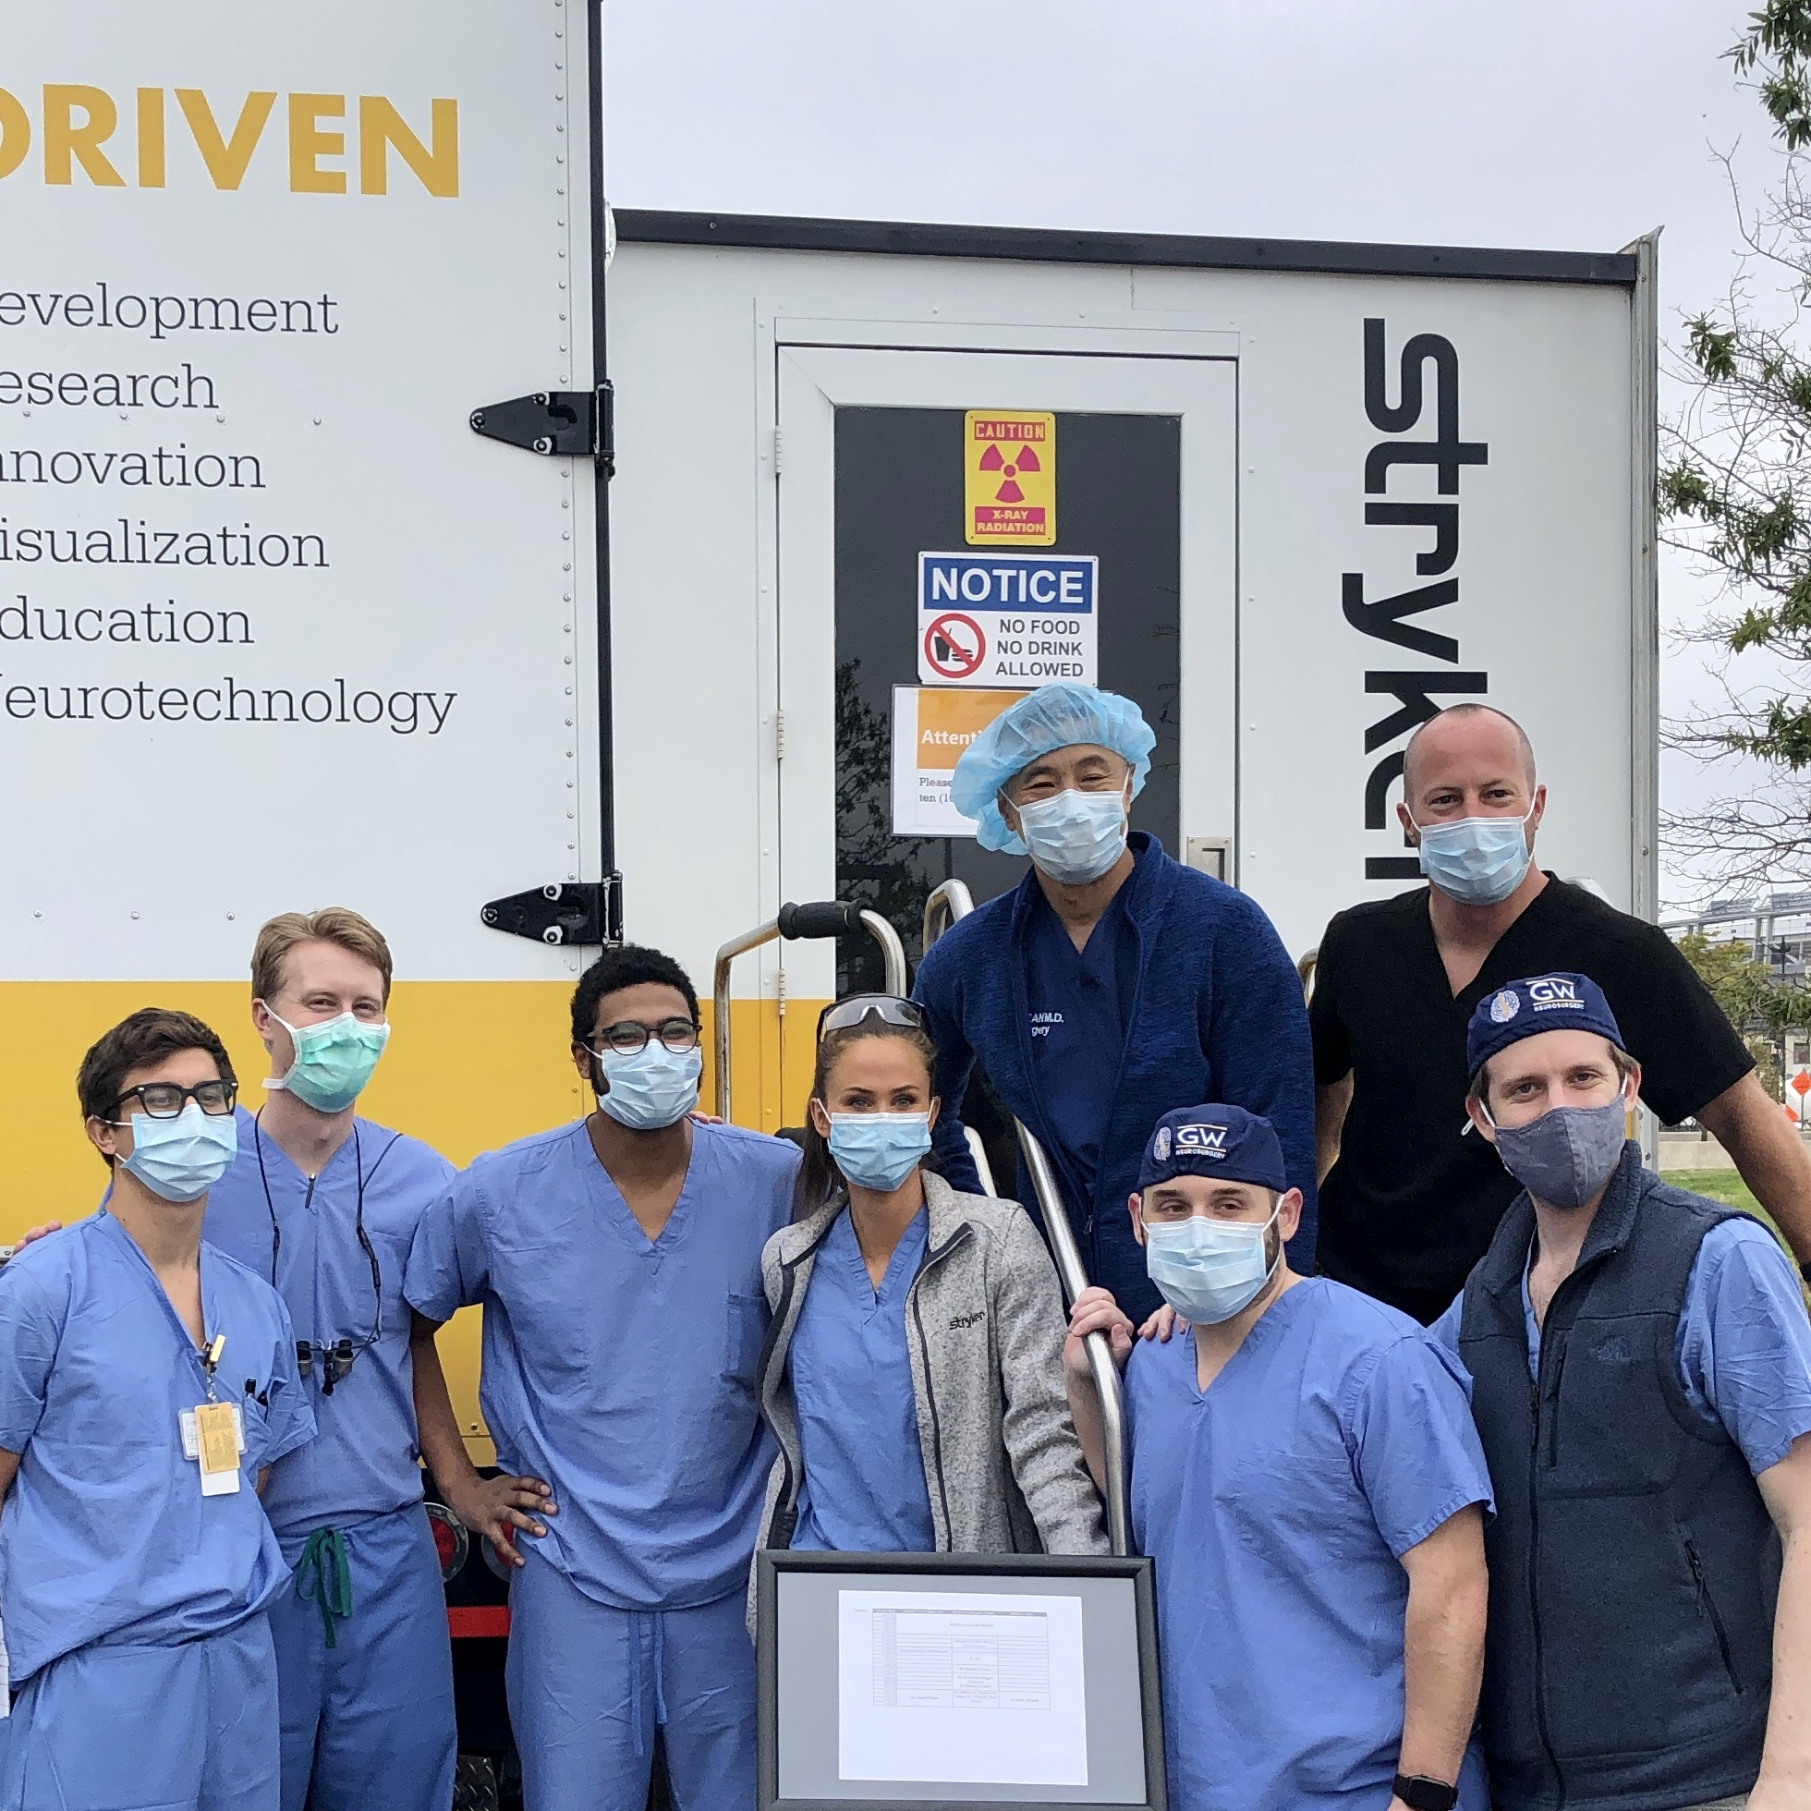
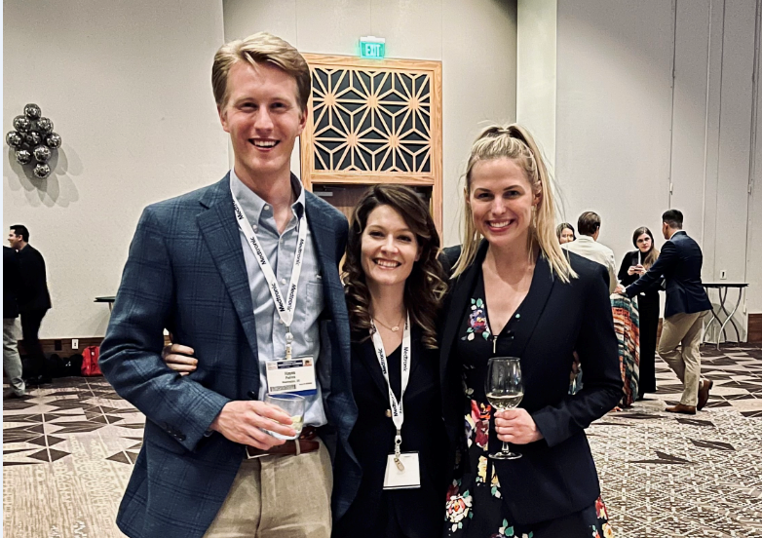
GW Neurosurgery Perks
Night Float System (12 shifts in 2-week blocks)
Loupes, Headlight, Lead, iPad, books
EndNote X9, PubMed access
Annual Charity Softball Tournament in NYC
National and Regional Conferences/RUNN Course
Stryker/Medtronic Dissection Labs

Slide 6
Ammerman Dissection Lab
https://gwu0.sharepoint.com/:v:/r/sites/GWNSGY-GRP/Shared%20Documents/Ammerman%20Lab/Ammerman%20Lab.mp4?csf=1&web=1&e=g57XEd
Faculty Advisors:
Dr. Carlos Sanchez
Dr. Daniel Donoho
Dr. Saleem Abdulrauf

Slide 7
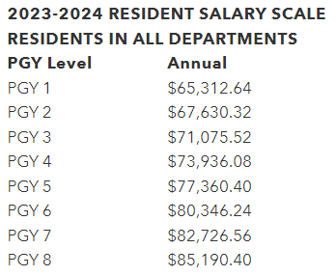
GW Salaries and Benefits
Above average salary for residents
Food credit in the hospital
Free parking underneath the hospital
3 weeks paid vacation, plus holidays and sick leave
Up to 6 weeks of maternity/paternity leave
Wellness resources
Retirement benefits (403b with matching from GW for up to 4% of your salary)
Health insurance: H.S.A. vs P.P.O.
  6% matching from GW into health savings account with rollover savings

Slide 8
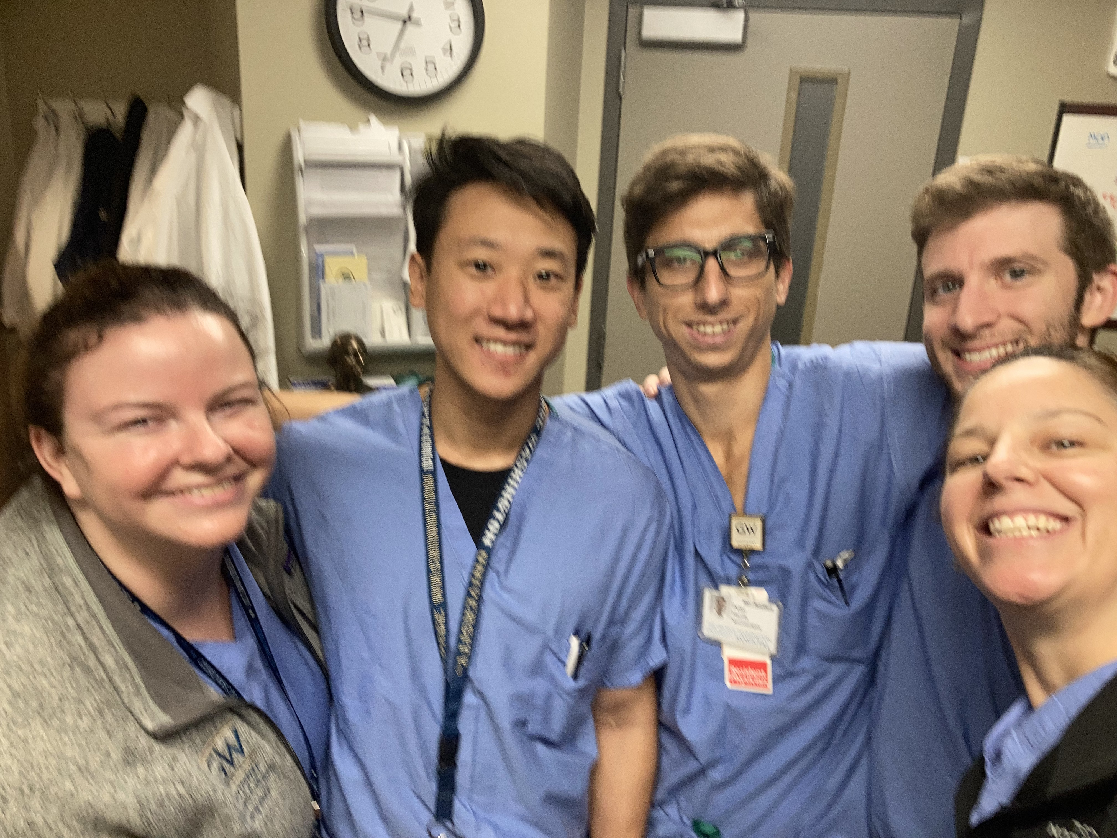
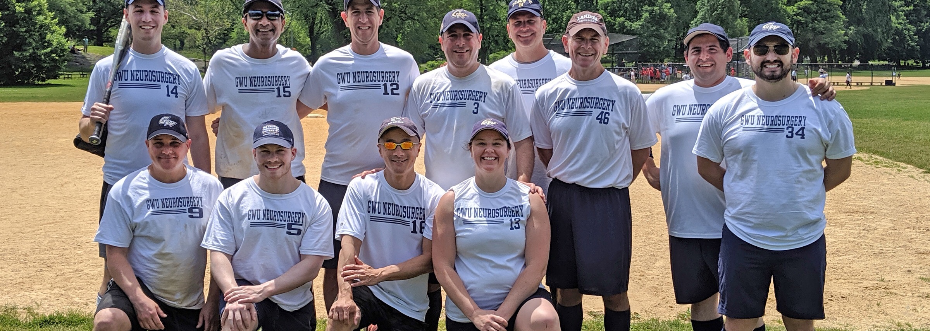
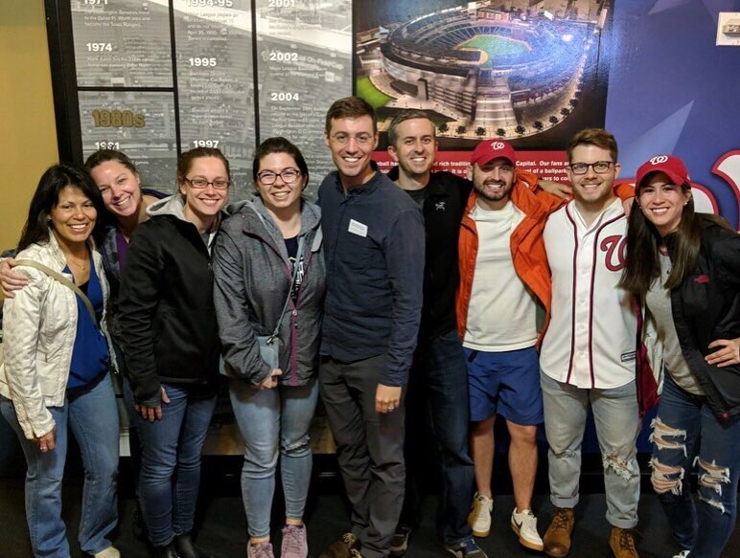
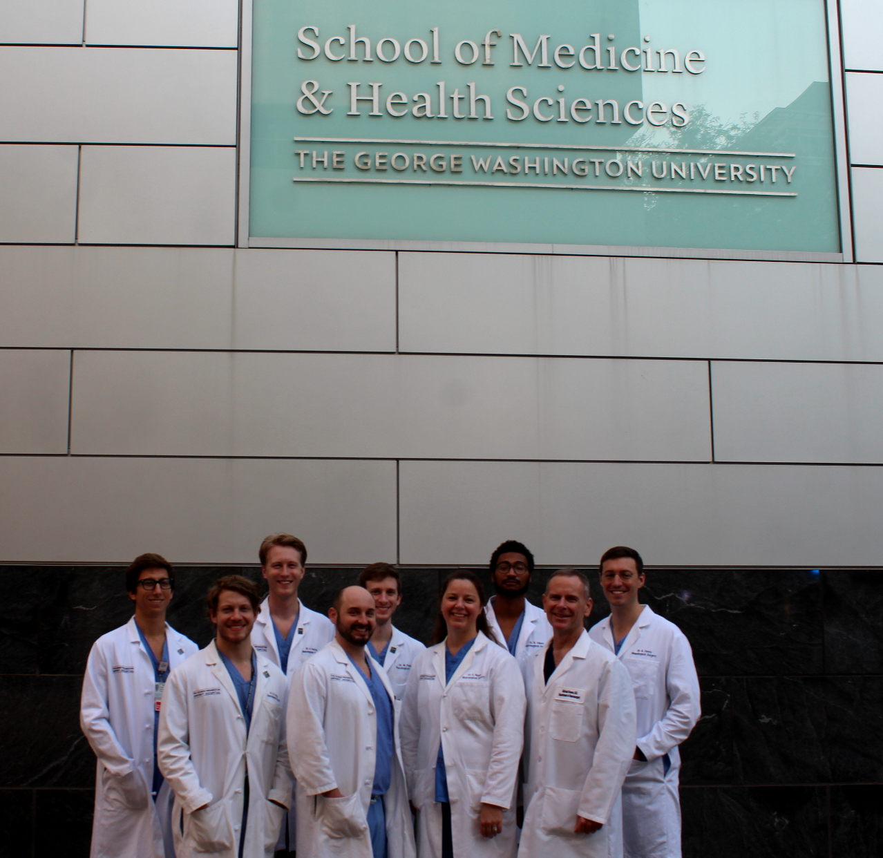
The Residents

Slide 9
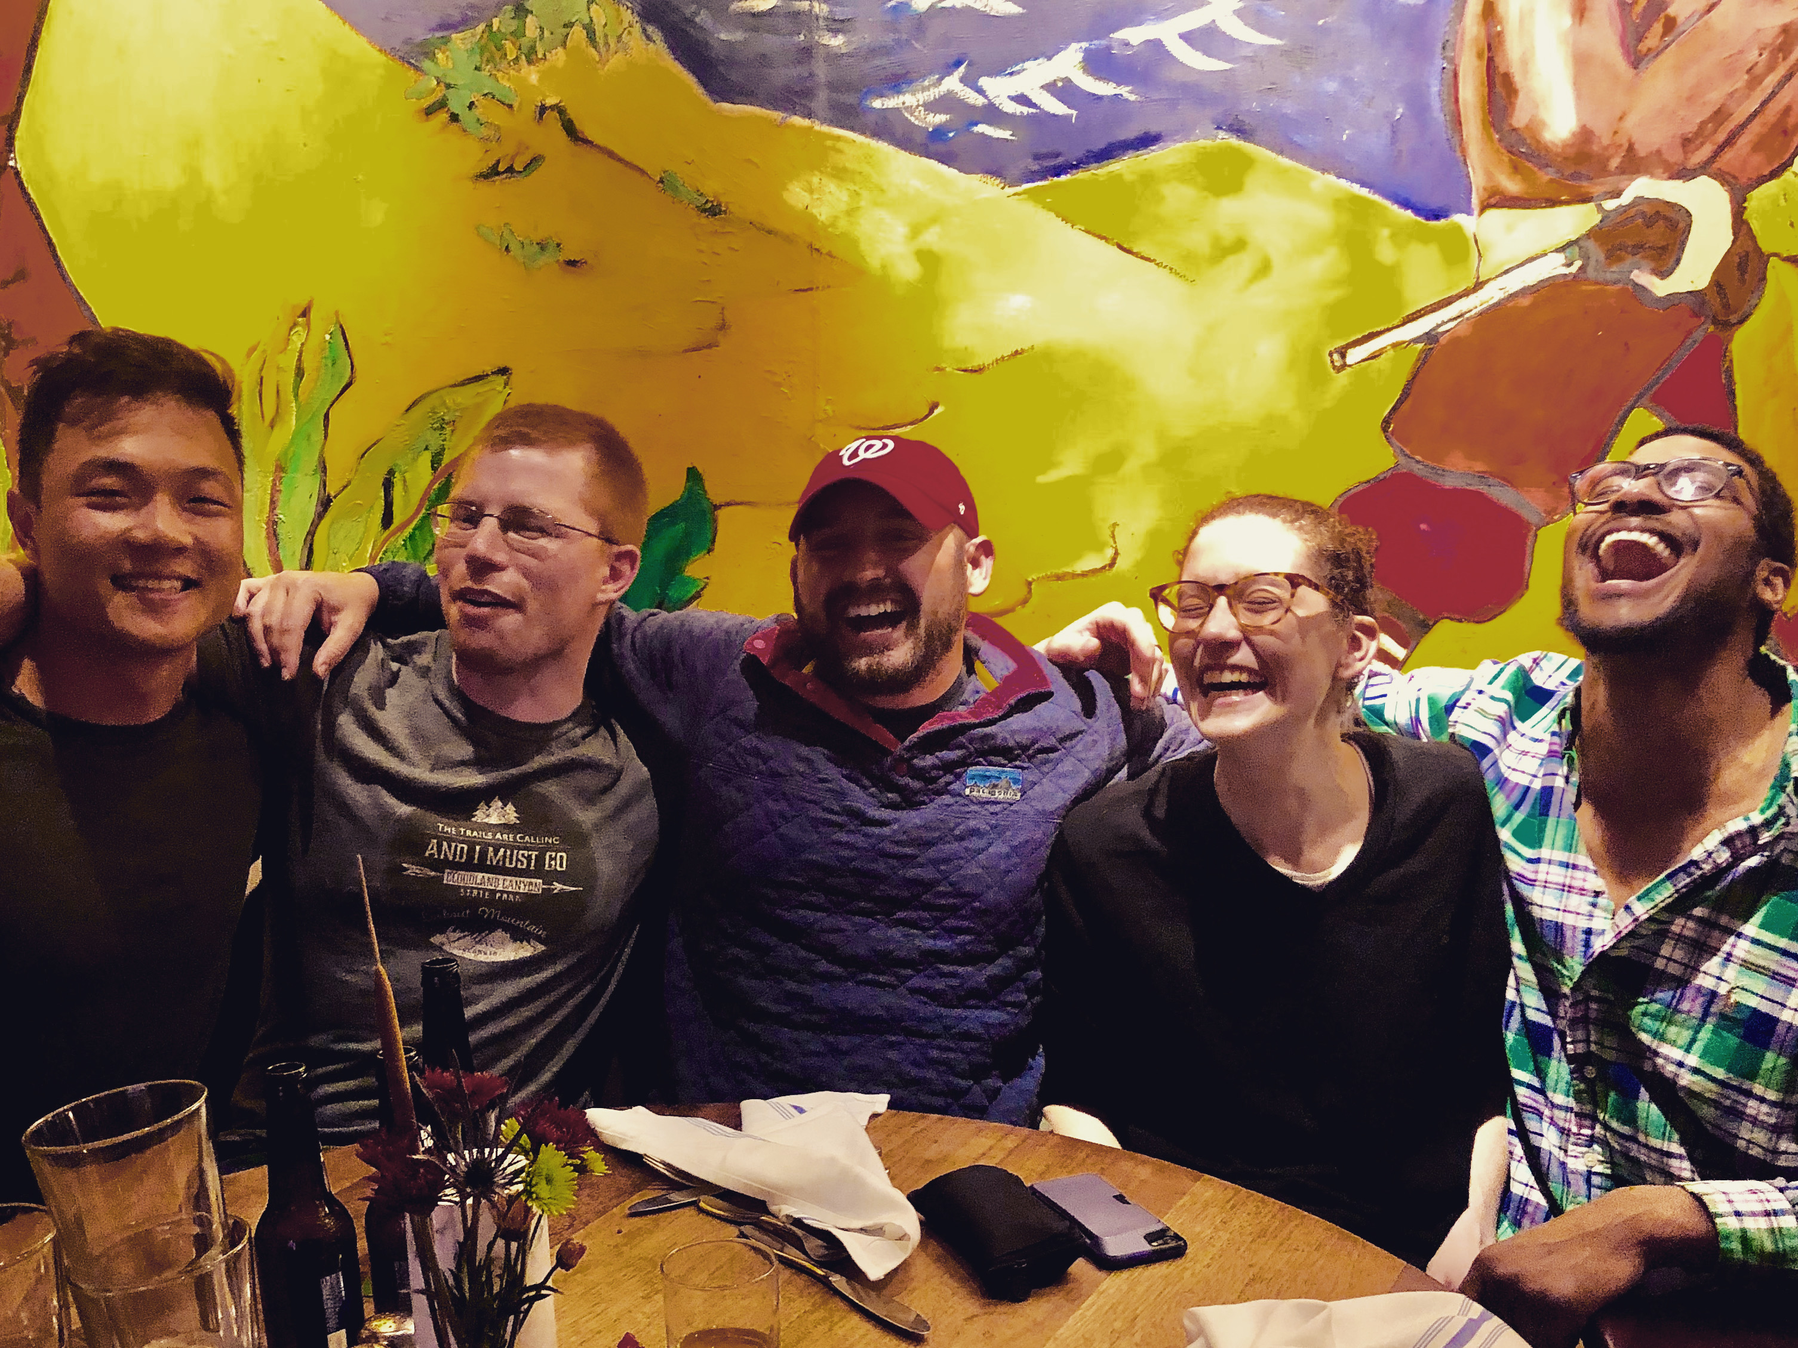
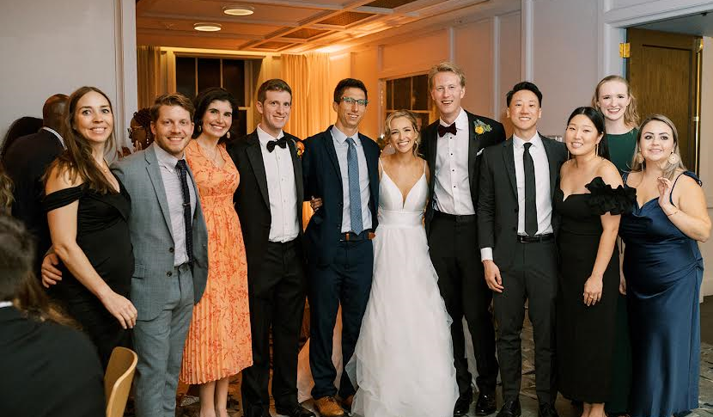
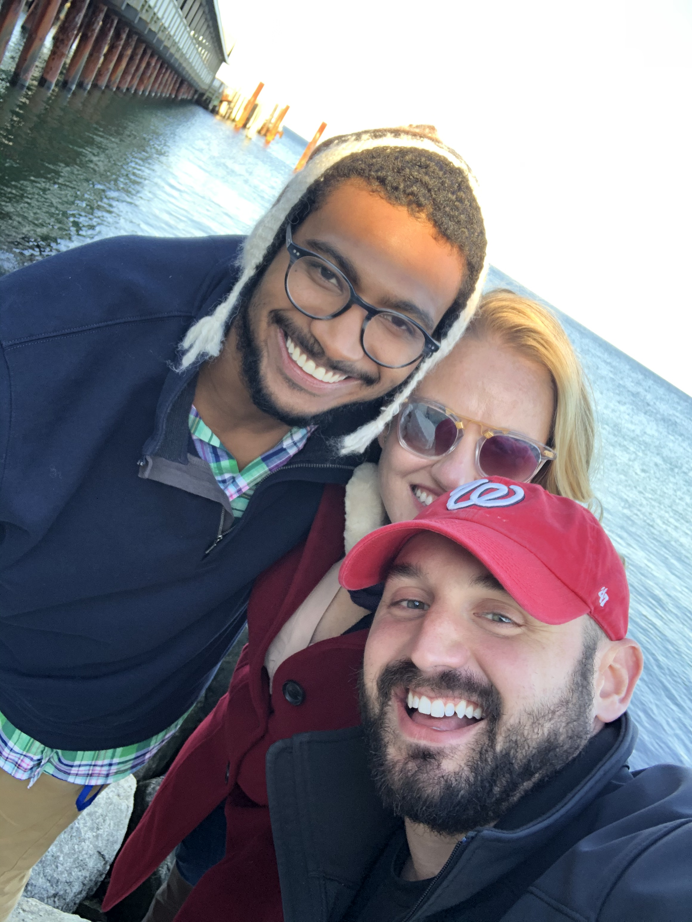
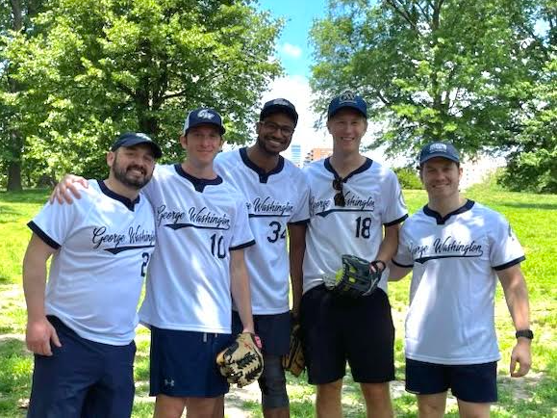
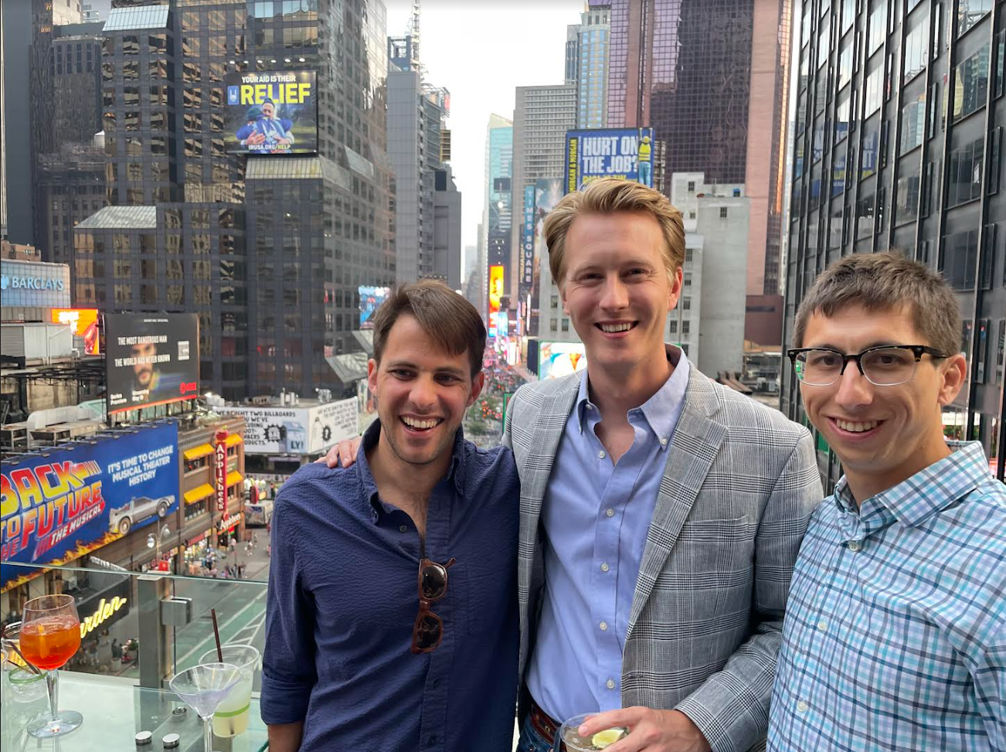

Slide 10

Living in DC
Live in DC, Arlington, Rosslyn
  50/50 rent vs own
Excellent public transportation
Biking/walking-friendly
Culture and politics
Restaurants, entertainment
3 major airports within 1 hour
Within driving distance:
  Hiking/camping
  Beach
  Most major cities in New England

Slide 11
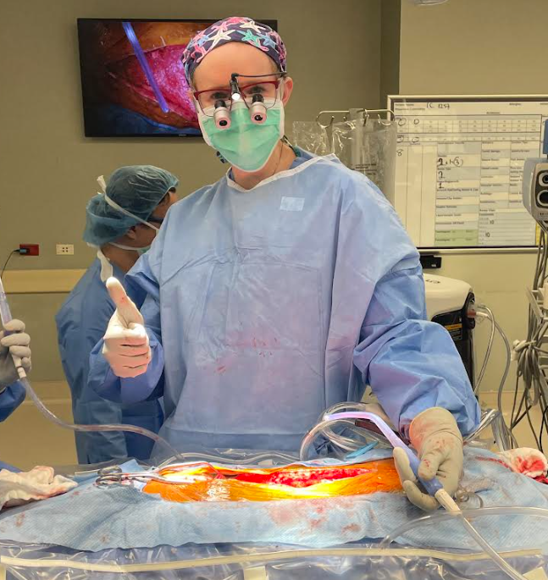
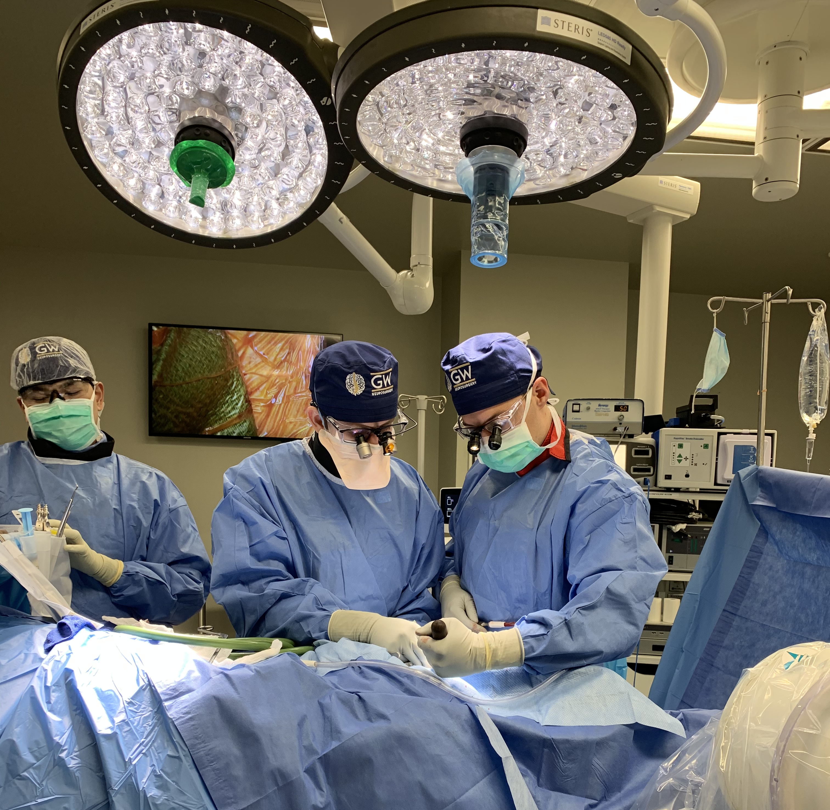
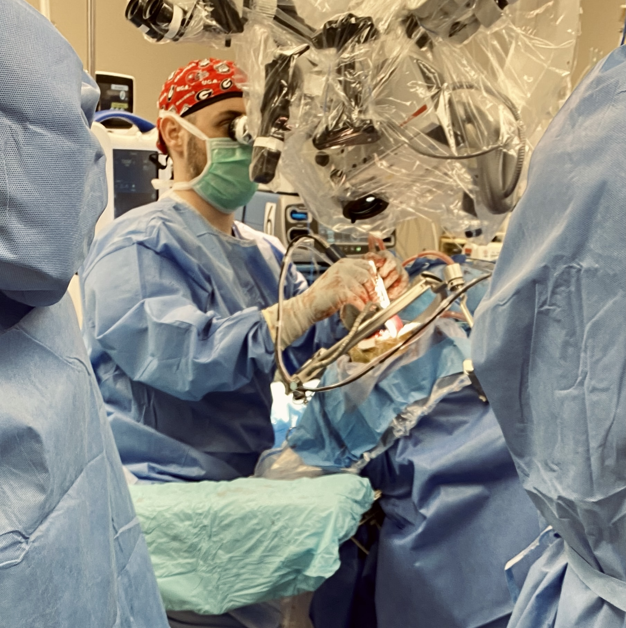

Why Come Train with Us?
Hands-on operative residency
Resident & Education focused program
One of the best cities to live in
Close knit resident cohort
Tailor your training and career path

Slide 12
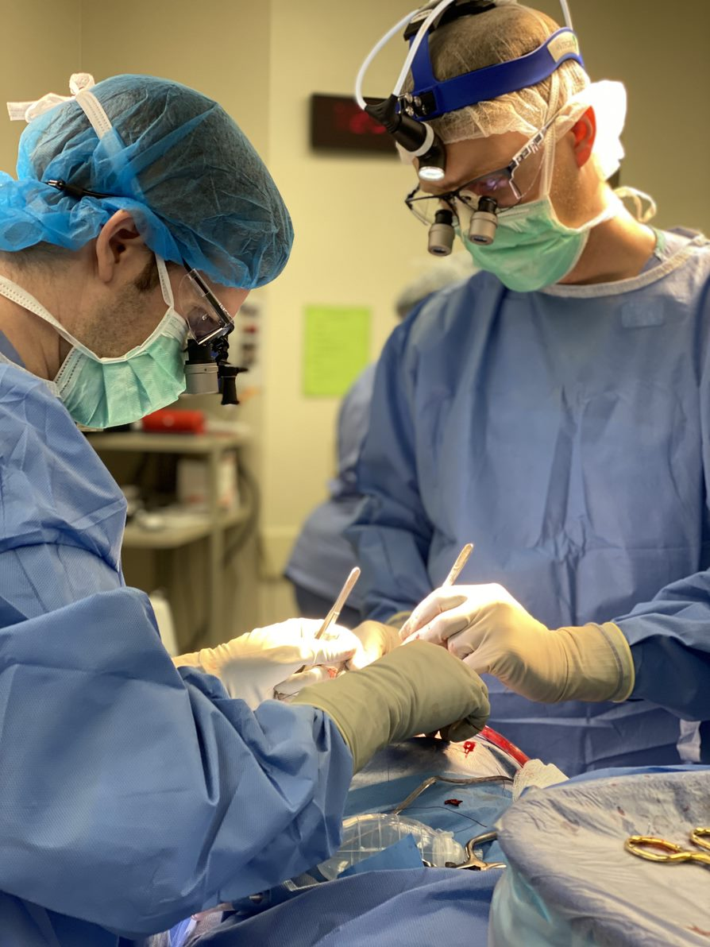

Come do a sub-internship with us!
World-class training from outstanding faculty who prioritize resident education
Learn to give exceptional care to your patients who come from all backgrounds
Join a wonderful hardworking, supportive resident team
Live in (and enjoy!) an amazing city for the next 7 years
To apply:
1. Email Stefanie Dalgo, sdalgo@mfa.gwu.edu
2. Fill out your VSAS application through your medical school
3. neurosurgery.smhs.gwu.edu to learn more

Slide 13
Questions?
Peter Harris, PGY4
pnharris@gwu.edu
808-230-5416
Hayes Patrick, PGY5
hpatrick@gwu.edu
225-341-0137
Max Fleisher, PGY5
maxsfleisher@gwu.edu
904-525-9076

