Slide 1
A Neurosurgeon’s Guide to Pulmonary Critical Care for COVID-19
Alan Hoffer, M.D.
Chair, Critical Care Committee
AANS/CNS Joint Section on Neurotrauma and Critical Care
Co-Director, Neurocritical Care Center
Associate Professor of Neurosurgery and Neurology
Rana Hejal, M.D.
Medical Director, Medical Intensive Care Unit
Associate Professor of Medicine
University Hospitals of Cleveland
Case Western Reserve University

Slide 2

To learn more, visit our website at:
www.neurotraumasection.org

Slide 3
Introduction
As the number of people infected with the novel coronavirus rapidly increases, some neurosurgeons are being asked to participate in the care of critically ill patients, even those without neurological involvement. This presentation is meant to be a basic guide to help neurosurgeons achieve this mission.

Slide 4
Disclaimer
The protocols discussed in this presentation are from the Mission: Possible program at University Hospitals of Cleveland, based on guidelines and recommendations from several medical societies and the Centers for Disease Control (CDC).
Please check with your own hospital or institution to see if there is any variation from these protocols before implementing them in your own practice.

Slide 5
Disclaimer
The content provided on the AANS, CNS website, including any affiliated AANS/CNS section website (collectively, the “AANS/CNS Sites”), regarding or in any way related to COVID-19 is offered as an educational service. Any educational content published on the AANS/CNS Sites regarding COVID-19 does not constitute or imply its approval, endorsement, sponsorship or recommendation by the AANS/CNS. The content should not be considered inclusive of all proper treatments, methods of care, or as statements of the standard of care and is not continually updated and may not reflect the most current evidence. Nothing in the educational content published on the [AANS/CNS Sites should be considered, or used as a substitute for, medical advice, diagnosis or treatment. The AANS/CNS Sites and the educational services offered therein do not constitute the practice of medicine or any medical or other professional health care advice, diagnosis or treatment. The AANS/CNS assumes no responsibility for any injury or damage to persons or property arising out of or related to any use of this content or for any errors or omissions.

Slide 6
COVID-19
Coronavirus disease 2019 (COVID-19) is a respiratory tract infection caused by a newly emergent coronavirus, SARS-CoV-2, that was first recognized in Wuhan, China, in December 2019.
Genetic sequencing of the virus suggests that SARS-CoV-2 is a betacoronavirus closely linked to the SARS.

Slide 7
Personal Protective Equipment
When taking care of COVID-19 patients, please adhere to all of your institution’s policies regarding personal protective equipment (PPE)
To help others, you must stay healthy yourself!

Slide 8
Our Isolation Protocols
Admit to negative pressure room if available; if not enough negative pressure rooms available for all admitted COVID patients, preference given to non-intubated patients since their respiration is in an open system and they may require intubation
Patient requires surgical mask when out of room for tests/procedures and when on HFNC
Patient must remain in room with door closed
No visitors unless comfort measures are being implemented – then, provide visitors with PPE and educate on procedures – one visitor at a time
Use clear cassette drape/probe covers for portable imaging to minimize equipment contamination
Staff require strict contact and droplet precautions
Nurses to perform lab draws from lines to minimize contact among staff
Minimize number of staff interacting with patients
Bundle patient care duties to minimize number of interactions with patient by nurse (medications, vitals, I/Os, lab draws, meal service, etc)

Slide 9
ICU Admission for COVID-19
Pneumonia with hypoxic respiratory failure
Acute Respiratory Distress Syndrome (ARDS)
Sepsis
Septic shock
Post cardiac arrest

Slide 10
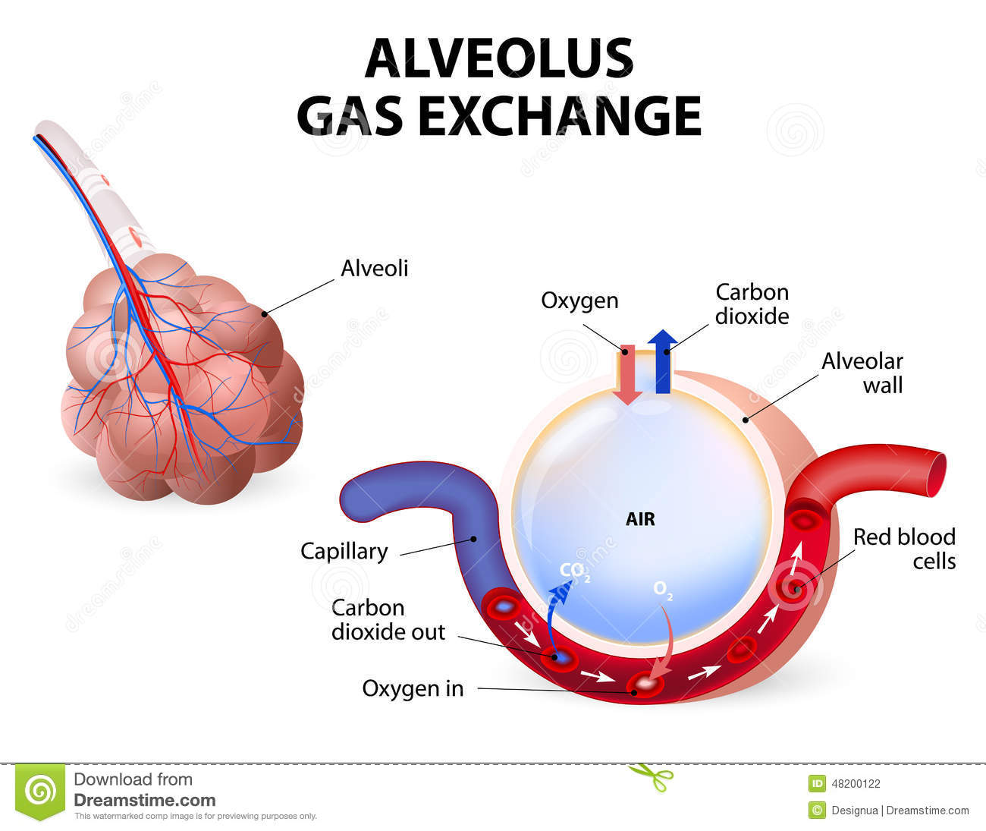
Pulmonary System

Slide 11
Pulmonary Function
Gas exchange occurs in the alveoli of the lung
  Respiration: oxygen exchange
  Ventilation: CO₂ exchange
Acid-base balance: Because CO₂ is in equilibrium with H⁺, ventilation affects pH

Slide 12
Causes of Respiratory Symptoms
Inflammation or fluid in the alveoli preventing adequate gas exchange
Airway sections
Airway inadequacy
Reactive airway disease
Gas trapping
Gas exchange abnormalities
Clinically significant hypoxia is defined by:
SpO₂ ≤90% in non-pregnant adults
SpO₂ ≤92-95% in pregnant patients

Slide 13
Managing Hypoxia
Standard supplemental oxygen therapy – by nasal cannula - Start immediately to patients with SARI (severe acute respiratory infection) and respiratory distress, hypoxemia, or shock.
Initiate oxygen therapy at 6L/min low flow nasal cannula or with face mask with or without reservoir bag (flow rates of 10-15 L/min, which is typically the minimum flow required to maintain bag inflation; FiO₂ 0.60-0.95)

Slide 14
Managing Hypoxia
High-flow nasal oxygen (HFNC)
Use in pure hypoxic respiratory failure – aim for SpO₂ ≥94%
Start flow at 20-30 L and FiO₂ 50%
If FiO₂ > 80%, may increase flow up to a maximum of 40 L
Use an isolation mask on top of the HFNC
Patient should be closely monitored
  Increases in flow or FiO₂ should prompt immediate reassessment for intubation, especially if accompanied by an increase in respiratory rate

Slide 15
Managing Hypoxia
Non-invasive ventilation (NIV)
Use in selected group of patients
Don’t transfer on NIV
If used, all personnel in room must wear N95 masks
Must have viral filter placed prior to expiratory limb
Titrate EPAP to 8-10 cm H₂O
Monitor every 2 hours
  If FiO₂ needs or EPAP continue to increase, consider early initiation of mechanical ventilation

Slide 16
Bronchodilators
In spontaneously breathing patients, avoid nebulizing medication
  Increases risk of provider infection due to aerosolized particles
  MDIs are preferred
In mechanically ventilated patients, nebulizers are tolerated because the circuit is closed
  If MDI is used, use 4 puffs with a spacer per dose

Slide 17
Mechanical Ventilation
Mechanical ventilation is to be implemented early in patients with COVID-19 pneumonia in respiratory failure
Positive pressure ventilation (PPV)
Most common mode is Volume Control
  Delivers a set volume with each breath
  Airway pressures will vary with respiratory mechanics and must be monitored to avoid further injury to the lungs

Slide 18
Goals Of Mechanical Ventilation
Oxygenation - PaO₂ 55-80 mmHg or oxygen saturation (SpO₂) 88-95% in ARDS in general
    Improved outcomes in COVID-19 patients when SpO₂ is kept above 94%
I:E ratio- Duration of inspiration ≤ duration of expiration as long as tolerated hemodynamically in patients with ARDS

Slide 19
Ventilator Parameters
FiO₂- percent inspired oxygen
RR- respiratory rate
V_{T}- tidal volume
PEEP- positive end-expiratory pressure
Minute ventilation = RR x V_{T}

Slide 20
Initiating Mechanical Ventilation
Calculate predicted body weight (PBW) in kg
    Males = 50 + 2.3 [height (inches) - 60]
    Females = 45.5 + 2.3 [height (inches) -60]
Select ventilator mode as volume control/assist control
Set ventilator breath at V_{T} = 8 ml/kg PBW
Set initial rate to approximate baseline minute ventilation (not > 35 breaths/min)
If Pplat > 28-30, Reduce V_{T} by 1 ml/kg at intervals ≤ 2 hours until V_{T} = 6ml/kg PBW and Plat < 30

Slide 21
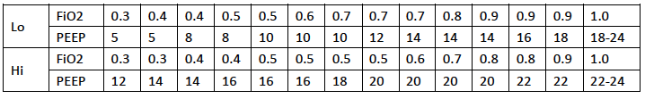
Initiating Mechanical Ventilation
Start PEEP at 10 cm H₂O. Titrate PEEP/FiO₂ as guided by chart below
If patient develops hypotension associated with increased PEEP do not continue to increase PEEP
Initially, low PEEP strategies should be used. High PEEP may be used for patients who require increased support and have low lung compliance.
ARDSnet table

Slide 22
Hemodynamic Effects of PPV
Decreased preload
Mechanism - Positive alveolar pressure
    → compression of the heart by the inflated lungs
    → the intramural pressure of the heart cavities rises
    → venous return decreases
    → preload is reduced
    → stroke volume decreases
    → cardiac output and blood pressure may drop
Treatment – fluid therapy
    restore adequate venous return and preload
    Over-resuscitation however should be avoided in this patient population
Conditions sensitive to change in preload include
    hypovolemia, pericardial tamponade, Pulmonary embolism, pulmonary HTN, and severe air trapping like asthma and COPD

Slide 23
Hemodynamic Effects of PPV
Reduced afterload
Lung expansion increases extramural pressure (which helps pump blood out of the thorax) and thereby reduces LV afterload
When the cardiac performance is mainly determined by changes in afterload than in preload conditions (e.g., hypervolemic patient with systolic heart failure), PPV may be associated with an improved stroke volume. PPV is very helpful in patients with cardiogenic pulmonary edema, as it helps to reduce preload (lung congestion) and afterload. As a result stroke volume tends to increase.

Slide 24
Ventilator Airway Pressures
Peak pressure
  Maximal airway pressure any time during inspiration
  Amount of pressure necessary to overcome airway resistance and expand the thoracic cage
Plateau pressure
  Amount of pressure necessary to overcome the elastic recoil of the lung and thoracic cage
  Measured at the end of an Inspiratory Hold maneuver

Slide 25
Peak
resistance
flow
Plateau
end-inspiratory
alveolar pressure
compliance
tidal volume
PEEP
From lecture by Kacmarek, RM

Slide 26
Goals Of Mechanical Ventilation
Plateau pressure goal: ≤ 30 cm H₂O
Check P_{plat} (0.5 second inspiratory pause) at least q 4h and after each change in PEEP or tidal volume (V_{T})
  If Pplat > 30 cm H₂O: decrease V_{T} by 1ml/kg steps (minimum = 4 ml/kg)
  If Pplat < 25 cm H₂O and VT< 6 ml/kg, increase V_{T} by 1 ml/kg until Pplat > 25 cm H₂O or V_{T} = 6 ml/kg.
  If Pplat < 30 and breath stacking or dyssynchrony occurs: may increase V_{T} by 1ml/kg increments to 7 or 8 ml/kg if Pplat remains < 30 cm H₂O

Slide 27
Acid-Base Management
Arterial blood gas
  pH, PaO₂, PaCO₂, calculated bicarbonate level
Comprehensive metabolic panel
  measured bicarbonate level, anion gap
Baseline pH and CO₂ levels may be altered in patients with chronic conditions such as COPD and kidney disease. Adjustments to treatment goals may be necessary

Slide 28
Acid-Base Management
Respiratory acidosis
pH<7.4, PaCO₂>40
Treat by increasing minute ventilation (avoid increasing V_{T} if barotrauma is a concern)
Metabolic acidosis
pH<7.4, PaCO₂<40
Anion gap acidosis: consider elevated lactate from hypoperfusion or sepsis, ketoacidosis, etc.
Non-anion gap acidosis: often from renal dysfunction
Treat underlying condition

Slide 29
Acid-Base Management
Respiratory alkalosis
pH>7.4, PaCO2<40
Treat by decreasing minute ventilation
Metabolic alkalosis
pH >7.4, PaCO₂>40
Contraction alkalosis (hypovolemia)
  Treat with intravascular volume resuscitation
Loss of acid such as gastric suctioning

Slide 30
Acid-Base Management
pH goal: 7.30-7.45
Acidosis Management: (pH < 7.30)
If pH 7.15-7.30: Increase RR until pH > 7.30 or PaCO₂ < 25 (Maximum set RR = 35)
If pH < 7.15: Increase RR to 35.
If pH remains < 7.15, V_{T} may be increased in 1 ml/kg steps until pH > 7.15 (Pplat target of 30 may be exceeded)
Alkalosis Management: (pH > 7.45) Decrease vent rate if possible

Slide 31
Berlin Definition of ARDS
Timing: Within 1 week of a known clinical insult or new or worsening respiratory symptoms
Chest imaging: Bilateral opacities not fully explained by effusions, lobar/lung collapse, or nodules
Origin of edema: Respiratory failure not fully explained by cardiac failure or fluid overload. Need objective assessment (e.g., echocardiography) to exclude hydrostatic edema if no risk factor present
Oxygenation
  Mild 200 mmHg < PaO₂/FIO₂ ≤300 mmHg with PEEP or CPAP ≥5 cmH₂O
  Moderate 100 mmHg < PaO₂/FIO₂ ≤200 mmHg with PEEP ≥5 cmH₂O
  Severe PaO₂/FIO₂ ≤100 mmHg with PEEP ≥5 cmH₂O

Slide 32
Barotrauma
Inflammation and fluid accumulation may result in stiffening of alveoli and inability to expand. When this occurs, positive pressure is shunted away from these alveoli into healthy alveoli. This can result in over-distention and injury, known as barotrauma.

Slide 33
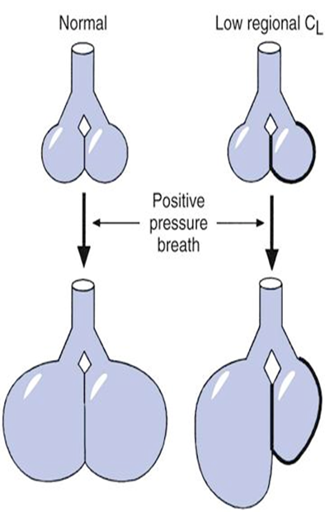
Avoid Barotrauma: lung-protective measures
4-8 ml/kg tidal volumes (ideal body weight based on height)
Higher positive end-expiratory pressure (PEEP) in patients with moderate or severe ARDS
Plateau pressures <30 cm H₂O

Slide 34
Rescue Therapy
For patients requiring FiO₂>70% with optimal PEEP
Proning
Recruitment maneuvers
Airway Pressure Release Ventilation (APRV)
Inhaled Epoprostenol
ECMO

Slide 35
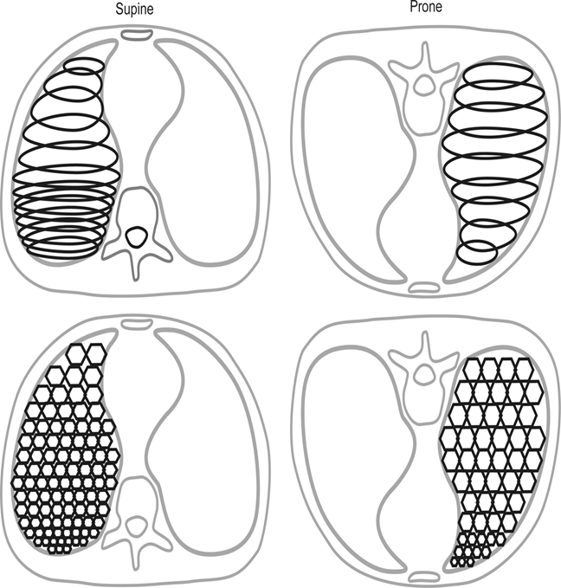
Proning
Prone positioning for12-16 hours/day in severe ARDS in an option

Slide 36
Proning- Contraindications
Shock (eg. Mean arterial pressure < 65mg)
Acute bleeding (eg. hemorrhagic shock, massive hemoptysis)
Multiple fractures or trauma (eg. unstable fractures of femur, pelvis, face)
Spinal instability
Pregnancy
Raised intracranial pressure > 30mmHg or cerebral perfusion pressure < 60 mmHg
Tracheal surgery or sternotomy within two weeks

Slide 37
Proning- Relative Contraindications
Recent DVT treated for < 2days
Anterior chest tube(s) with air leaks
Recent pacemaker
Clinical conditions limiting life expectancy (eg. Oxygen or ventilator dependent respiratory failure)
Severe burns
Lung transplant recipient
Prior use of rescue therapies

Slide 38
Proning- Immediate Interruption
Inadvertent extubation
ETT obstruction
Hemoptysis
SpO₂ < 85% or PaO₂ < 55 for more than 5 min
Cardiac arrest
HR < 30 for more than 1 minute
SBP < 60 mm Hg for more than 5 minutes

Slide 39
Proning- Technique
Prepare patient
Have one sheet under patient
Enteral feedings off for 1 hour
Pad face and contact points
Lubricate eyes

Slide 40
Proning- Technique
Prepare patient
Account for all lines and catheters
Remove ventral EKG leads
Have emergency airway equipment on hand in case of unplanned extubation
Pre-oxygenate with 100% O₂
Sedate to RAS -4 to -5
Neuromuscular blockade after sedation

Slide 41
Proning- Technique
Proning
Place second sheet (remove wrinkles) over patient
Place 3 pillows over the chest, pelvis, and shins
Place third sheet over pillows
Roll all sheets toward the patient until the patient is tightly held between them

Slide 42
Proning- Technique
Proning
Account for all lines and catheters, avoid placing under tension
Disconnect ventilator
Slide patient away from ventilator
Roll patient toward ventilator

Slide 43
Proning- Technique
After Proning
Turn head to one side
Reconnect ventilator
Remove sheet on back (first sheet)
Place dorsal EKG leads
Monitor for hemodynamic instability and treat (may last up to 10 minutes after proning)

Slide 44
Proning- Technique
After Proning
Place patient in swimmer’s pose
Arm up on the side to which the head is turned
Other arm at the patient’s side
Alternate head position every 2 hours
May place patient in reverse Trendelenburg position if hemodynamically stable
Reverse technique to place supine

Slide 45
Proning- Complications
Nerve Compression (eg. Brachial plexus injury)
Crush injury
Venous stasis (eg. Facial edema)
Dislodging endotracheal tube
Diaphragm limitation
Pressure sores (eg. facial)
Dislodging vascular catheters or drainage tubes
Retinal damage
Transient reduction in arterial oxygen
Vomiting
Transient arrhythmias

Slide 46
Proning Non-Ventilated Patients
There may be a role for proning patients not on mechanical ventilation to improve oxygenation and possibly prevent intubation
Please check with your local institution for their protocol regarding non-invasive ventilation strategies

Slide 47
Recruitment Maneuvers
Ensure Cuff is well inflated and patient hemodynamically stable
Set PEEP according to ARDSnet table
Switch to CPAP at 35-40 cm H₂O for 20-40 seconds
Return to original settings and PEEP
STOP if hypotension, arrhythmias or desaturation < 85% O₂
Recruitability criteria -SpO₂ increase > 5% Or compliance increase > 10% O₂
Contraindications - Obstructive lung disease (bullous disease, COPD, Asthma) - Unilateral disease - Pneumothorax - Hemodynamic instability - Increased intracranial pressure

Slide 48
Other Rescue Therapies
Consult your pulmonologist regarding the need for:
Airway Pressure Release Ventilation (APRV)
Inhaled Epoprostenol
Extracorporeal Membrane Oxygenation (ECMO)

Slide 49
Hemodynamic Goals in COVID-19
Goal is euvolemia – WHO and ARDSnet recommended FACTT Algorithm
Attempt de-resuscitation within 24-48 hours of achieving stability
Point of care ultrasound of IVC and cardiac output maybe utilized in selected patients
Pharmacy to concentrate all IV medications
Enteral fluids to be determined on case by case basis by intensivist

Slide 50
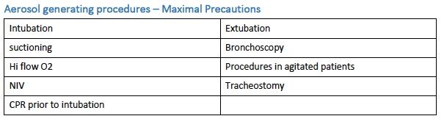
ICU Procedures

Slide 51
Shock
 | Intravascular Volume Status | Cardiac Output | Systemic Vascular Resistance
Distributive | ⬇ | ⬆ | ⬇
Hypovolemic | ⬇ | ⬆ | ⬆
Cardiogenic |  | ⬇ | ⬆
Neurogenic |  | ⬇ | ⬇

Slide 52
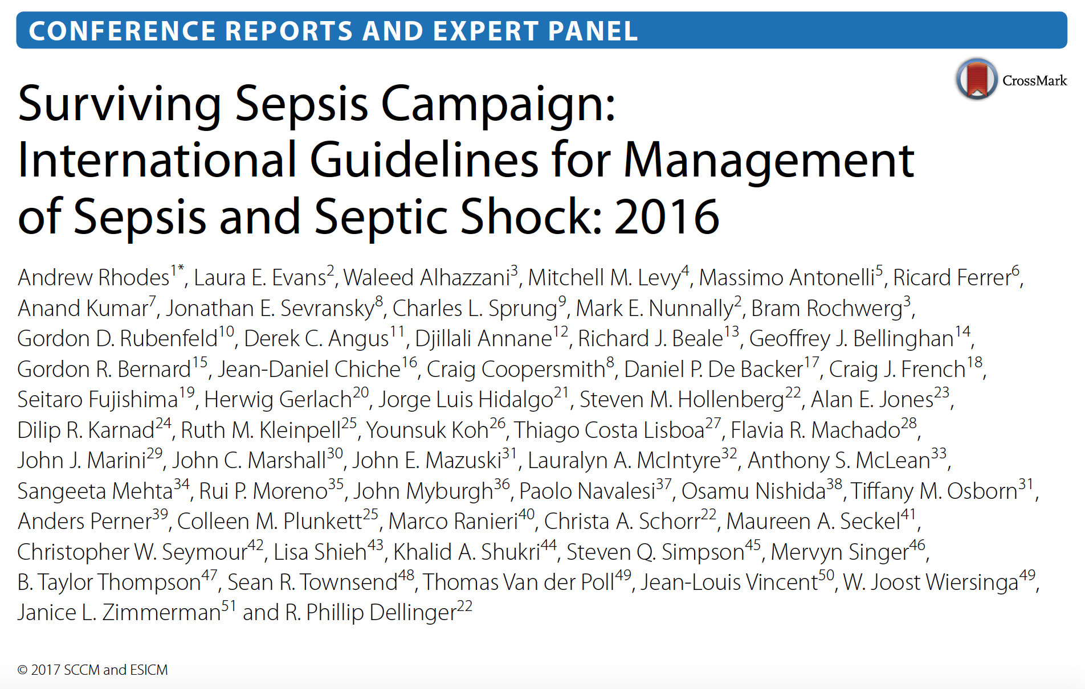

Slide 53
2016 Sepsis Guidelines
Obtain cultures before starting antibiotics
Start broad-spectrum i.v. antibiotics within one hour
Volume resuscitation with i.v. crystalloids > 30 mL/kg within the first 3 hours
Colloid fluids may also be given if large amounts of crystalloids are being used

Slide 54
Treatment of Septic Shock
Initial target MAP >65 mmHg in patients with septic shock requiring vasopressors
Norepinephrine is the first choice vasopressor for septic shock
Vasopressin or epinephrine may be added if necessary

Slide 55
Treatment of Septic Shock
Hemodynamic/cardiac assessment may be necessary (echo, cardiac output monitoring) if clinical examination does not reveal the cause of the shock
Hydrocortisone may be used as a supplement to pressors
Lactate measurement can be used to guide extent of resuscitation with the goal of returning to normal lactate levels.

Slide 56
General Critical Care
GI prophylaxis
  H2 blocker
  Proton pump inhibitor
DVT prophylaxis
    There have been reports of a prothrombotic state associated with COVID-19. Standard VTE prophylaxis may need to be adjusted for this. Consult your institutional protocols for your standard of care.
Nutrition
Glycemic control
  Goal blood glucose levels 140-180 g/dL

Slide 57
You May As Well Get Credit For This
Neurosurgeons are certified by the American Board of Neurological Surgery to provide critical care for patients.

Slide 58
Critical Care Billing
Based on time spent delivering critical care
Examining the patient
Reviewing laboratory, imaging, and other data
Communicating and carrying out care plan
99291- 30-75 minutes of critical care
99292- each additional 30 minutes of critical care

Slide 59
Critical Care Documentation
Consider organizing notes by organ systems
Pulmonary
Cardiovascular
Neurologic
Renal
GI
Fluids/Electrolytes/Nutrients
Hematologic
Endocrine
Infectious Disease
Prophylaxis
Code Status

Slide 60
Critical Care Billing
Requires documentation of critical illness diagnosis:
“The patient is critically ill with…”
Common diagnoses may include:
Acute respiratory failure (document hypoxia, hypercapnea, ARDS, etc.)
Respiratory distress
Pneumonia
Sepsis
Septic shock

Slide 61
Critical Care Billing
Requires attestation of time and involvement:
“I have seen and examined the patient. I have reviewed the relevant clinical, laboratory, and imaging data. I have spent (insert time) minutes providing critical care for this patient.”

Slide 62
The End
Remember:
Follow your local protocols
Stay safe and healthy

Slide 63
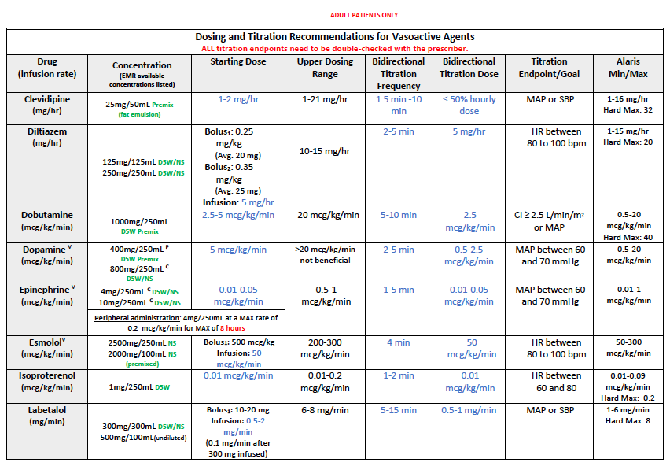
Appendix 1: Vasoactive Drugs

Slide 64
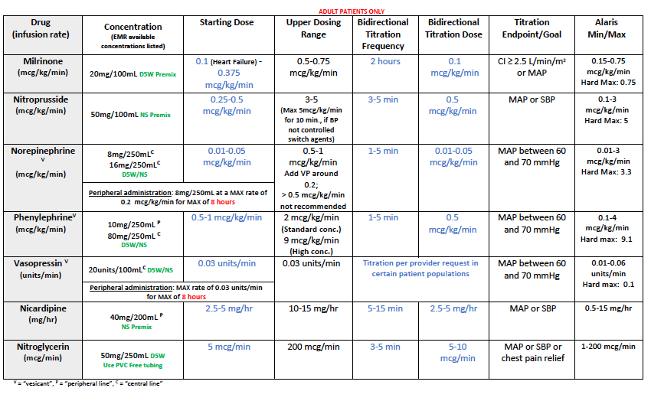
Appendix 1: Vasoactive Drugs

Slide 65
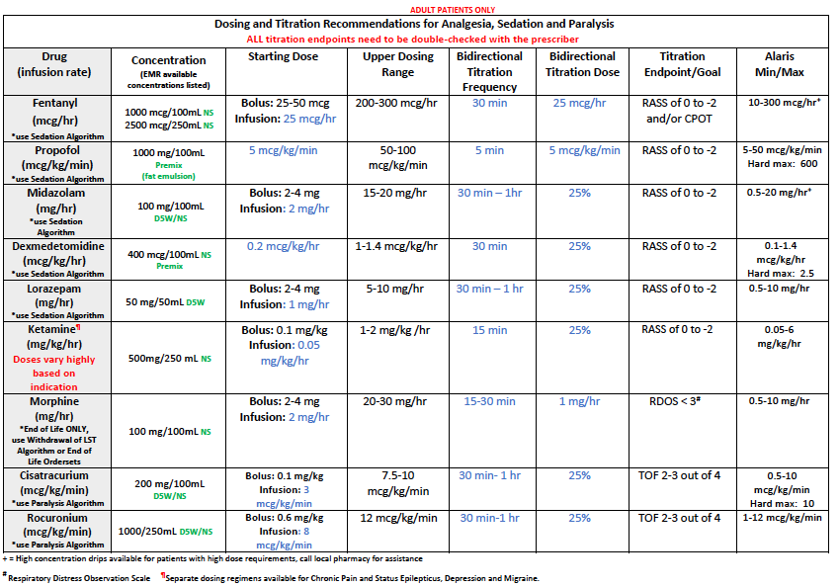
Appendix 2: Sedative Drugs

Slide 66
Appendix 3: Surviving Sepsis Campaign: Guidelines for the Management of COVID-19
I. Infection Control
For aerosol-generating procedures, use fitted respirator masks (N95 respirators, FFP2, or equivalent) (best practice).
Perform aerosol-generating procedures in negative pressure room (best practice).
For usual care for non-ventilated patients, use surgical/medical masks (weak recommendation).
For non-aerosol-generating procedures on ventilated patients, use surgical/medical masks (weak recommendation).
For intubation, use video-guided laryngoscopy over direct laryngoscopy (weak recommendation).
Intubation should be performed by provider most experienced with airway management (best practice).
II. Laboratory Diagnosis and Specimens
For intubated and mechanically ventilated adults:
  Obtain lower respiratory tract over nasopharyngeal/oropharyngeal samples (weak recommendation).
  Obtain endotracheal aspirates over bronchial wash/bronchoalveolar lavage samples (weak recommendation).

Slide 67
Appendix 3: Surviving Sepsis Campaign: Guidelines for the Management of COVID-19
III. Supportive Care
Use dynamic parameters, skin temperature, capillary refilling time, and/or serum lactate over static parameters to assess fluid responsiveness (weak recommendation).
Use conservative over liberal fluid strategy (weak recommendation).
Use crystalloids over colloids (strong recommendation).
Use buffered/balanced crystalloids over unbalanced crystalloids (weak recommendation).
Do not use hydroxyethyl starches (strong recommendation).
Do not use gelatins (weak recommendation).
Do not use dextrans (weak recommendation).
Do not routinely use albumin for initial resuscitation (weak recommendation).
Use norepinephrine as first-line vasoactive agent (weak recommendation).
If norepinephrine not available, use vasopressin or epinephrine (weak recommendation).
Do not use dopamine if norepinephrine is available (strong recommendation).
Add vasopressin as second-line agent if target MAP can’t be achieved by norepinephrine alone (weak recommendation).
Titrate vasoactive agents to target MAP of 60-65 mmHg (weak recommendation).
For cardiac dysfunction and persistent hypoperfusion despite fluid resuscitation and norepinephrine, add dobutamine (weak recommendation).
For refractory shock, use low-dose corticosteroid therapy (weak recommendation).
Start supplemental O2 if SPO2 is < 92% (weak recommendation) and if SPO2 is < 90% (strong recommendation).

Slide 68
Appendix 3: Surviving Sepsis Campaign: Guidelines for the Management of COVID-19
Maintain SPO2 no higher than 96% (strong recommendation).
For acute hypoxemic respiratory failure despite conventional O2 therapy, use HFNC (weak recommendation).
In acute hypoxemic respiratory failure, used HFNC over NIPPV (weak recommendation).
If HFNC not available and no urgent indication for intubation, trial NIPPV with close monitoring (weak recommendation).
No recommendation regarding use of helmet NIPPV compared with mask NIPPV.
Recommend close monitoring for worsening of respiratory status (best practice).
Use low tidal volume ventilation (Vt 4-8 mL/kg) (strong recommendation).
Target plateau pressures (Pplat) of < 30 cm H2O (strong recommendation).
For moderate to severe ARDS, use higher PEEP strategy (weak recommendation).
For ARDS, use conservative fluid strategy (weak recommendation).
For moderate to severe ARDS, use prone ventilation for 12 to 16 hours (weak recommendation).
For moderate to severe ARDS:
  Use intermittent boluses of neuromuscular blocking agents over continuous infusion (weak recommendation).
  If persistent ventilator dyssynchrony, use continuous NMBA infusion for up to 48 hours (weak recommendation).
Do not routinely use inhaled nitric oxide (strong recommendation).
In severe ARDS and hypoxemia, trial inhaled pulmonary vasodilator; if no rapid improvement, treatment should be tapered off (weak recommendation).
For hypoxemia despite optimizing ventilation, use recruitment maneuvers (weak recommendation).
For recruitment, do not use staircase (incremental PEEP) recruitment maneuvers (strong recommendation).
In refractory hypoxemia despite optimizing ventilation, rescue therapies, and proning, use venovenous ECMO (weak recommendation).

Slide 69
Appendix 3: Surviving Sepsis Campaign: Guidelines for the Management of COVID-19
IV. COVID-19 Therapy
In respiratory failure (without ARDS), do not routinely use systemic corticosteroids (weak recommendation).
In ARDS, use systemic corticosteroids (weak recommendation).
In respiratory failure, use empiric antimicrobials/antibacterial agents (weak recommendation).
For fever, use acetaminophen for temperature control (weak recommendation).
Do not routinely use IVIG (weak recommendation).
Do not routinely use convalescent plasma (weak recommendation).
In critically ill adults:
  Do not routinely use lopinavir/ritonavir (weak recommendation).
  Insufficient evidence on the use of other antiviral agents.
Insufficient evidence on the use of recombinant rIFNs.
Insufficient evidence on the use of chloroquine or hydroxychloroquine.
Insufficient evidence on the use of tocilizumab.

