Slide 1
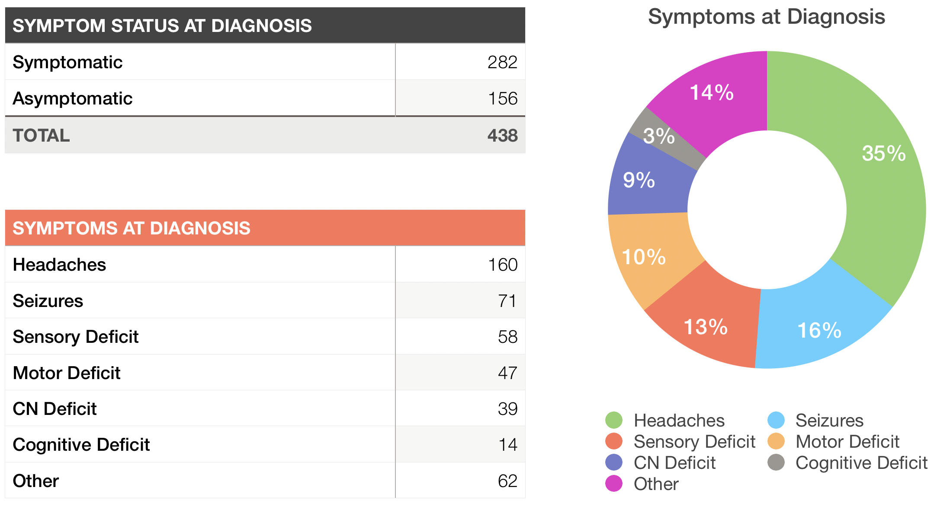
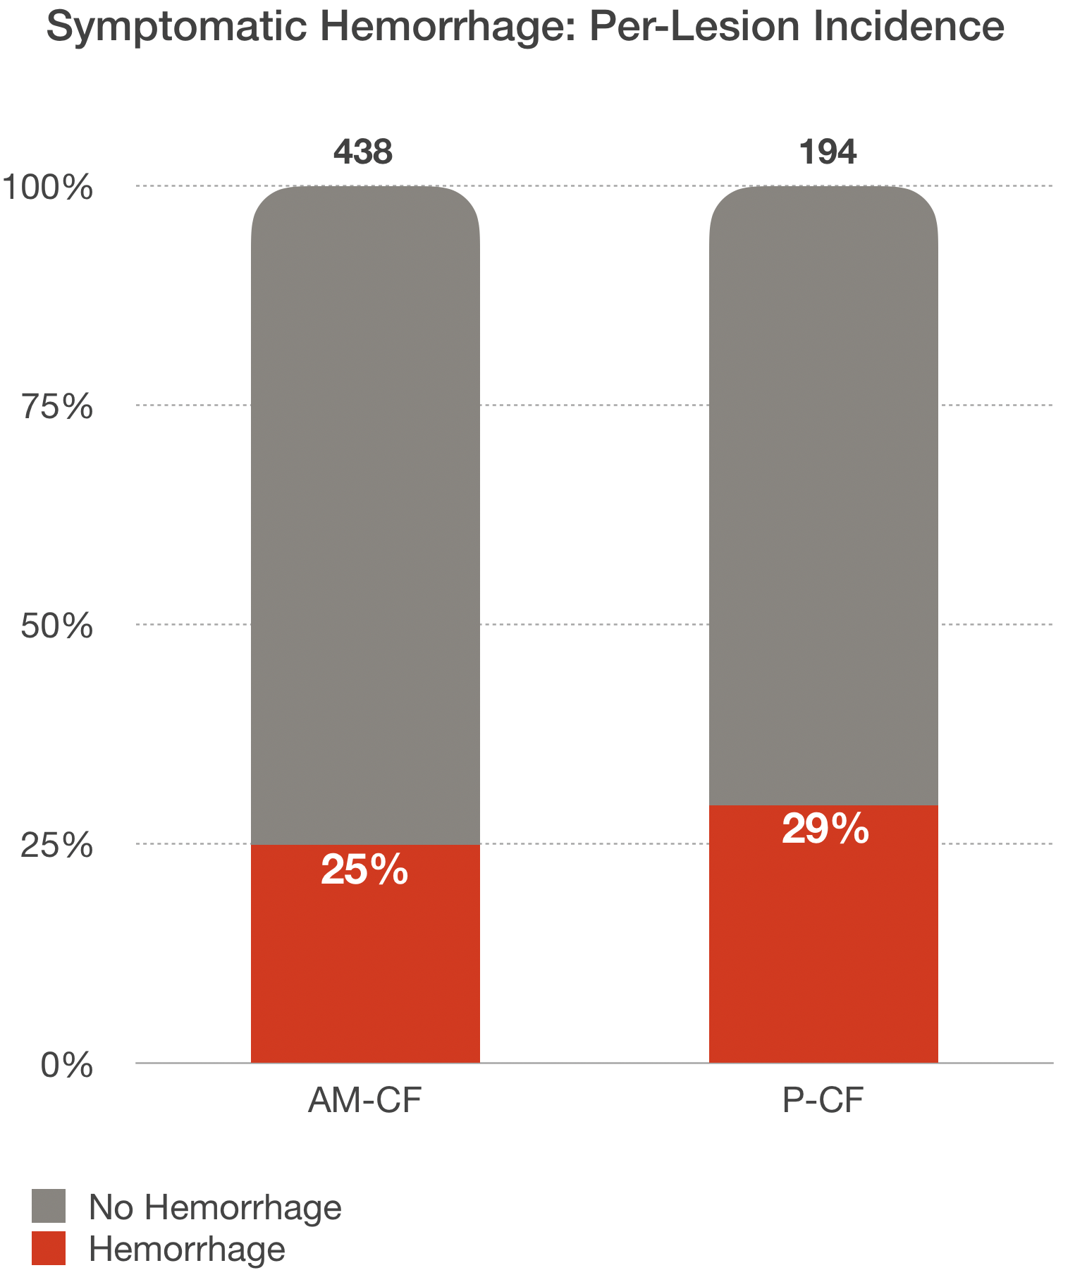
PIV and computational fluid dynamics modeling are useful tools for analyzing aneurysm flow fields across the range of physiological values.
3D Particle Image Velocimetry to improve understanding of flow-diverting stent treatment of intracranial aneurysms
Michael Barbour, Fanette Chassagne, Laurel Marsh, Venkat Chivukula, Sam Levy, Cory Kelly, Louis Kim, Alberto Aliseda, Michael Levitt
INTRODUCTION
Intracranial aneurysms are often treated endovascularly using flow-diverting stents (FDS).
FDS promote thrombosis and subsequent re-endothelialization by decreasing flow into the aneurysm and reducing shear stress along the wall.
OBJECTIVES
By the conclusion of this session, participants should be able to 1) Understand Particle Image Velocity methods in the study of aneurysm flow, particularly in flow-diverting stents. 2) Recognize the effect of pulsatile waveform frequency, mean flow-rate, and parent vessel curvature on aneurysmal hemodynamics.
METHODS
We conducted 3D particle image velocimetry (PIV) to study the flow inside idealized aneurysm models before and after treatment with FDS.
We utilized a pulsatile flowloop to vary the pulsatile waveform frequency, mean flow-rate, and parent vessel curvature to determine effects on Reynolds number (Re), Dean number (De) and Womersley number (Wom).
RESULTS
Treatment with FDS demonstrated a reduction of the flow entering the aneurysm which contributes to a reduction of stress along the vessel wall (Eularian analysis) as well as on flowing platelets (Langrangian analysis).
However, at high values of De, reduction is minimal which may comprise effectiveness of FDS.
The direction of the rotation of the primary vortex in the aneurysm dome is highly dependent on De and Womersley.
CONCLUSIONS
PIV and computational fluid dynamics modeling are useful tools for analyzing aneurysm flow fields across the range of physiological values.
Further understanding of the relationship between intracranial aneurysm hemodynamics and treatment with FDS will inform treatment decisions and improve clinical outcomes.
EXAMPLE

Slide 2
Add a conclusion statement from your research findings here.
Title of Abstract
Presenter name, Associates and Collaborators
INTRODUCTION
Your text
OBJECTIVES
Your text
METHODS
Your text
RESULTS
Your text
CONCLUSIONS
Your text
Add figures and tables to this column.

Slide 3
Add full poster or additional material on this slide.

