Slide 1
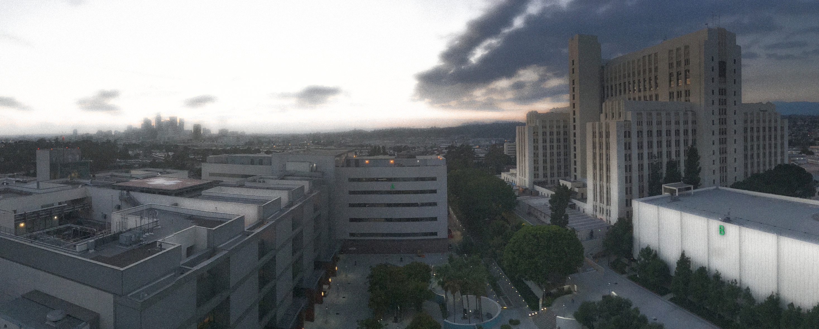
2023 CNS Virtual Residency Fair USC Keck School of Medicine
2021 CNS Virtual Residency Fair

Slide 2
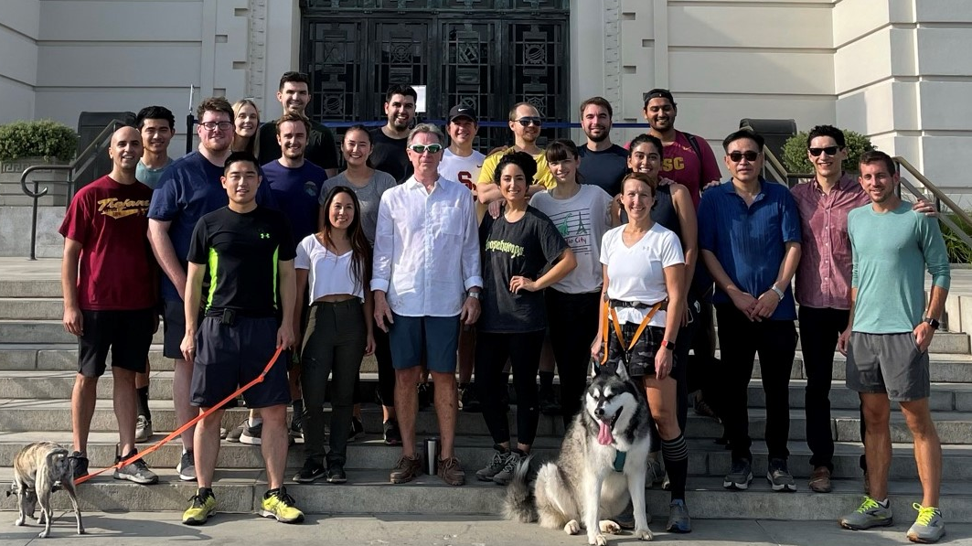

Slide 3
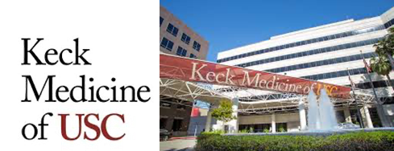
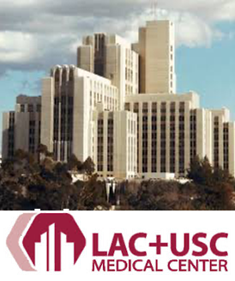
Whereabouts
UCLA, Cedars
Lincoln Heights
Downtown
Arts District
Silverlake
Echo Park
Los Feliz
Pasadena
Culver City
Larchmont

Slide 4
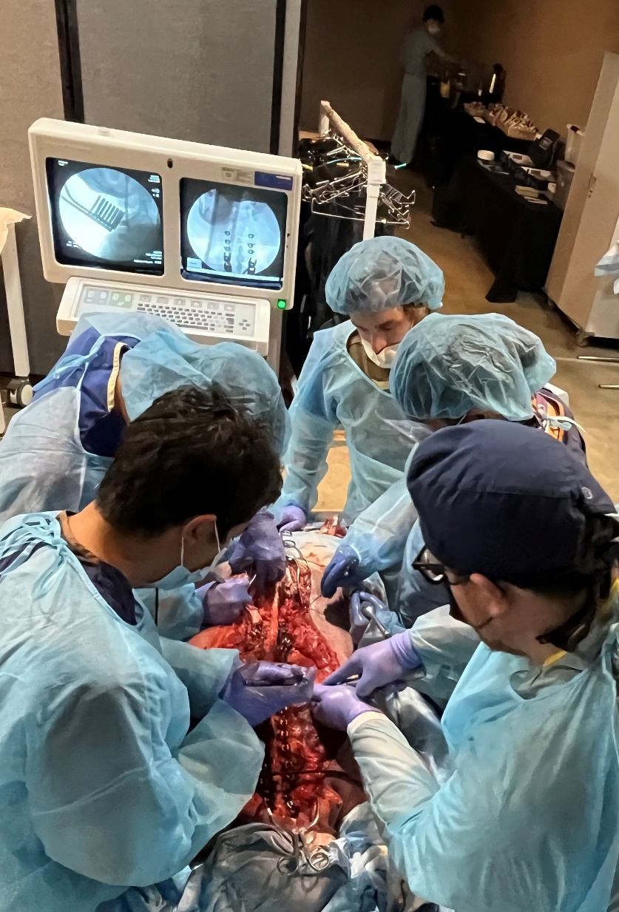
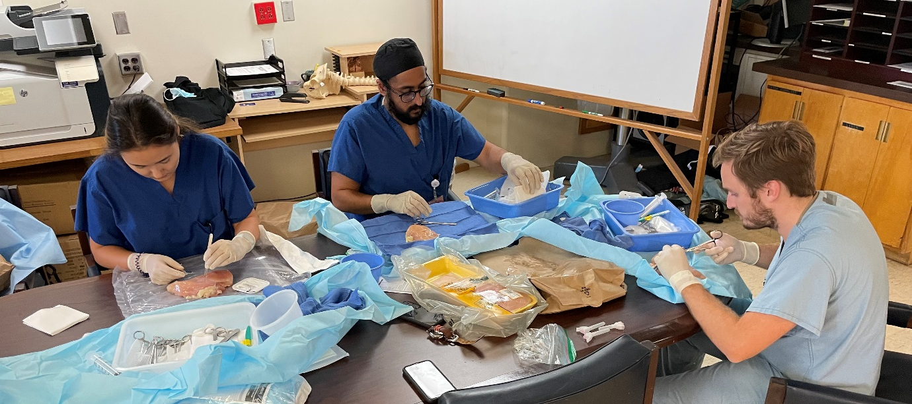
Program Highlights
Los Angeles General Medical Center
Largest safety net hospital for Los Angeles
Busy Level 1 county trauma center
USC Keck Medical Center
Private hospital, no ER
State of the art cranial and spine practices
Doximity #13 by Reputation

Slide 5
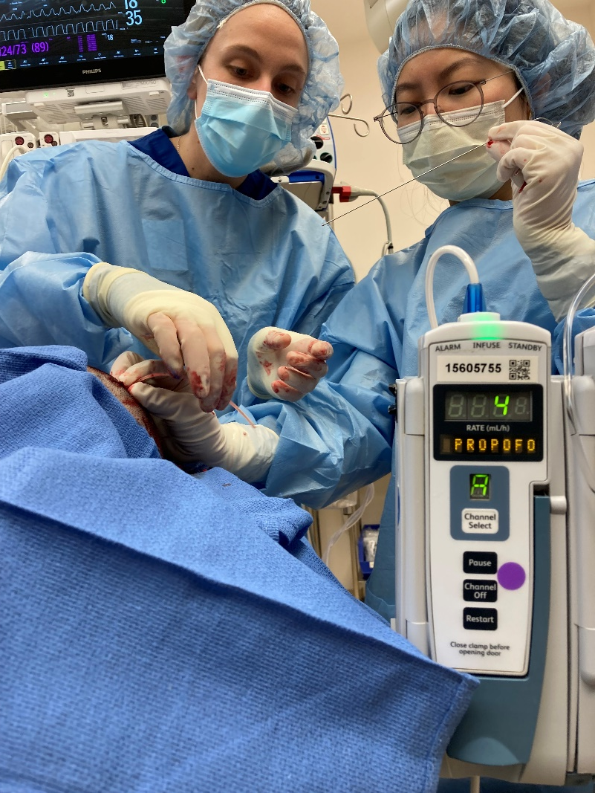
Program Highlights
PGY1: 9 months in neurosurgery ICU (PGY2 elsewhere)
Run the ICU
EVDs, lumbar drains, start getting into OR
PGY2: County junior, learn to operate (PGY4 elsewhere)
Independent in straightforward cases
PGY3: Endovascular, Spine, CHLA
PGY4: Keck cranial, County Integrated Spine, Stereotactic radiosurgery/peripheral nerve
PGY5: Keck chief (PGY6/7 “chief year” elsewhere)
PGY6: Elective year
R25 research
Enfolded fellowships
PGY7: County chief (first-year attending elsewhere)
“Transition to Practice”
Unrivaled autonomy
New: Flexible 6/7 Model for PGY7 Fellowships

Slide 6
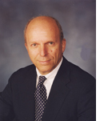
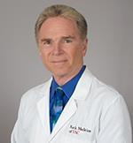
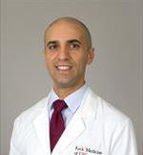
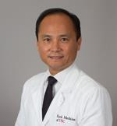
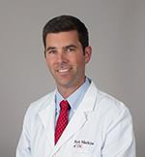
Faculty
17 clinical faculty + 2 neurology-trained endovascular
Leaders in vascular, tumor, spine, functional, and pediatrics sub-specialties
Among the most stable programs in neurosurgery
Dr. Weiss
Emeritus Chair
Dr. G
Chair
(Skull base, Vascular)
Dr. Zada
Program Director
(Skull base, Tumor)
Dr. John Liu
Associate PD
(MIS Spine)
Dr. Mack
Vice Chair,
Academic Affairs
(Endo/Open Vascular)
Dr. Durham
Chief, CHLA
(Peds)

Slide 7
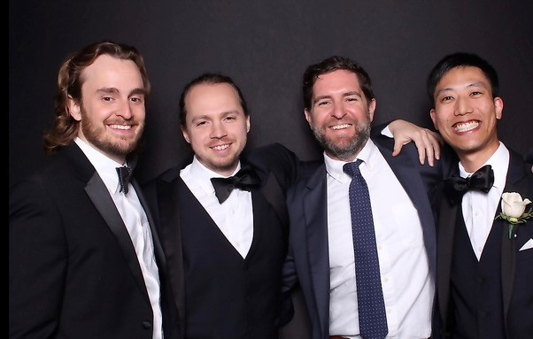
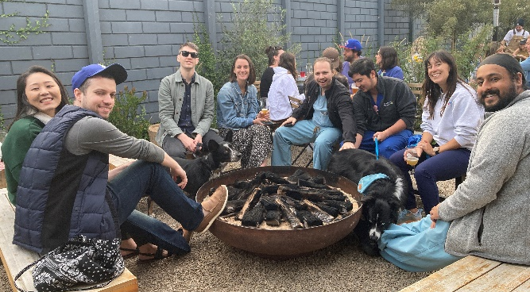
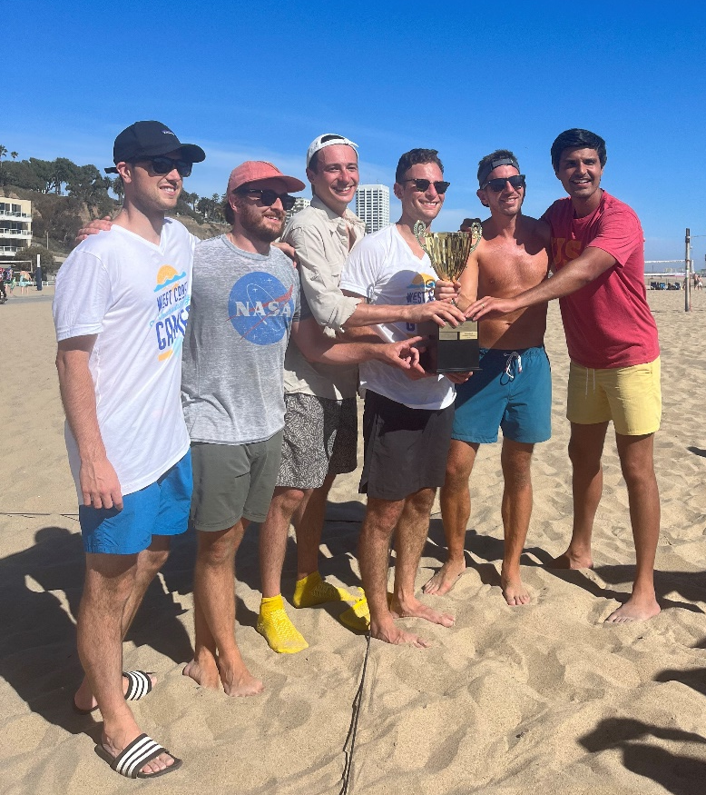
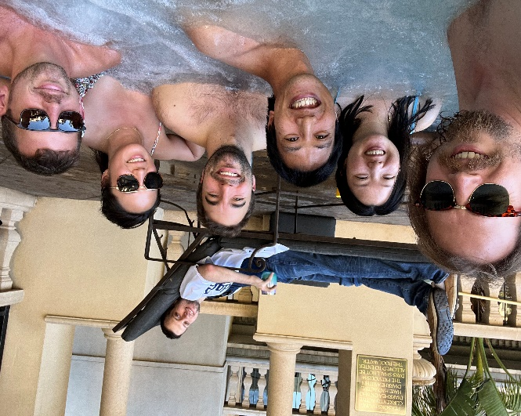
Resident Cross Section
3 residents/year since 2014
More residents = fewer junior calls
Last in-house call as PGY4
We’re from all over the place
Local, Norcal, East Coast, South, Midwest
Big name schools, small name schools
2 MD-PhDs
Families:
2 Babies
3 Cats
7 Dogs
A variety of interests (tumor/skull base, combined endo/open vascular, complex spine, MIS spine, pediatrics)

Slide 8
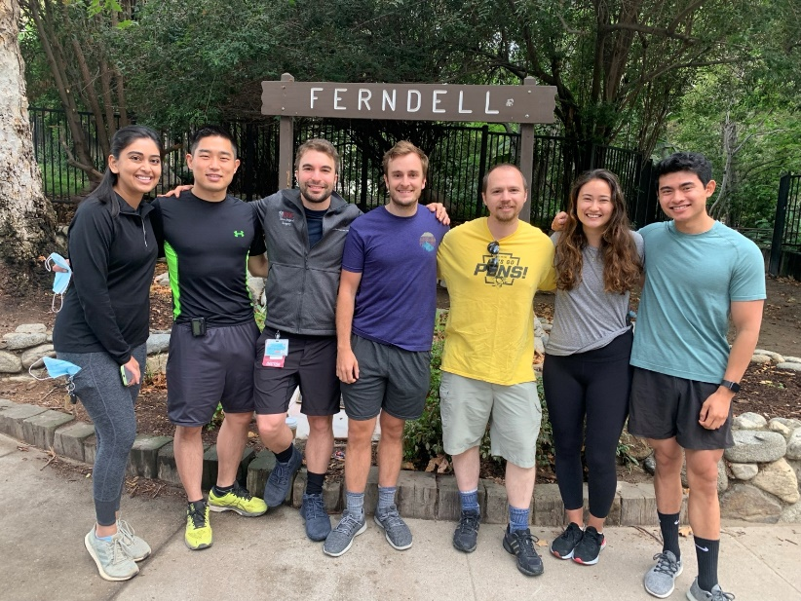
Who We Are Looking For
Personal attributes
Grit
Integrity
Self-motivated
Hardworking
Team player
Commitment to neurosurgery
Track record for achievement
Research

Slide 9
Why Should I Come to USC?
I don’t want to watch. I want to learn to operate.
Nationally renowned training
Grads get the best fellowships --> jobs
I want an easy-going, busy environment.
West Coast = best coast
Diverse group, lots of comradery
Easy to work with attendings
I want to be part of a team.
Look out for your co-residents
Teach the juniors

Slide 10
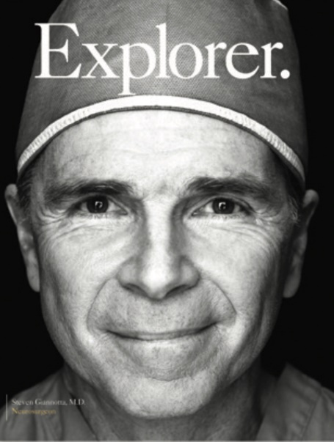
Why Should I Come to USC?
I want to be an academic neurosurgeon.
6 active chairs trained here
Over half of us take academic jobs
Well funded faculty, mentorship, R25 grant
2019
Stanford Epilepsy > Academic
BNI Spine > Academic
2020
Brigham Skull Base (Laws) > Academic
Columbia (Lenke) Spine > Academic
BNI Endovascular > Private Practice
2021
Miami MIS Spine > Private Practice
Stanford Open Vascular (Steinberg) > Private Practice
UCSF Peds > Academic
2022
Columbia Spine > Academic
Brown Tumor/Deformity (Gokaslan) > Naval Medical
Emory Open Vascular (Barrow) > Academic

Slide 11
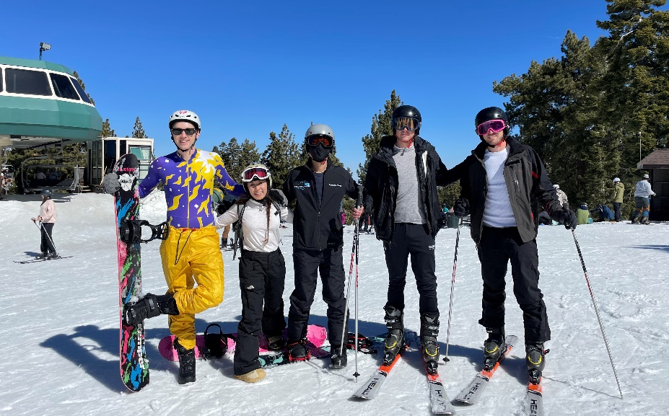
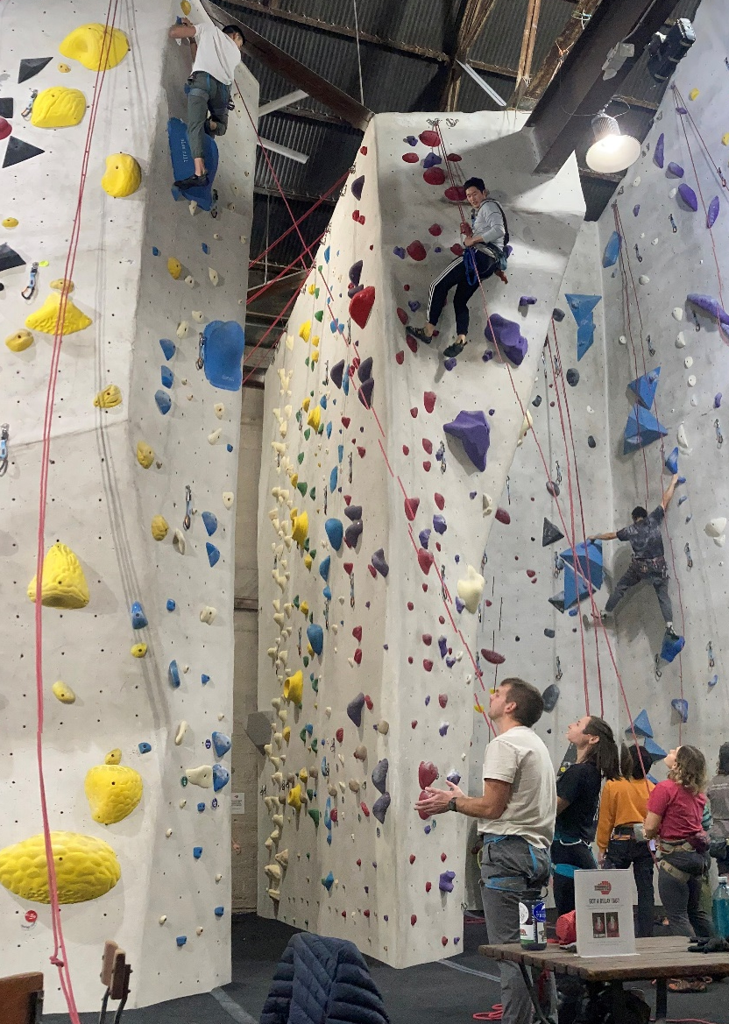
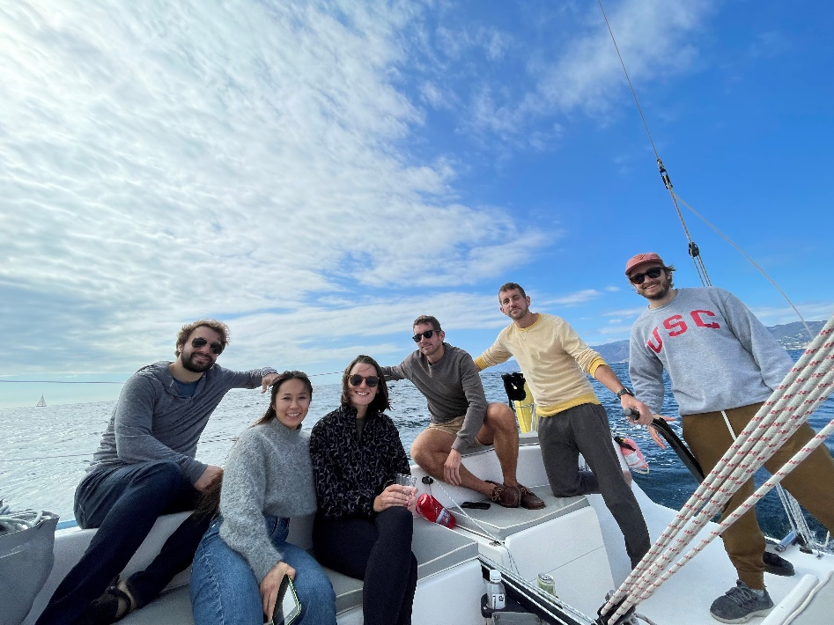
Realities
We work hard
Cost of living vs salary

Slide 12
Resources
Resident-run Instagram
usc_neurosurgery_residency
Program Overview Video on Youtube
https://www.youtube.com/watch?v=9HVlAj5p320
“USC Neurological Surgery Residency Training Program”
Contacts
Michelle Lin (michelle.lin@med.usc.edu)
James Yu (james.yu@med.usc.edu)
Grady Briggs (robert.briggs@med.usc.edu)

