Slide 1

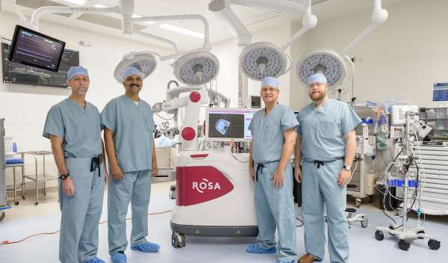

University of Florida Department of Neurosurgery
Residency Interview Presentation
University of Florida
CNS Virtual Residency Fair

Slide 2
Agenda
Where
What
Who
Why

Slide 3
Our Program
Located in Gainesville, FL
21 residents (3 per year)
15 clinical faculty
17 research faculty

Slide 4
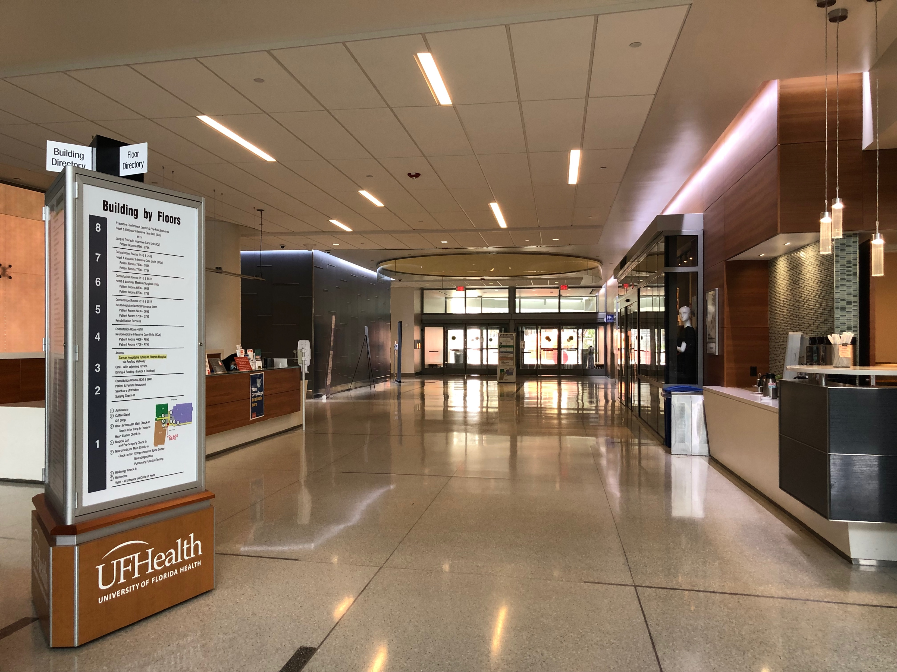
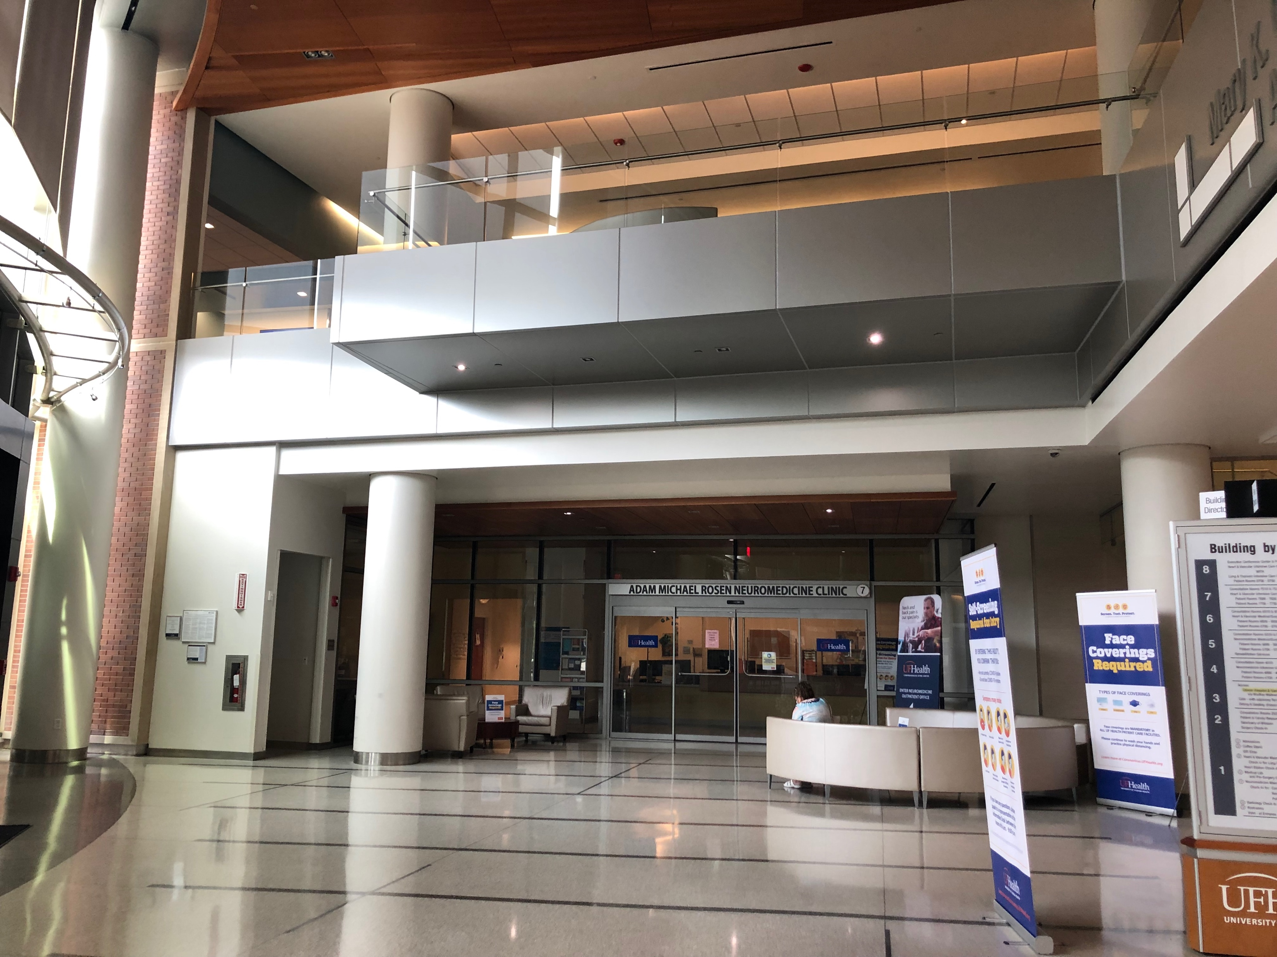
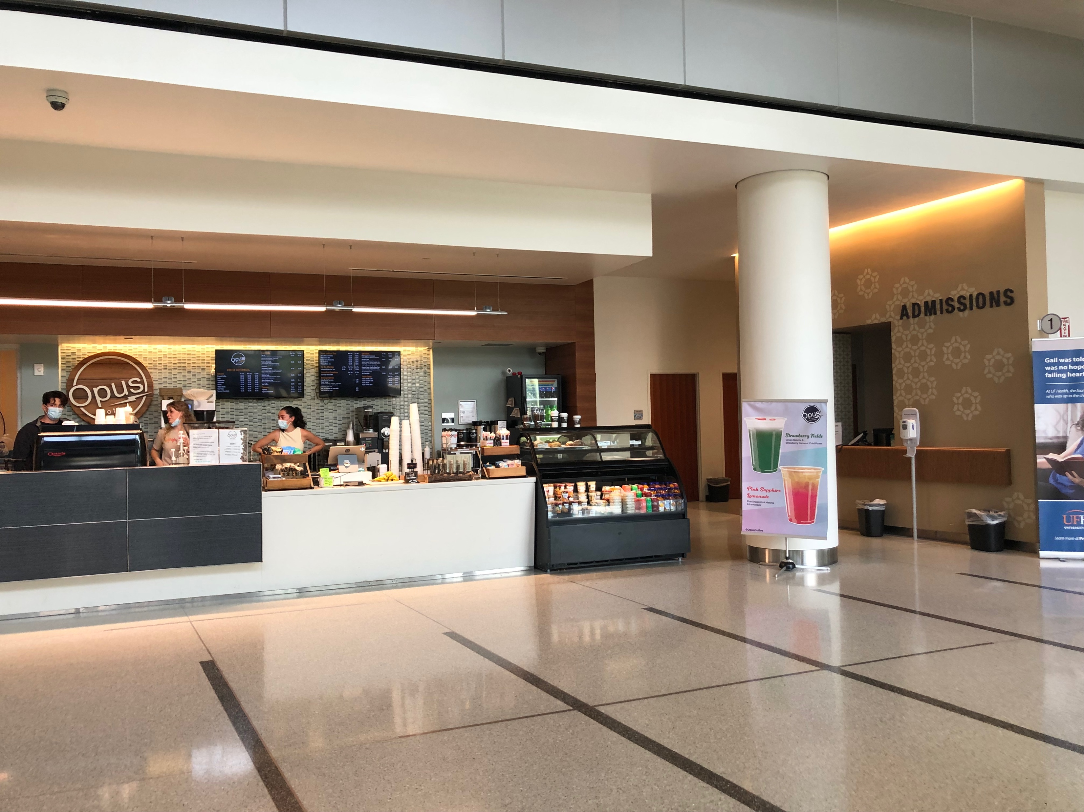
Our Workplace

Slide 5
What We Do at Work
~5000 cases/year
4-6 Operating Rooms/day
Extender Support for Ward Tasks
Equitable Call Schedule

Slide 6
Our Structure
PGY-1
PGY2/3
PGY-4
PGY-5
PGY-6
PGY-7
TTP
Chief
Senior
Flex
Junior
Intern

Slide 7
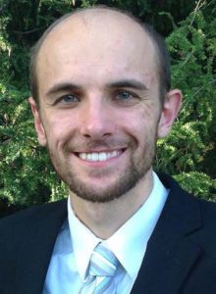
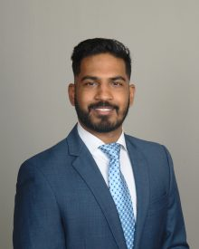
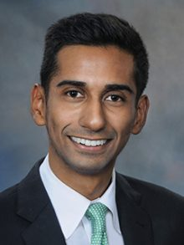
Flex Year (PGY-4)
R25
Functional Fellowship
MBA
Research
Clinical
Academic
Opportunities

Slide 8
Transition to Practice (TTP)
PGY 7 Rotation
Formerly an Independent Practice Rotation
Supervised Independence

Slide 9
Our Residents
38% Female
45% Minority
82% from outside Florida
5 residents have 9 children
>50% residents have pets

Slide 10
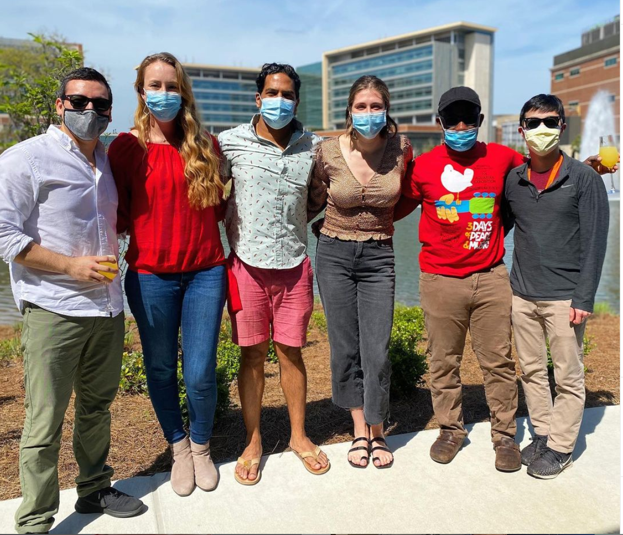
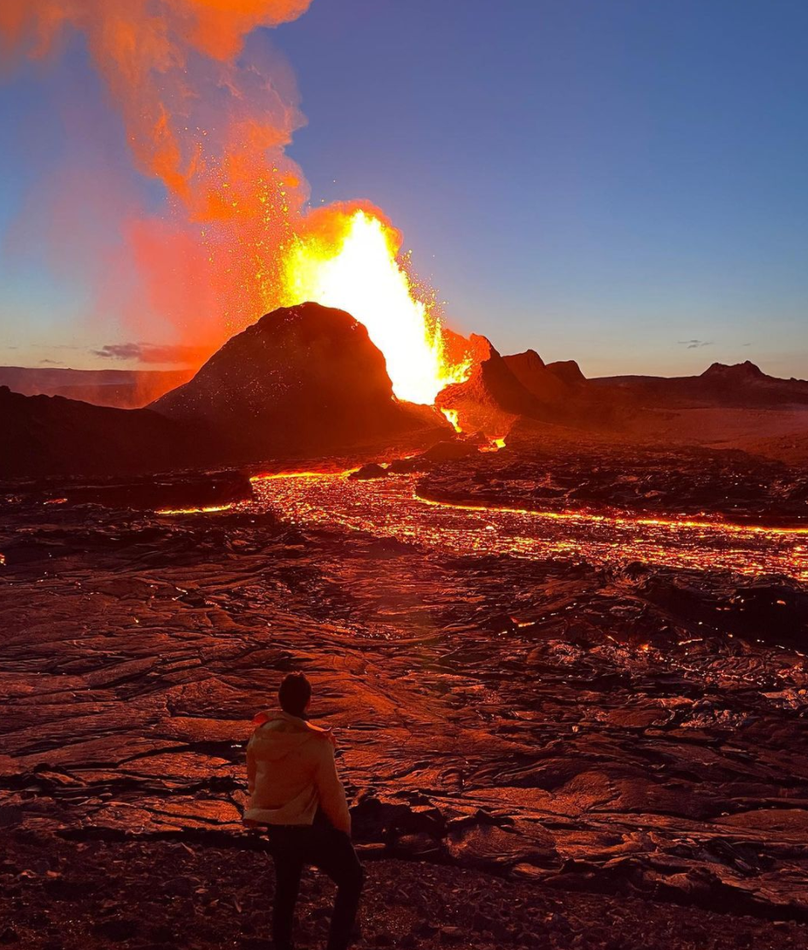
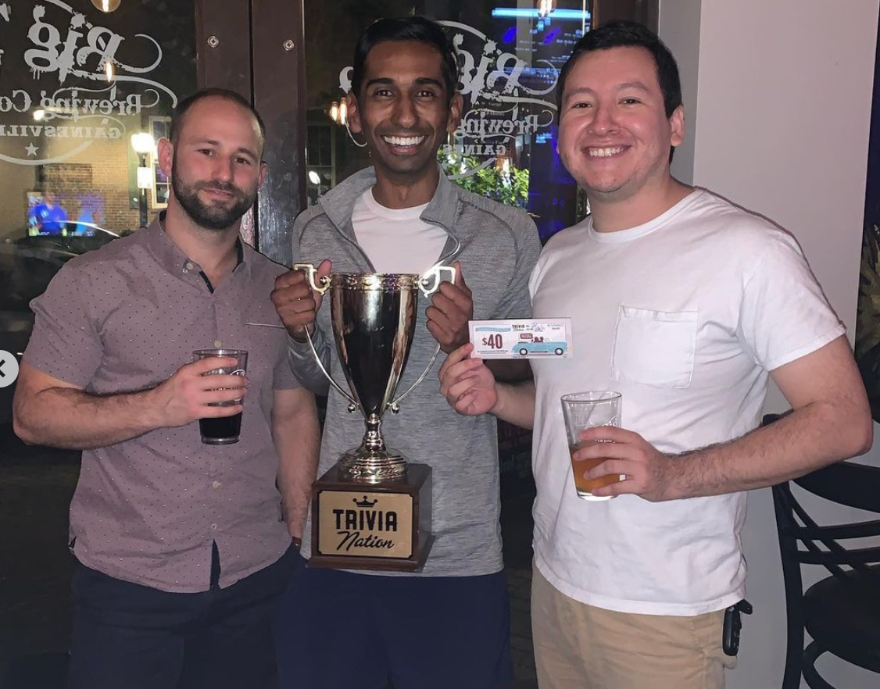
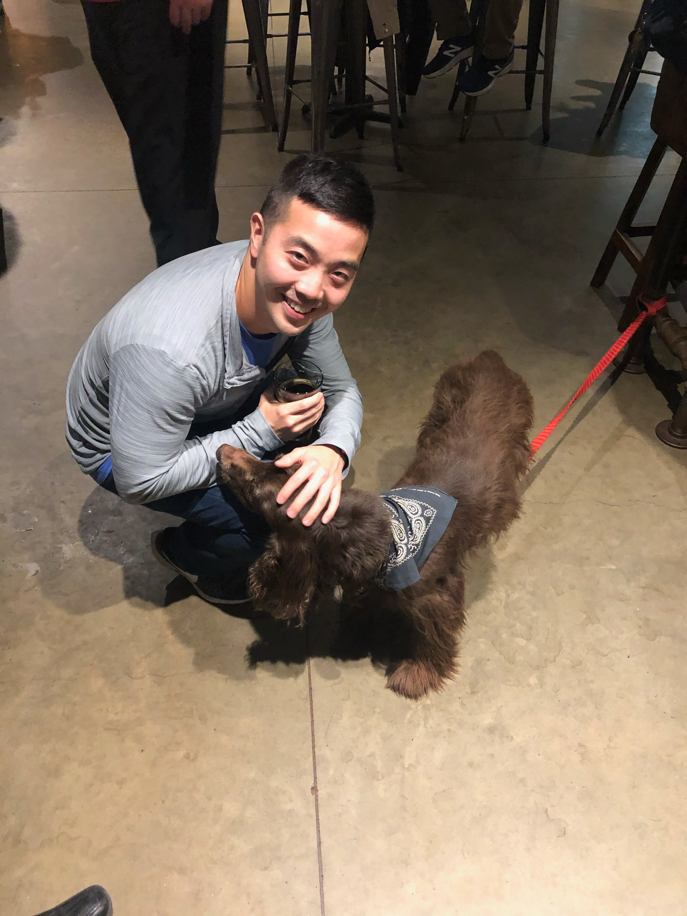
Resident Life

Slide 11
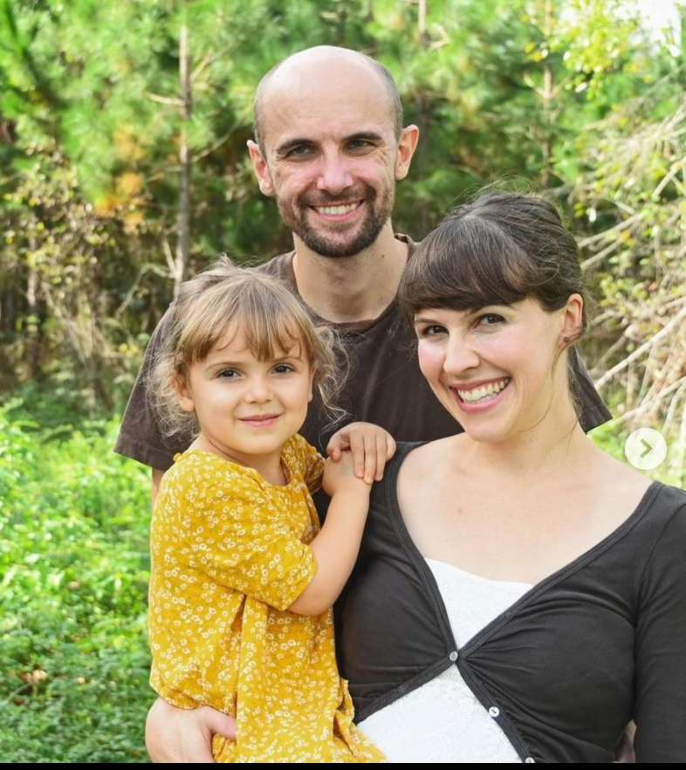
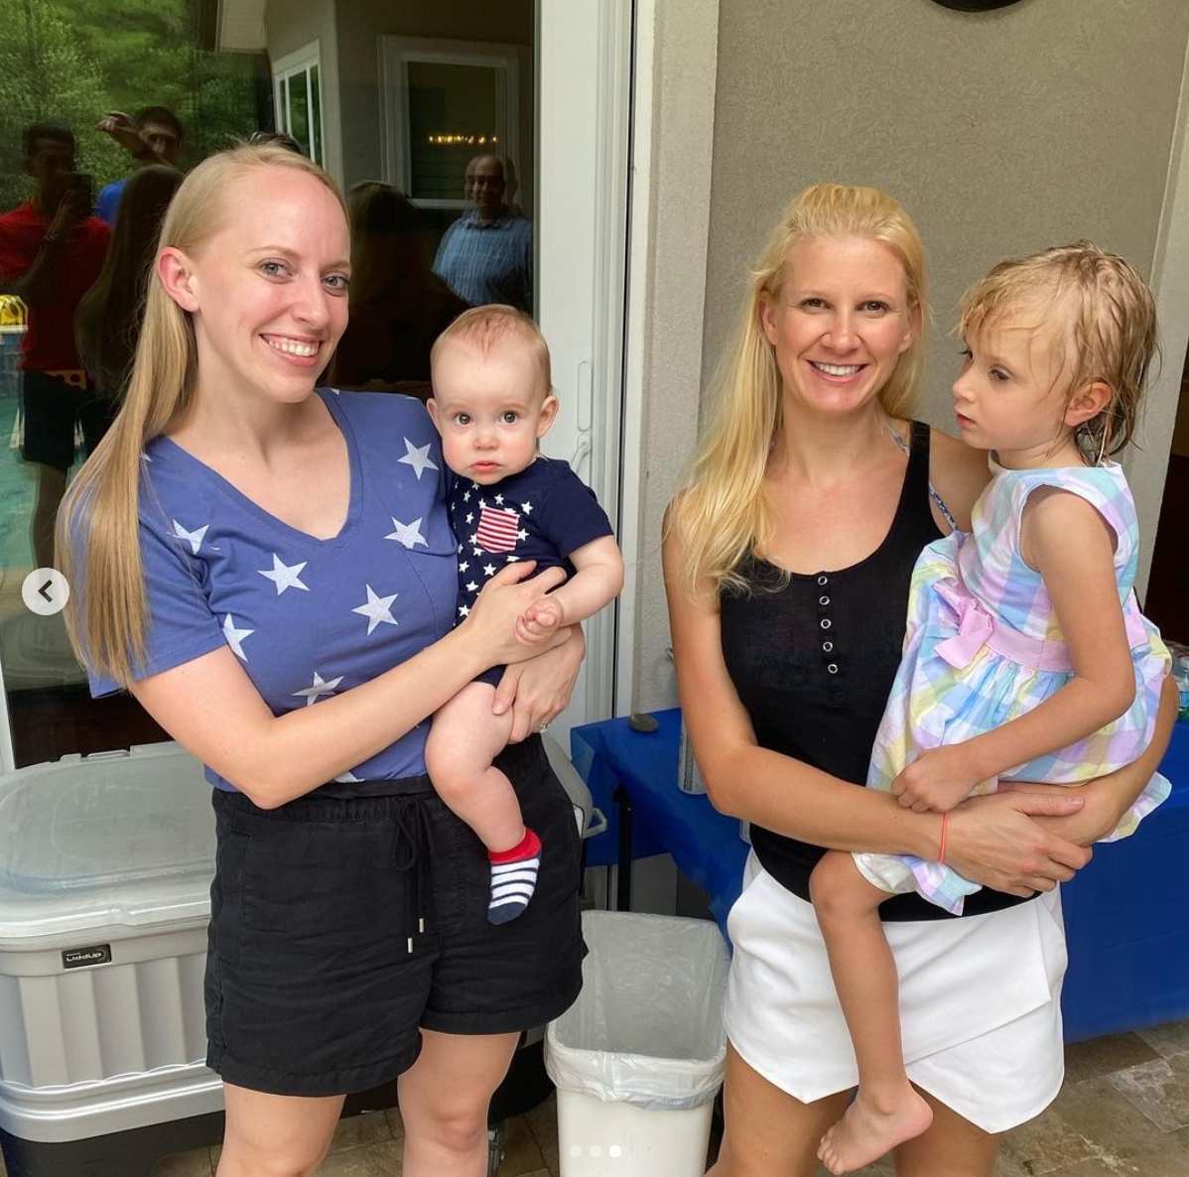
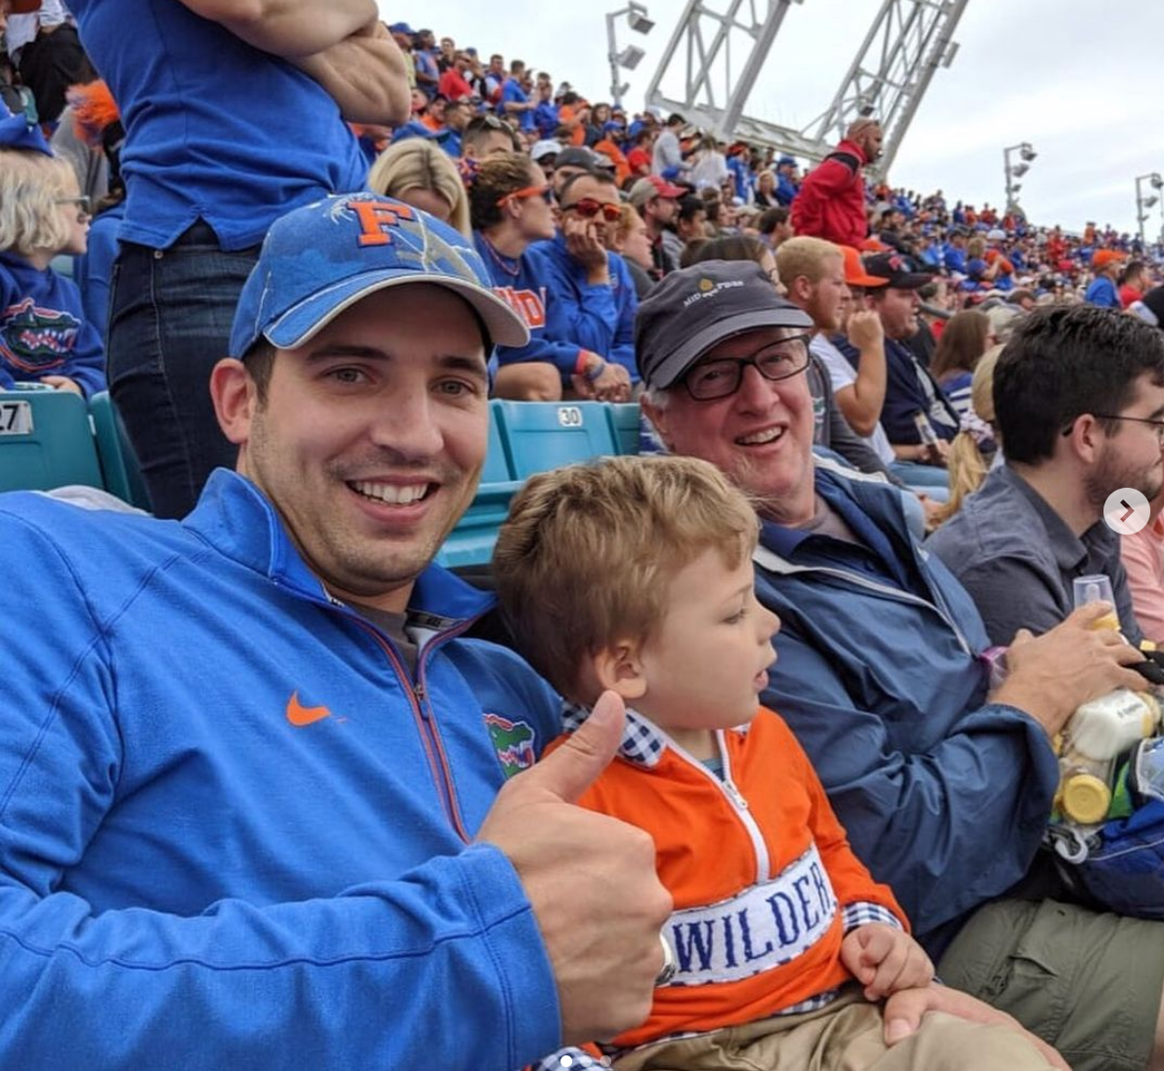

Slide 12
Concluding Points
Balanced, Supportive Program
Diverse group of Residents
We love living in GNV!

Slide 13
Contact Us
Arvind.mohan@neurosurgery.ufl.edu: Presenter
Gregory.murad@neurosurgery.ufl.edu: Program Director
Jamie.dow@neurosurgery.ufl.edu: Program Coordinator
Instagram.com/ufnsgyresidency
https://www.youtube.com/watch?v=0osi4WCYZjs

Slide 14
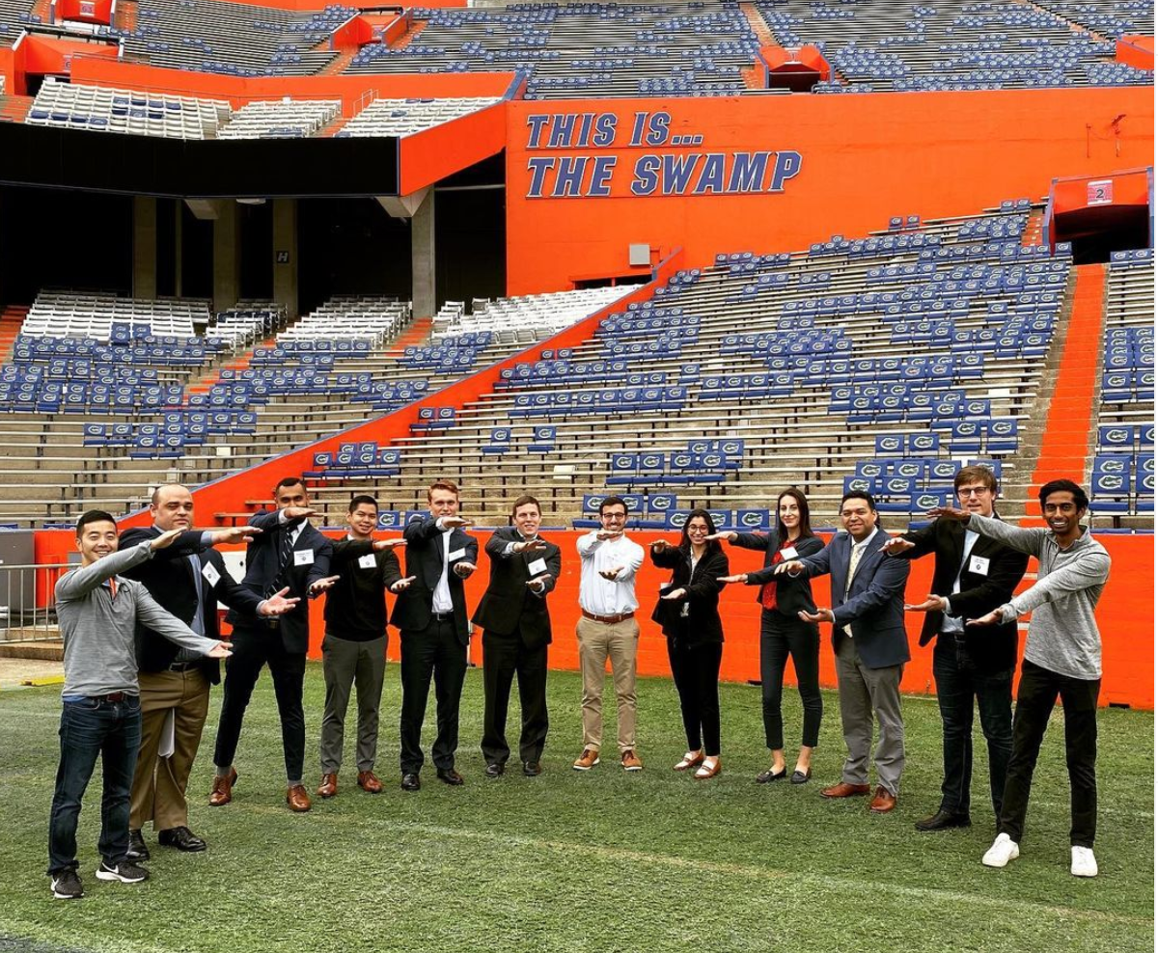
Questions?

