Slide 1
A Neurosurgeon’s Guide to Cardiovascular and Renal Critical Care for COVID-19
Alan Hoffer, M.D.
Chair, Critical Care Committee
AANS/CNS Joint Section on Neurotrauma and Critical Care
Co-Director, Neurocritical Care Center
Associate Professor of Neurosurgery and Neurology
Rana Hejal, M.D.
Medical Director, Medical Intensive Care Unit
Associate Professor of Medicine
University Hospitals of Cleveland
Case Western Reserve University

Slide 2

To learn more, visit our website at:
www.neurotraumasection.org

Slide 3
Introduction
As the number of people infected with the novel coronavirus rapidly increases, some neurosurgeons are being asked to participate in the care of critically ill patients, even those without neurological involvement. This presentation is meant to be a basic guide to help neurosurgeons achieve this mission.

Slide 4
Disclaimer
The protocols discussed in this presentation are from the Mission: Possible program at University Hospitals of Cleveland, based on guidelines and recommendations from several medical societies and the Centers for Disease Control (CDC).
Please check with your own hospital or institution to see if there is any variation from these protocols before implementing them in your own practice.

Slide 5
Disclaimer
The content provided on the AANS and CNS websites, including any affiliated AANS/CNS section website (collectively, the “AANS/CNS Sites”), regarding or in any way related to COVID-19 is offered as an educational service. Any educational content published on the AANS/CNS Sites regarding COVID-19 does not constitute or imply its approval, endorsement, sponsorship or recommendation by the AANS or CNS. The content should not be considered inclusive of all proper treatments, methods of care, or as statements of the standard of care and is not continually updated and may not reflect the most current evidence. Nothing in the educational content published on the AANS/CNS Sites should be considered, or used as a substitute for, medical advice, diagnosis or treatment. The AANS/CNS Sites and the educational services offered therein do not constitute the practice of medicine or any medical or other professional health care advice, diagnosis or treatment. The AANS and CNS assume no responsibility for any injury or damage to persons or property arising out of or related to any use of this content or for any errors or omissions.

Slide 6
COVID-19
Coronavirus disease 2019 (COVID-19) is a respiratory tract infection caused by a newly emergent coronavirus, SARS-CoV-2, that was first recognized in Wuhan, China, in December 2019.
Genetic sequencing of the virus suggests that SARS-CoV-2 is a betacoronavirus closely linked to the SARS.

Slide 7
Personal Protective Equipment
When taking care of COVID-19 patients, please adhere to all of your institution’s policies regarding personal protective equipment (PPE)
To help others, you must stay healthy yourself!

Slide 8
Aerosol Generating Procedures in ICU
PPE = | Fit tested respirator N95 or PAPR + Eye Protection with face shield or Goggles + Gown + Gloves
Intubation | Extubation | Airway surgeries – ENT, Thoracic Transsphenoidal
Open Suctioning | Nebulizer therapy | Procedures in agitated patients
Sputum induction | Manual Bag-mask ventilation | Chest physical therapy
CPR | Bronchoscopy | Mechanical In-Exsufflator [ Cough Assist Device ]
NIV | Tracheostomy | Upper and Lower Endoscopy
Hi Flow O2 | Tracheostomy change | Ventilator circuit manipulation

Slide 9
Organ System Interactions
While this guide focuses on organ pathophysiology and treatment, it should be remembered that each organ system interacts with the others. Sometimes the best treatment of one organ is detrimental to another. It is always important to do what is best for the whole organism, not just one organ.

Slide 10
Organ System Interactions
For example, consider a patient with systolic heart failure with pulmonary edema and hypoxic respiratory failure who also has an acute kidney injury with oliguria. While the best treatment for the hypoxia might be diuresis to reduce the pulmonary edema, this could worsen the kidney injury and push this patient into renal failure with the need for dialysis. This would decrease the chances of recovery. A better strategy might to be to increase PEEP to improve oxygenation while the kidney injury resolves.

Slide 11
COVID-19 Infection in ICU
In addition to the hypoxic respiratory failure, several organ and physiologic derangements are observed.
Marked increase in acute phase reactants
Venous thromboembolic disease
Hemodynamic instability
Cardiac Dysfunction
Acute Kidney Injury

Slide 12
COVID-19 - Hematologic Profile
Several pro‐coagulant factors are increased
  Factor VIII
  VWF
  Fibrinogen known to be associated with an increased risk of thrombosis
Increased D-Dimer suggestive of local on going fibrinolysis
Normal platelet counts
Normal PT and PTT
No DIC

Slide 13
Venous Thromboembolic Disease
Common in the ICU population
Immobility
Prothrombotic conditions
  Reports of higher rates of thrombosis with COVID-19
Conditions
Deep vein thrombosis (DVT)
Pulmonary embolism (PE)
Sagittal sinus thrombosis

Slide 14
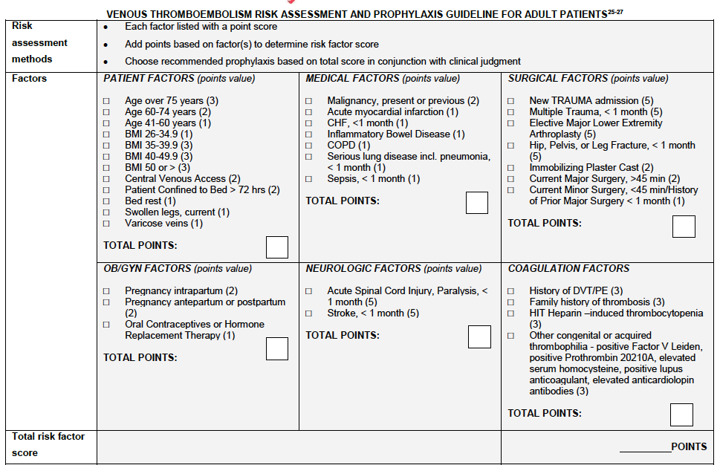
DVT Risk Assessment

Slide 15
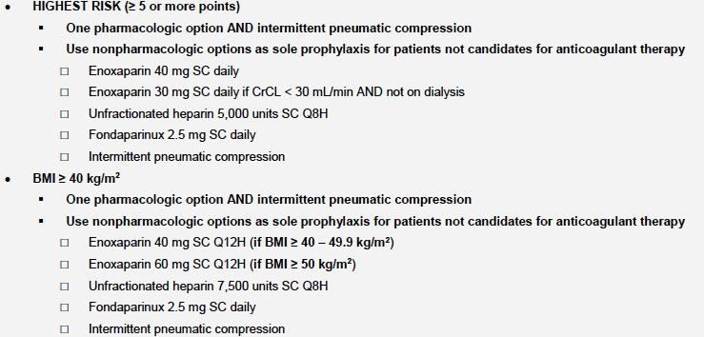
Usual VTE Prophylaxis
Most ICU patients will be high risk

Slide 16
VTE Prophylaxis
Prophylaxis may be held for high risk of bleeding
Ongoing or recent severe hemorrhage
Thrombocytopenia (platelets <100,000)
Renal failure, end stage liver disease
Coagulopathy
Currently on anticoagulation therapy

Slide 17
COVID-19 Venous Thromboembolic Disease
Standard prophylaxis is not adequately preventing thromboembolic events
Several reports
  Pulmonary embolism
  Arterial thrombosis
  Strokes
  Thrombosis in unusual areas
  Microthrombi in lungs on autopsy series
J Thromb Haemost. April 2020
Notes:
Cui S, Chen S, Li X, Liu S, Wang F. Prevalence of venous thromboembolism in patients with severe novel coronavirus pneumonia. J Thromb Haemost. April 2020. doi:10.1111/jth.14830

Slide 18
VTE Prophylaxis in COVID-19 Patients
STEP I – Calculate DIC Score
STEP II – POC ultrasound of lower extremities
  DVT present – full anticoagulation
  NO DVT – proceed to STEP III
ISTH Criteria for DIC - 5 points are needed for DIC Diagnosis
Platelets | 50-100 K | 1 point | If score is ≥ 5 – DIC is diagnosed – hematology consult If score is < 5 – there is no DIC – proceed to STEP II
 | < 50 K | 2 points
D-Dimer | 1000-3000 ng/ml | 1 point
 | > 3000 ng/ml | 3 points
Fibrinogen | < 100 mg/dl | 1 point
Prolonged PT | 3-6 seconds | 1 point
 | > 6 seconds | 2 points
University Hospitals COVID-19 DVT prophylaxis protocol

Slide 19
STEP III - VTE prophylaxis
D- Dimer ng/ml | Weight (kg) | Drug target Heparin Assay, Lovenox is 0.2 – 0.4 IU/mL
< 1000 | < 100 | Enoxaparin 40 mg qd
 | 100-150 | Enoxaparin 40 mg bid
 | > 150 | Enoxaparin 60 mg bid
 | Enoxparin should be timed for 0900 (and 2100 if BID) Heparin Assay, Lovenox should be drawn 4 hours after the second dose, then as needed based on level and renal function Adjust doses in increments of 10 – 20 mg depending on level and renal function If on CRRT or HD, use heparin 5,000 Units Q8H when weight < 150 Kg use heparin 7,500 Units Q8H when weight > 150 Kg
D- Dimer ng/ml | Weight (kg) | Drug target Heparin Assay, Lovenox is 0.2 – 0.4 IU/mL
1000 - 3000 | < 100 | Enoxaparin 40 mg bid
 | 100-150 | Enoxaparin 80 mg bid
 | > 150 | Enoxaparin 120 mg bid
 | For doses ≥ 80 mg, may need to use the “Enoxaparin Therapeutic Anticoagulation” UHCare orderset for ease of ordering higher doses Enoxparin should be timed for 0900 and 2100 Heparin Assay, Lovenox should be drawn 4 hours after the second dose, then as needed based on level and renal function Adjust doses in increments of 10 – 20 mg depending on level and renal function If on CRRT or HD, use low intensity unfractionated Heparin drip
D- Dimer ng/ml | Weight (kg) | Drug target Heparin Assay, 0.4 -0.7 IU/ml
> 3000 | In absence or renal failure and morbid Obesity use Enoxaparin 1 mg/Kg every 12 hr OR Start with Hi intensity unfractionated Heparin drip – as per EMR If no improvement in D-Dimer in 24-48 consult hematology and/or vascular medicine
University Hospitals COVID-19 DVT prophylaxis protocol

Slide 20
Pulmonary Embolism (PE): Definitions
Massive PE | Submassive PE | Minor/Nonmassive PE
High risk | Moderate/intermediate risk | Low risk
Sustained hypotension (systolic BP <90 mmHg for ≥15 min) Inotropic support Pulseless Persistent profound bradycardia (HR <40 bpm with signs or symptoms of shock) | Systemically normotensive (systolic BP ≥90 mmHg) RV dysfunction Myocardial necrosis | Systemically normotensive (systolic BP ≥90 mmHg) No RV dysfunction No myocardial necrosis
RV dysfunction suspected
RV/LV ratio > 0.9 or RV systolic dysfunction on echo
RV/LV ratio > 0.9 on CT
Elevation of BNP (>90 pg/mL)
Elevation of NTpro-BNP (>500 pg/mL)
ECG changes:
  new complete or incomplete RBBB
  anteroseptal ST elevation or depression
  anteroseptal T-wave inversion
V
Jaff et al. Circulation 2011;123(16):1788-1830.
Jaff et al. Circulation 2011;123(16):1788-1830.

Slide 21
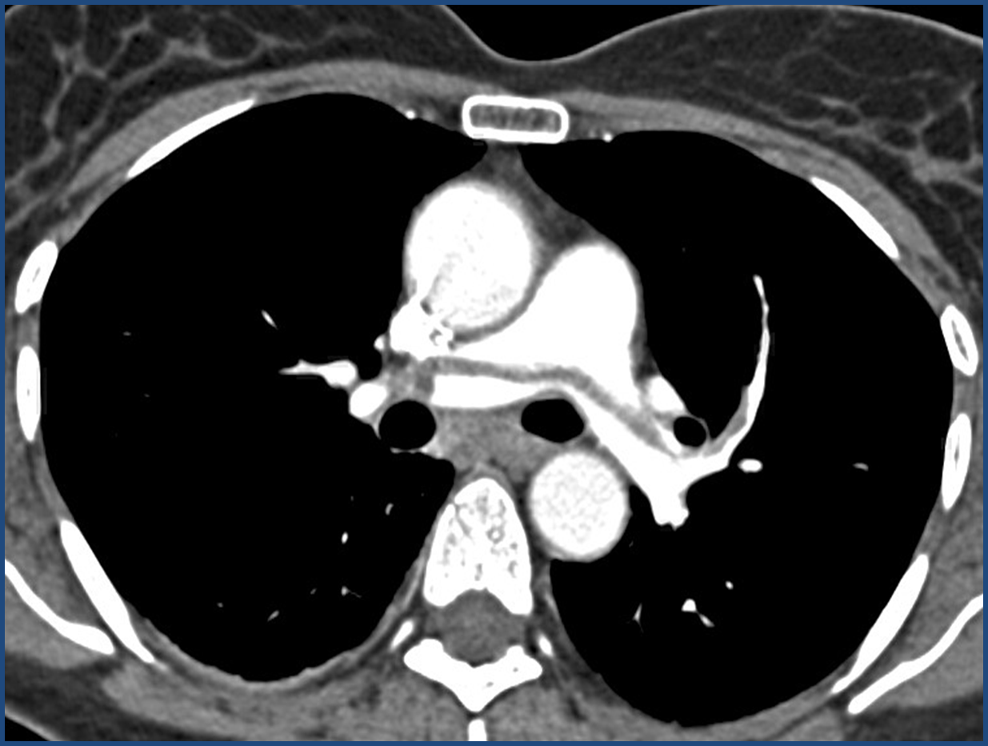
Physiologic Effects of PE
Impaired gas exchange in all types
  V/Q mismatch, elevated A-a gradient
  hypercapnia usually not present
  functional shunting
Hypotension in massive or submassive PE
  decreased pre-load, if RV can’t manage
  increased pulmonary vascular resistance
  RV strain (seen on EKG or echo)
  Rise in troponin and BNP reflect the degree of RV injury. Lactic acidosis reflect severity of shock

Slide 22
Diagnosis of Pulmonary Embolism
Evaluate hypoxia
  Chest x-ray to look for parenchymal disease that may explain hypoxemia
  Arterial blood gas to evaluate A-a gradient
Spiral contrasted chest CT
Cannot perform V/Q scan because of risk of viral spread from inhaled tracer

Slide 23
Treatment of PE
ABC’s always
Fluids, pressors, ventilator management
  hydration sparingly, can worsen right heart strain
  avoid tachycardia, can worsen hypotension
    further decrease in pre-load
  be careful with plateau pressures
PE Response Team (PERT) if available at your institution to navigate for the optimal therapeutic intervention

Slide 24
Pulmonary Embolism Treatment
Anticoagulation
  Goal PTT 50-70
  Goal Factor Xa 0.3-0.8
  Goal INR 2-3
IVC filter to prevent subsequent PE if anticoagulation is not an option
For massive PE or if anticoagulation is contraindicated
  Thrombectomy – by cardiac catheterization or surgical
  Systemic Thrombolysis: for life-threatening PE
    50 mg i.v., may repeat x1
  Catheter directed thrombolysis

Slide 25
Hemodynamic Instability
Distributive
Cardiogenic
Sepsis
Anaphylaxis
Spinal
Myocardial Infarct
Heart Failure
Valve D/O
Tissue Hypoperfusion
Tissue Hypoxemia
Anaerobic Metabolism
Lactic Production
End-Organ Injury
Hypovolemic
Obstructive
Hemorrhage
Trauma
Dehydration
Pulmonary Embolism
Cardiac Tamponade
Multi-System
Organ Dysfunction

Slide 26

In Shock
Optimize
DO2
Oxygen Delivery
$$DO2=CaO2xCO$$
CaO₂
Cardiac Output
PaO₂
SaO₂
Hgb
Heart Rate
Stroke Volume
Preload
Afterload
Contractility
Rhythm
CVP
PCWP
PVR
SVR
EF%

Slide 27
Stepwise Approach to Evaluate Shock
Step 1: Clinical assessment
Step 2: Volume status
Step 3: Preload and fluid responsiveness
Step 4: Cardiac output
Step 5: Cardiac contractility
Step 6: Differentiate shock state

Slide 28
Hemodynamic Goals in COVID-19
Goal is euvolemia – WHO and ARDSnet recommended FACTT Algorithm
Attempt de-resuscitation within 24-48 hours of achieving stability
Point of care ultrasound of IVC and cardiac output maybe utilized in selected patients
Pharmacy to concentrate all i.v. medications
Enteral fluids to be determined on case by case basis by intensivist

Slide 29
Normal Cardiac Parameters
Cardiac Output (CO = HR x stroke volume)
  Normal 4-8 L/min
Cardiac Index (CI = CO/body surface area)
  Normal 3-5 L/min/m²
CVP
  Normal 1-6 mm Hg
Pulmonary artery pressure
  Normal 16-24/5-12 mmHg

Slide 30
Hemodynamic Monitoring
Echocardiogram
  Heart chamber morphology and contractility (ejection fraction)
  Cardiac valve function
  Vena cava collapse (sign of hypovolemia)
  Estimates pulmonary artery pressure (may relate left ventricular filling and subsequently cardiac output)
Central venous catheter
  Central venous pressure
Pulmonary artery catheter (Swan-Ganz)
  Not for routine use. Reserve for patients with Pulmonary HTN and advanced heart failure
  Measures right ventricular pressures
  Measures PA wedge pressure
  Estimates cardiac output

Slide 31
Shock
 | Intravascular Volume Status | Cardiac Output | Systemic Vascular Resistance
Distributive | ⬇ | ⬆ | ⬇
Hypovolemic | ⬇ | ⬆ | ⬆
Cardiogenic |  | ⬇ | ⬆
Neurogenic |  | ⬇ | ⬇

Slide 32
Adrenergic Receptors
α₁ Smooth muscle contraction
α₂ CNS inhibition
β₁ Cardiac inotropy and chronotropy
β₂ Smooth muscle relaxation

Slide 33
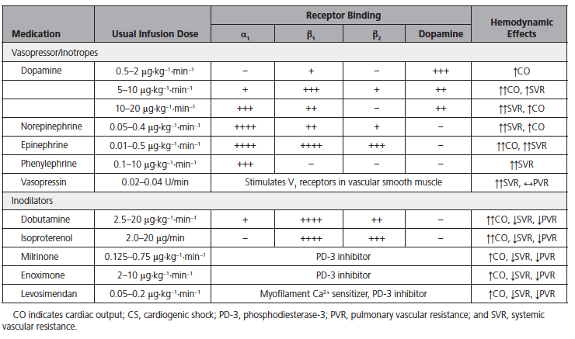
Circulation 2017;136:e232-e268

Slide 34
Sepsis – 3 Clinical Identification
Outside ICU - Known or presumed active infection who are likely to have poor outcomes can be identified by Sequential Organ Failure Assessment (SOFA)
  SBP <100 mmHg
  RR > 22
  Altered mental status (encephalopathy)
ICU patients with suspected or presumed infection who are likely to have poor outcomes can be identified by 2 or more SOFA points
Septic shock
  Despite adequate fluid resuscitation pressors are needed to maintain MAP > 65 AND
  Serum Lactate > 2 mmol/L

Slide 35
SOFA Score
 |  |  | Score
System | 1 | 2 | 3 | 4 | 5
Respiration
PaO₂/FiO₂ mmHg | <400 | <400 | <300 | <200 with respiratory support | <100 with respiratory support
Coagulation
Platelets, x10³/μl | ≥150 | <150 | <100 | <50 | <20
Liver
Bilirubin mg/dL | <1.2 | 1.2-1.9 | 2-5.9 | 6-11.9 | >12
Cardiovascular | MAP≥70 mmHg | MAP<70 mmHg | Dopamine<5 or dobutamine (any dose) | Dopamine 5.1-15 or epinephrine≤0.1 or norepinephrine≤0.1 | Dopamine >15 0r epinephrine>0.1 or norepinephrine>0.1
CNS
GCS | 15 | 13-14 | 10-12 | 6-9 | <6
Renal
Creatinine mg/dL | <1.2 | 1.2-1.9 | 2-3.4 | 3.5-4.9 | >5
Urine Output mL/day |  |  |  | <500 | <200
All catecholamine doses are given as μL/kg/min for at least 1 hour

Slide 36
Sepsis Management Outline
Initial resuscitation | Fluid therapy
Infection issues | Diagnoses Infection prevention | Antimicrobial therapy Source control
Hemodynamic support | Fluid therapy Vasopressors | Inotropic support Blood products
Adjunctive therapy | Corticosteroids
Supportive measures | Mechanical ventilation Sedation, analgesia and neuromuscular blockade | Glucose control RRT Nutrition and prophylaxis

Slide 37
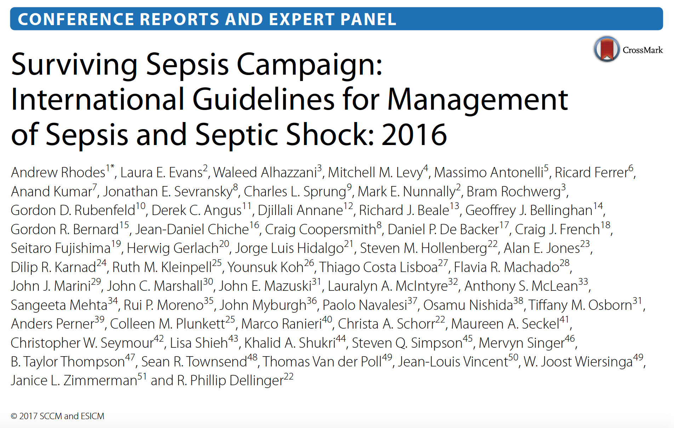

Slide 38
2016 Sepsis Guidelines
Obtain cultures before starting antibiotics
Start broad-spectrum i.v. antibiotics within one hour
Volume resuscitation with i.v. crystalloids > 30 mL/kg within the first 3 hours
  Administration of balanced crystalloids has a favorable effect on the composite of death, new RRT, and persistent renal impairment
Colloid fluids may also be given if large amounts of crystalloids are being used

Slide 39
Treatment of Septic Shock
Initial target MAP >65 mmHg in patients with septic shock requiring vasopressors
Norepinephrine is the first choice vasopressor for septic shock
Vasopressin or epinephrine may be added if necessary

Slide 40
Treatment of Septic Shock
Hemodynamic/cardiac assessment may be necessary (echo, cardiac output monitoring) if clinical examination does not reveal the cause of the shock
Hydrocortisone – stress dose may be used as a supplement to pressors
Lactate measurement can be used to guide extent of resuscitation with the goal of returning to normal lactate levels.

Slide 41
Cardiogenic Shock
Hypotension secondary to decreased cardiac output
Must ensure that there is no hypovolemia and optimal cardiac perfusion
May require inotropic agent to promote contraction e.g. dobutamine
Mechanical support (LVAD, aortic balloon pump, etc.) for refractory cases

Slide 42
Stress Cardiomyopathy
Catecholamine-induced cardiac injury
  Takotsubo cardiomyopathy
Dilation of cardiac apex, LV outflow obstruction
Reversible, support until recovery

Slide 43
Hypovolemic Shock
Causes:
Hemorrhage
Fluid loss (gastric fluid, diarrhea, burns)
Interstitial fluid accumulation (third spacing)
Volume resuscitation with crystalloids
  Whole blood may be considered in the case of significant anemia

Slide 44
Anemia and Transfusion
Evaluate for active bleeding
  GI: varices, ulcers, hemorrhoids, etc.
  Procedure-related (retroperitoneal, hemothorax)
Reversible causes
  Check iron, vitamin B₁₂, folate levels
  Marrow-suppressing medications
Transfuse packed rbc’s for Hb<7 g/dL
  May consider whole blood for severe hypovolemic shock
NEJM 1999 Feb 11;340(6):409-17

Slide 45
COVID-19 Cardiac Involvement
Mechanism of injury is unclear
High troponin levels are associated with poor prognosis
Current observations include:
  Diffuse LV dysfunction
  Cardiogenic shock related to cytokine storm
  Fatal arrhythmias
  Pericadiomyocarditis

Slide 46
Congestive Heart Failure
Cardiac dysfunction resulting in reduced cardiac output and/or elevated intracardiac pressures
May be from impairment of either systolic or diastolic function

Slide 47
Diastolic Failure
During diastole, the atria of the heart contract, filling the ventricles
Decreased cardiac compliance, impaired atrial contractility, or tricuspid/mitral valve stenosis may result in poor filling
Heart becomes pre-load dependent
Patients may benefit from higher CVP (8-12 mmHg) to optimize cardiac filling
  May give fluids to increase filling pressures

Slide 48
Systolic Failure
During systole, ventricular contraction pumps blood into the pulmonary artery and aorta
Poor ventricular contraction, tricuspid/mitral valve regurgitation, pulmonic/aortic valve stenosis can result in poor ventricular output
LV ejection fraction ≤40%

Slide 49
Systolic Failure
Heart becomes afterload sensitive
Patients may benefit from afterload reduction
  Traditional diuretics (Loop diuretics)
  ACE inhibitors
  Direct vasodilators: hydralazine in combination with nitrates for patients with renal pathology
  Patients with hypotension may require positive inotropic agent +/- pressor

Slide 50
Tachycardia
Sinus tachycardia
  Common causes include hypovolemia/hypotension, hypoxia, PE, and pain
  Address underlying condition
  Narrow Complex (QRS ≤ 120ms)
  Atrial fibrillation/flutter
  Re-entrant tachycardia
  Wide Complex (QRS ≥ 120ms)
    Ventricular tachycardia until proven otherwise

Slide 51
Atrial Fibrillation
Common cause of tachycardia in the ICU
May have rapid ventricular response (HR>120)
Look for exacerbating factors such as volume overload causing atrial stretching, hyperthyroidism, electrolyte abnormalities
May cause hypotension as rapid heart rate can decrease filling time and subsequently stroke volume
Initiate treatment to identify and control the precipitating factor then control HR

Slide 52
Acute Medical Treatment of RVR
Selective β₁ antagonists
  Metoprolol 5 mg i.v. over 1-2 minutes, may be repeated x2
Calcium channel antagonist – like Diltiazem or Verapamil if LV systolic function is normal
Patients may require drips of β-blocker or calcium channel blocker (see Appendix 1)
Amiodarone drip for refractory RVR
When SVT is suspected Adenosine can be used
  Causes transient cardiac pause
  6 mg i.v. push. If no response repeat at 12 mg i.v. push.

Slide 53
Ventricular Tachycardia
Sustained Monomorphic Ventricular Tachycardia
  Unstable = Cardioversion and ACLS
  Stable
    Related to structural heart disease
      Amiodarone then cardioversion if not terminated
    Idiopathic
      Verapamil if history of verapamil sensitive VT
      β-blockers for outflow track VT
Cardiology consult for further support

Slide 54
Acute Coronary Syndrome
Constellation of clinical symptoms compatible with acute myocardial ischemia
  ST-segment elevation MI (STEMI): coronary occlusion resulting in transmural ischemia
  non-ST-segment elevation MI (NSTEMI): Partial coronary obstruction resulting in subendocardial ischemia
  unstable angina: pain at rest or with minimal exertion, crescendo pattern

Slide 55
General Measures for MI
Optimize oxygen delivery
Obtain EKG, ensure electrolytes are within normal limits
Decrease cardiac workload
  β-blocker to decrease cardiac wall stress and heart rate
  Make sure the patient is adequately resuscitated as decrease in heart rate may result in decreased cardiac output in the setting of hypovolemia
Serial troponin levels
Echocardiogram

Slide 56
Treatment of STEMI
Percutaneous coronary intervention
Fibrinolytic therapy for cases where PCI cannot be performed in a timely fashion

Slide 57
Treatment of NSTEMI/UA
Antiplatelet therapy
  aspirin
  clopidogrel
  glycoprotein 2b/3a inhibitors
β-blockers, ACEIs, statins
Avoid calcium channel blockers in the acute setting

Slide 58
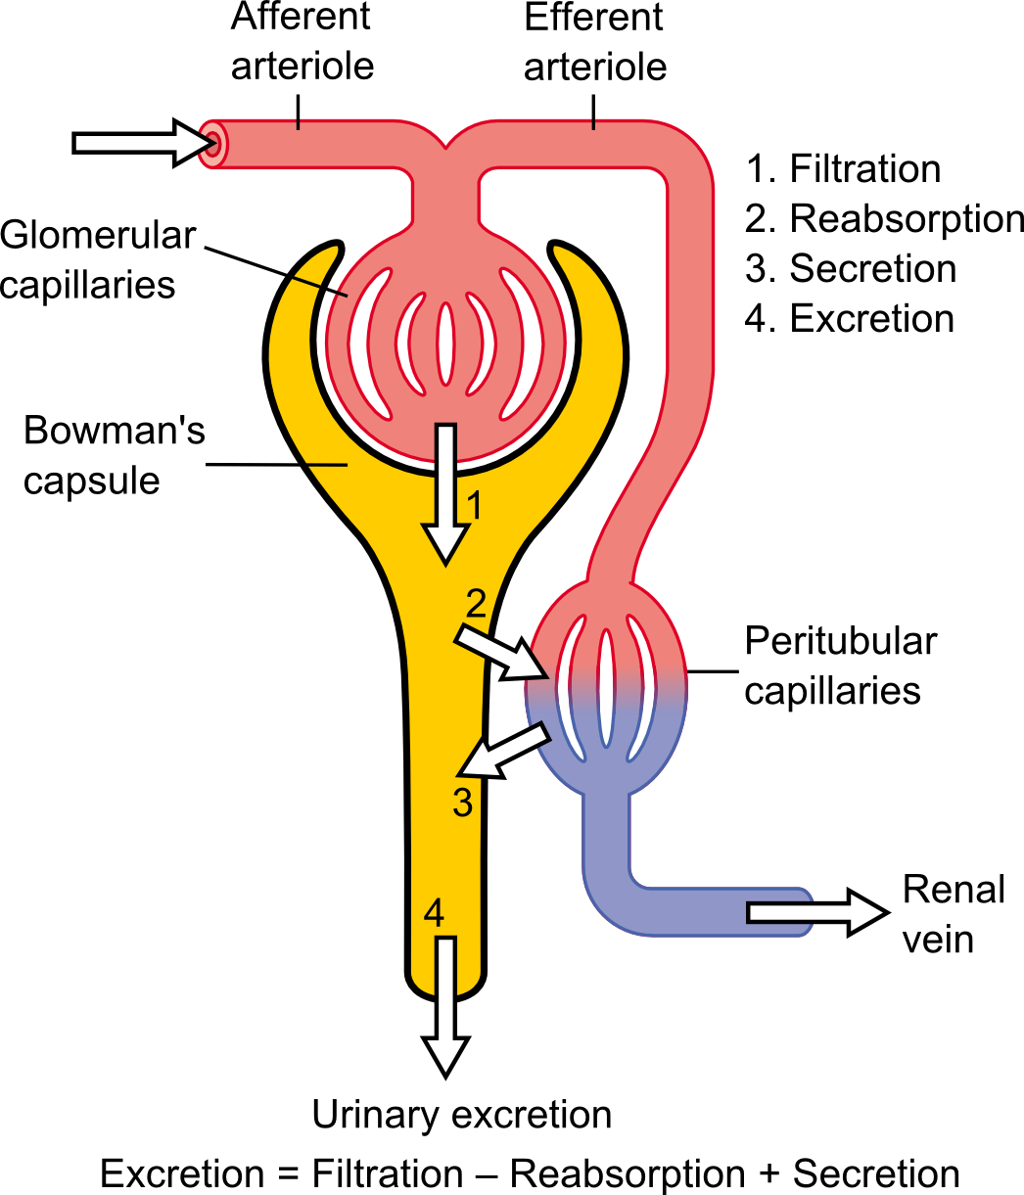
Acute Kidney Injury and Renal Failure

Slide 59
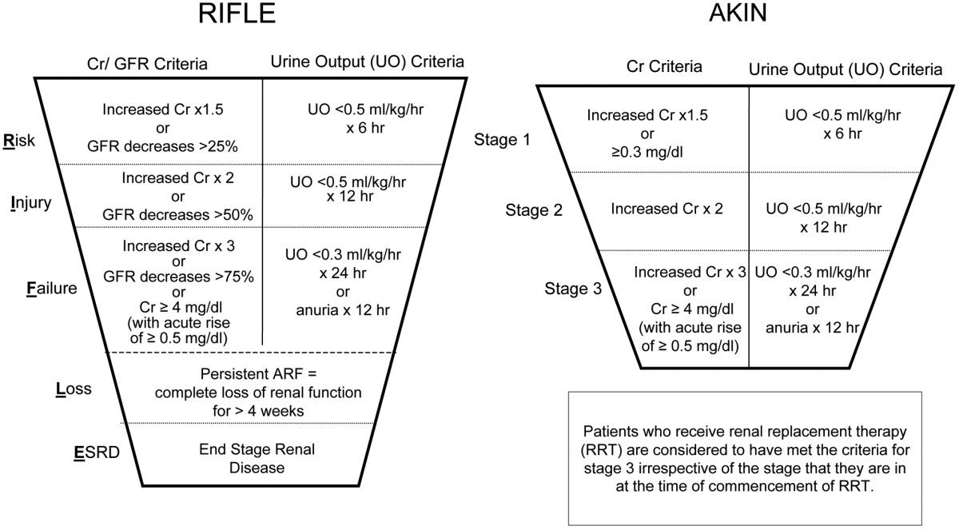
RIFLE Criteria
Oliguria: urine output less than 0.5 ml/kg/hr
Developed by the Acute Dialysis Quality Initiative (ADQI)

Slide 60
Acute Kidney Injury Network (AKIN)
Stage | Serum Creatinine | Urine Output
1 | 1.5-1.9 times baseline OR ≥0.3 mg/dl increase | <0.5 ml/kg/hr for 6-12 hours
2 | 2.0-2.9 times baseline | <0.5 ml/kg/hr for ≥12 hours
3 | 3.0 times baseline OR Increase to ≥4.0 OR Initiation of renal replacement therapy | <0.3 mg/kg/hr for ≥24 hours OR Anuria for ≥12 hours
Kidney International Suppl 2012; 2(1)

Slide 61
Acute Kidney Injury Network (AKIN)
Does not require known historical creatinine
Only considered after adequate volume resuscitation
Post-renal obstruction has been ruled out
Kidney International Suppl 2012; 2(1)

Slide 62
Pre-Renal AKI
Intravascular volume depletion
Decreased effective volume
CHF
Hypovolemia and dehydration
Cirrhosis
Early sepsis
Renal vasocontriction
Selective ischemia- renal artery stenosis

Slide 63
Diagnosis of Pre-Renal AKI
Urine specific gravity > 1.020
FeNa < 1%
Urine osmolarity >350

Slide 64
Etiology of (intra-renal) AKD and Typical* Urinalysis Findings
Acute Tubular Necrosis (ATN) [~ 90% of AKD cases]
  urine sediment benign, mild proteinuria/hematuria
  muddy-brown casts
Allergic Interstitial Nephritis
  urine eosinophils
  variable urine sediment, proteinuria and hematuria
Rhabdomyolysis
  brown urine, dip stick (+) blood but RBC (-) by microscopy
  myoglobin (+)
Glomerulonephritis
  marked proteinuria
  RBC casts (highly specific)
* urinalysis is often non-diagnostic

Slide 65
Acute Tubular Necrosis
Death of renal tubular cells
Hypotension/hypoxia
Rhabdomyolysis
Cytotoxic drugs
Aminoglycosides
Blood transfusion reactions
Usually reversible if underlying cause is remedied

Slide 66
Prevention
Maintain hydration (isotonic i.v. fluids)
Reducing risk from nephrotoxins
  Single vs. multiple daily doses of aminoglycosides
  Lipid complex vs. standard amphotericin
  Iso-osmomotic vs. standard or “low” osmolality radiocontrast media
Maintain perfusion pressure

Slide 67
Acute Kidney Injury
High Risk
1
2
3
Discontinue all nephrotoxic agents when possible
Ensure volume status and perfusion pressure
Consider functional hemodynamic monitoring
Monitor Serum creatinine and urine output
Avoid hyperglycemia
Consider alternatives to radiocontrast procedures
Non-invasive diagnostic workup
Consider invasive diagnostic workup
Check for changes in drug dosing
Consider Renal Replacement Therapy
Consider ICU admission
Avoid subclavian catheters if possible
Kidney International Suppl 2012; 2(1)

Slide 68
Treatment of AKI
Avoid or minimize exposure to nephrotoxic agents
Diuretics only used to treat volume overload
  Have no impact on recovery or prognosis
Use crystalloids for volume expansion except in cases of hypovolemic shock
Vasopressors may be used in conjunction with fluid resuscitation in cases of vasomotor shock
Do not use low-dose dopamine
Kidney International Suppl 2012; 2(1)

Slide 69
Indications For Dialysis
Life-threatening conditions
  Acute pulmonary edema from volume overload
  Electrolyte Imbalance
    Hyperkalemia
    Hyponatremia
    Increased calcium phosphate product
  Uremia
    Encephalopathy
    Pericarditis
    Intractable nausea and vomiting
  Acidosis
Kidney International Suppl 2012; 2(1)

Slide 70
Palliative Care
Ultimately, the goal of treatment is to facilitate a patient’s recovery to a condition that the patient would find acceptable.
If this cannot be achieved, limitations of care should be discussed with the patient and the patient’s family.
A provider may choose to withhold a therapy if it is believed to be futile in the care of the patient.

Slide 71
Palliative Care
Limitations of care may include (but are not limited to):
DNR Arrest
  Pursue all care unless patient suffers a cardiac arrest
DNI
  Do not intubate
DNR Comfort Care
  Withdraw supportive measures
  Patient’s comfort becomes the highest priority

Slide 72
Palliative Care
May consider specific therapies individually:
Dialysis
Vasopressors
Antibiotics
Procedures
  Tracheostomy
  Percutaneous gastostomy/feeding tube
  Vascular access

Slide 73
Palliative Care – ICU Triggers
SNF patient with poor performance status
Advanced dementia
Age over 80 – all COVID +
Age over 70 + 1 advanced organ system disease – ESRD, O₂-dependent COPD, Stage C/D CHF, Childs B/C cirrhosis
Metastatic malignancy
Advanced organ system disease
  ESRD
  O₂ dependent COPD
  Advanced CHF
  Child B/C cirrhosis
Worsening clinical course on mechanical ventilation
Shock state needing pressors for more than 2 days

Slide 74
The End
Remember:
Follow your local protocols
Stay safe and healthy
Special thanks to:
Berje Shammassian, M.D
Neurosurgery Training Program
University Hospitals of Cleveland/Case Western Reserve University

Slide 75
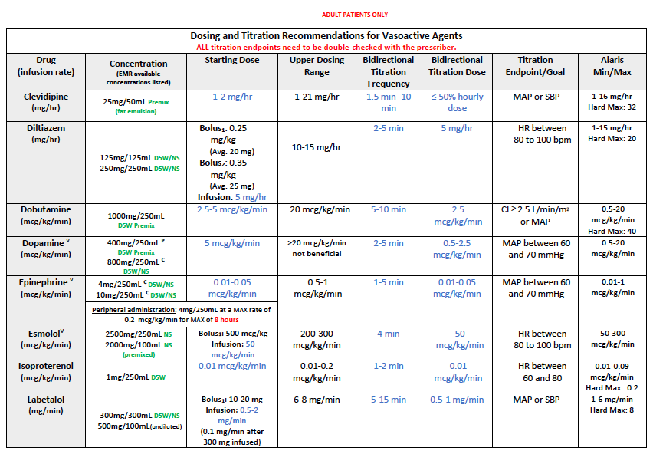
Appendix 1: Vasoactive Drugs

Slide 76
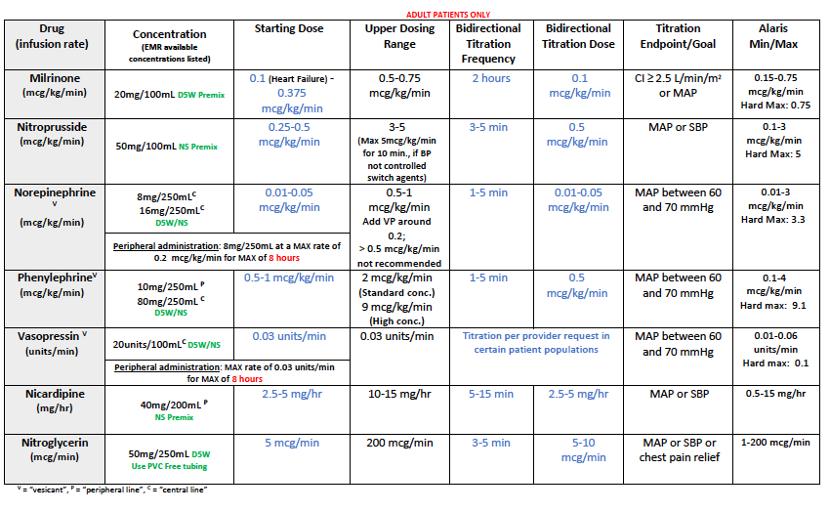
Appendix 1: Vasoactive Drugs

Slide 77
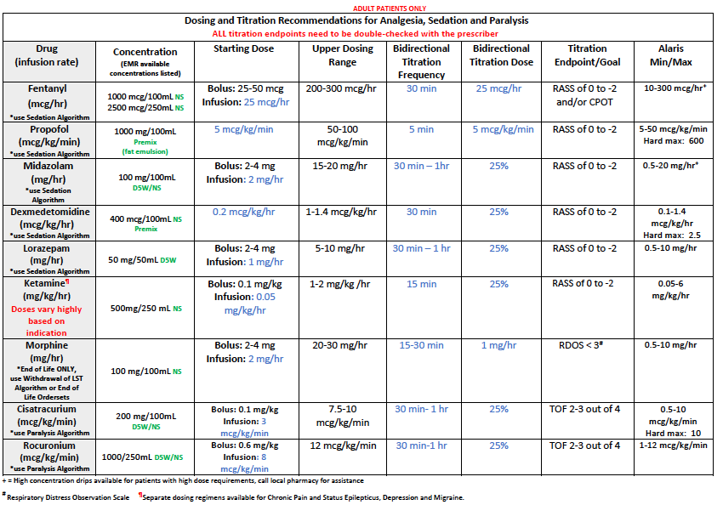
Appendix 2: Sedative Drugs

Slide 78
Appendix 3: Surviving Sepsis Campaign: Guidelines for the Management of COVID-19
I. Infection Control
For aerosol-generating procedures, use fitted respirator masks (N95 respirators, FFP2, or equivalent) (best practice).
Perform aerosol-generating procedures in negative pressure room (best practice).
For usual care for non-ventilated patients, use surgical/medical masks (weak recommendation).
For non-aerosol-generating procedures on ventilated patients, use surgical/medical masks (weak recommendation).
For intubation, use video-guided laryngoscopy over direct laryngoscopy (weak recommendation).
Intubation should be performed by provider most experienced with airway management (best practice).
II. Laboratory Diagnosis and Specimens
For intubated and mechanically ventilated adults:
  Obtain lower respiratory tract over nasopharyngeal/oropharyngeal samples (weak recommendation).
  Obtain endotracheal aspirates over bronchial wash/bronchoalveolar lavage samples (weak recommendation).

Slide 79
Appendix 3: Surviving Sepsis Campaign: Guidelines for the Management of COVID-19
III. Supportive Care
Use dynamic parameters, skin temperature, capillary refilling time, and/or serum lactate over static parameters to assess fluid responsiveness (weak recommendation).
Use conservative over liberal fluid strategy (weak recommendation).
Use crystalloids over colloids (strong recommendation).
Use buffered/balanced crystalloids over unbalanced crystalloids (weak recommendation).
Do not use hydroxyethyl starches (strong recommendation).
Do not use gelatins (weak recommendation).
Do not use dextrans (weak recommendation).
Do not routinely use albumin for initial resuscitation (weak recommendation).
Use norepinephrine as first-line vasoactive agent (weak recommendation).
If norepinephrine not available, use vasopressin or epinephrine (weak recommendation).
Do not use dopamine if norepinephrine is available (strong recommendation).
Add vasopressin as second-line agent if target MAP can’t be achieved by norepinephrine alone (weak recommendation).
Titrate vasoactive agents to target MAP of 60-65 mmHg (weak recommendation).
For cardiac dysfunction and persistent hypoperfusion despite fluid resuscitation and norepinephrine, add dobutamine (weak recommendation).
For refractory shock, use low-dose corticosteroid therapy (weak recommendation).
Start supplemental O2 if SPO2 is < 92% (weak recommendation) and if SPO2 is < 90% (strong recommendation).

Slide 80
Appendix 3: Surviving Sepsis Campaign: Guidelines for the Management of COVID-19
Maintain SPO2 no higher than 96% (strong recommendation).
For acute hypoxemic respiratory failure despite conventional O2 therapy, use HFNC (weak recommendation).
In acute hypoxemic respiratory failure, used HFNC over NIPPV (weak recommendation).
If HFNC not available and no urgent indication for intubation, trial NIPPV with close monitoring (weak recommendation).
No recommendation regarding use of helmet NIPPV compared with mask NIPPV.
Recommend close monitoring for worsening of respiratory status (best practice).
Use low tidal volume ventilation (Vt 4-8 mL/kg) (strong recommendation).
Target plateau pressures (Pplat) of < 30 cm H2O (strong recommendation).
For moderate to severe ARDS, use higher PEEP strategy (weak recommendation).
For ARDS, use conservative fluid strategy (weak recommendation).
For moderate to severe ARDS, use prone ventilation for 12 to 16 hours (weak recommendation).
For moderate to severe ARDS:
  Use intermittent boluses of neuromuscular blocking agents over continuous infusion (weak recommendation).
  If persistent ventilator dyssynchrony, use continuous NMBA infusion for up to 48 hours (weak recommendation).
Do not routinely use inhaled nitric oxide (strong recommendation).
In severe ARDS and hypoxemia, trial inhaled pulmonary vasodilator; if no rapid improvement, treatment should be tapered off (weak recommendation).
For hypoxemia despite optimizing ventilation, use recruitment maneuvers (weak recommendation).
For recruitment, do not use staircase (incremental PEEP) recruitment maneuvers (strong recommendation).
In refractory hypoxemia despite optimizing ventilation, rescue therapies, and proning, use venovenous ECMO (weak recommendation).

Slide 81
Appendix 3: Surviving Sepsis Campaign: Guidelines for the Management of COVID-19
IV. COVID-19 Therapy
In respiratory failure (without ARDS), do not routinely use systemic corticosteroids (weak recommendation).
In ARDS, use systemic corticosteroids (weak recommendation).
In respiratory failure, use empiric antimicrobials/antibacterial agents (weak recommendation).
For fever, use acetaminophen for temperature control (weak recommendation).
Do not routinely use IVIG (weak recommendation).
Do not routinely use convalescent plasma (weak recommendation).
In critically ill adults:
  Do not routinely use lopinavir/ritonavir (weak recommendation).
  Insufficient evidence on the use of other antiviral agents.
Insufficient evidence on the use of recombinant rIFNs.
Insufficient evidence on the use of chloroquine or hydroxychloroquine.
Insufficient evidence on the use of tocilizumab.

