Slide 1
Angelique Tay, MD and Daniel Chang, MD
Chief Residents
Cedars-Sinai Neurosurgery

Slide 2

Cedars-Sinai Neurosurgery by the numbers…
2022-2023 US News Ranked #7 for Neurology and Neurosurgery
14 Residents
4 Fellowship Programs (3 CAST accredited)
18 Teaching Faculty Members
5 Clinical Programs
      Tumors, Functional, Pediatrics, Spine and Endovascular
2500+ operative cases a year
1500+ cases per graduating resident
70+ peer reviewed articles

Slide 3
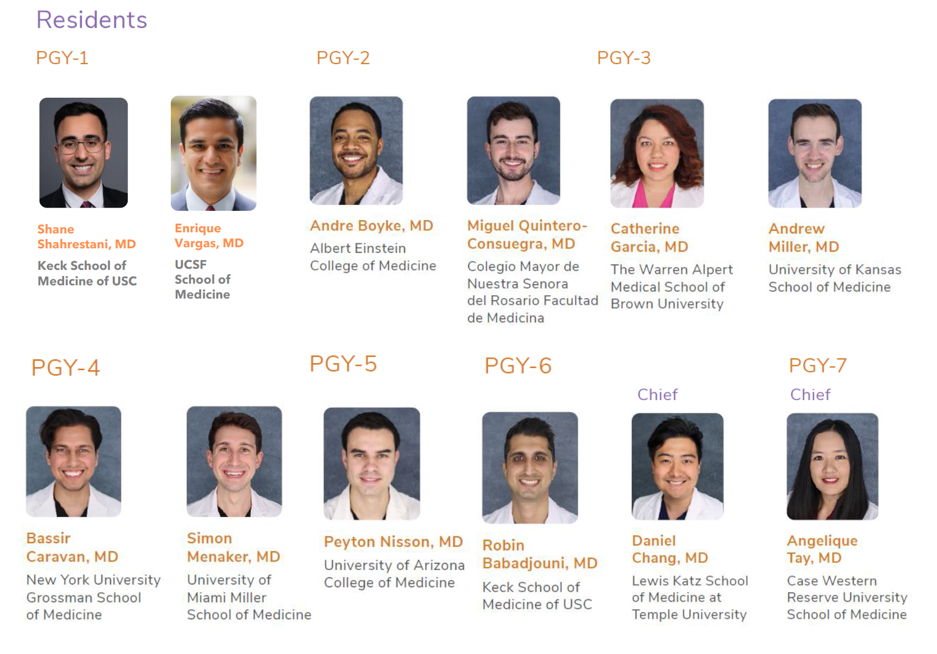
Our 2023-2024 Resident Cohort

Slide 4
Academic OR Clinical Tracks
Academic Track
  Chief Resident as PGY7
  Research Year PGY5
  Option of an additional year after PGY7 as clinical instructor for continued research
Clinical Scholars Program for Clinical or Translational Clinical Research
  PGY4 didactics twice a week as part of the program in the evenings
  PGY5 dedicated mentored research year in the program OR
Lab Research
  Identify a lab by PGY2 year
  PGY5 dedicated year for lab-based research
  Protected time for lab meetings and research
Clinical Sub-specialty Track
  Chief year as PGY6
  CAST fellowship PGY7 at Cedars-Sinai (unless received funding for another program)
Tracks need to be defined by end of PGY2 year and finalized by PGY3 year

Slide 5
Conference Schedule
Weekly:
Mondays
Spine Tumor Board at 7:00am
Tuesdays
Spine Didactics at 6:30am
Wednesdays
  Spine Conference at 7:00am
  Brain Tumor Board at 8:00am
  Radiosurgery Conference 9:00am (every other week)
  Neurovascular Conference at 12:00pm
  Annually:
Yearly skull base cadaver lab
Yearly spine surgery cadaver
Yearly cerebrovascular angiography simulation lab
Various simulation center workshops
Twice a month didactic days:
2nd Friday:
  Breakfast with Program Directors
  Faculty Educational Sessions (case presentations and journal club)
  Visiting Professor Rounds w/Residents
  Visiting Professor Neurosciences Grand Rounds
  Chairman’s Review
  Academic clinic
  4th Friday:
  M&M
  Neurosciences Didactic Lecture
  Faculty Educational Sessions (case presentations and journal club)
  Neurosciences Grand Rounds
  Resident Research Roundtable/Chief Review
  Academic clinic
  *Weekly 1:1 cerebrovascular simulation center sessions

Slide 6
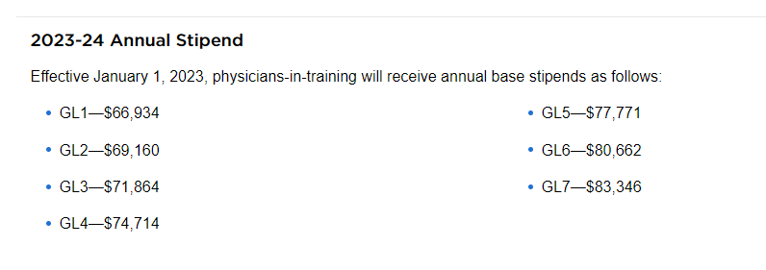
Compensation and Benefits Highlights
4% increase in salary per level
Housing Stipend: $12K to help offset housing costs
Meal cards: $3400/year
$2000/year Educational Fund
100% travel fees covered for presenting at conferences
28 days VHT / 40hrs Sick
Medical Licensure Reimbursement
DEA Reimbursement
USLME Reimbursement
Personalized loupes and lead after PGY1 year
Personalized scrubs, labcoats and jacket
And much more

Slide 7
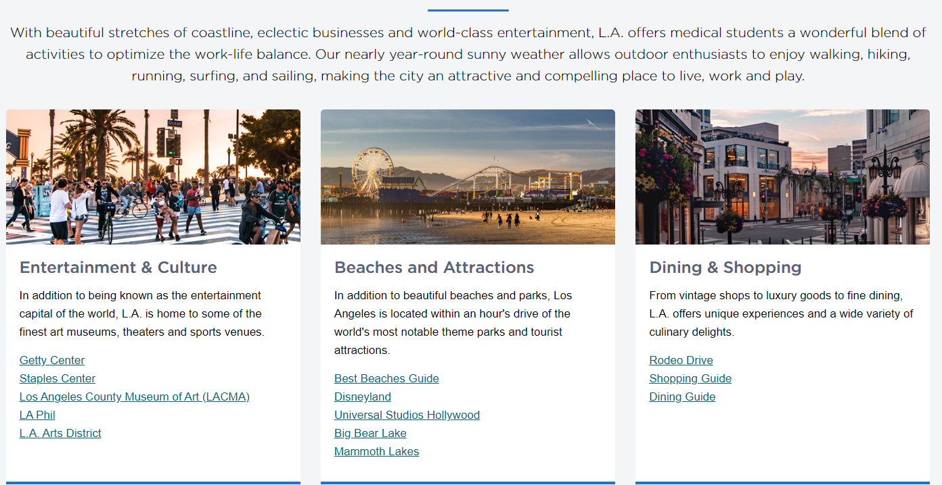
Los Angeles: A Day in the Life

Slide 8
Contact Information
2023-2024 Interview Season will be in Person (with coordinated dates w/USC).
Any further questions you can contact:
  Our chief residents, Angelique Tay, MD at angeliquesaom.tay@cshs.org or Daniel Chang, MD at daniel.chang@cshs.org
  Our program director, Chirag Patil, MD at chirag.patil@cshs.org
  Our program coordinator, Samantha Phu at Samantha.phu@cshs.org

